Slide 1
Chef Analytics + Provisioning
Galen Emery – Automation Engineer, CHEF

Slide 2
Agenda
Analytics
actions
run_converge
Provisioning
machine_batch
Analytics
audit_controls
Delivery (sneak peek)

Slide 3
Who is Galen?
10+ years experience in system administration and infrastructure
Roles included SysAdmin, IT Lead, Migration Technician
Participant in the DevOps, Chef and Windows communities
Professional verticals have included Telecom, Non-Profit, and Real-Estate
Based in Seattle, Washington

Slide 4


Computing Resources Have Been Increasing Exponentially
Millions
120
Virtual Nodes
Physical Hardware
100
80
Millions of Servers
60
1980
Mainframe
1990
Client/Server
2000
Datacenter
2010+
Web-Scale
40
20
Notes:
Frame the problem
- growing infrastructure
- fewer resources
- can't watch everything
- surface problems faster

Slide 5
Increased Size Leads to Operational Complexity
WEB SERVERS
ADD 1 SERVER
APPLICATION SERVERS
20+ Changes
12+ New dependences
DATABASE
Notes:
----- Meeting Notes (9/15/14 13:28) -----
- infrastructure more dynamic
- higher rate of change requires more data to allow for safety

Slide 6
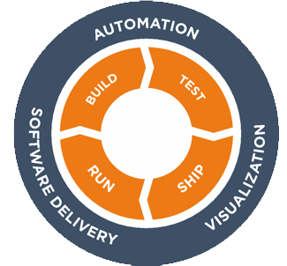
To Operate at Velocity:
Engine
Insights
A policy application & execution engine
A system to visualize all changes happening in real-time, whether automatic or manual
Delivery
Compliance
A system to deliver changes at speed, safely, reliably, predictably
A system to enforce node state and report on violations for compliance reasons
Notes:
Chef is not just a CM product – it's a platform for driving this.

Slide 7
To Operate at Velocity, Teams Need Visibility
SECURITY LOGS
AUDITING
PERFORMANCE MONITORING
CHANGE TRACKING

Slide 8
Chef Analytics Provides Visibility in Three Ways
TRACK CHANGES FROM ALL SOURCES
Chef Server Policy (Actions)
Chef Client Runs (Run History)
Node state (Audit Controls)
NOTIFICATIONS
Built-in messaging and email integration
Extend notifications to your existing systems
REAL-TIME VISIBILITY
Simple dashboard with search, filters and sorting options
Integrate with existing tools via API
Notes:
- Policy is cookbook, role, environment

Slide 9
Actions – Who did what and when?
Provide a read-only view of what happened
Allow administrators to react to events as they happen or after the fact investigation
“What changed just before nodes started failing runs?”
Can be customized to meet audit and compliance reporting requirements

Slide 10
Actions – Catching Manual Changes
Actions – We expect all changes to be run through the Chef Delivery pipeline.
Action
Rule
Upload a cookbook
Modify an environment
Add/remove a node
Full list of available fields: https://docs.chef.io/analytics_rules.html
rules 'Robots Only'
rule on action
when
requestor_type = "user"
and requestor_name != "delivery"
then
notify("hipchat","ALARM: The humans are changing things!")
set(#silly_human,"changes are for robots!")
end
end

Slide 11
Run Converge – What happened on the run?
Know if individual resources converged
Specify the policy that nodes should follow
Is the administrators group being modified every run?
Do our nodes have the monitoring agent installed?
See the state before and after a chef run

Slide 12
Chef Provisioning

Slide 13
Why Would You Want Chef to Handle This?
Provisioning is hard
Most people use basic scripts or one-off manual deployment
No automation = no documentation
Tough to test complex deployments
Devs often deploy without testing clustered configurations
Multi stage deployments (such as with primary/secondary databases) rarely tested
Provisioning as recipes enable whole new solutions

Slide 14
Provisioning Unlocks Your Infrastructure
Using provisioning gives you all the flexibility of Chef
Enables code as repeatable processes of your configurations
Unlocks you from a single physical or cloud provider
Extends the Chef DSL to include the machine Resource
Includes Drivers for Cloud, VMs & Bare-Metal
Machines started with this method will have chef-client before executing the run_list

Slide 15
Current Drivers
Fog (which connects with OpenStack, DigitalOcean and SoftLayer)
AWS
Azure
VMware vSphere
Vagrant (VirtualBox and VMware Fusion)
LXC
Docker
Raw SSH (with a list of already-provisioned servers)

Slide 16
Cluster Example
Use the machine_batch Resource to run in parallel
machine_batch do
machine “db” do
recipe “mysql”
end
1.upto(5) do |i|
machine “web#{i}” do
recipe “apache”
end
end
end

Slide 17
Audit Controls
Continually assess the baseline of your system
Create IT Controls on the state of a node
Package installations and version information, file contents, running services, open ports, registry keys, users and groups
Multiple uses
Audit and Compliance (PCI, SOX, CIS, STIG, HIPAA, etc)
Unmanaged fleet migration
Separation of Controls
Allows for separation of controls via integration with Chef role based access controls
Notes:
“When someone not in the ‘siteops’ group modifies the DNS cookbook, alert the siteops team via email to siteops@example.com”
“When the /etc/ssh/ssh_config file is modified, raise audit rule 24.1”

Slide 18
Controls - PCI Compliance
PCI 2.3 - Encrypt all non-console administrative access such as browser/Web-based management tools.
Control
Rule
controls 'port compliance' do
control port(23) do
it "has nothing listening"
expect(port(23)).to_not be_listening
end
end
end
rules ’PCI 2.3 – Confirm telnet port not available'
rule on run_control
when
name = 'should be listening’ and
resource_type = 'port’ and
resource_name = '23’ and
status != 'success'
then
audit:error("PCI 2.3 - Encrypt all non-console administrative access such as browser/Web-based management tools.")
notify("security-team@financialcorp.com”)
end
end

Slide 19
Notifications
Adds a language which allows you to express rules on all Chef events
Runs
Resource convergence
Actions
Controls
Extensible for your business requirements
Build custom rules that match your infrastructure and team
Send to different external data sinks
Messaging systems, e.g. HipChat, SMTP
Extensible to anything that supports webhook notifications

Slide 20
How You Can Get Analytics
Available as a Premium Feature of Chef Server
Supported on Enterprise Chef 11.2 and Chef Server 12
Included in Chef Subscription
Also available free for installations less than 25 nodes
Installation instructions
https://docs.chef.io/install_analytics.html
Download from https://downloads.chef.io/analytics/

Slide 21
How You Can Get Provisioning
Free release as part of Chef 12
Supported on Chef Client 12+
Included in ChefDK
Included as part of the ChefDK, along with Test-Kitchen, Berkshelf, foodcritic and other helpful tools
Instructions
https://docs.chef.io/provisioning.html
Download from https://downloads.chef.io/chef-dk/

Slide 22
Questions?

Slide 24
Controls - SOX Compliance
SOX Section 302.4.B – Establish verifiable controls to track data access.
Control
Rule
controls 'password authentication' do
control file('/etc/ssh/sshd_config') do
it "is disabled"
expect(file('/etc/ssh/sshd_config')) .to match(/PasswordAuthentication\s+no/)
end
end
end
rules 'SOX Section 302.4.B - force key based auth'
rule on run control
when
name = 'is disabled’ and
resource_type = 'File’ and
resource_name = '/etc/ssh/sshd_config’ and
status = 'failed'
then
audit:error("SOX Section 302.4.B – Establish verifiable controls to track data access.")
notify('security-team')
end
end

Slide 25
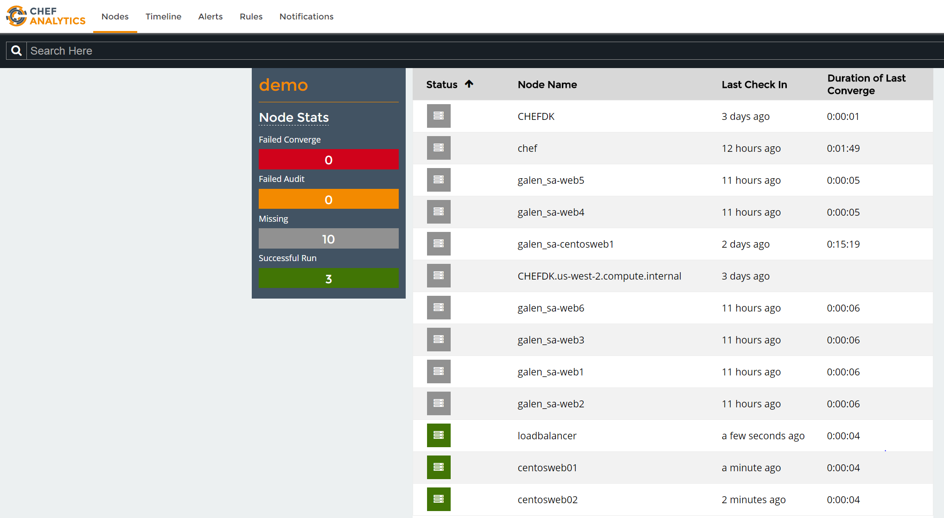

Slide 26
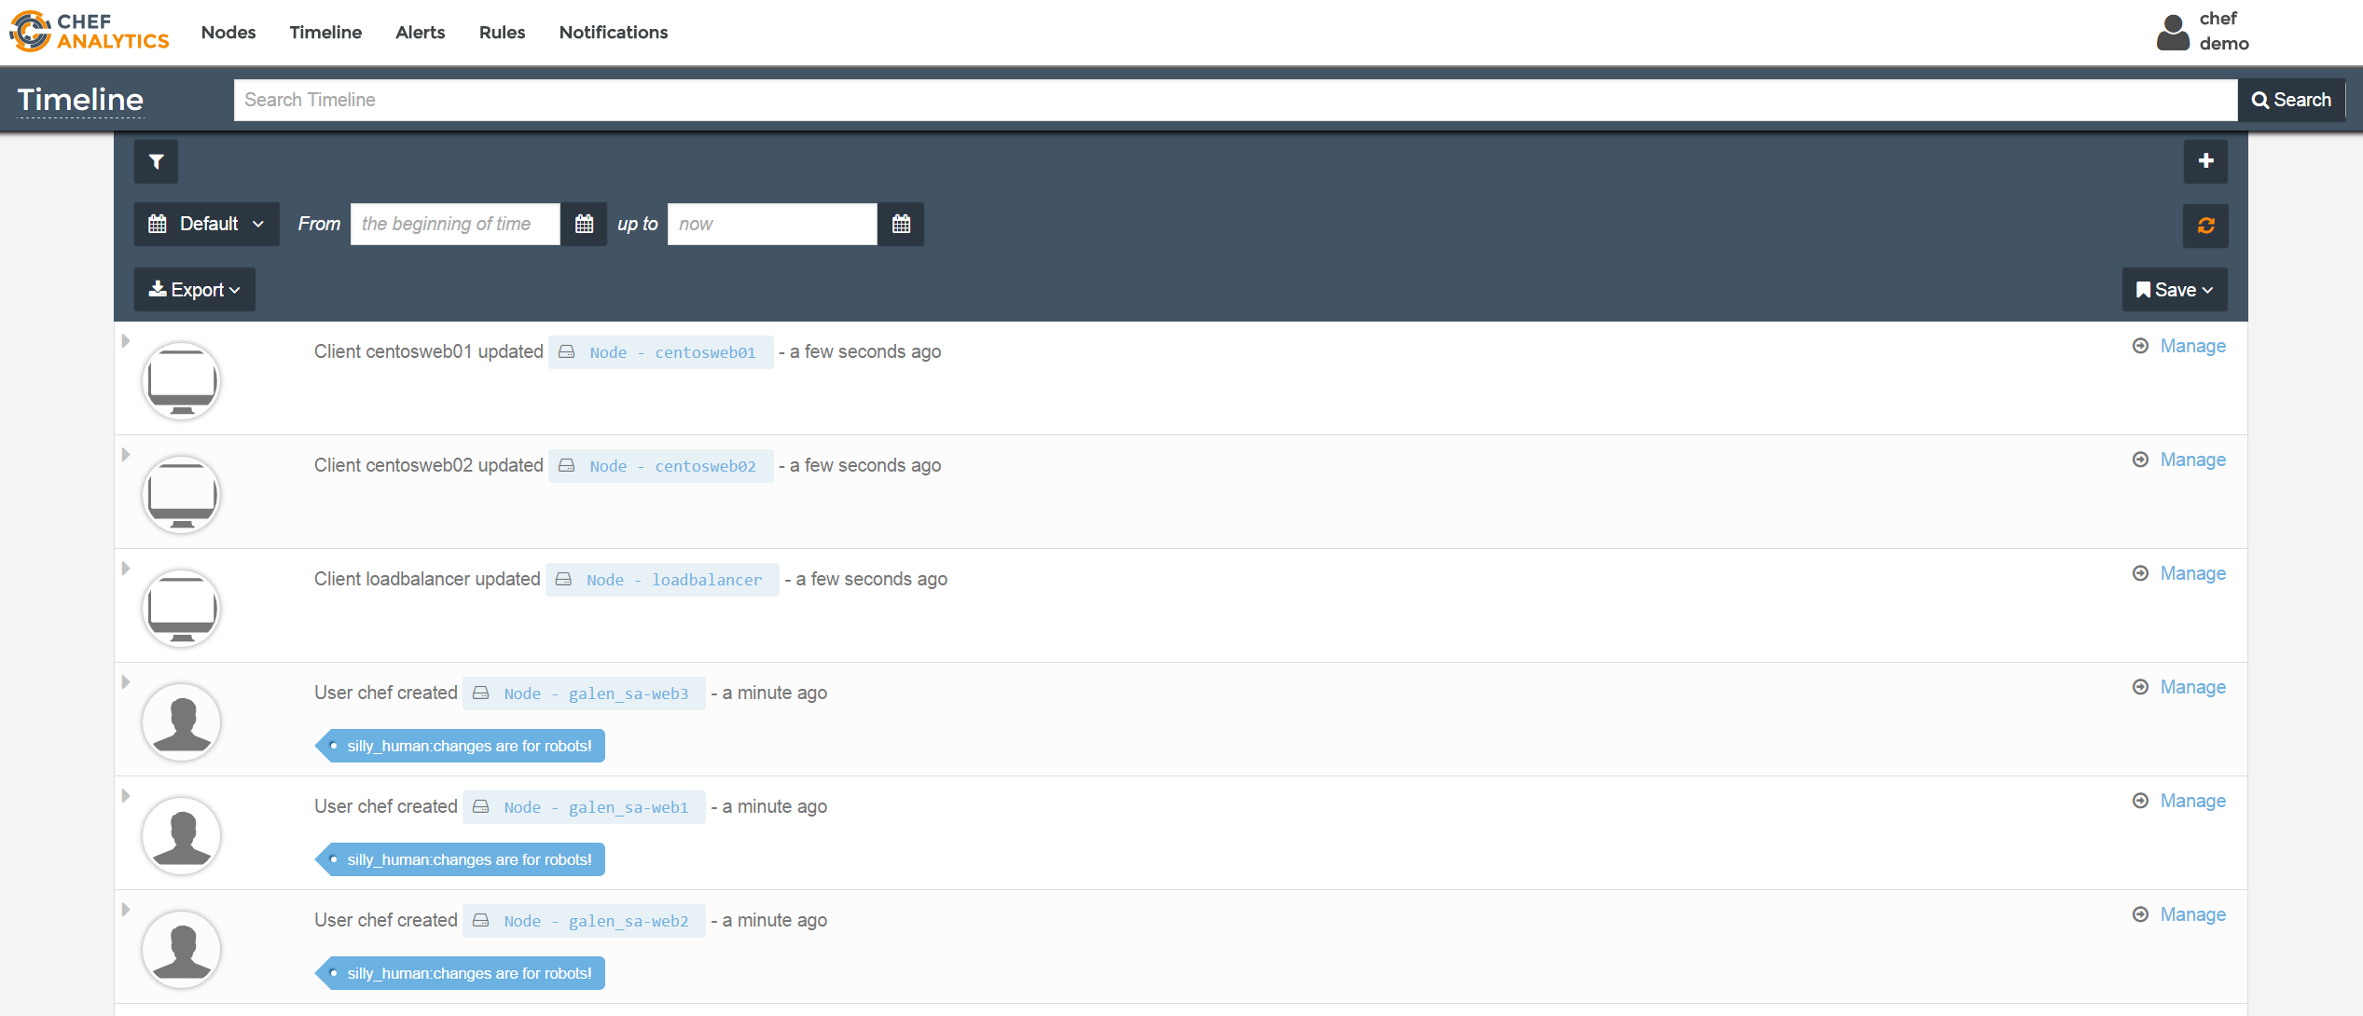

Slide 27
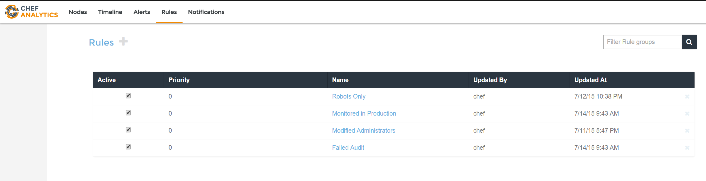

Slide 28
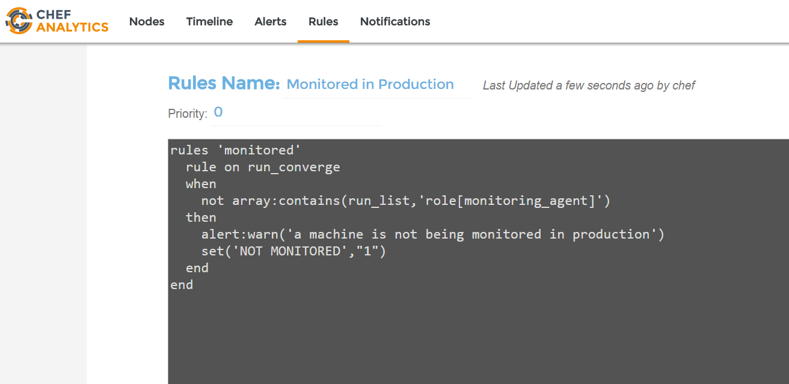

Slide 29
