Slide 1
Python HTML Reporter
Josh Larsen
10/27/2020

Slide 2
Overview
Ml_report is a small collection of modules to assist in the automated reporting of machine learning processing.
ML_report can be used to plot
interactive html tables
Interactive charts
Interactive maps (heatmaps) of data
ML_report can generate multiple ‘report sections’ that can be added to a single html document

Slide 3
Requirements
Python 3.6 or greater
Python libraries
pyshp
geojson
pandas
numpy
plotly

Slide 4
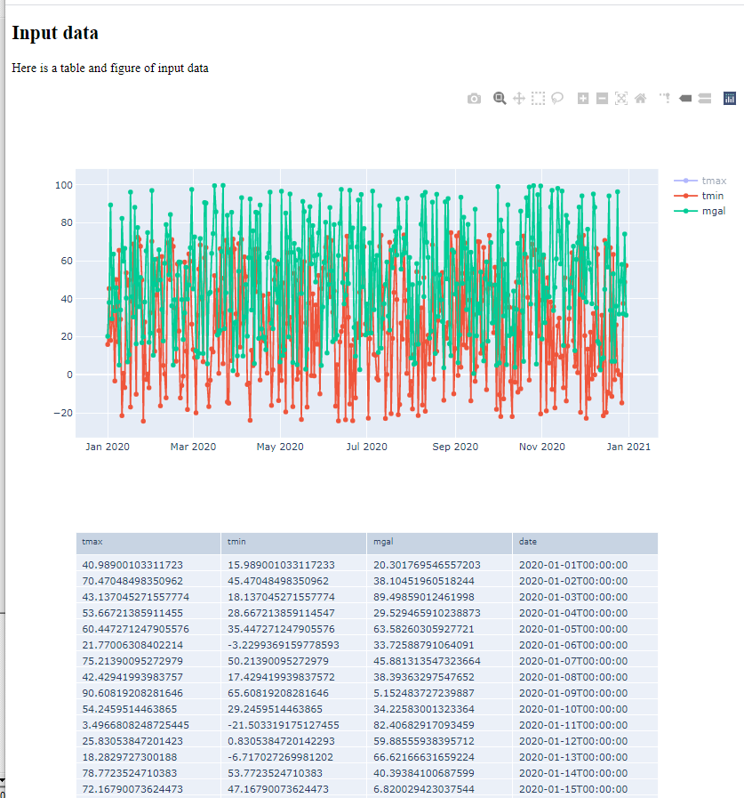
Functionality
ReportSection()
Basic building block for a report
User can add
A section title
A description
Methods allow users to add
Scatter plots
Tables
GIS heatmaps

Slide 5
Functionality
pandas_to_scatter()
Method to add an interactive scatter plot of data to the report
Accepts pandas dataframe objects
pandas_to_table()
Method to add an interactive table of data to the report
Accepts pandas dataframe objects

Slide 6
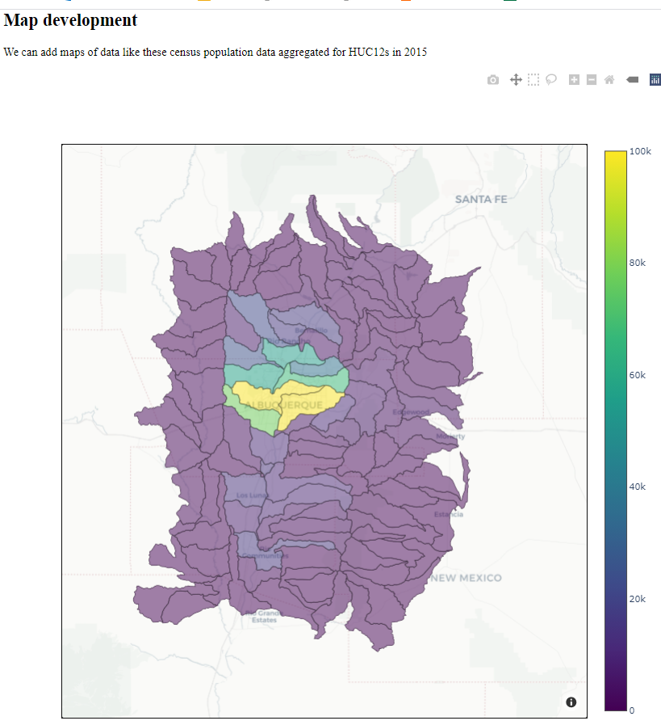
Functionality
geojson_to_heatmap()
Method to add an interactive map of data to the report
Method accepts a list of geojson feature objects

Slide 7
Functionality
compile_html()
Method to compile the ReportSection object into an html representation.
Returns a html string that can be written to file using pythons built in file writing methods
with open(myfile, ‘w’) as foo:
foo.write(myhtml)

Slide 8
Extensibility
The simple class-based structure of ML_report can be extended by adding additional methods.
Examples of potential methods
pandas_to_summary_stats()
pandas_to_histogram()
pandas_to_bar_chart()
geojson_to_points()
etc …

Slide 9
Future work
Report class object (wrapper)
Recraft report class to “snap” together ReportSubsection() objects
Handle html reading and writing

