Slide 1
File Syncing Tool for ScienceBase
Scott Paulinski

Slide 2
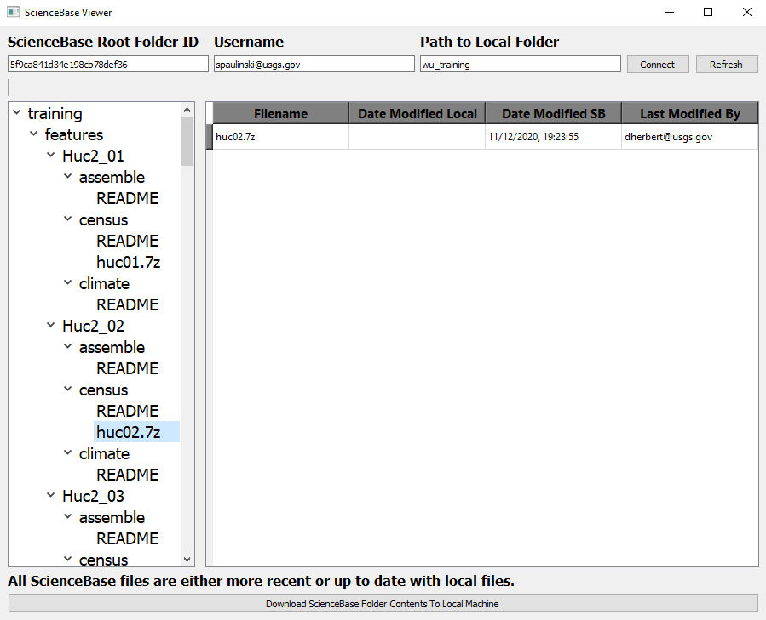
Introduction
sbsync.py
Encapsulates and extends ScienceBasePy library
sbtreeview.py
Graphical user interface built on top of sbsync.py
Allows you to synchronize ScienceBase files and folders with your local file system
Both python scripts recently written
Currently Beta version 0.12
If you use these scripts now, consider yourself a Beta tester!

Slide 3
Dependencies
Both sbsync.py and sbtreeview.py were developed and tested using python 3.7
sbsync.py dependencies
ScienceBasePy
sbtreeview.py dependencies
sbsync.py (and therefore ScienceBasePy)
PyQT5

Slide 4
Downloading and Running ScienceBase Viewer (sbtreeview.py/sbtreeview.exe)
Files are currently on Github
https://github.com/rniswon/CAWSC_WaterUse/tree/master/etc/sciencebase
Download all the files in the sciencebase folder
Windows users
Just run “sbtreeview.exe”
Running sbtreeview as a python script
Install Anaconda for Python 3.x
Set up python environment. Do one of the following:
Use sbsync_env.yml to set up environment
conda.exe env create -f sbsync_env.yml
Install ScienceBasePy and PyQt5 libraries
Run “sbtreeview.py”

Slide 5
Connecting to ScienceBase
Your folder’s Root Folder ID can be found on the ScienceBase website
Your USGS email address
Where you want to store ScienceBase files locally
Once you have completed all three fields, click “Connect”

Slide 6
Details of Connecting to a ScienceBase Folder
Enter ScienceBase folder ID of the root folder you want to connect to
The ScienceBase folder ID can be found by accessing the folder you want on the ScienceBase website and looking at the last part of the URL
For example, for the URL: https://www.sciencebase.gov/catalog/item/5fbe75fad34e4b9faad7e8a1 the ScienceBase folder ID is “5fbe75fad34e4b9faad7e8a1” without the quotes.
Once connected you will have access to all files and folder in the directory tree under that folder
Enter your username that you use to connect to ScienceBase
Enter the local folder path where you want to store the ScienceBase directory tree
This can be an absolute path or a path relative to sbtreeview.py
Click “Connect”
Enter your ScienceBase password when prompted
Folder ID, username, and local folder path stored in _sbtv_settings.txt and automatically entered for you whenever you run sbtreeview.py from the current location

Slide 7
Synchronizing with ScienceBase - File Modification Dates
sbtreeview.py tracks whether files are out of sync
File modification dates are used to determine if local and ScienceBase files are out of sync
Modification dates stored when you either download or upload a file from/to ScienceBase in file _sync_log.csv
Local modification date
ScienceBase modification date
Current modification dates checked against modification dates at time of download/upload
Local modification date changed → ScienceBase file out of date
ScienceBase modification date changed → Local file out of date
Both modification dates changed → Merge required

Slide 8
Synchronizing with ScienceBase – Sync Log
_sync_log.csv
Do not delete this file
File automatically created which stores modification date of ScienceBase files at time of download
Created in root folder
File contains these columns
Relative file path
Local modification date
ScienceBase modification date
File checksum

Slide 9
Downloading a ScienceBase File
In the ScienceBase Viewer tree view click on the folder containing the file you want to download
In the list view to the click on the file you want to download
Click “Download File From ScienceBase” button at the bottom of the ScienceBase Viewer window
Zip archives are automatically extracted
Currently only supports zip archives with single file

Slide 10
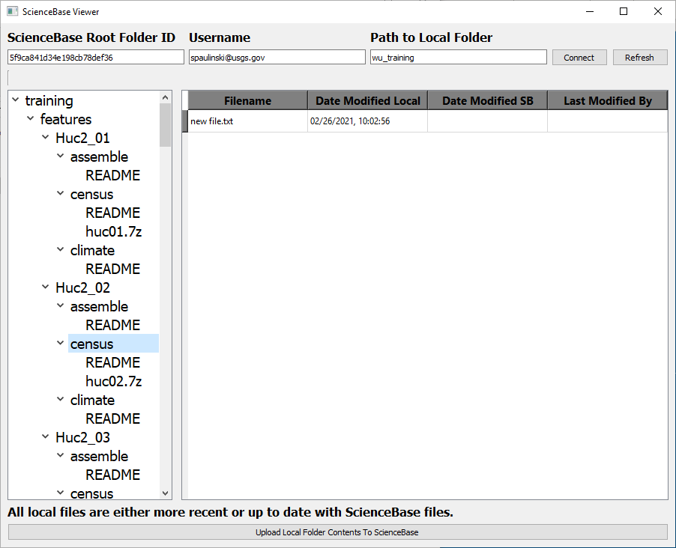
Uploading a File to ScienceBase
Create or modify a file within the mirrored ScienceBase folder structure on your local machine
In the ScienceBase Viewer window upper-right corner click “Refresh”
In the ScienceBase Viewer tree view to the click on the folder containing the file you want to upload
In the list view to the click on the file you want to upload
Click “Upload File To ScienceBase” button at the bottom of the ScienceBase Viewer window
For new files a checkbox will appear below the button
Click checkbox to zip and upload file

Slide 11

Downloading or Uploading all Files in Folder
Click on the folder to upload/download files from
Button “Download ScienceBase Folder Contents to Local Machine” appears if:
No files in the folder require a merge
No files in the folder have been modified locally
One or more files on ScienceBase either does not exist or are out of date locally
Button “Upload Local Folder Contents to ScienceBase” appears if:
No file in the folder require a merge
No files in the folder have been modified on ScienceBase since you last synchronized the file
One or more files locally either do not exist or are out of date on ScienceBase

Slide 12
ScienceBasePy and sbsync.py
ScienceBasePy
Python library designed to access, update, and synchronize ScienceBase files and folders with file and folder are your local computer
sbsync.py
Python library that encapsulates and extends ScienceBasePy
Allows access to files and folders in ScienceBase using an object structure that mimicks a file tree
Folder object has methods to access that folder’s subfolders, parent folder, or files
Retries network operations for redundancy
Library keeps track of whether files are out of date

Slide 13
sbsync.py
A simple python library for synchronizing a ScienceBase archive with a local structure of files and folders
All calls to ScienceBasePy are made through the SBAccess class
Encapsulates certain ScienceBasePy operations adding error/retry code to the operations
Default is to retry each operation up to 100 times before failing
Create a folder tree using the SBTreeRoot class
Once connected the SBTreeRoot object contains SBTreeNode and SBFile objects in a tree structure
Each SBTreeNode object represents a folder
Each SbFile object represents a file

Slide 14
Example Using the sbsync.py Library
Use SBTreeRoot to connect to a specific ScienceBase folder structure
tree_root = SBTreeRoot(‘my_sb_folder', 'spaulinski@usgs.gov',
sb_root_folder_id='5fbe75fad34e4b9faad7e8a1’)
Get the “data” folder immediately under the root folder
data_folder = tree_root['data’]
Print the title of all subfolders under the ‘data’ folder
for name, folder_obj in data_folder.folder_child_items.items():
print(folder_obj.sb_title)
Get the file “data_file.csv” stored in the ‘data’ folder
data_file = tree_root[‘data’]['data_file.csv’]
data_file = data_folder[‘data_file.csv’]
ScienceBase Folder Structure

Slide 15
Example (Continued)
ScienceBase Folder Structure
Print all files in the “data” folder
for name, file_obj in data_folder.files.items():
print(file_obj.sb_name)
Copy files and folders under the root folder from ScienceBase to the local machine
tree_root.mirror_sciencebase_locally(copy_files=True)
Check the synchronization status of a file
Files match, local file out of date, ScienceBase file out of date, merge needed
fs = data_file.file_status

Slide 16
Example (Continued)
ScienceBase Folder Structure
Upload the latest version of a file or a new file to ScienceBase
data_file.upload_to_sciencebase()
Populate local files and folders into the tree structure under the ‘data’ folder
data_folder.populate_local_folder_structure()
Upload new file to ScienceBase
data_folder[‘new_file.txt’].upload_to_sciencebase()

Slide 17
Reporting a Bug
sbsync.py and sbtreeview.py are currently early-release (Beta)
Should a problem occur in sbsync.py
Sbsync.py should automatically create a “debug_log_sbsync.txt” debug file in the folder where the script was run
Should a problem occur in sbtreeview.py
Red bold text should appear at the bottom of the window describing the error
Sbtreeview.py should automatically create a “debug_log_sbtreeview.txt” debug file in the folder where the script was run
When Reporting a bug
Describe what you were doing at the time the bug occurred
Specifics on what file or folder you were accessing at the time would be helpful
Include the red text that appears at the bottom of sbtreeview.py, if any
Attach any debug log that was created. Please look at the debug log modification date before sending to confirm that the log was created at the time of the bug.

