Slide 1
Capstone project presentation

Slide 2
Problem description
Toronto is Canada's most populous city
Looking for new business opportunity
Focusing on only one particular area: East Toronto

Slide 3
Data
Use Coursera provided data
Use Foursquare’s API for location data
Visualize the location data into topographical maps

Slide 4
Methodology
Use standard libraries such as Pandas, Numpy and Folium
Use additional specialized libraries such as BeautifulSoup4

Slide 5
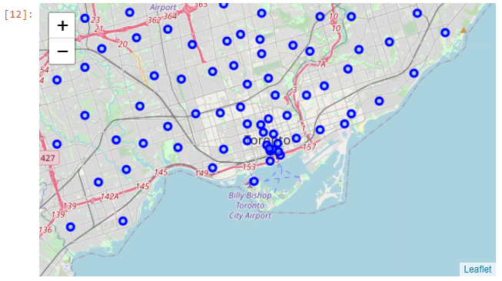
Results

Slide 6
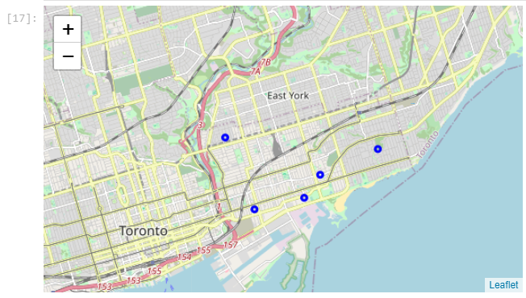
East Toronto

Slide 7
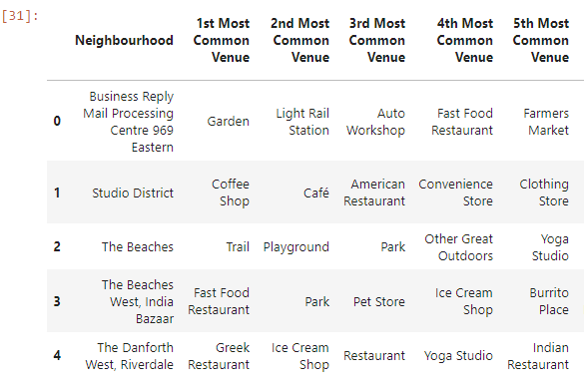
Most common venues

Slide 8
Result Summary
Two categories of venues stand out: hospitality and outdoors
The beaches neighborhood stands out with most outdoor venues
The Danforth West neighborhood has the highest frequency of food hospitality venues
The Studio district stands out for its abundance of cafes and bars
The India Bazaar shows a great deal of diversity in its shopping venues

Slide 9
discussion
The analysis shows the clear diversity of venues in some parts of the region such as the India Bazaar and the clear distinction between the outdoor and hospitality venues such the Beaches.
Furthermore, additional analysis of neighboring areas might be needed in order to clarify the prospectus data.

Slide 10
Thank you for reading

