Slide 1
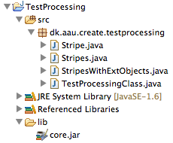
Processing and Java
David Meredith
dave@create.aau.dk

Slide 2
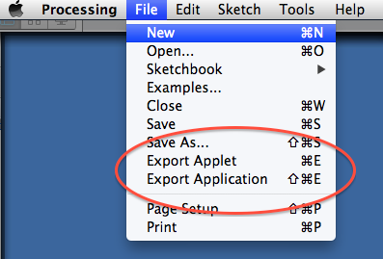
Introduction
Processing is based on Java
When you run a Processing sketch, a Java program is created and run
You can export a Processing sketch as
a Java applet
a Java application

Slide 3
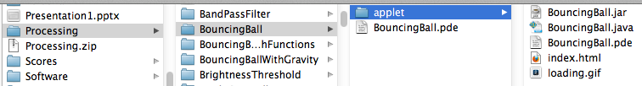
Exporting as an applet
Exporting a sketch as an applet creates a subfolder called “applet” in your sketch folder
This applet folder contains a .jar file and a .java file
The .jar file is an executable file – you can double-click on it to make it run
The .java file is the Java source code for the program

Slide 4
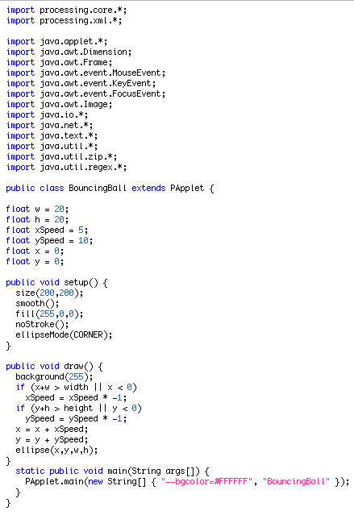
The .java file
The .java file contains the Java source code generated by Processing from your sketch
This .java file is compiled by the Java compiler to give the executable .jar file

Slide 5
Importing libraries
Processing imports all the libraries the sketch might need when it generates the .java file
At the top of the .java file, we see all the java packages (libraries) that need to be imported in order for the program to be able to use all of Processing’s functionality
The basic Processing functions are defined in processing.core
The other libraries are mostly for creating and managing windows and interface events
Many processing sketches actually don’t need to use all of these packages, so when you write your own Java code (as opposed to getting Processing to generate it for you), you probably won’t need to import all of these libraries

Slide 6
The class declaration line
The class declaration line names the Java class and states that this class is a PApplet
Every Java .java file contains one definition of a public class
The name of the class must be the same as that of the file
The class may be a subclass of at most one other Java class
The class for a Processing sketch must extend PApplet
This is because the sketch has been exported as an applet

Slide 7
The main method
If you want to be able to run your Java class, then it must have a main method
In order to run this sketch, we call the PApplet class’s “main” method
The PApplet’s main method takes an array of Strings as its argument
You can make a new array of Strings from scratch using new String[]{s1, s2,...}
The second String in the array must the name of the class
If you want the program to run in “present” mode, then make the first string “--present”
You can also define the background colour as the first String in the array
If class is to be runnable, must have a main method

Slide 8
The rest is the same as in the sketch!
Variables, setup() and draw() are the same as in the Processing sketch itself

Slide 9
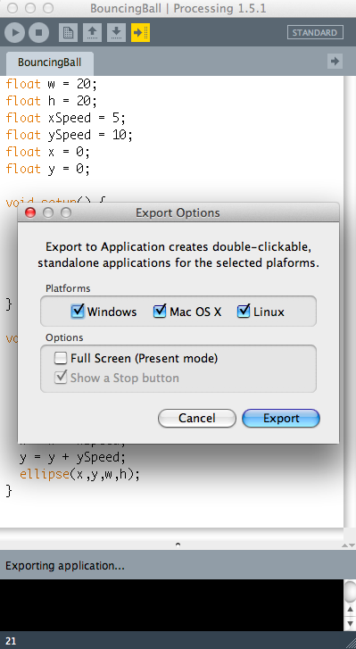
Export sketch to an application
Choice which platforms you want to create executable files for
Choose whether your want Full-screen “present” mode or not

Slide 10
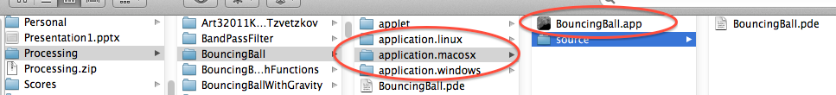
Exporting to an application
Creates three subfolders in the sketch folder, one for each operating system
Each of these subfolders contains a double-clickable, executable file for the specified OS

Slide 11
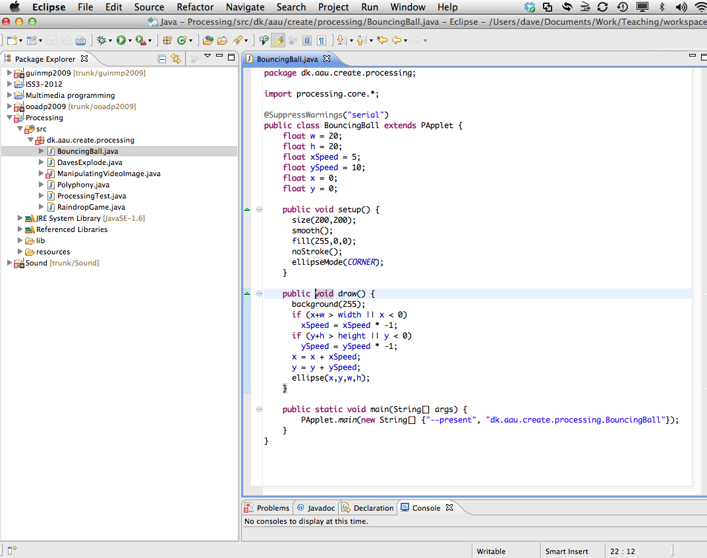
Eclipse
I recommend you use the Eclipse IDE for programming in Java
You can download it by going to eclipse.org
Choose “Eclipse IDE for Java developers” and pick the version that’s right for your system

Slide 12
Run button
Should always have a package declaration at the beginning
You may only have to import the processing.core package
Code arranged into Projects.
Each project contains an src folder which contains packages.
Each package contains class definitions.
The@SuppresWarnings line tells Processing to ignore certain types of warning
Needs to be fully qualified name of class

Slide 13
Tutorial on installing and running Eclipse
There’s a tutorial on how to use Eclipse for processing here:
http://processing.org/learning/eclipse/
We’ll now work through this tutorial together and cover
Installing Eclipse and creating a new project
Importing the Processing libraries
Porting a Processing class to Java manually
Porting a Processing sketch with multiple classes as inner classes
Porting a Processing sketch with multiple classes as external classes

