Slide 1
More than two groups: ANOVA and Chi-square

Slide 2
First, recent news…
RESEARCHERS FOUND A NINE-FOLD INCREASE IN THE RISK OF DEVELOPING PARKINSON'S IN INDIVIDUALS EXPOSED IN THE WORKPLACE TO CERTAIN SOLVENTS…

Slide 3
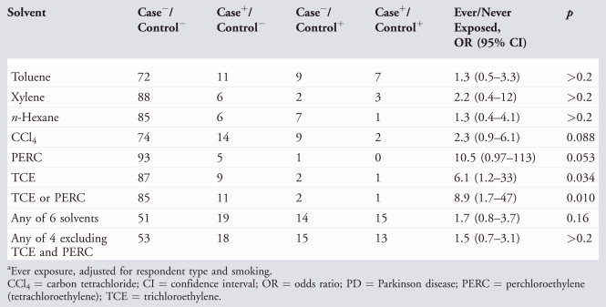
The data…
Table 3. Solvent Exposure Frequencies and Adjusted Pairwise Odds Ratios in PD–Discordant Twins, n = 99 Pairsª

Slide 4
Which statistical test?
Outcome Variable | Are the observations correlated? |  | Alternative to the chi-square test if sparse cells:
 | independent | correlated
Binary or categorical (e.g. fracture, yes/no) | Chi-square test: compares proportions between two or more groups Relative risks: odds ratios or risk ratios Logistic regression: multivariate technique used when outcome is binary; gives multivariate-adjusted odds ratios | McNemar’s chi-square test: compares binary outcome between correlated groups (e.g., before and after) Conditional logistic regression: multivariate regression technique for a binary outcome when groups are correlated (e.g., matched data) GEE modeling: multivariate regression technique for a binary outcome when groups are correlated (e.g., repeated measures) | Fisher’s exact test: compares proportions between independent groups when there are sparse data (some cells <5). McNemar’s exact test: compares proportions between correlated groups when there are sparse data (some cells <5).

Slide 5
Comparing more than two groups…

Slide 6
Continuous outcome (means)
Outcome Variable | Are the observations independent or correlated? |  | Alternatives if the normality assumption is violated (and small sample size):
 | independent | correlated
Continuous (e.g. pain scale, cognitive function) | Ttest: compares means between two independent groups ANOVA: compares means between more than two independent groups Pearson’s correlation coefficient (linear correlation): shows linear correlation between two continuous variables Linear regression: multivariate regression technique used when the outcome is continuous; gives slopes | Paired ttest: compares means between two related groups (e.g., the same subjects before and after) Repeated-measures ANOVA: compares changes over time in the means of two or more groups (repeated measurements) Mixed models/GEE modeling: multivariate regression techniques to compare changes over time between two or more groups; gives rate of change over time | Non-parametric statistics Wilcoxon sign-rank test: non-parametric alternative to the paired ttest Wilcoxon sum-rank test (=Mann-Whitney U test): non-parametric alternative to the ttest Kruskal-Wallis test: non-parametric alternative to ANOVA Spearman rank correlation coefficient: non-parametric alternative to Pearson’s correlation coefficient

Slide 7
ANOVA example
Mean micronutrient intake from the school lunch by school
S1ª, n=28
S2^{b}, n=25
S3^{c}, n=21
P-value^{d}
Calcium (mg)
Mean
117.8
158.7
206.5
0.000
SDe
62.4
70.5
86.2
Iron (mg)
Mean
2.0
2.0
2.0
0.854
SD
0.6
0.6
0.6
Folate (μg)
Mean
26.6
38.7
42.6
0.000
SD
13.1
14.5
15.1
Zinc (mg)
Mean
1.9
1.5
1.3
0.055
SD
1.0
1.2
0.4
ª School 1 (most deprived; 40% subsidized lunches).
^{b} School 2 (medium deprived; <10% subsidized).
^{c} School 3 (least deprived; no subsidization, private school).
^{d} ANOVA; significant differences are highlighted in bold (P<0.05).
FROM: Gould R, Russell J, Barker ME. School lunch menus and 11 to 12 year old children's food choice in three secondary schools in England-are the nutritional standards being met? Appetite. 2006 Jan;46(1):86-92.

Slide 8
ANOVA
(ANalysis Of VAriance)
Idea: For two or more groups, test difference between means, for quantitative normally distributed variables.
Just an extension of the t-test (an ANOVA with only two groups is mathematically equivalent to a t-test).

Slide 9
One-Way Analysis of Variance
Assumptions, same as ttest
  Normally distributed outcome
  Equal variances between the groups
  Groups are independent

Slide 10
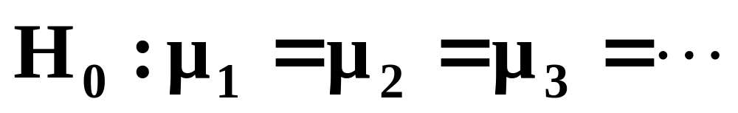
Hypotheses of One-Way ANOVA

Slide 11
ANOVA
It’s like this: If I have three groups to compare:
  I could do three pair-wise ttests, but this would increase my type I error
  So, instead I want to look at the pairwise differences “all at once.”
  To do this, I can recognize that variance is a statistic that let’s me look at more than one difference at a time…

Slide 12
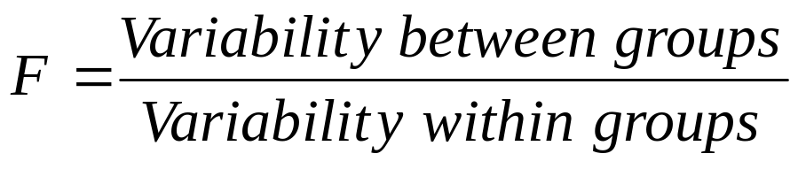
The “F-test”
Is the difference in the means of the groups more
than background noise (=variability within groups)?
Summarizes the mean differences between all groups at once.
Analogous to pooled variance from a ttest.
Recall, we have already used an “F-test” to check for equality of variances→ If F>>1 (indicating unequal variances), use unpooled variance in a t-test.

Slide 13
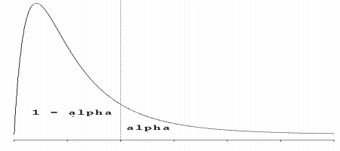
The F-distribution
The F-distribution is a continuous probability distribution that depends on two parameters n and m (numerator and denominator degrees of freedom, respectively):
http://www.econtools.com/jevons/java/Graphics2D/FDist.html

Slide 14
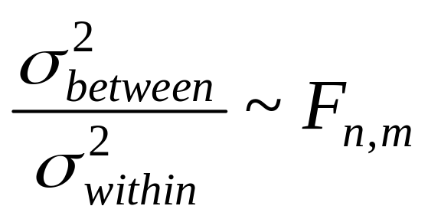
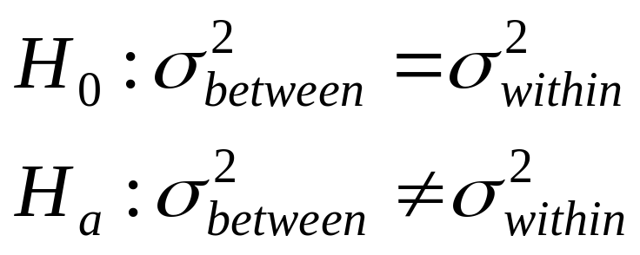
The F-distribution
A ratio of variances follows an F-distribution:
The F-test tests the hypothesis that two variances are equal.
F will be close to 1 if sample variances are equal.

Slide 15
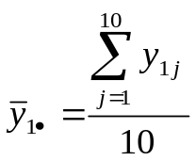
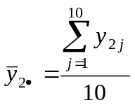

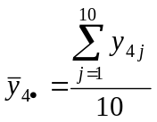
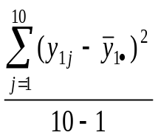
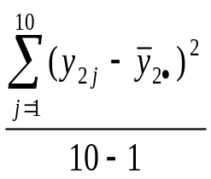
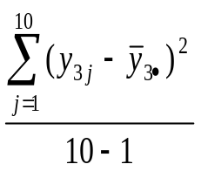
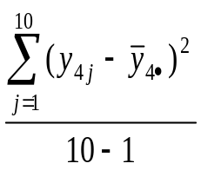
How to calculate ANOVA’s by hand…
Treatment 1
Treatment 2
Treatment 3
Treatment 4
y₁₁
y₂₁
y₃₁
y₄₁
y₁₂
y₂₂
y₃₂
y₄₂
n=10 obs./group
k=4 groups
y₁₃
y₂₃
y₃₃
y₄₃
y₁₄
y₂₄
y₃₄
y₄₄
y₁₅
y₂₅
y₃₅
y₄₅
y₁₆
y₂₆
y₃₆
y₄₆
y₁₇
y₂₇
y₃₇
y₄₇
y₁₈
y₂₈
y₃₈
y₄₈
y₁₉
y₂₉
y₃₉
y₄₉
y₁₁₀
y₂₁₀
y₃₁₀
y₄₁₀
The group means
The (within) group variances

Slide 16
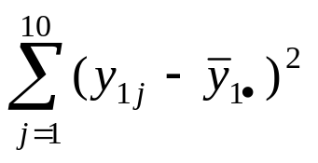
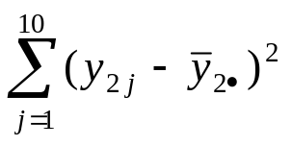
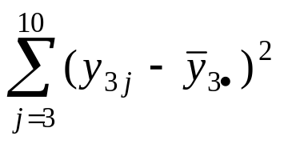
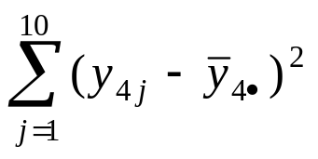
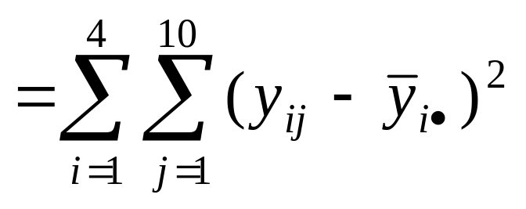
Sum of Squares Within (SSW), or Sum of Squares Error (SSE)
The (within) group variances
+
+
+
Sum of Squares Within (SSW) (or SSE, for chance error)

Slide 17
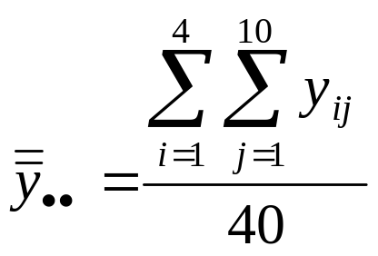
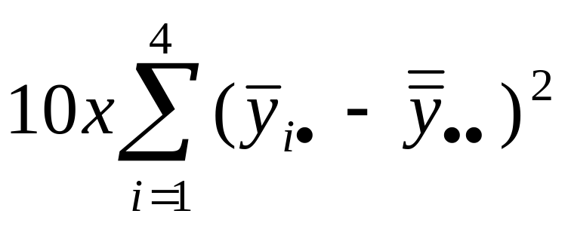
Sum of Squares Between (SSB), or Sum of Squares Regression (SSR)
Overall mean of all 40 observations (“grand mean”)
Sum of Squares Between (SSB). Variability of the group means compared to the grand mean (the variability due to the treatment).

Slide 18
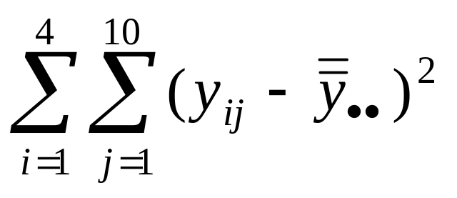
Total Sum of Squares (SST)
Total sum of squares(TSS).
Squared difference of every observation from the overall mean. (numerator of variance of Y!)

Slide 19
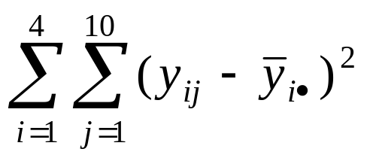
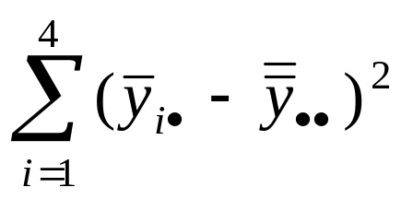

Partitioning of Variance
+
=
SSW + SSB = TSS

Slide 20
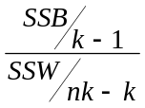
ANOVA Table
Mean Sum of Squares
F-statistic
p-value
Source of variation
d.f.
Sum of squares
Between
(k groups)
k-1
SSB
(sum of squared deviations of group means from grand mean)
SSB/k-1
Go to
F_{k-1,nk-k}
chart
Within
(n individuals per group)
nk-k
SSW
(sum of squared deviations of observations from their group mean)
s²⁼SSW/nk-k
Total variation
nk-1
TSS
(sum of squared deviations of observations from grand mean)
TSS=SSB + SSW

Slide 21
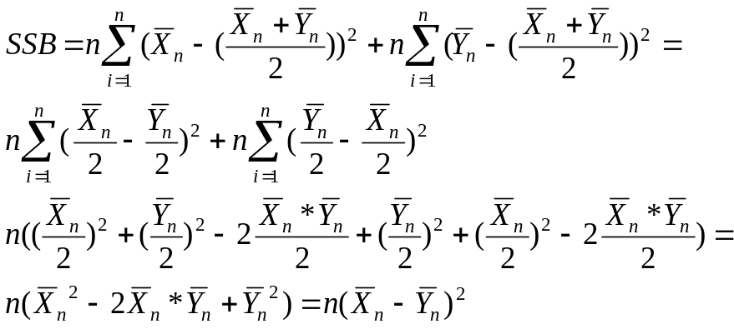
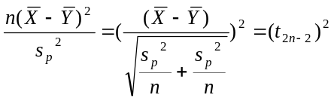
ANOVA=t-test
Mean Sum of Squares
F-statistic
p-value
Source of variation
d.f.
Sum of squares
Between (2 groups)
1
SSB
(squared difference in means multiplied by n)
Squared difference in means times n
Go to
F_{1, 2n-2}
Chart→ notice values are just (t _{2n-2})²
Within
2n-2
SSW
Pooled variance
equivalent to numerator of pooled variance
Total variation
2n-1
TSS

Slide 22
Example
Treatment 1
Treatment 2
Treatment 3
Treatment 4
60 inches
50
48
47
67
52
49
67
42
43
50
54
67
67
55
67
56
67
56
68
62
59
61
65
64
67
61
65
59
64
60
56
72
63
59
60
71
65
64
65

Slide 23
Example
Step 1) calculate the sum of squares between groups:
Mean for group 1 = 62.0
Mean for group 2 = 59.7
Mean for group 3 = 56.3
Mean for group 4 = 61.4
Grand mean= 59.85
Treatment 1
Treatment 2
Treatment 3
Treatment 4
60 inches
50
48
47
67
52
49
67
42
43
50
54
67
67
55
67
56
67
56
68
62
59
61
65
64
67
61
65
59
64
60
56
72
63
59
60
71
65
64
65
SSB = [(62-59.85)² + (59.7-59.85)² + (56.3-59.85)² + (61.4-59.85)² ] xn per group= 19.65x10 = 196.5

Slide 24
Example
Step 2) calculate the sum of squares within groups:
(60-62) ²+(67-62) ²+ (42-62) ²+ (67-62) ²+ (56-62) ²+ (62-62) ²+ (64-62) ²+ (59-62) ²+ (72-62) ²+ (71-62) ²+ (50-59.7) ²+ (52-59.7) ²+ (43-59.7) ²+67-59.7) ²+ (67-59.7) ²+ (69-59.7) ²…+….(sum of 40 squared deviations) = 2060.6
Treatment 1
Treatment 2
Treatment 3
Treatment 4
60 inches
50
48
47
67
52
49
67
42
43
50
54
67
67
55
67
56
67
56
68
62
59
61
65
64
67
61
65
59
64
60
56
72
63
59
60
71
65
64
65

Slide 25
Step 3) Fill in the ANOVA table
Source of variation
d.f.
Sum of squares
Mean Sum of Squares
F-statistic
p-value
Between
3
196.5
65.5
1.14
.344
Within
36
2060.6
57.2
Total
39
2257.1

Slide 26
Step 3) Fill in the ANOVA table
Source of variation
d.f.
Sum of squares
Mean Sum of Squares
F-statistic
p-value
Between
3
196.5
65.5
1.14
.344
Within
36
2060.6
57.2
Total
39
2257.1
INTERPRETATION of ANOVA:
How much of the variance in height is explained by treatment group?
R²⁼“Coefficient of Determination” = SSB/TSS = 196.5/2275.1=9%

Slide 27
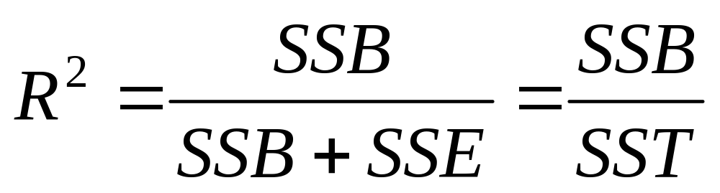
Coefficient of Determination
The amount of variation in the outcome variable (dependent variable) that is explained by the predictor (independent variable).

Slide 28
Beyond one-way ANOVA
Often, you may want to test more than 1 treatment. ANOVA can accommodate more than 1 treatment or factor, so long as they are independent. Again, the variation partitions beautifully!
TSS = SSB1 + SSB2 + SSW

Slide 29
ANOVA example
Table 6. Mean micronutrient intake from the school lunch by school
S1ª, n=25
S2^{b}, n=25
S3^{c}, n=25
P-value^{d}
Calcium (mg)
Mean
117.8
158.7
206.5
0.000
SDe
62.4
70.5
86.2
Iron (mg)
Mean
2.0
2.0
2.0
0.854
SD
0.6
0.6
0.6
Folate (μg)
Mean
26.6
38.7
42.6
0.000
SD
13.1
14.5
15.1
Zinc (mg)
Mean
1.9
1.5
1.3
0.055
SD
1.0
1.2
0.4
ª School 1 (most deprived; 40% subsidized lunches).
^{b} School 2 (medium deprived; <10% subsidized).
^{c} School 3 (least deprived; no subsidization, private school).
^{d} ANOVA; significant differences are highlighted in bold (P<0.05).
FROM: Gould R, Russell J, Barker ME. School lunch menus and 11 to 12 year old children's food choice in three secondary schools in England-are the nutritional standards being met? Appetite. 2006 Jan;46(1):86-92.

Slide 30
Answer
Step 1) calculate the sum of squares between groups:
Mean for School 1 = 117.8
Mean for School 2 = 158.7
Mean for School 3 = 206.5
Grand mean: 161
SSB = [(117.8-161)² + (158.7-161)² + (206.5-161)²] x25 per group= 98,113

Slide 31
Answer
Step 2) calculate the sum of squares within groups:
S.D. for S1 = 62.4
S.D. for S2 = 70.5
S.D. for S3 = 86.2
Therefore, sum of squares within is:
(24)[ 62.4² + 70.5 ²+ 86.2²]=391,066

Slide 32
Answer
Step 3) Fill in your ANOVA table
Source of variation
d.f.
Sum of squares
Mean Sum of Squares
F-statistic
p-value
Between
2
98,113
49056
9
<.05
Within
72
391,066
5431
Total
74
489,179
**R²=98113/489179=20%
School explains 20% of the variance in lunchtime calcium intake in these kids.

Slide 33
ANOVA summary
A statistically significant ANOVA (F-test) only tells you that at least two of the groups differ, but not which ones differ.
Determining which groups differ (when it’s unclear) requires more sophisticated analyses to correct for the problem of multiple comparisons…

Slide 34
Question: Why not just do 3 pairwise ttests?
Answer: because, at an error rate of 5% each test, this means you have an overall chance of up to 1-(.95)³= 14% of making a type-I error (if all 3 comparisons were independent)
If you wanted to compare 6 groups, you’d have to do ₆C₂ = 15 pairwise ttests; which would give you a high chance of finding something significant just by chance (if all tests were independent with a type-I error rate of 5% each); probability of at least one type-I error = 1-(.95)¹⁵=54%.

Slide 35
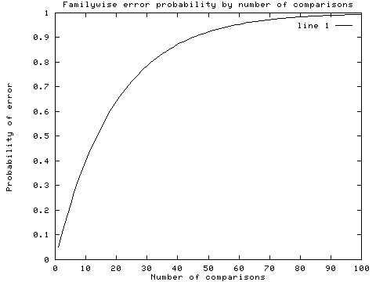
Recall: Multiple comparisons

Slide 36
Correction for multiple comparisons
How to correct for multiple comparisons post-hoc…
Bonferroni correction (adjusts p by most conservative amount; assuming all tests independent, divide p by the number of tests)
Tukey (adjusts p)
Scheffe (adjusts p)
Holm/Hochberg (gives p-cutoff beyond which not significant)

Slide 37
Procedures for Post Hoc Comparisons
If your ANOVA test identifies a difference between group means, then you must identify which of your k groups differ.
If you did not specify the comparisons of interest (“contrasts”) ahead of time, then you have to pay a price for making all _{k}C_{r} pairwise comparisons to keep overall type-I error rate to α.
Alternately, run a limited number of planned comparisons (making only those comparisons that are most important to your research question). (Limits the number of tests you make).

Slide 38
1. Bonferroni
For example, to make a Bonferroni correction, divide your desired alpha cut-off level (usually .05) by the number of comparisons you are making. Assumes complete independence between comparisons, which is way too conservative.
Obtained P-value
Original Alpha
# tests
New Alpha
Significant?
.001
.05
5
.010
Yes
.011
.05
4
.013
Yes
.019
.05
3
.017
No
.032
.05
2
.025
No
.048
.05
1
.050
Yes

Slide 39
2/3. Tukey and Sheffé
Both methods increase your p-values to account for the fact that you’ve done multiple comparisons, but are less conservative than Bonferroni (let computer calculate for you!).
SAS options in PROC GLM:
    adjust=tukey
    adjust=scheffe

Slide 40
4/5. Holm and Hochberg
Arrange all the resulting p-values (from the T=_{k}C_{r} pairwise comparisons) in order from smallest (most significant) to largest: p₁ to p_{T}

Slide 41
Holm
Start with p₁, and compare to Bonferroni p (=α/T).
If p₁< α/T, then p₁ is significant and continue to step 2. If not, then we have no significant p-values and stop here.
If p₂< α/(T-1), then p₂ is significant and continue to step. If not, then p₂ thru p_{T} are not significant and stop here.
If p₃< α/(T-2), then p₃ is significant and continue to step If not, then p₃ thru p_{T} are not significant and stop here.
Repeat the pattern…

Slide 42
Hochberg
Start with largest (least significant) p-value, p_{T}, and compare to α. If it’s significant, so are all the remaining p-values and stop here. If it’s not significant then go to step 2.
If p_{T-1}< α/(T-1), then p_{T-1} is significant, as are all remaining smaller p-vales and stop here. If not, then p_{T-1} is not significant and go to step 3.
Repeat the pattern…
Note: Holm and Hochberg should give you the same results. Use Holm if you anticipate few significant comparisons; use Hochberg if you anticipate many significant comparisons.

Slide 43
Practice Problem
A large randomized trial compared an experimental drug and 9 other standard drugs for treating motion sickness. An ANOVA test revealed significant differences between the groups. The investigators wanted to know if the experimental drug (“drug 1”) beat any of the standard drugs in reducing total minutes of nausea, and, if so, which ones. The p-values from the pairwise ttests (comparing drug 1 with drugs 2-10) are below.
a. Which differences would be considered statistically significant using a Bonferroni correction? A Holm correction? A Hochberg correction?
Drug 1 vs. drug …
2
3
4
5
6
7
8
9
10
p-value
.05
.3
.25
.04
.001
.006
.08
.002
.01

Slide 44
Answer
Bonferroni makes new α value = α/9 = .05/9 =.0056; therefore, using Bonferroni, the new drug is only significantly different than standard drugs 6 and 9.
Arrange p-values:
6
9
7
10
5
2
8
4
3
.001
.002
.006
.01
.04
.05
.08
.25
.3
Holm: .001<.0056; .002<.05/8=.00625; .006<.05/7=.007; .01>.05/6=.0083; therefore, new drug only significantly different than standard drugs 6, 9, and 7.
Hochberg: .3>.05; .25>.05/2; .08>.05/3; .05>.05/4; .04>.05/5; .01>.05/6; .006<.05/7; therefore, drugs 7, 9, and 6 are significantly different.

Slide 45
Practice problem
b. Your patient is taking one of the standard drugs that was shown to be statistically less effective in minimizing motion sickness (i.e., significant p-value for the comparison with the experimental drug). Assuming that none of these drugs have side effects but that the experimental drug is slightly more costly than your patient’s current drug-of-choice, what (if any) other information would you want to know before you start recommending that patients switch to the new drug?

Slide 46
Answer
The magnitude of the reduction in minutes of nausea.
If large enough sample size, a 1-minute difference could be statistically significant, but it’s obviously not clinically meaningful and you probably wouldn’t recommend a switch.

Slide 47
Continuous outcome (means)
Outcome Variable | Are the observations independent or correlated? |  | Alternatives if the normality assumption is violated (and small sample size):
 | independent | correlated
Continuous (e.g. pain scale, cognitive function) | Ttest: compares means between two independent groups ANOVA: compares means between more than two independent groups Pearson’s correlation coefficient (linear correlation): shows linear correlation between two continuous variables Linear regression: multivariate regression technique used when the outcome is continuous; gives slopes | Paired ttest: compares means between two related groups (e.g., the same subjects before and after) Repeated-measures ANOVA: compares changes over time in the means of two or more groups (repeated measurements) Mixed models/GEE modeling: multivariate regression techniques to compare changes over time between two or more groups; gives rate of change over time | Non-parametric statistics Wilcoxon sign-rank test: non-parametric alternative to the paired ttest Wilcoxon sum-rank test (=Mann-Whitney U test): non-parametric alternative to the ttest Kruskal-Wallis test: non-parametric alternative to ANOVA Spearman rank correlation coefficient: non-parametric alternative to Pearson’s correlation coefficient

Slide 48
Non-parametric ANOVA
Kruskal-Wallis one-way ANOVA
(just an extension of the Wilcoxon Sum-Rank (Mann Whitney U) test for 2 groups; based on ranks)
Proc NPAR1WAY in SAS

Slide 49
Binary or categorical outcomes (proportions)
Outcome Variable | Are the observations correlated? |  | Alternative to the chi-square test if sparse cells:
 | independent | correlated
Binary or categorical (e.g. fracture, yes/no) | Chi-square test: compares proportions between two or more groups Relative risks: odds ratios or risk ratios Logistic regression: multivariate technique used when outcome is binary; gives multivariate-adjusted odds ratios | McNemar’s chi-square test: compares binary outcome between correlated groups (e.g., before and after) Conditional logistic regression: multivariate regression technique for a binary outcome when groups are correlated (e.g., matched data) GEE modeling: multivariate regression technique for a binary outcome when groups are correlated (e.g., repeated measures) | Fisher’s exact test: compares proportions between independent groups when there are sparse data (some cells <5). McNemar’s exact test: compares proportions between correlated groups when there are sparse data (some cells <5).

Slide 50
Chi-square test for comparing proportions
(of a categorical variable) between >2 groups
I. Chi-Square Test of Independence
When both your predictor and outcome variables are categorical, they may be cross-classified in a contingency table and compared using a chi-square test of independence.
A contingency table with R rows and C columns is an R x C contingency table.

Slide 51
Example
Asch, S.E. (1955). Opinions and social pressure. Scientific American, 193, 31-35.

Slide 52
The Experiment
A Subject volunteers to participate in a “visual perception study.”
Everyone else in the room is actually a conspirator in the study (unbeknownst to the Subject).
The “experimenter” reveals a pair of cards…

Slide 53
The Task Cards
Standard line
Comparison lines
A, B, and C

Slide 54
The Experiment
Everyone goes around the room and says which comparison line (A, B, or C) is correct; the true Subject always answers last – after hearing all the others’ answers.
The first few times, the 7 “conspirators” give the correct answer.
Then, they start purposely giving the (obviously) wrong answer.
75% of Subjects tested went along with the group’s consensus at least once.

Slide 55
Further Results
In a further experiment, group size (number of conspirators) was altered from 2-10.
Does the group size alter the proportion of subjects who conform?

Slide 56
The Chi-Square test
Conformed?
Number of group members?
2
4
6
8
10
Yes
20
50
75
60
30
No
80
50
25
40
70
Apparently, conformity less likely when less or more group members…

Slide 57
20 + 50 + 75 + 60 + 30 = 235 conformed
out of 500 experiments.
Overall likelihood of conforming = 235/500 = .47

Slide 58
Calculating the expected, in general
Null hypothesis: variables are independent
Recall that under independence:
P(A)*P(B)=P(A&B)
Therefore, calculate the marginal probability of B and the marginal probability of A. Multiply P(A)*P(B)*N to get the expected cell count.

Slide 59
Expected frequencies if no association between group size and conformity…
Conformed?
Number of group members?
2
4
6
8
10
Yes
47
47
47
47
47
No
53
53
53
53
53

Slide 60
Do observed and expected differ more than expected due to chance?

Slide 61
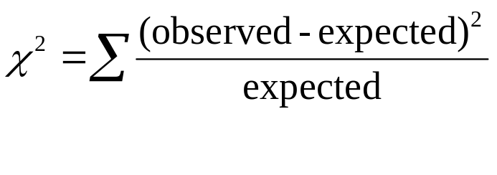
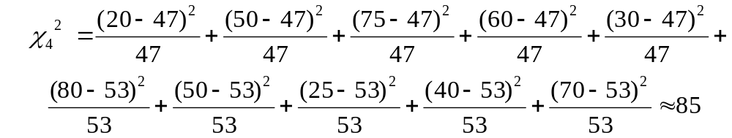
Chi-Square test
Degrees of freedom = (rows-1)*(columns-1)=(2-1)*(5-1)=4

Slide 62
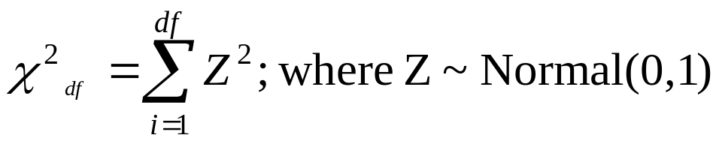
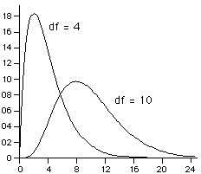
The Chi-Square distribution: is sum of squared normal deviates
The expected value and variance of a chi-square:
E(x)=df
Var(x)=2(df)

Slide 63
Chi-Square test
Degrees of freedom = (rows-1)*(columns-1)=(2-1)*(5-1)=4
Rule of thumb: if the chi-square statistic is much greater than it’s degrees of freedom, indicates statistical significance. Here 85>>4.

Slide 64
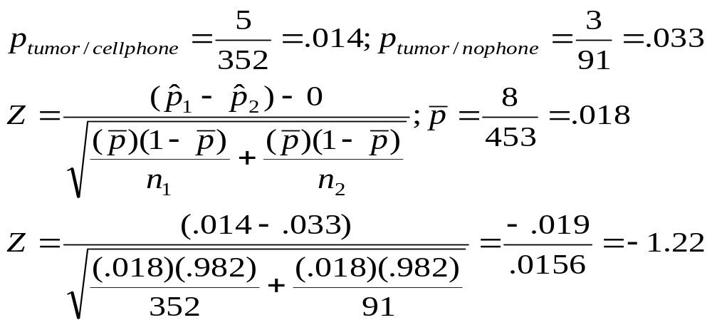
Chi-square example: recall data…
Brain tumor
No brain tumor
Own a cell phone
5
347
352
Don’t own a cell phone
3
88
91
8
435
453

Slide 65
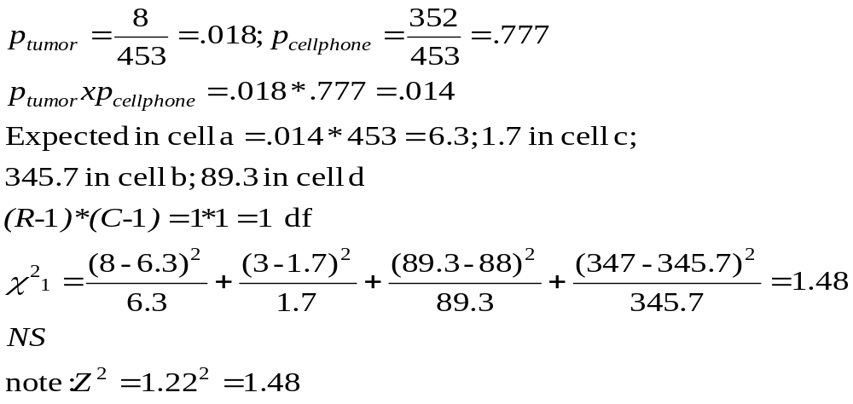
Same data, but use Chi-square test
Brain tumor
No brain tumor
Own
5
347
352
Don’t own
3
88
91
8
435
453
Expected value in cell c= 1.7, so technically should use a Fisher’s exact here! Next term…

Slide 66
Caveat
**When the sample size is very small in any cell (expected value<5), Fisher’s exact test is used as an alternative to the chi-square test.

Slide 67
Binary or categorical outcomes (proportions)
Outcome Variable | Are the observations correlated? |  | Alternative to the chi-square test if sparse cells:
 | independent | correlated
Binary or categorical (e.g. fracture, yes/no) | Chi-square test: compares proportions between two or more groups Relative risks: odds ratios or risk ratios Logistic regression: multivariate technique used when outcome is binary; gives multivariate-adjusted odds ratios | McNemar’s chi-square test: compares binary outcome between correlated groups (e.g., before and after) Conditional logistic regression: multivariate regression technique for a binary outcome when groups are correlated (e.g., matched data) GEE modeling: multivariate regression technique for a binary outcome when groups are correlated (e.g., repeated measures) | Fisher’s exact test: compares proportions between independent groups when there are sparse data (np <5). McNemar’s exact test: compares proportions between correlated groups when there are sparse data (np <5).

