Slide 1
DELHI HACKS 1.0
Team Name : AIB HACKS
Team Members
Omkar Mane | Aditya Gurnani | Advait Naik
Krish Amesur | Tejas Dhopavkar
Domain :
ARTIFICIAL INTELLIGENCE

Slide 2

PROBLEM STATEMENT
A live video monitoring system to track students activity during online/offline examination and to get a clear view of each student in the frame and to record their attendance using face recognition and to classify student’s activity as suspicious or normal based on head movement and body movement. These recordings can be played back for future references.

Slide 3
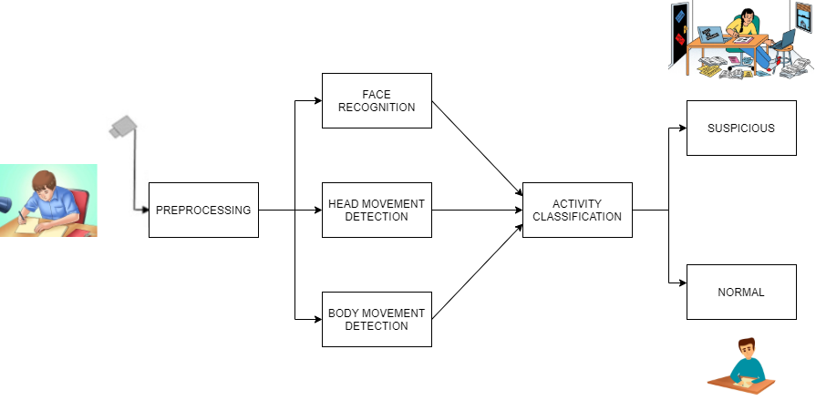
SYSTEM ARCHITECTURE :

Slide 4

SOLUTION :
System will use face recognition for marking student’s attendance even if a student is wearing a mask considering current situation.
The next main feature of this software would be that it will track the activity of students appearing for the exams.
System will note their actions and based on their actions the system will categorize the activity into suspicious activity or normal activity.

