Slide 1

Log files
The idea of software logging in general (and also ROS’s logging) is to allow programs to generate a stream of short text strings called log messages. In ROS, log messages are classified into five groups called severity levels.

Slide 2
The levels are, in order of increasing importance:
DEBUG
INFO
WARN
ERROR
FATAL

Slide 3
For example
Severity Example message
DEBUG reading header from buffer
INFO Waiting for all connections to establish
WARN Less than 5GB of space free on disk
ERROR Publisher header did not have required element: type
FATAL You must call ros::init() before creating the first NodeHandle

Slide 4
What are the severitys and when to use it ?
DEBUG messages may be generated very frequently, but are not generally interesting when the program is working correctly.
at the other hand, FATAL messages are likely to be very rare but very important, indicating a problem that prevents the program from continuing.
The other three levels, INFO , WARN , and ERROR , represent intermediate degrees of importance between these two extremes.
This variety of severity levels is intended to provide a consistent way to classify and manage log messages (notice, generating a fatal\debug message will not cause the program to end\ debug your code, they are just a message,in case of fatal error\info for debug, we use those messages to help us control the situation).

Slide 5
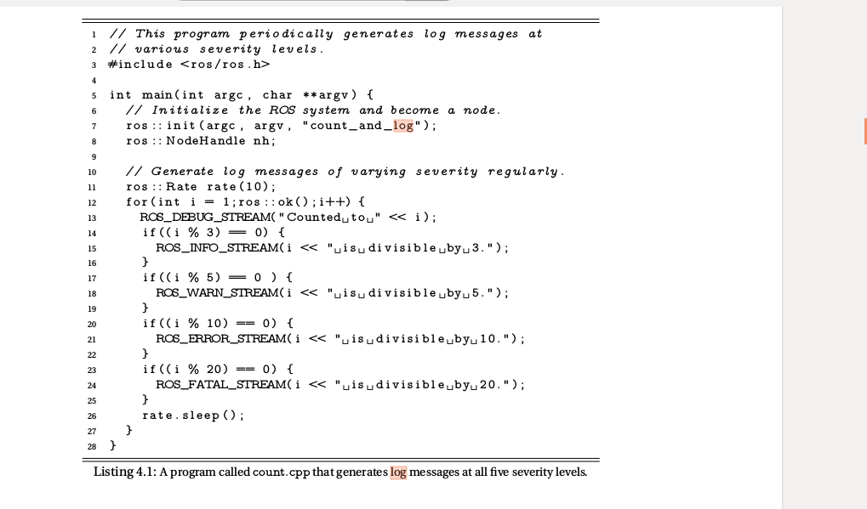


Slide 6
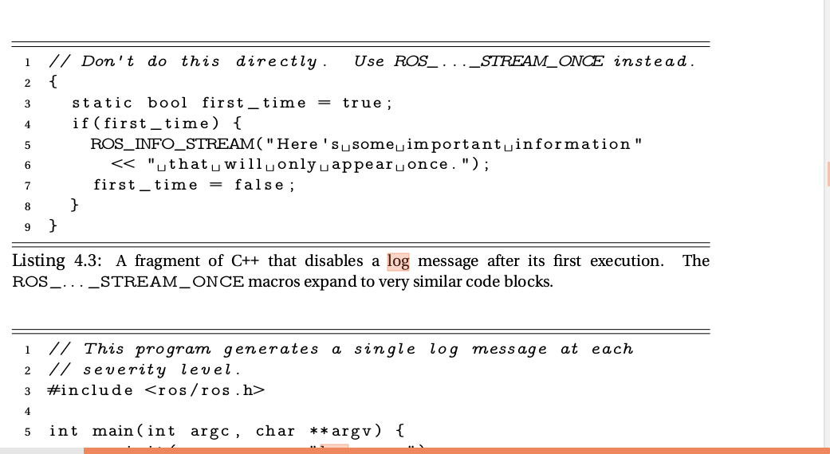
for only one time message instead of multiple messages of the same issue:
or in launch file : <arg name=”debug” deafult=”true”/>
setting it in your own cpp:
#include <ros/console.h>
…
…
ROS_DEBUG("Hello %s", "World");
#include <ros/console.h>
for (int i = 0; i < 10; ++i)
{
ROS_DEBUG_ONCE("This message will only print once");
}

Slide 7
so..how do we set the severity of the logs
by default, ROS C++ programs only generate log messages at the INFO level and higher.
there are two ways to change it:
from the command line:
$rosservice call /node-name/set_logger_level ros.package-name level
This command calls a service called set_logger_level , which is provided automatically
by each node
The node-name is the name of the node whose logger level you would like to set.
The package-name is the name of the package that owns the
node.
The level parameter is a string, chosen from DEBUG , INFO , WARN , ERROR ,
and FATAL , naming the logger level to use for that node.
(Note that because this command communicates directly with the node in question, we
cannot use it until after the node is started)

Slide 8
you can also set the sevirity from code for a specific node:
passing the log_level keyword argument to rospy.init_node() when initializing the node.
For example:
rospy.init_node('battery_monitor', log_level=rospy.DEBUG)
Following that initialization, the node will print, log, and publish messages that are at
least as severe as rospy.DEBUG (which is all log messages). Usually, you would make
such a change temporarily, only while you’re actively debugging a problem with the
node.

Slide 9
Where does log appear
a. output on the console-
first and most visibly messages are send to console. DEBUG and INFO messages are printed on standard output where as WARN,FATAL and ERROR messages are send to standard error.
The distinction here between standard output and standard error is basically irrelevant, unless you want to redirect one or both of these streams to a file or a pipe, in which case it causes some complications.
The usual file redirection technique:
command > file
redirects standard output, but not standard error. To capture all of the log messages
to the same file, use something like this instead:
command &> file

Slide 10
Be careful, however, because differences in the way these two streams are buffered
can cause the messages to appear out of order—with DEBUG and INFO messages
appearing later than one might expect—in the result.
You can force the messages into their natural order by using the stdbuf command to convince standard output
to use line buffering:
stdbuf -oL command &> file

Slide 11
here is how to change logs (on launch file) to show in screen
talker_listener.launch:
<launch>
<node name="talker" pkg="rospy_tutorials"
type="talker.py" output="screen" />
<node name="listener" pkg="rospy_tutorials"
type="listener.py" output="screen" />
</launch>
(Each <node> tag includes attributes declaring the ROS graph name of the node, the
package in which it can be found, and the type of node, which is simply the filename
of the executable program). the output="screen" attributes indicate
that the talker and listener nodes should dump their console outputs to the current console, instead of only to log files. This is a commonly used setting for debugging. once things start working, it is often convenient to remove this attribute so that the console has less noise.

Slide 12
Logs appear also as a message on rosout topic-
In addition to appearing on the console, every log message is also published on the topic /rosout .
The message type of this topic is rosgraph_msgs/Log.
The primary usefulness of the /rosout topic, compared to the console output, is that it includes, in a single stream, log messages from every node in the system.
All of those log messages show up on /rosout , regardless
of where, when, or how their nodes were started, or even which computer they’re running
on.
Since /rosout is just an ordinary topic, you could use: rostopic echo /rosout to see the messages directly.
It is designed to allow any node to publish a log message so that it can be viewed by anyone else on the network. You can think of /rosout as an enhanced print() : instead of just printing a string to the console, you send that string, along with a bunch of useful metadata, to anyone who wants to know about it.

Slide 13
a well-written ROS node won’t use print() at all, because those printed
strings will be seen only by someone who happens to look at the terminal where the
node was started. ROS nodes publish their log messages to /rosout so that
they can be seen by anyone.
The simplest way to see /rosout messages is to use this command
rqt_console
It shows log messages from all nodes, one per line,
along with options to hide or highlight messages based on various kinds of filters.

Slide 14
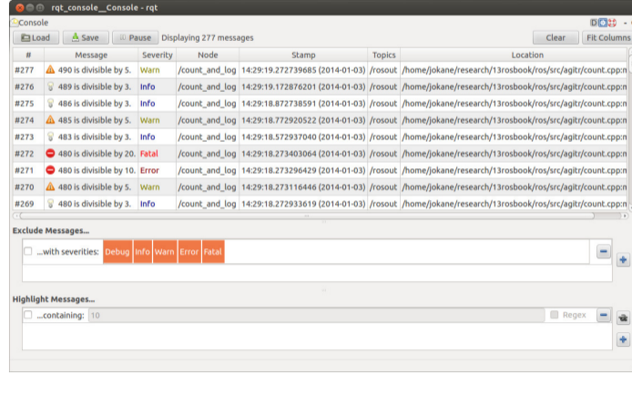
The difference from changing the log level is that changing the logger level prevents log messages
from ever being generated at their source, whereas the filters in rqt_console accept
any incoming log messages, and selectively choose not to display some of them

Slide 15
Logs appear also an entry in a log file :
a log file generated by the rosout node. this node writes a line to a file with a
name like this:
∼ /.ros/log/run_id/rosout.log
It can be viewed with any text editor.
The run_id is a universally-unique identifier (UUID) which is generated based on your computer’s hardware MAC address
and the current time when the master is started.an example run_id :
57aa1860-d765-11e2-a830-f0def1e189cc
The use of this sort of unique identifier makes it possible to distinguish logs from separate
ROS sessions.

Slide 16
There two easy ways to learn the run_id of the current session:
You can examine the output generated by roscore . Near the end of this output, you’ll
see a line that looks something like this.
setting /run_id to run_id
2. You can ask the master for the current run_id , using a command like this:
rosparam get /run_id
This works because the run_id is stored on the parameter server.

Slide 17

How to look for the logs
at path: ~/home (where catkin_folder is)
press ctrl+h
now we can see all hidden files. Go to .ros/logs
there you have all logs from latest (last run) and few days before.

Slide 18
More logs...
Linux logs provide a timeline of events for the Linux operating system, applications, and system, and are a valuable troubleshooting tool when you encounter issues.
they can be found in the /var/log directory and subdirectory. There are Linux logs for everything: system, kernel, package managers, boot processes, Xorg, Apache, MySQL. (cd/var/log)

Slide 19
Apport logs
it is a log file contains crash log messages, can be found in: /var/log/apport.log
use it for:
intercepts crashes right when they happen the first time
gathers potentially useful information about the crash and the OS environment,
can be automatically invoked for unhandled exceptions in other programming languages (e. g. in Ubuntu this is done for Python),
can be automatically invoked for other problems that can be automatically detected (e. g. Ubuntu automatically detects and reports package installation/upgrade failures from update-manager) -presents a UI that informs the user about the crash and instructs them on how to proceed,
and is able to file non-crash bug reports about software, so that developers still get information about package versions, OS version etc.

Slide 20
syslog
One of the most important logs to view is the syslog, which logs everything but auth-related messages.
general messages, as well as system-related information. Essentially, this log stores all activity data across the global system. Ubuntu and other Debian-based systems are stored in Syslog

