Slide 1

Electric Vehicle EDA

Slide 2
About me
Background
Currently pursuing B.Tech in Computer Science with a focus on acquiring skills in Data Science.
Why I Want to Learn Data Science
I am passionate about analyzing data to extract meaningful insights that can drive impactful decisions. My goal is to build proficiency in data-driven problem solving, and I aim to contribute to innovation through machine learning and AI technologies.
Data science offers a dynamic field where I can apply my mathematical and programming skills to solve real-world problems in various industries.
Any Work Experience
Currently, I do not have formal work experience but have completed multiple personal and academic projects in programming, machine learning, and algorithms, which have strengthened my technical skills.
GitHub and LinkedIn
GitHub: github.com/galgotiasuniversity1
LinkedIn: linkedin.com/in/neeraj-kumar-900b9b330

Slide 3
Objective
Perform Exploratory Data Analysis (EDA) on the Electric Vehicle EDA data-set
Create a Choropleth using plotly.express to display the number of EV vehicles based on location. Create a Choropleth using plotly.express to display the number of EV vehicles based on location.
Create a Racing Bar Plot to display the animation of EV Make and its count each year.

Slide 4
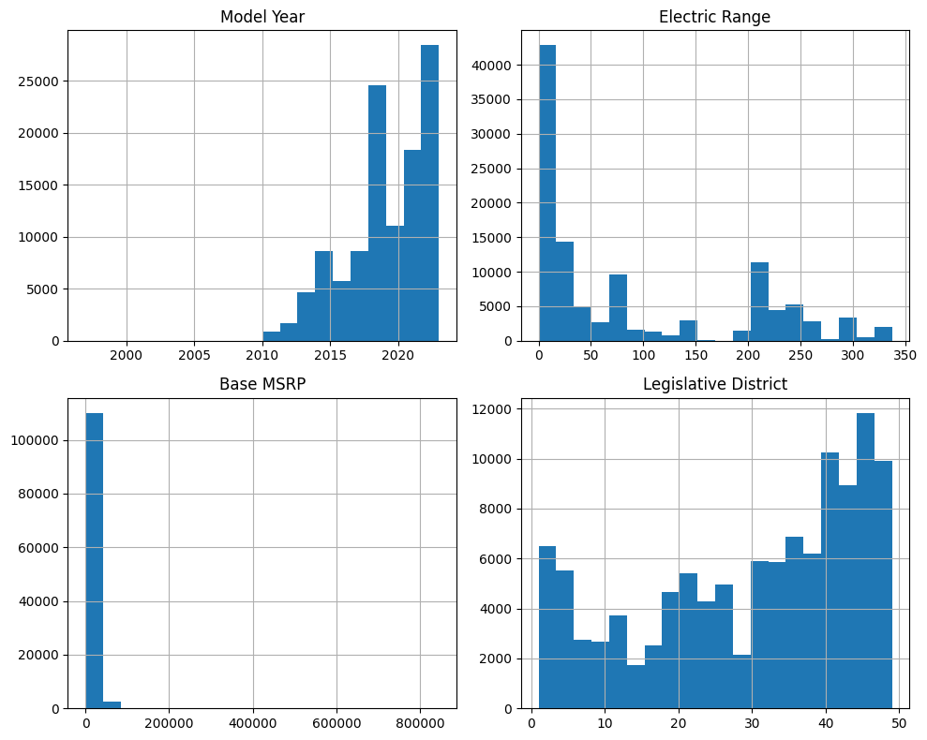
Univariate Analysis Steps

Slide 5
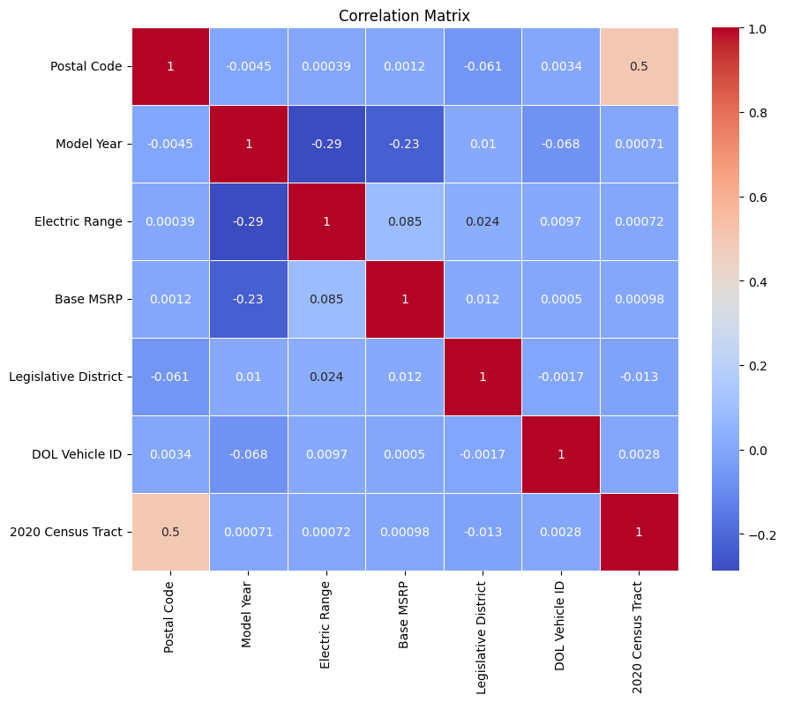
Univariate Analysis Steps

Slide 6
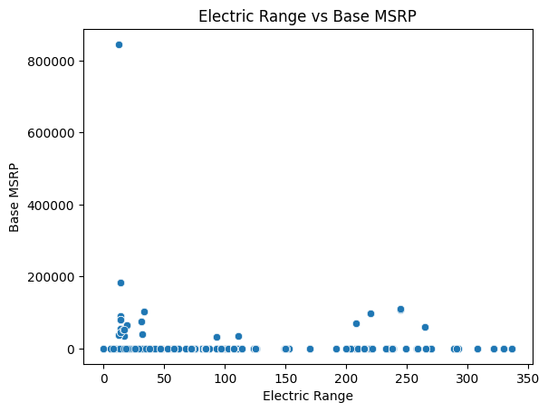
Univariate Analysis Steps

Slide 7
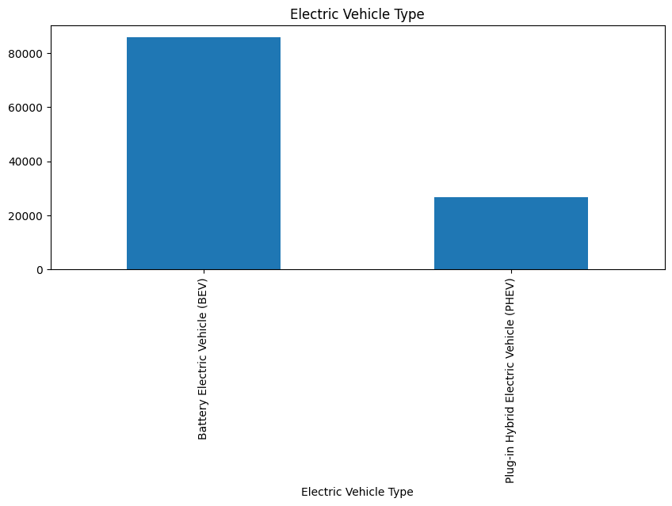
Univariate Analysis Steps

Slide 8
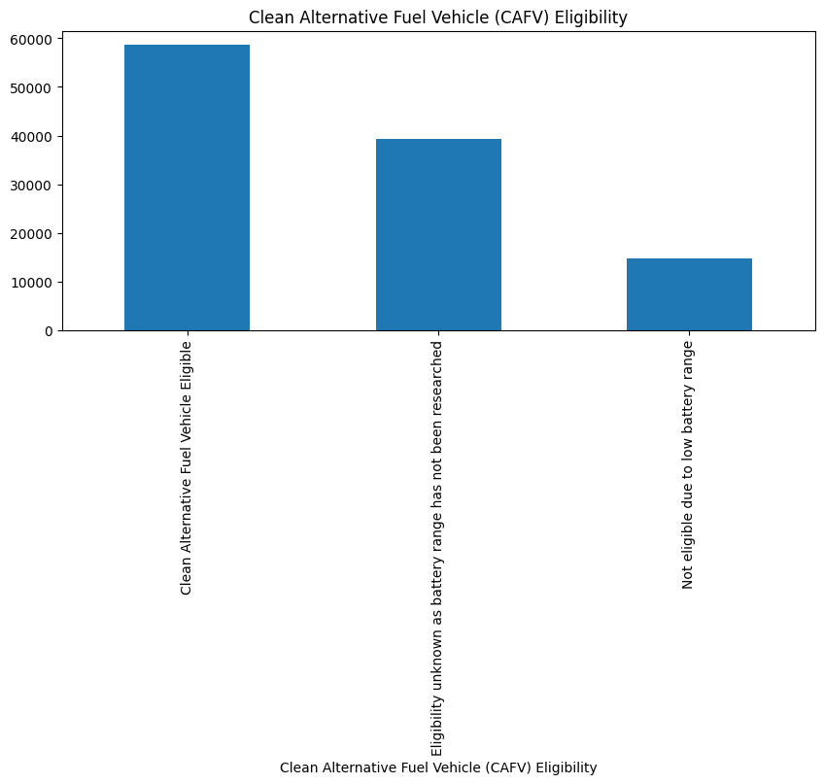
Univariate Analysis Steps

Slide 9
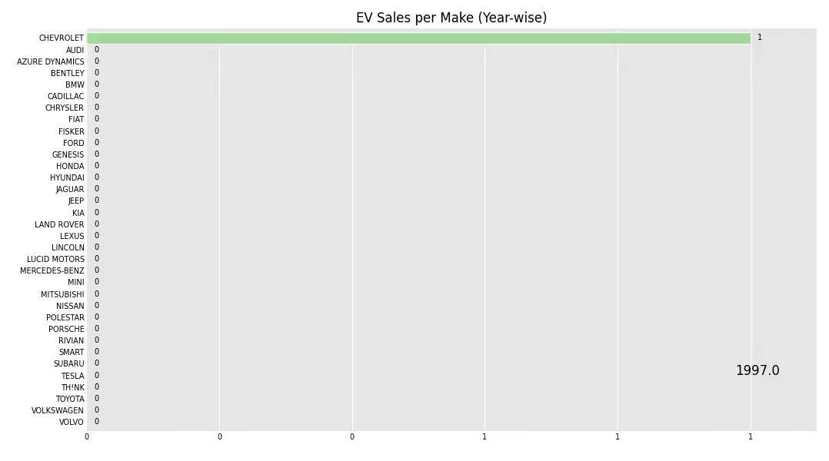
Univariate Analysis Steps
Number of Male and Female

Slide 10
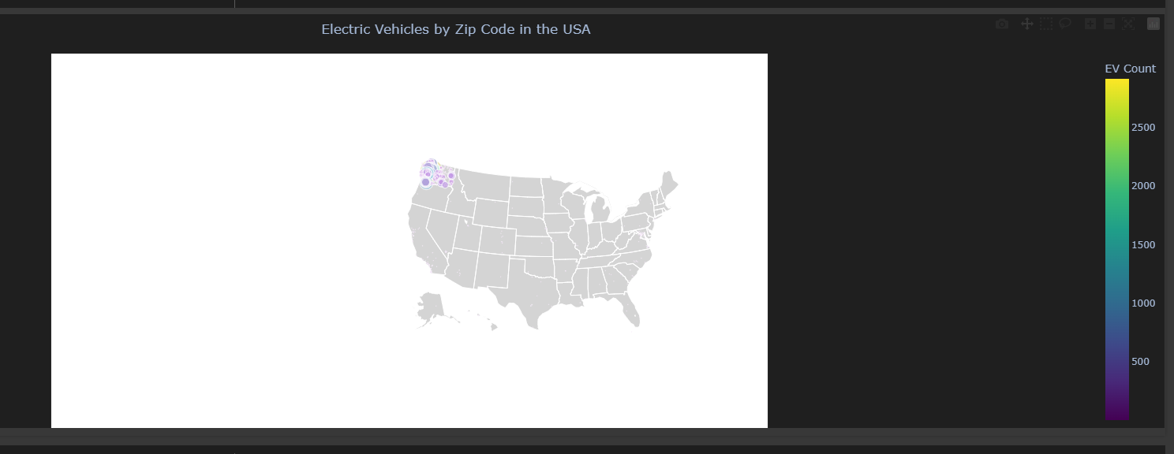

Slide 11
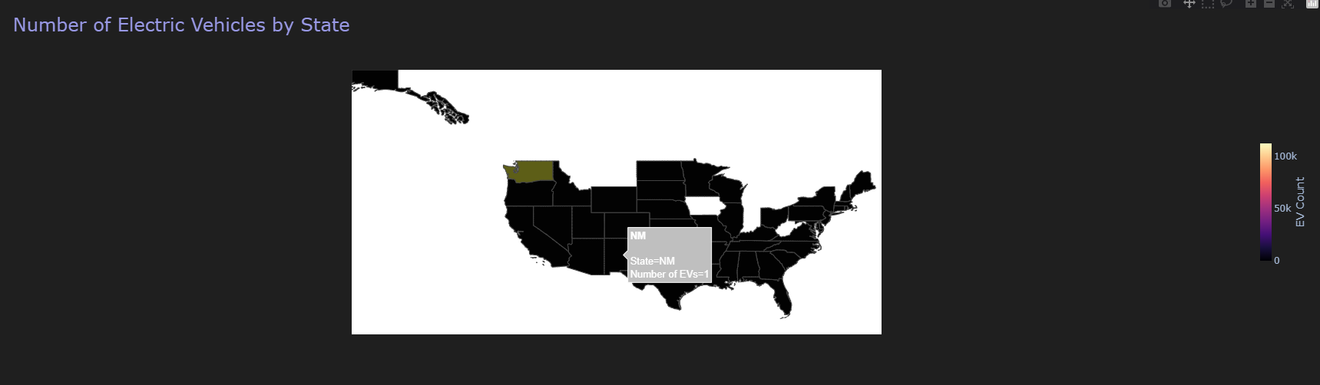

Slide 12

THANK YOU

