Slide 1

AMCAT EDA

Slide 2
About me
Background
Currently pursuing B.Tech in Computer Science with a focus on acquiring skills in Data Science.
Why I Want to Learn Data Science
I am passionate about analyzing data to extract meaningful insights that can drive impactful decisions. My goal is to build proficiency in data-driven problem solving, and I aim to contribute to innovation through machine learning and AI technologies.
Data science offers a dynamic field where I can apply my mathematical and programming skills to solve real-world problems in various industries.
Any Work Experience
Currently, I do not have formal work experience but have completed multiple personal and academic projects in programming, machine learning, and algorithms, which have strengthened my technical skills.
GitHub and LinkedIn
GitHub: github.com/galgotiasuniversity1
LinkedIn: linkedin.com/in/neeraj-kumar-900b9b330

Slide 3
Objective
Perform Exploratory Data Analysis (EDA) on the AMCAT data-set

Slide 4
Summary of the Data
Salary:
Relationship with CollegeTier: Analyze how college tier (1, 2, etc.) impacts salary. Higher-tier colleges may correlate with higher salaries.
Relationship with GraduationYear: Compare salary growth trends across different graduation years to identify salary inflation or recent graduate salary trends.
Relationship with Specialization and Degree: Determine if specific degrees or specializations lead to higher salaries.

Slide 5
Agenda (This should be the PPT flow)
Business Problem and Use case domain understanding(If Required)
Objective of the Project
Web Scraping – Details (Websites, Processor you followed)
Summary of the Data
Exploratory Data Analysis:
Data Cleaning Steps
Data Manipulation Steps
Univariate Analysis Steps
Bivariate Analysis Steps
Key Business Question
Conclusion (Key finding overall)
Q&A Slide
Your Experience/Challenges working on Web Scraping – Data Analysis Project.

Slide 6
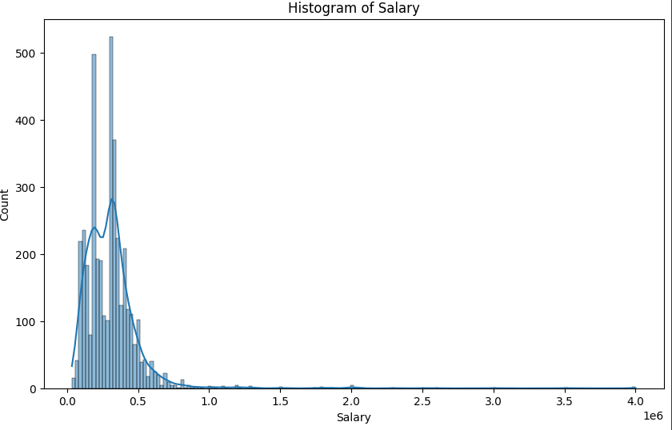
Univariate Analysis Steps
Salary histogram tells us that less people have more salary and most people have same salary which is true in real life

Slide 7
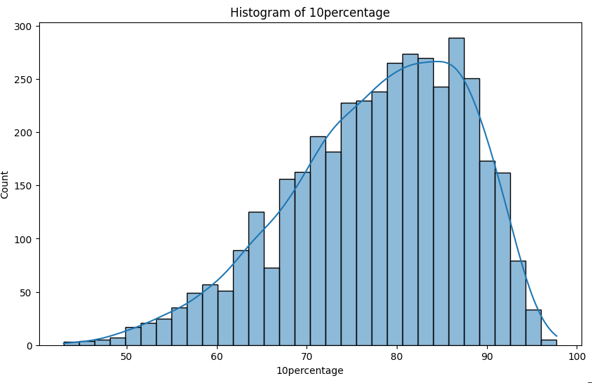
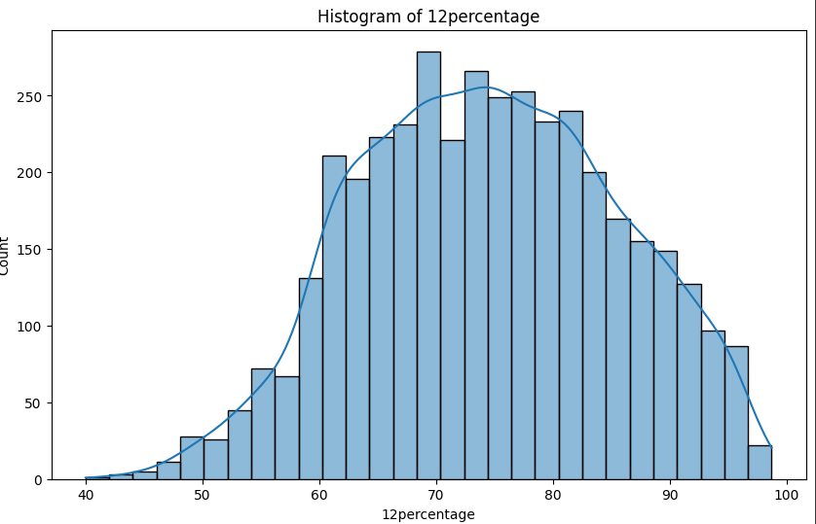
Univariate Analysis Steps
This show students study more in 10th standard than 12th standard

Slide 8
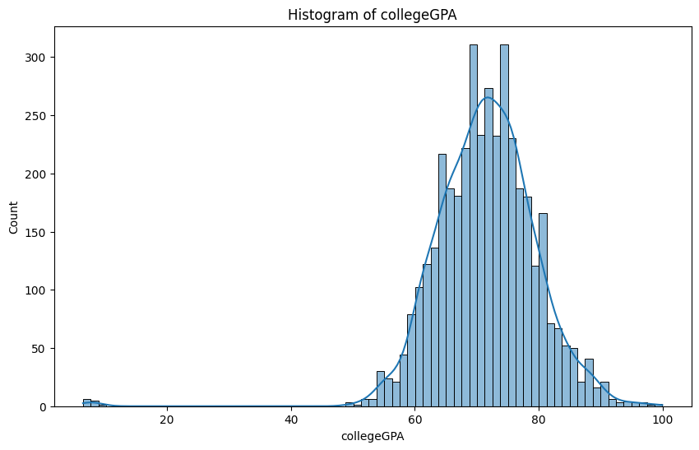
Univariate Analysis Steps
This shows very few fails in college and most of the student pass which is opposite of school

Slide 9
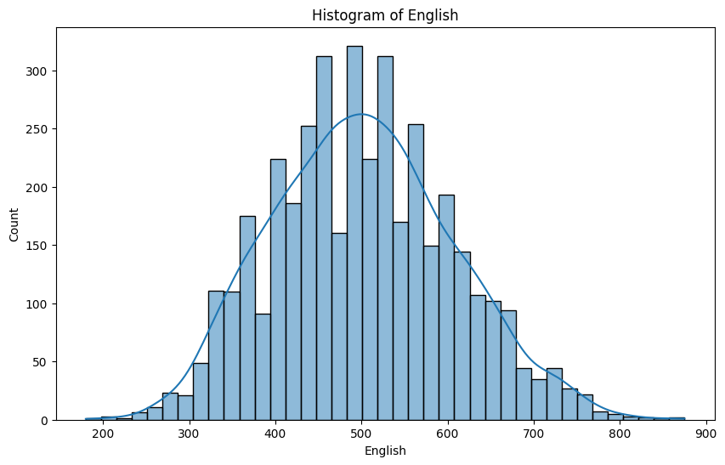
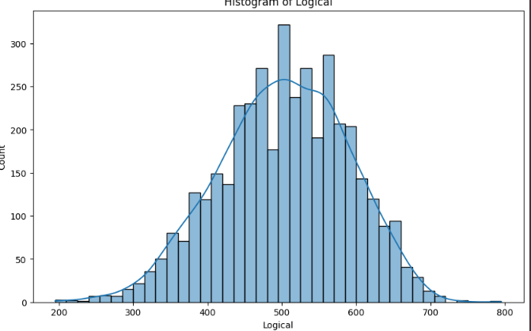
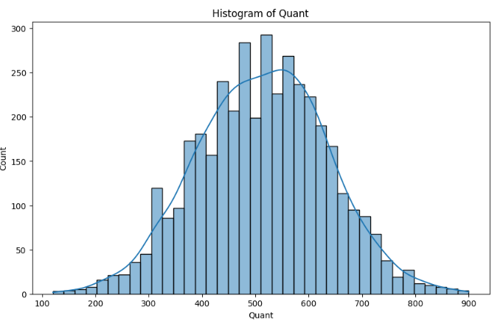
Univariate Analysis Steps
English,logical,quant distribution is similar to normal distribution

Slide 10
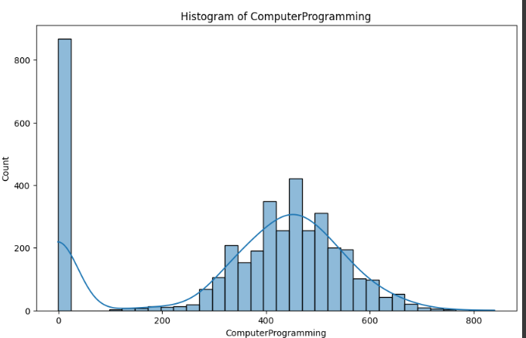
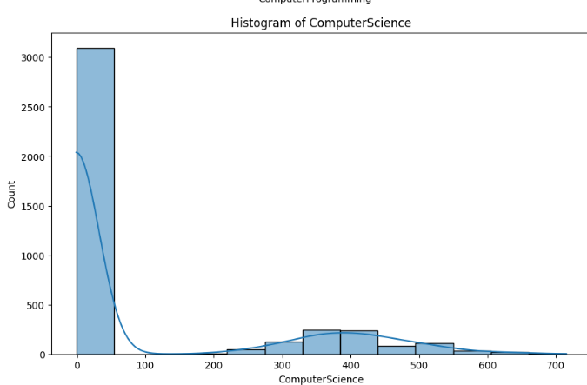
Univariate Analysis Steps
This show most of the computer science students just take computer science but do not study it
Only less than 50% student study

Slide 11
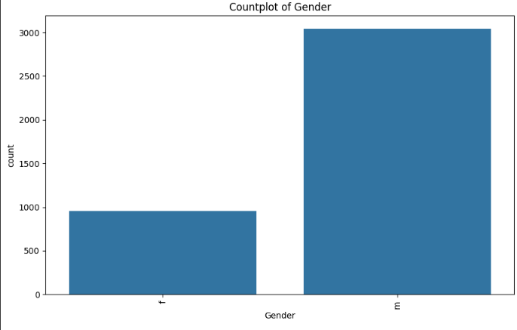
Univariate Analysis Steps
Number of Male and Female

Slide 12
Agenda (This should be the PPT flow)
Research Questions
Times of India article dated Jan 18, 2019 states that “After doing your Computer Science Engineering if you take up jobs as a Programming Analyst, Software Engineer, Hardware Engineer and Associate Engineer you can earn up to 2.5-3 lakhs as a fresh graduate.” Test this claim with the data given to you.
Average Salary for ['programmer analyst', 'software eng', 'software engg', 'software engineersoftware engineere', 'software enginner', 'hardware engineer', 'associate engineer']: 332770.7006369427 The claim does not hold true.
Is there a relationship between gender and specialization? (i.e. Does the preference of Specialisation depend on the Gender?)
Chi-Square Test: p-value = 1.2453868176976918e-06
There is a significant relationship between Gender and Specialization.

Slide 13

THANK YOU

