Slide 1

Sklean-Pandas
By: Gal Hever
Notes:
שני כלים שיעזרו לנו בשלב של ה-feature engineering

Slide 2
Sklearn-Pandas for Easy Data Preprocessing
Fast and easy way for features transformations
Notes:
דרך נוחה וקלה לבצע טרנספורנמציות בדאטה

Slide 3
Featuretools for Easy Brute Force
An open source python framework for automated feature engineering
Notes:
דרך קלה ונוחנ לג'נרט פיצ'רים חדשים

Slide 4
Short Example
The Movies Dataset
Metadata on over 45,000 movies. 26 million ratings from over 270,000 users.

Slide 5
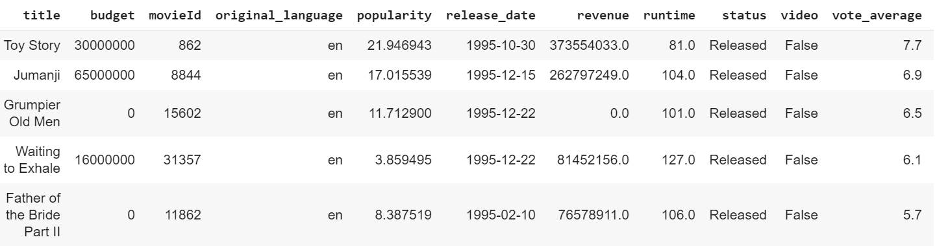
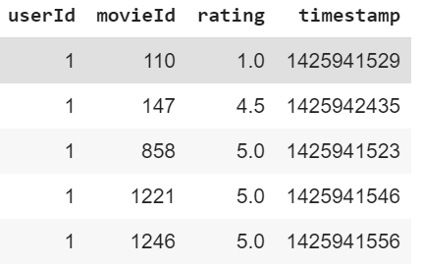
Tables
Movies
Ratings

Slide 6
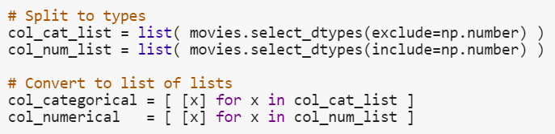
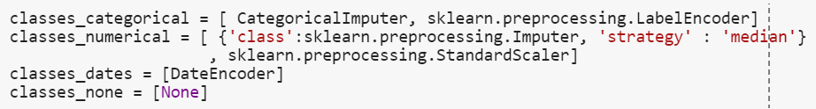
Sklearn-Pandas Let’s code!

Slide 7

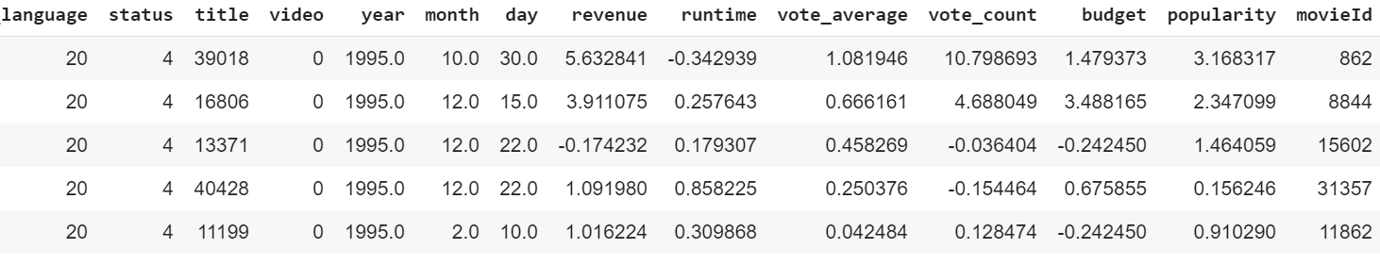
Ready to get into the model!

Slide 8
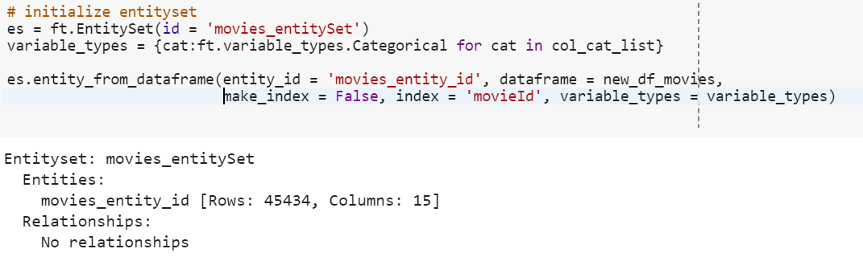
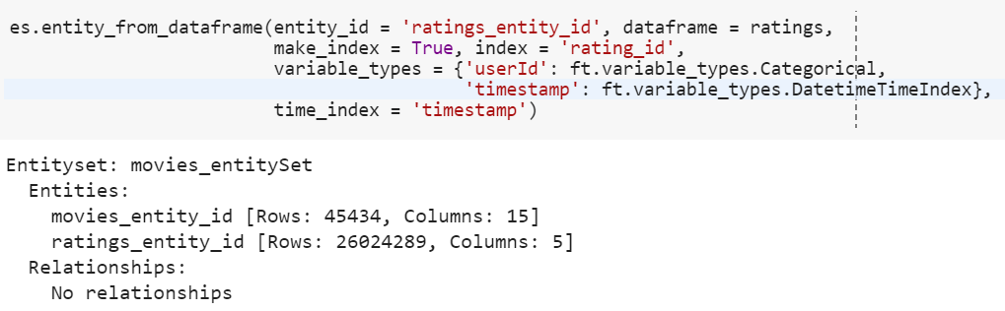
Featuretools Let’s brute force!
Entity = Table
EntitySet = A collection of Entities
** Each Entity must have an Index column that is used as a unique key for each row.

Slide 9
New features creations
Transformation
can create new features by using different operations on one or multiple features in a single table.
Aggregation
create new features by using different operations on one feature in a multiple table.

Slide 10
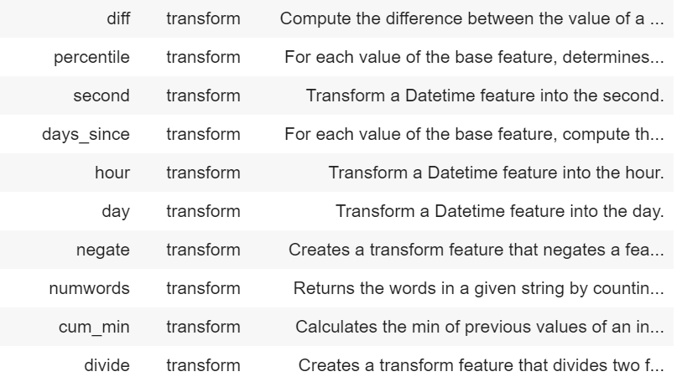
Transformation - Example

Slide 11
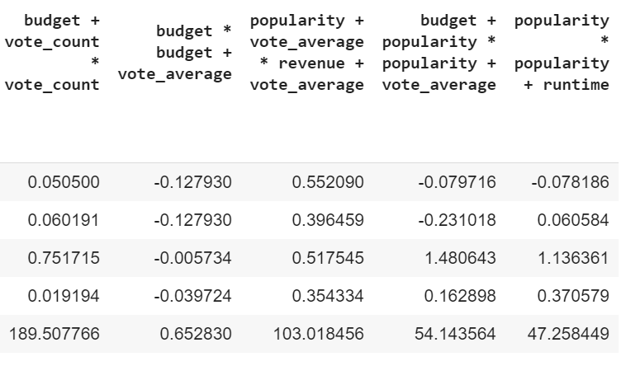
Transformation - Example

Slide 12
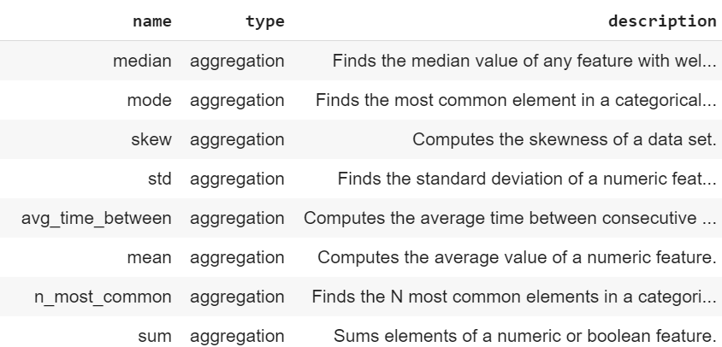
Aggregation - Example

Slide 13
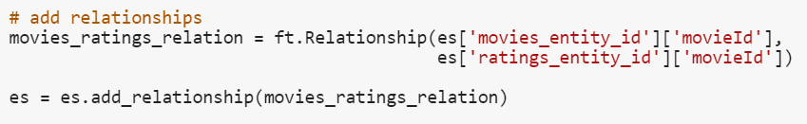
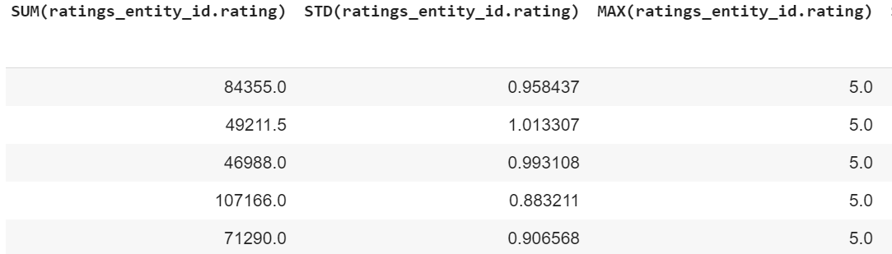
Aggregation - Example

Slide 14
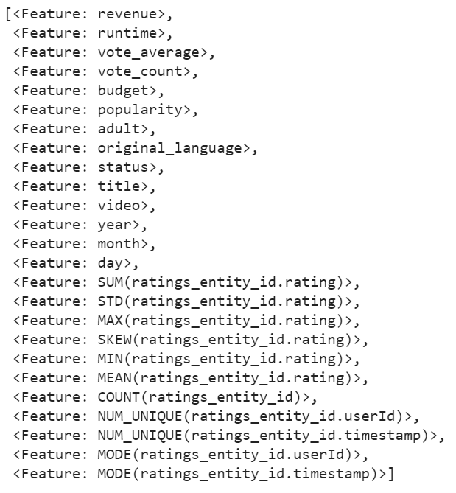
Aggregation - Example

Slide 15

Questions
You can find the full code in my Git

