Slide 1
Android Malware Detection: A Hybrid Approach using Machine Learning Techniques
Thesis Proposal

Slide 2
Presented By
Asadullah Hill Galib
MSSE 0718
Institute of Information Technology
University of Dhaka
Supervised By
Dr. B. M. Mainul Hossain
Associate Professor
Institute of Information Technology
University of Dhaka

Slide 3

Introduction (Android Malware)
Android Malware (malicious application) is any application with mischievous intention -
disrupt normal functioning
bypass access controls
gather sensitive information
display unwanted advertising
getting control of device without user’s knowledge

Slide 4
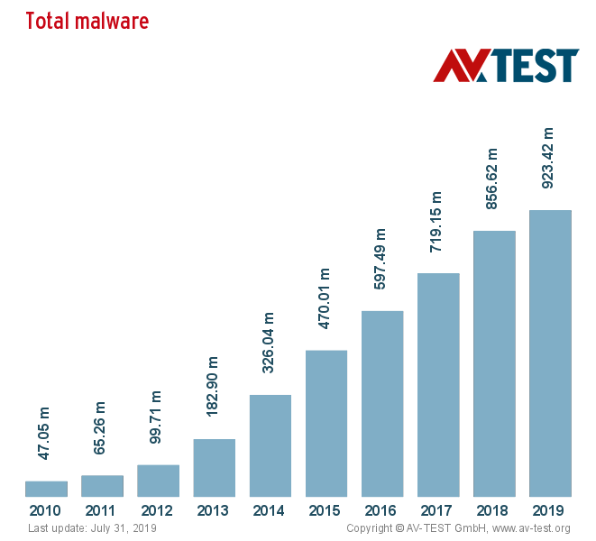
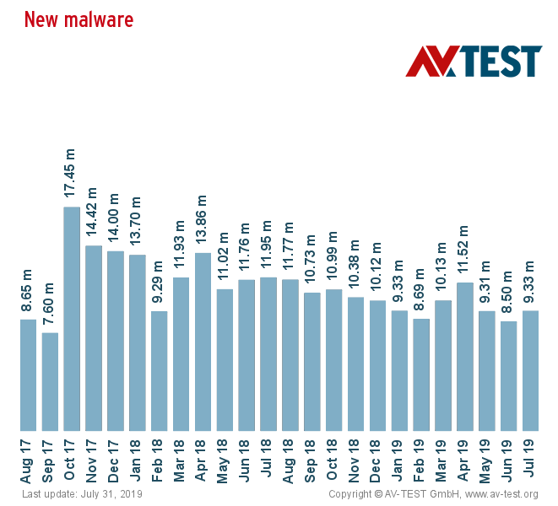
Introduction (Android Malware)

Slide 5
Malware Detection Techniques
Static Analysis
Dynamic Analysis
Hybrid Analysis

Slide 6
Static and DynamicAnalysis Drawbacks
Static Analysis
Data obfuscation
Control flow obfuscation
Dynamic XML loading
Native code
Encryption
Dynamic Analysis
Limited code coverage
Tricked in emulated environment by smart malware

Slide 7
Hybrid Analysis
A fusion of static and dynamic analysis would be a good candidate as it prevails over the individual drawbacks of static and dynamic analysis.

Slide 8
Research Question

Slide 9
RQ: How can we improve the performance of android malware detection using hybrid analysis with machine learning techniques?

Slide 10
Research Question (sub-questions)
SQ1. What are the important static and dynamic features for android malware detection using machine learning?
SQ2. How to select the important static and dynamic features for android malware detection?

Slide 11
Rationale of the Research

Slide 12
Rationale of the Research (Academia)
To alleviate the evasion techniques of malware authors by integrating Hybrid Analysis.
To improve the performance of malware detection process.

Slide 13
Rationale of the Research (National)
The new millennium development goal:
Digital Bangladesh
by 2021

Slide 14
Rationale of the Research (National)
IT and Communications Ministry of the Government has taken many projects and performed many activities regarding android app.

Slide 15
Rationale of the Research (National)
This research aims to detect android malware in advance effectively.
By so, this research work can assist the Bangladesh government’s new millennium development goal - “Digital Bangladesh” by 2021.

Slide 16
References
Spreitzenbarth, M., Freiling, F., Echtler, F., Schreck, T., Hoffmann, J. (2013, March).Mobile-sandbox: having a deeper look into android applications. In Proceedings of the28th Annual ACM Symposium on Applied Computing (pp. 1808-1815). ACM
Lindorfer, M., Neugschwandtner, M., Platzer, C. (2015, July). Marvin: Efficient andcomprehensive mobile app classification through static and dynamic analysis. In 2015IEEE 39th annual computer software and applications conference (Vol. 2, pp. 422-433).IEEE.
Arshad, S., Shah, M. A., Wahid, A., Mehmood, A., Song, H., Yu, H. (2018). Samadroid:a novel 3-level hybrid malware detection model for android operating system. IEEEAccess, 6, 4321-4339.
Kapratwar, A., Di Troia, F., Stamp, M. (2017). Static and dynamic analysis of androidmalware. In ICISSP (pp. 653-662).

Slide 17
References
Xu, L., Zhang, D., Jayasena, N., Cavazos, J. (2016, September). Hadm: Hybrid analysisfor detection of malware. In Proceedings of SAI Intelligent Systems Conference (pp. 702-724). Springer, Cham.
OperatingSystemMarketShareBangladesh.(n.d.).Retrievedfromhttp://gs.statcounter.com/os-market-share/all/Bangladesh
ACTIVITIES. (n.d.). Retrieved from https://www.nationalappsbd.com/?pageid= 690

