Slide 1
Project Final Presentation Project Title: Expense Tracker
Course No.: 0613-306
Course: Markup and Scripting Language Lab Presented By:
Name: Galib Ahmed
Roll: 27 Batch: D-83
Instructor: Md. Manirujjaman Lecturer, Department of CSE, BAUST

Slide 2
Outlines
Project Overview
Objectives
System Architecture / Workflow
Key Features
Technology Stack
Implementation Screenshots
Database Design
Challenges & Learning Outcomes
Future Enhancements & Conclusion
References

Slide 3
Project Overview
Brief description: A web-based Expense Tracker that lets users record, view, update, and delete personal expenses.
Purpose: Simplify personal finance tracking and provide a
lightweight CRUD interface for expense management.
Target users: Students, freelancers, and anyone who needs a
simple personal expense log.

Slide 4
Objectives
Build a dynamic web app using Django to practice server-side rendering and routing.
Implement CRUD operations for expenses with form validation.
Persist data with SQLite and visualize DB contents using DB
Browser.
Create responsive frontend pages with HTML, CSS, and
JavaScript for basic interactivity.

Slide 5
System Architecture / Workflow
User → Frontend (HTML / CSS / JS) → Django Views → Models → SQLite DB.
Workflow summary:
User fills form on Add Expense page → POST to Django view
→ View validates and saves Model instance → Redirect to
Expense List.
List page queries DB via model manager and renders template.
Edit/Delete actions map to dedicated views and templates.
Admin panel available for site administration.

Slide 6
Key Features
Add new expense with fields: title, amount, date, category,
optional note.
View paginated list of recorded expenses.
Edit and delete existing expenses.
Server-side validation and simple client-side checks.
Admin interface for database management.

Slide 7
Technology Stack
Framework: Django (Python)
Backend language: Python
Frontend: HTML, CSS, JavaScript (Django templates)
Database: SQLite (db.sqlite3)
Tools: DB Browser for SQLite, Django admin, basic built-in Django libraries

Slide 8
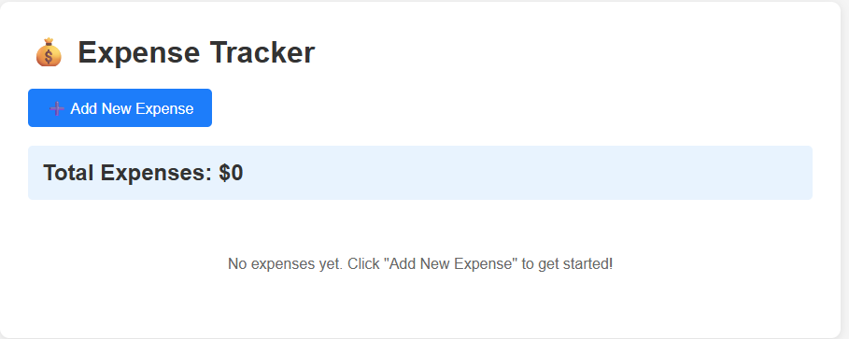
Implementation Screenshots
Homepage

Slide 9
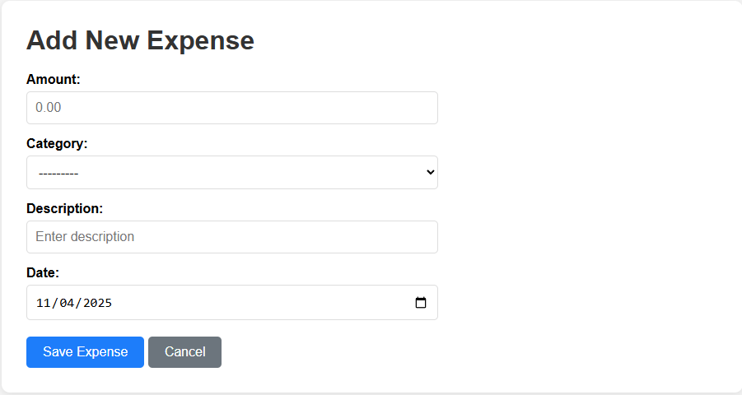
Add Expense
•

Slide 10
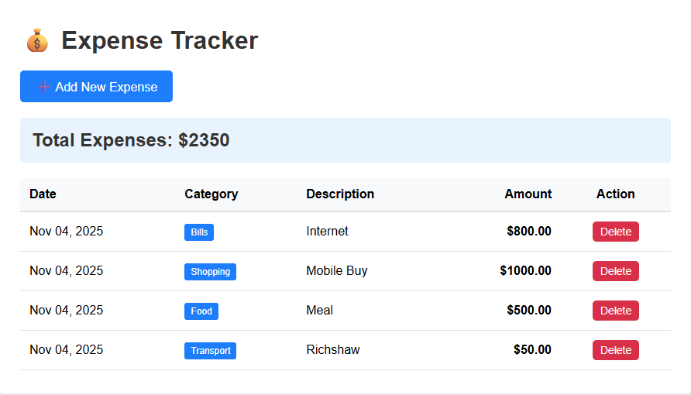
Expense

Slide 11
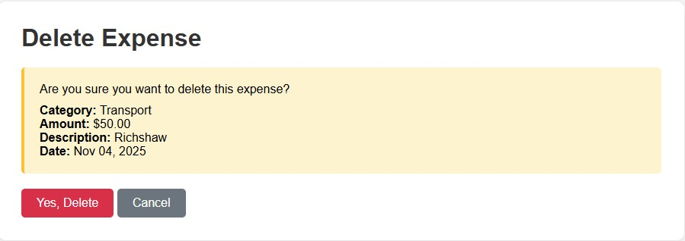
Delete Confirmation

Slide 12
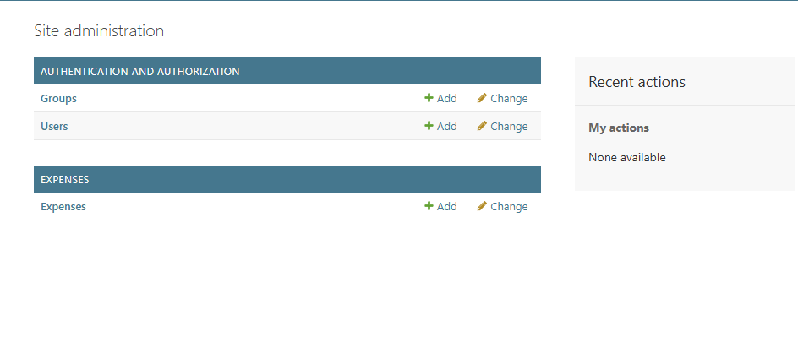
Admin Panel

Slide 13
Database Design
App: expenses (models.py present)
Main model: Expense (typical fields inferred)
id (AutoField, primary key)
title (CharField)
amount (DecimalField / FloatField)
date (DateField)
category (CharField)
note / description (TextField, optional)
created_at, updated_at (DateTimeFields)
Database used: SQLite (db.sqlite3) — migrations included (migrations/0001_initial.py).

Slide 14
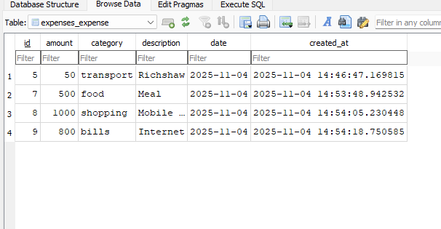
Example tables to show in DB Browser:

Slide 15
Challenges faced during development
Problem Faced:
Understanding Django request-response flow and URL routing.
Properly mapping forms to model fields and handling validation
errors.
Template inheritance and organizing templates for reuse.
Handling date and numeric formats consistently across forms and
templates.

Slide 16
Learning Outcomes :
Practical experience building a full-stack Django app.
Hands-on with CRUD operations and Django ORM.
Improved template design and simple JavaScript validation.
Familiarity with SQLite and using DB Browser to inspect tables.

Slide 17
Future Enhancements
Add user authentication and per-user expense separation.
Implement categories/tags and expense filtering with graphs.
Add CSV/Excel export and import features.
Integrate basic statistics and charts (monthly spending, category
breakdown).
Add mobile responsiveness improvements and pagination.

Slide 18
Conclusion
Conclusion: This Expense Tracker demonstrates Django-based CRUD, templating, and SQLite persistence suitable for small- scale personal finance tasks.
Thank you for your attention. Questions?

Slide 19
References
Django documentation https://docs.djangoproject.com/
DB Browser for SQLite documentation
Tutorials and examples used while developing (list the video or
article tutorials you followed)

