Slide 1
Micro-Credit Defaulter Model Using Machine Learning Techniques

Slide 2
AGENDA
Problem Overview
Conclusion
Dataset
Overview
Credit Card Default Problem (DEMO)
Evaluation
Data Preparation
Proposed Models

Slide 3
Overview
A Microfinance Institution (MFI) is an organization that offers financial services to low-income populations. MFS becomes very useful when targeting especially the unbanked poor families living in remote areas with not much sources of income.
The Microfinance services (MFS) provided by MFI are Group Loans, Agricultural Loans, Individual Business Loans and so on.
Telecom Industry is collaborating with an MFI to provide micro-credit on mobile balances to be paid back in 5 days.
The Consumer is believed to be defaulter if he deviates from the path of paying back the loaned amount within the time duration of 5 days.

Slide 4
Goal
The model we built here will use all possible factors to predict data on customers to find who are defaulters and non-defaulters.

Slide 5
Process Design
The process is done by Supervised learning Algorithm.
The idea behind using this is we have a prior knowledge on our output values.
It acts as a guide to teach the algorithms what conclusion it should come up with.
Common algorithms in supervised learning includes logistic regression, naive bayes, support vector machines and decision tree classifier.

Slide 6
Approach Design
Preparation of data
Applying models
Comparing the applied models
Evaluation Model
Analyse the Best model

Slide 7
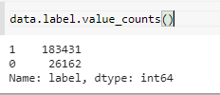
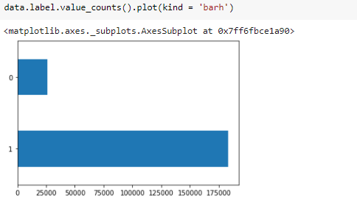
Dataset overview
Graph shows total number of records for defaulters and non-defaulters.
In this case, Label ‘1’ indicates that the loan has been payed ie. non-defaulters.
Label ‘0’ indicates that the loan has not been payed i.e. defaulter
22% - default
78% - non-default
(Screenshot: Taken during evaluation process)

Slide 8
Data Preprocessing
Data set is divided in 70:30 ratio for train and test respectively.
msisdn, pdate, pcircle columns are dropped as its unnecessary for our modeling.
No Null values in dataset.
Standard Scaler – Shifts the distribution of each attribute to have a mean of zero and a standard deviation of one. It is useful to standardize attributes for a model that relies on the distribution of attributes such as Gaussian processes.

Slide 9
Logistic Regression: It is used for Binary classification. Outputs have a nice probabilistic interpretation, and the algorithm can be regularized to avoid over fitting. In logistic regression the hypothesis is that the conditional probability p of class belongs to ”1” if probability is greater than threshold probability, generally 0.5, else it belongs to the class ”0”.
Decision Tree Classifier:
the branch represents a decision rule, and each leaf node represents the outcome. The topmost node in a decision tree is known as the root node.
A decision tree is a flowchart-like tree structure where an internal node represents feature.
It's visualization like a flowchart diagram which easily mimics the human level thinking.
This flowchart-like structure helps you in decision making.

Slide 10
Evaluation Process
Evaluation Metrics:
Accuracy: Accuracy determine how often the model predicts default and non-default correctly.
Precision: Precision calculates whenever our models predicts it is default how often it is correct.
Recall: Recall regulate the actual default that the model is actually predict.
Precision Recall Curve: PRC will display the tradeoff between precision and recall threshold.
Cross Validation:
K Fold cross validation; k = 10

Slide 11
Confusion Metrics
True Positive – A person who is defaulter and predicted as defaulter.
True Negative – A person who is non-defaulter and predicted as non-defaulter. False Positive – A person who is predicted defaulter is non-defaulter.
False Negative – A person who is predicted non-defaulter is defaulter.
 | Non-defaulter (predicted) - 0 | Defaulter (predicted) - 1
Non-defaulter (actual) - 0 | TN | FP
Defaulter (actual) - 1 | FN | TP

Slide 12
Conclusion
We investigated the data, checking for data unbalancing, visualizing the features and understanding the
relationship between different features.
We used both train-validation split and cross-validation to evaluate the model effectiveness to predict the target value.
We then investigated five predictive models:
We started with Logistic Regression, Decission Tree, SVM, Random Forest accuracy is almost same.
We choose based model based on minimum value of False Negative value and AUC curve.

Slide 13
References
Li, Xiao-Lin, and Yu Zhong. An overview of personal credit scoring: techniques and future work. Journal: International Journal of Intelligence Science ISSN 2163-0283. 2012.
Federal Reserve. (2017) “Report to the Congress on the Profitability of Credit Card Operations of Depository Institutions”.
Taiwo Oladipupo Ayodele. (2010) “Types of Machine Learning Algorithms”, New Advances In Machine
Learning, Yagang Zhang (Ed.), IntechDefault Credit Card Clients Dataset, https://www.kaggle.com/uciml/default-of-credit-card-clients-dataset/
https://www.analyticsvidhya.com/blog/2016/03/introduction-deep-learning-fundamentals-neural-
networks/

Slide 14
Thank You

