Slide 1

MALIGNANT COMMENTS CLASSIFICATION Using Machine Learning Techniques

Slide 2

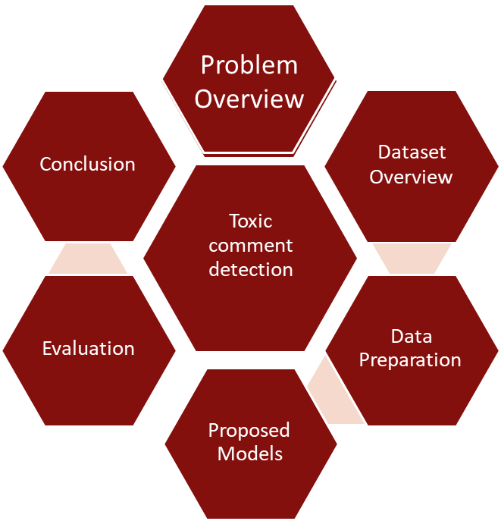



Agenda

Slide 3
Overview
Now-a-days, derogatory comments are often made by one another, not only in offline environment but also immensely in online environments like social networking websites and online communities. So, an identification combined with prevention system in all social networking websites and applications, including all the communities, existing in the digital world is a necessity. In such a system, the identification block should identify any negative online behavior and should signal the prevention block to act accordingly. Such an automated system should be deployed for enhancing healthy online conversation

Slide 4

Goal
The model we built here will use all possible factors to predict text for detecting types of toxicity in comments

Slide 5
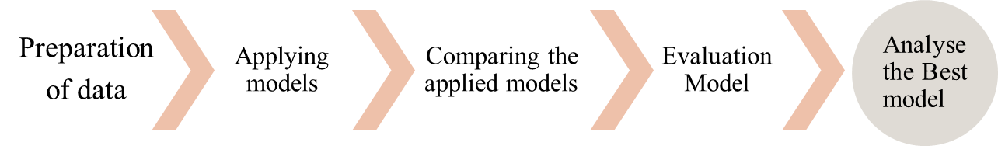
Approach design

Slide 6
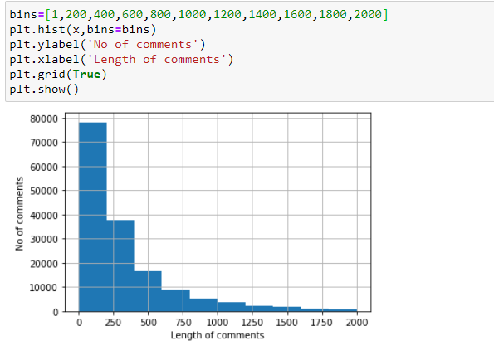
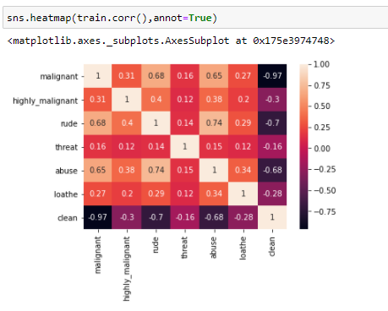
Dataset overview
Visualizations are done in the form of Histograms showing the distribution of comment lengths over the whole corpus of the dataset.
Correlation between labels

Slide 7
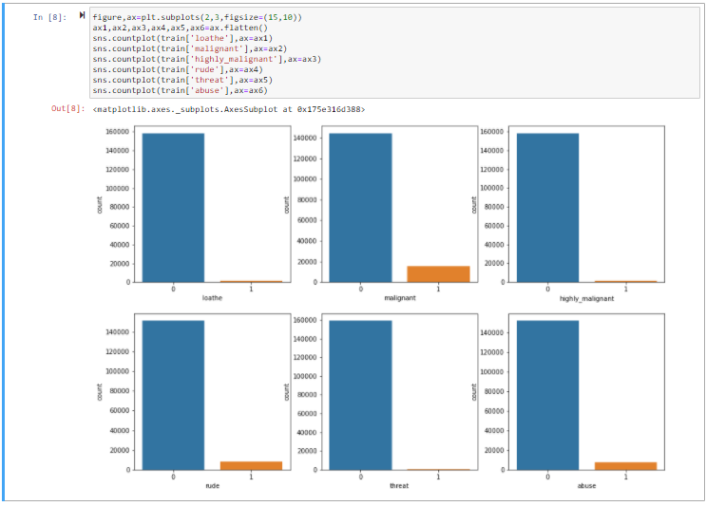
Count of different toxicity of comments in each label

Slide 8
Data Preprocessing
Removal of punctuation: all the punctuation marks in every comment are removed.
Lemmatisation: inflected forms of words which may be different verb forms or singular/plural forms etc. The process of grouping these lemmas together is called lemmatisation. So, lemmatisation is performed for every comment.
Removal of stopwords: frequently occurring common words like articles, prepositions etc. Are called stopwords. So, stopwords are removed for each comment
Tf-idf transformer: Term Frequency (TF) and Inverse Document Frequency (IDF), combined as tf-idf.

Slide 9

Applying classification algoritms
Apply different classification models like Logistic Regression, Decision tree Classifier, Random forest Classifier, SVC and find the best fit model

Slide 10

Evaluation Process
Evaluation Metrics:
Accuracy: Accuracy determine how often the model predicts default and non-default correctly.
Precision: Precision calculates whenever our models predicts it is default how often it is correct.
Recall: Recall regulate the actual default that the model is actually predict.
Precision Recall Curve: PRC will display the tradeoff between precision and recall threshold.
Log loss: loss is a number indicating how bad the model's prediction was on a single example. If the model's prediction is perfect, the loss is zero; otherwise, the loss is greater.

Slide 11
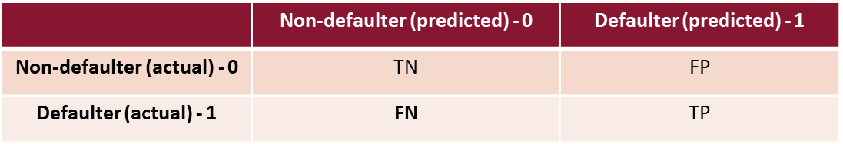
Confusion Metrics
True Positive – A person who is defaulter and predicted as defaulter.
True Negative – A person who is non-defaulter and predicted as non-defaulter.
False Positive – A person who is predicted defaulter is non-defaulter.
False Negative – A person who is predicted non-defaulter is defaulter.

Slide 12

Conclusion
Machine Learning ,Deeplearing and NLP can be used to work with the toxic comment detection. We’ve built a machine learning model using given data for detecting toxic comments. You will need first to collect the data, pre-process the data ,implemented a TfidfVectorizer, initialized different classifiers, and fit our model. We ended up obtaining an accuracy of 99% in magnitude with Decision Tree Classifier.

Slide 13

Thank you

