Slide 1
RELIGIO PRO
Sistem manajemen travel umroh & haji
End-to-end · Web + PWA · Multi-role · Production-ready
Backend Node.js 20 · Express · Prisma · MySQL
Frontend
EJS · PWA Service Worker · IndexedDB · Web Push
Integrasi
Midtrans Snap · Fonnte WA · SMTP · sharp · web-push
Religio Pro Engineering · Overview Deck

Slide 2
01 · INTRODUKSI
Apa itu Religio Pro
Platform terintegrasi yang mendigitalkan setiap titik kontak dalam bisnis travel umroh & haji
Satu sistem untuk owner, manajer ops, kasir, agen, muthawwif (crew), dan jemaah — 8 role RBAC.
Lead → Booking → Payment → Komisi → Payout dijalankan otomatis di satu pipeline.
Web-based + Progressive Web App: bisa di-install seperti aplikasi native di HP jemaah & crew.
Bahasa Indonesia di seluruh UI (lang="id"). Tema "premium VVIP" — onyx + gold + cream.
Production-ready: rate limit, CSRF, audit log permanen, retention policy, backup nightly.
RELIGIO PRO · OVERVIEW
2 / 20

Slide 3
02 · TEKNOLOGI
Stack & Dependensi
Pilihan teknologi yang battle-tested + ekosistem npm yang sehat
BACKEND
FRONTEND
INTEGRASI
OPS
Node.js ≥ 20.6
Express 4
Prisma 6
MySQL / MariaDB
Zod (validation)
JWT (HS256)
bcrypt
EJS templating
CSS custom-props
Service Worker
IndexedDB
Web Push API
fetch API
Sharp (thumbnails)
Midtrans Snap (gateway)
Fonnte WA
Nodemailer SMTP
web-push (VAPID)
Redis (rate limit)
sharp (images)
pptxgenjs (decks)
Cron / systemd timers
mysqldump backup
JobRun freshness
logrotate
/api/health
~370 tests (node:test)
PWA manifest + SW
RELIGIO PRO · OVERVIEW
3 / 20

Slide 4
03 · ARSITEKTUR
Architecture overview
4 portal · 1 backend · 1 database · cron jobs untuk maintenance
LAYER PRESENTASI · 4 portal
PUBLIC
/p/:slug
JEMAAH (PWA)
/saya
AGEN
/agen
CREW (PWA)
/crew + ADMIN /admin
BACKEND · Express + Prisma
Services
(business logic)
Notifikasi
Email · WA · Push
Audit Log
(append-only)
DATA · MySQL · Maintenance Jobs
MySQL · Prisma migrations · indexes
Cron: expire-docs · expire-intents · send-notifs · prune · backup
RELIGIO PRO · OVERVIEW
4 / 20

Slide 5
04 · KEAMANAN
RBAC 8 role · separation of duties
Setiap role punya scope yang ketat — uang masuk (kasir) ≠ uang keluar (manajer ops)
OWNER
Akses penuh + financial reports
SALES
Read-only — reporting only
SUPERADMIN
Akses penuh kecuali edit OWNER
AGEN
Lead CRM · Marketing kit · Komisi
MANAJER_OPS
Cancel · refund · transfer · payout
MUTHAWWIF
Read-only manifest + attendance + SOS
KASIR
Record payment + walk-in booking (TIDAK refund / payout)
JEMAAH
Self-service: profil · dokumen · bayar
RELIGIO PRO · OVERVIEW
5 / 20

Slide 6
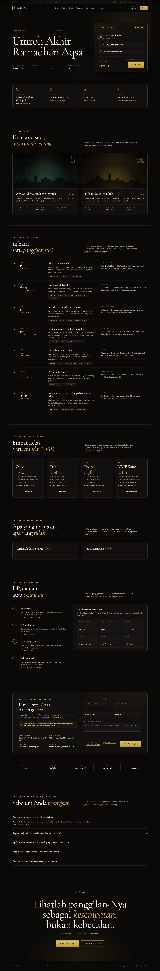
05 · FITUR · PUBLIC
Landing /p/:slug — agent attribution
Halaman jualan paket dengan deep-link agen lock-in untuk attribution audit-able
URL pattern /p/<paketSlug>?a=<agentSlug> — auto-link booking ke agen.
agentSlugCap di-snapshot saat booking — tetap survive walaupun slug agen di-rename.
Auto pre-fill nama + telepon untuk jemaah yang sudah login.
Rate-limit 8/min/IP untuk public booking endpoint.
BookingNo scheme RP-YYYY-NNNNN dengan retry-on-collision (5x).
screens/paket-detail.html — public sales page
RELIGIO PRO · OVERVIEW
6 / 20

Slide 7
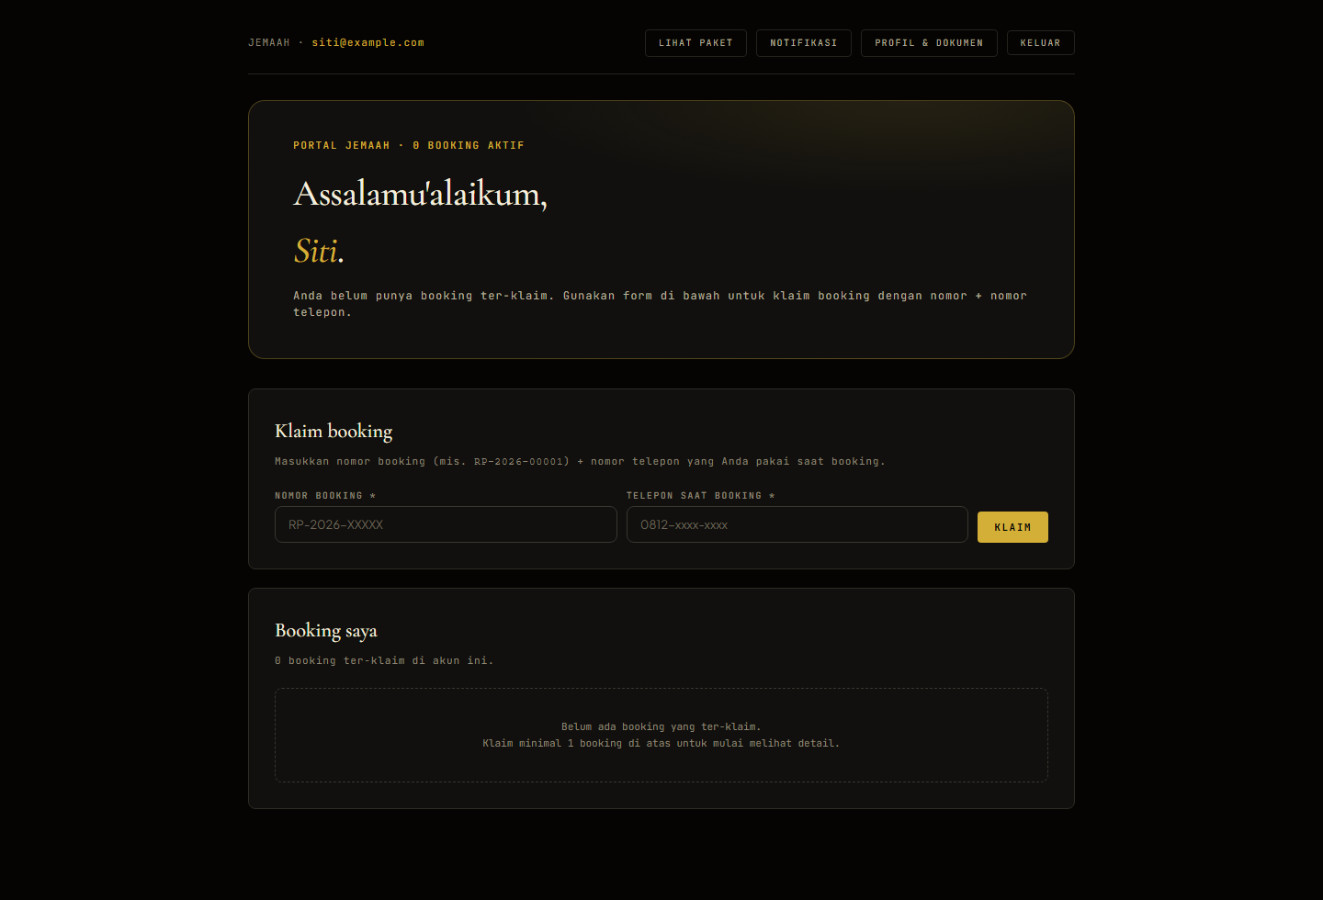
06 · FITUR · JEMAAH
Portal /saya — PWA installable
Self-service jemaah: lihat booking, bayar online, upload dokumen, kirim profil
PWA installable di Android Chrome + iOS Safari (Share → Add to Home Screen + onboarding hint).
Bottom-nav 4-tab: Beranda · Paket · Notifikasi · Profil.
Bayar online via Midtrans Snap (VA · QRIS · Card · E-wallet).
Upload paspor / visa / vaccine cert dengan auto-thumbnail (sharp 256px).
Notifikasi inbox dengan unread badge (5rr).
Voucher booking printable A4 (stage 20).
Soft-merge: claim booking lama otomatis konsolidasi profil.
/saya — jemaah dashboard (PWA-installable)
RELIGIO PRO · OVERVIEW
7 / 20

Slide 8
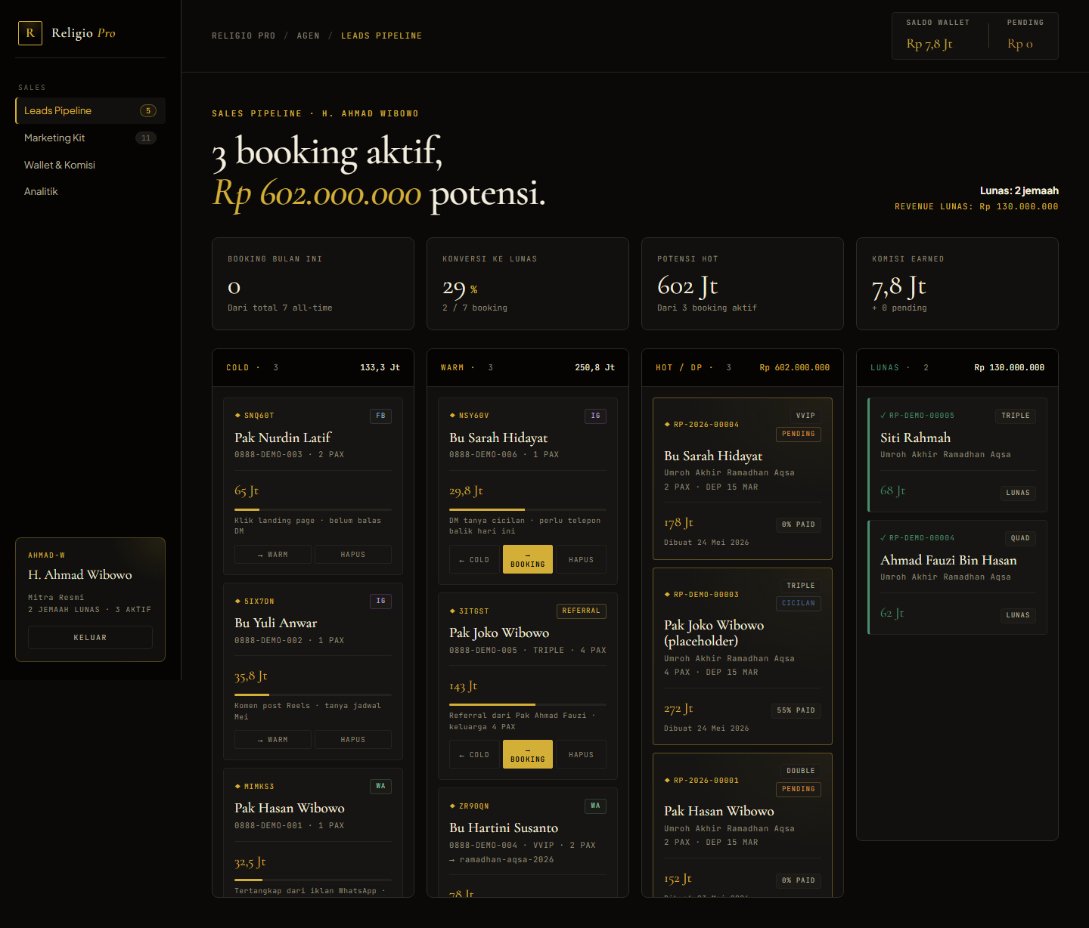
07 · FITUR · AGEN
Portal /agen — CRM untuk agen reseller
Leads kanban · Marketing kit · Wallet · Analitik · 4 tab terintegrasi
Pipeline kanban 4-kolom: Cold · Warm · Hot · LUNAS (campuran Lead + Booking).
Marketing kit: link auto-generated /p/<slug>?a=<agentSlug> + copy-to-clipboard.
Wallet & komisi: pending · earned · paid · cancelled + 20 payout terakhir.
Analitik: funnel SVG 5-stage · sumber lead · sparkline 30-hari · per-paket leaderboard · komisi 6 bulan bar chart.
Komisi rate dengan 4-tier precedence: AgentPaketKomisi → komisiRateOverride → Paket.komisiRate → DEFAULT.
/agen — Leads pipeline kanban
RELIGIO PRO · OVERVIEW
8 / 20

Slide 9
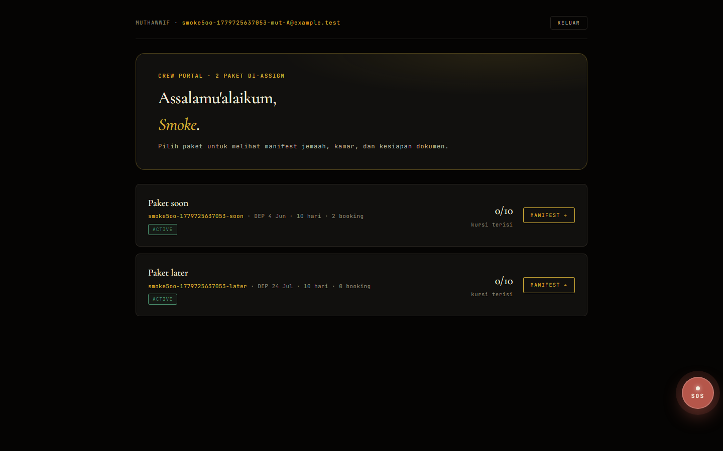
08 · FITUR · CREW
Portal /crew — muthawwif workspace
Read-only manifest · attendance offline-friendly · SOS dengan 3-channel fan-out
Dashboard paket yang di-assign, manifest jemaah tanpa kolom uang (separation of duty).
CSV export untuk offline reference (5ss) — UTF-8 BOM, RFC 4180.
Attendance per-day grid dengan IndexedDB queue (5xx) — replay form submit saat online lagi.
SOS button floating (ruby pulse) di setiap halaman /crew — modal 5 jenis incident.
SOS fan-out 3 channel: EMAIL (queued) · WA (queued) · Web Push (real-time browser).
Tidak ada akses ke money — KASIR & MANAJER_OPS yang handle.
/crew — paket list + SOS button
RELIGIO PRO · OVERVIEW
9 / 20

Slide 10
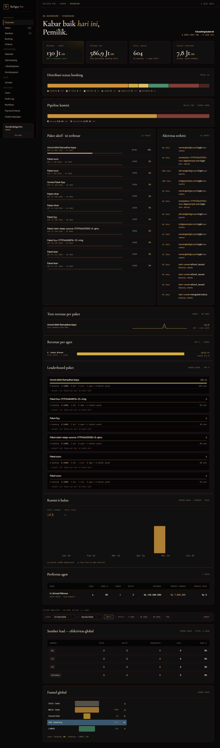
09 · FITUR · ADMIN
Dashboard /admin — HQ control center
5 tab + 10+ sub-page · semua data agen + jemaah + finance dalam satu pane
Tab Overview: KPI · funnel · top paket · revenue trend per paket · komisi 6-bulan bar chart.
Tab Paket / Manifest / Bunking / Finance.
Sub-page: Users · Jemaah · Bookings (global search) · Audit · Notifikasi · Payment Intents · Incidents · Payouts · Calendar · Checklist.
Per-paket profitability (stage 22): revenue − cost − komisi liability = net margin %.
Print-friendly outputs: manifest (A4 landscape) · voucher per-jemaah · slip payout · pre-departure checklist.
Calendar view bulanan (stage 24) untuk planning + drill per tanggal.
/admin — overview tab dengan KPI + charts
RELIGIO PRO · OVERVIEW
10 / 20

Slide 11
10 · MONEY FLOW
Payment → Komisi → Payout
Append-only Payment ledger + state machine forward-only
recordPayment() = single source of truth — admin-recorded + gateway webhook lewat fungsi yang sama.
State machine forward-only: PENDING → BOOKED → DP_PAID → PARTIAL → LUNAS (CANCELLED/REFUNDED terminal).
Auto-Komisi pada LUNAS transition — idempotent, rate locked-in di Komisi.amount snapshot.
Refund = negative-amount Payment row, append-only (tidak edit original).
Payout bundles all EARNED komisi for one agent, transactional, payoutNo = PO-YYYY-NNNNN.
Midtrans Snap webhook delegate ke recordPayment — single math path, idempotent on retry.
RELIGIO PRO · OVERVIEW
11 / 20

Slide 12
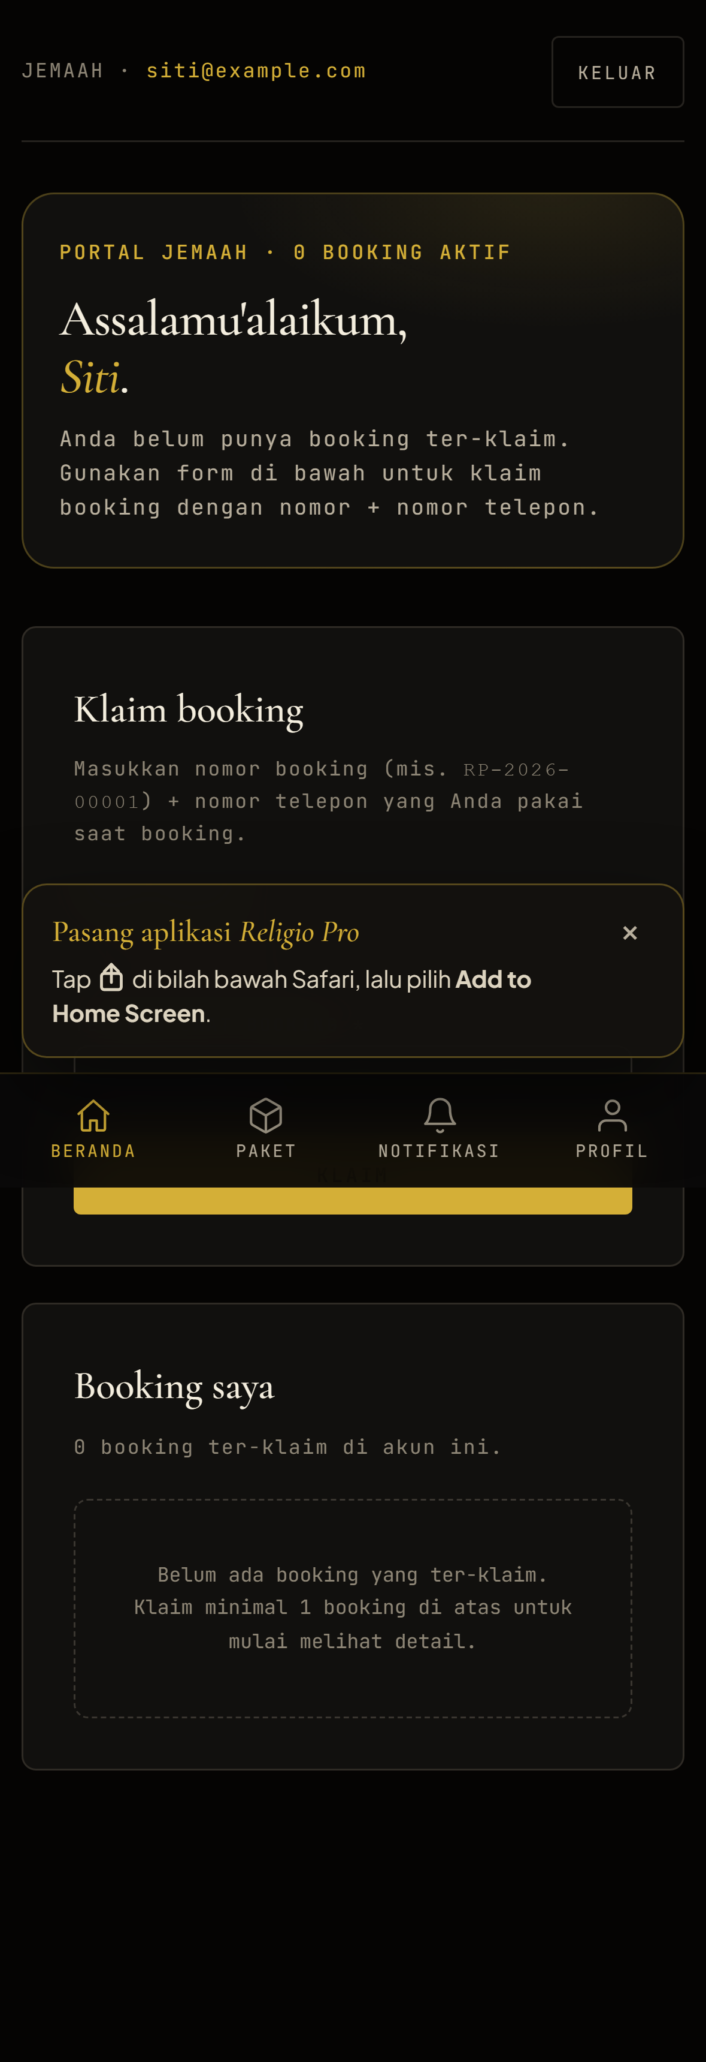
11 · MOBILE
PWA · offline · push
Installable di HP, attendance queue di IndexedDB, SOS push real-time
PWA shell: manifest.webmanifest · service worker · install prompt + iOS hint.
Cache strategy: static cache-first, HTML network-first, offline.html fallback.
Offline attendance: IndexedDB queue replay on online event + 20s tick (server upsert sudah idempotent).
Web Push: VAPID + browser subscription — 3rd channel di samping email + WA.
SOS: requireInteraction=true → toast nempel sampai admin klik.
Mobile bottom-nav untuk jemaah, responsive @media baseline, tap-target ≥ 44px.
/saya di mobile dengan bottom-nav + PWA install
RELIGIO PRO · OVERVIEW
12 / 20

Slide 13
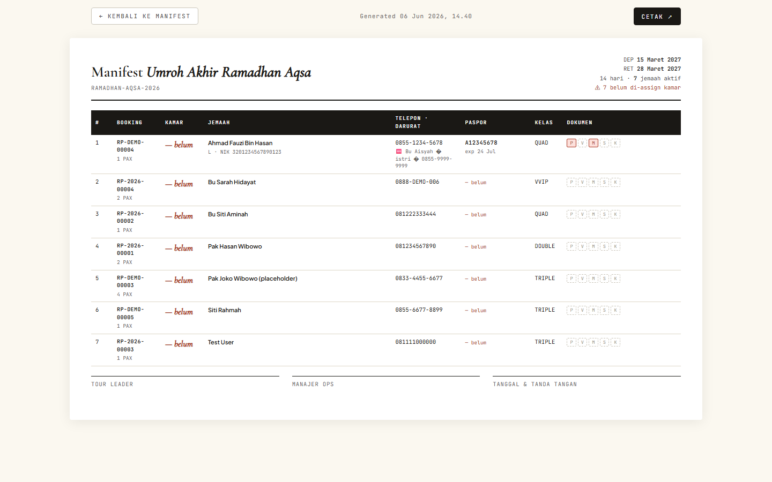
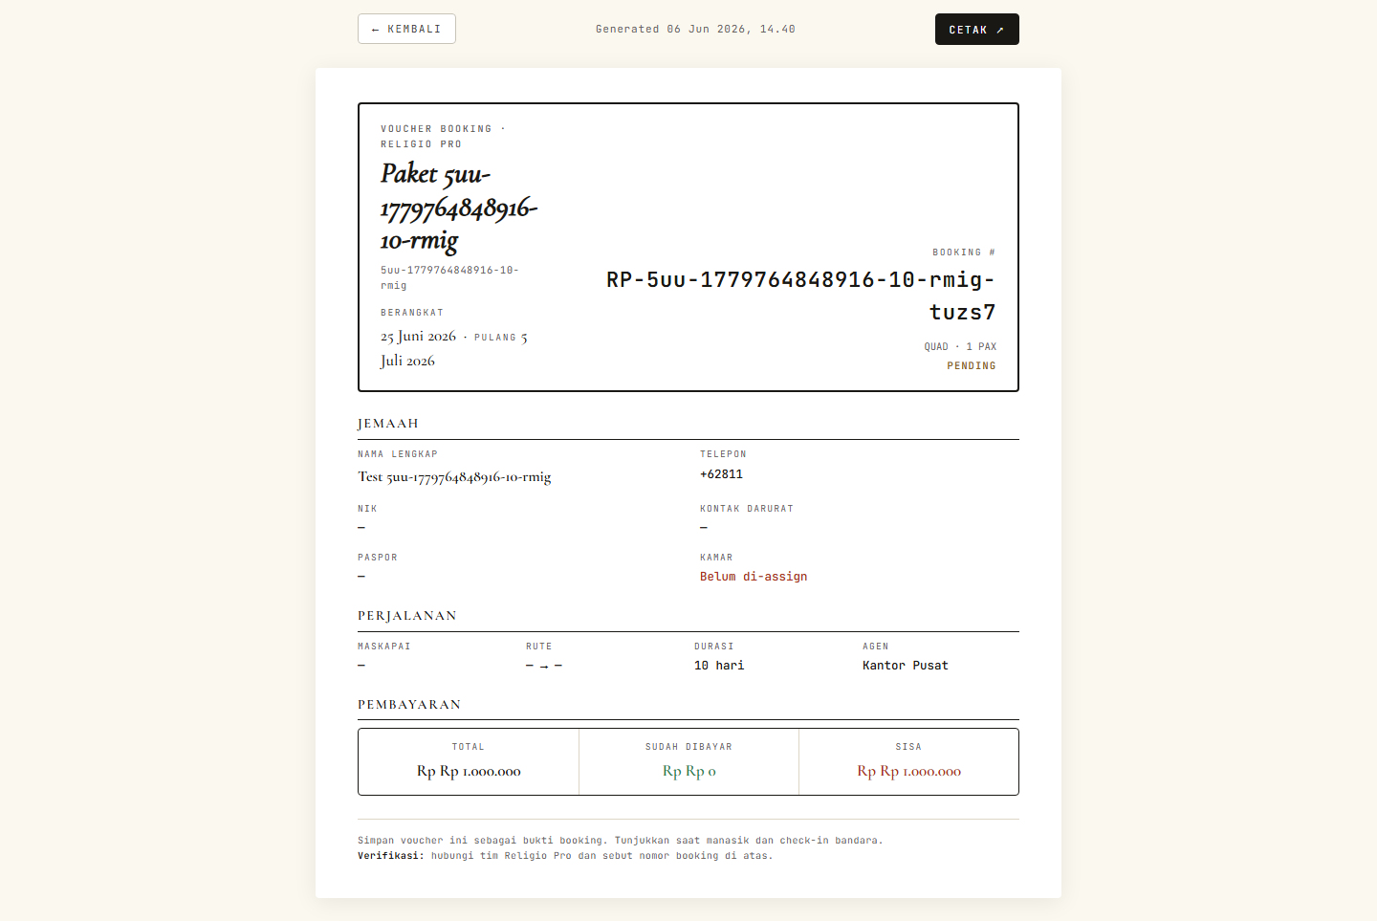
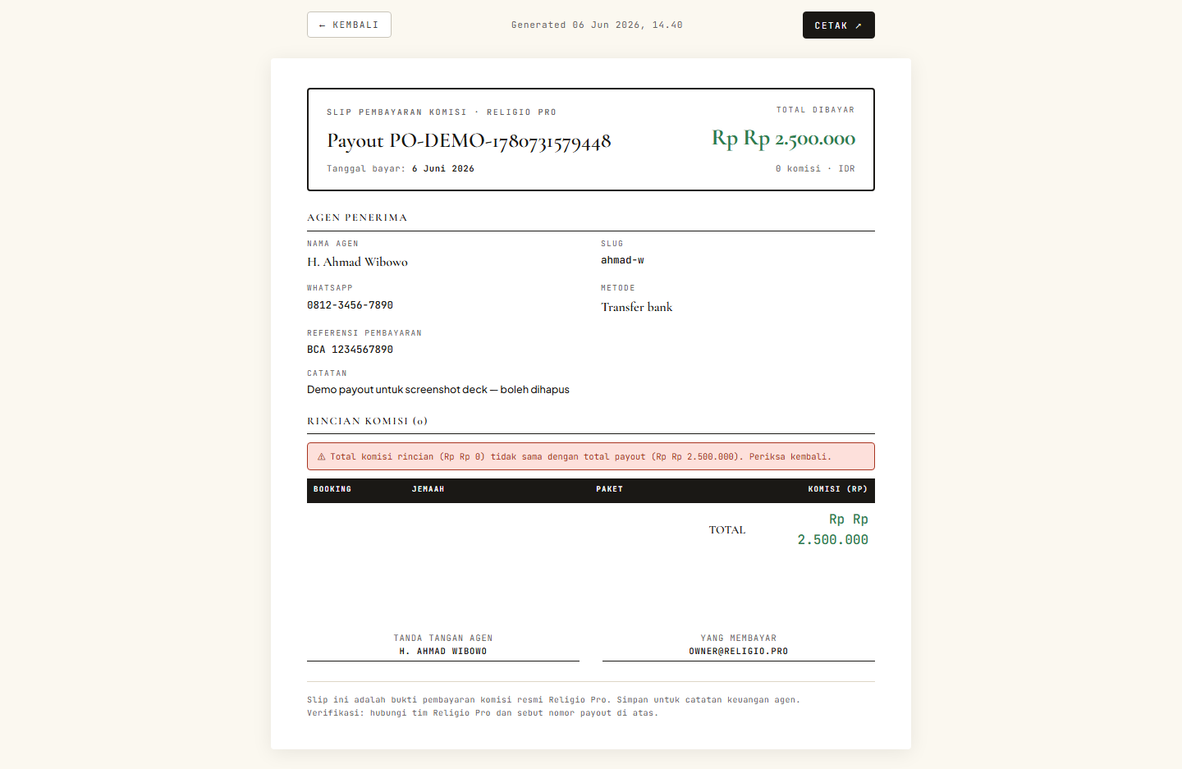
12 · PRINT OUTPUTS
Print trifecta — paperwork lengkap
Manifest + Voucher + Slip = full accounting + ops trail
MANIFEST
VOUCHER
SLIP PAYOUT
A4 landscape
Airport check-in worksheet
Room-first sort
Paspor + emergency contact
A4 portrait per-jemaah
Identity + paket + payment
Itinerary condensed
Backup for manasik handout
A4 portrait per-payout
Agen identity + komisi table
2 signature boxes
Untuk accounting record
RELIGIO PRO · OVERVIEW
13 / 20

Slide 14

13 · ANALYTICS
BI tooling — siapa untung, paket mana yang konversi
Funnel · leaderboard · monthly trend · net margin · checklist · calendar
Per-paket leaderboard dengan revenue + cost + komisi liability + NET MARGIN%.
Margin color tier: ≥20% emerald · ≥5% gold · ≥0% amber · negative ruby — losses tidak di-mask.
Komisi monthly bar chart 6-bulan: earned (amber) vs paid (emerald).
Pre-departure checklist 8-poin per jemaah (paspor 6-bulan rule + 4 verified docs + room + emergency).
Calendar bulanan untuk planning + drill per tanggal.
Sumber lead breakdown + funnel agen + sparkline 30-hari (semua agen / per agen).
Leaderboard paket dengan net margin
RELIGIO PRO · OVERVIEW
14 / 20

Slide 15
14 · NOTIFIKASI
Multi-channel queue · retry · opt-out
Email · WA · Web Push dengan template engine + retry backoff + audit trail
Notification model = durable queue + dispatch log. PENDING → SENT / FAILED / SKIPPED.
Senders: console (default) · Fonnte WA · SMTP (nodemailer) · web-push.
Templates JSON-based dengan {{var}} placeholders — easy localise per type × channel.
Retry exponential backoff (5nn): 1m · 5m · 30m · 2h · 12h sebelum terminal.
Per-channel opt-out di JemaahProfile.notifEmail/notifWa + per-type di JemaahNotifPref.
In-process worker (30s) + cron HTTP trigger — NOTIF_WORKER_DISABLED=true di production.
Jemaah inbox /saya/notifications dengan unread badge (5rr) auto-clear setelah view.
RELIGIO PRO · OVERVIEW
15 / 20

Slide 16
15 · PRODUCTION READINESS
Sudah siap untuk go-live
Security · observability · backup · retention · launch readiness drill
Boot-time env validation: production fail-fast kalau JWT_SECRET / COOKIE_SECURE / dll. tidak set.
CSRF protection double-submit cookie + Redis-backed rate-limit (multi-instance safe).
Audit log permanen (append-only) untuk setiap state change. Read-only viewer untuk admin.
Weekly retention job (prune): bound Notification/JobRun/failed-intent growth. AuditLog + Payment NEVER pruned.
/api/health dengan per-job freshness — eksternal uptime monitor cukup alert pada single field.
Nightly mysqldump --single-transaction + 14-day rotation. Production deploy guide lengkap di deploy/.
Pre-launch smoke runner (scripts/smoke-launch.js) — health + CSRF mint + sensitive-path block + bogus-creds.
RELIGIO PRO · OVERVIEW
16 / 20

Slide 17
16 · QUALITY
Test suite ~370 tests · node:test built-in
Zero-dependency test runner · serialized · DB fixture-based
Total tests
Test suites
Smoke scripts
Coverage
362
127
20+
service + route
node:test built-in (Node ≥ 18) — zero install, --test-concurrency=1 untuk DB isolation.
Tag-prefixed fixtures (makeTag) — tests share dev DB tapi isolated lewat tag prefix.
Smoke scripts berdampingan: pre-launch · payment gateway · offline attendance · web push.
Full suite 362/362 pass — green sebelum setiap commit.
RELIGIO PRO · OVERVIEW
17 / 20

Slide 18
17 · TIMELINE
24 stages dijalankan secara terstruktur
Build-out staged — setiap stage didokumentasi di CLAUDE.md
01-02 Skeleton + Prisma + MySQL seed
03 Auth + RBAC (8 role)
04 Public landing + booking
05 Agen portal CRM
06 Admin dashboard
07 Money flow + komisi
08 Ops jobs (cron)
09 Jemaah portal
10 Notifikasi (queue + retry)
11 Payment gateway (Midtrans)
12 Crew portal
13 Mobile experience (PWA + offline)
14 Per-paket × per-agen komisi matrix
15 Document thumbnails
16 Analytics extension
17 Web Push SOS
18 Paket clone
19 Print manifest
20 Per-jemaah voucher
21 Payout slip
22 Per-paket profitability
23 Pre-departure checklist
24 Departure calendar
RELIGIO PRO · OVERVIEW
18 / 20

Slide 19
18 · KELEBIHAN
Mengapa Religio Pro
8 alasan kuat dibanding solusi spreadsheet, WhatsApp group, atau platform generic
TERINTEGRASI
AUDIT TRAIL
Lead → Booking → Payment → Komisi → Payout otomatis. Tidak ada double-entry, tidak ada lupa.
Setiap state change ditulis ke AuditLog (append-only). Investigasi cepat, compliance ready.
BHS. INDONESIA
PRINT-READY
Seluruh UI dalam Bahasa Indonesia. Owner, kasir, agen, jemaah semua nyaman tanpa training translasi.
Manifest · voucher · slip payout siap cetak A4 — tidak perlu Excel/Word manual.
SEPARATION OF DUTIES
OWNER BI
8-role RBAC mencegah kasir menulis-off refund, mencegah agen lihat data agen lain.
Profitability per paket, komisi trend, leaderboard cross-agen — owner tahu paket mana yang untung.
OFFLINE-FRIENDLY
PRODUCTION-READY
PWA + IndexedDB. Attendance + SOS jalan di bus tanpa sinyal — sync saat online.
Rate limit · CSRF · backup · retention · health check · ~370 tests. Bukan prototype.
RELIGIO PRO · OVERVIEW
19 / 20

Slide 20
Terima kasih
Ready to demo, ready to deploy
Public landing · /p/ramadhan-aqsa-2026
Jemaah portal · /saya
Agen CRM · /agen
Crew workspace · /crew
Admin HQ · /admin
API health · /api/health

