Slide 1







Budget
Tracker
By Galilea Almaraz
Notes:
Hello everyone, I'm Galilea Almaraz and I would like to present my programming languages project: Budget Tracker

Slide 2





Outline
Introduction
Demo
Methodology
Conclusion
Notes:
I will go over a quick introduction, then the methodologies behind Budget Tracker, and end with a conclusion.

Slide 3



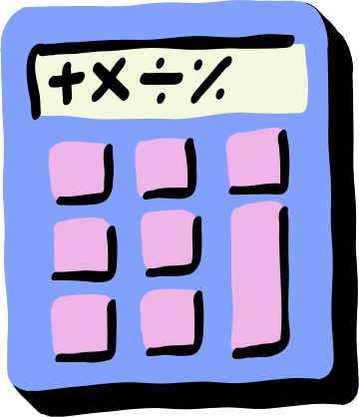
Introduction
Budget Tracker is an innovative application designed to assist users in effectively managing their personal finances. By enabling users to track income, expenses, and savings, the planner provides a holistic view of their financial health.
We aims to make budgeting accessible and engaging. Users can easily add, edit, or delete transactions while visualizing their spending through an interactive pie chart.
Notes:
Oink Saver is an interactive GUI designed to help users efficiently manage their finances by tracking income, expenses, and savings. With an intuitive and easy-to-use interface, it aims to simplify financial management for individuals, allowing them to make informed decisions about their financial health. This GUI offers features like adding, editing, and deleting transactions, along with a visual representation of spending habits through a dynamic pie chart, making budgeting an engaging and accessible process.

Slide 4


Developed using Python's Tkinter for GUI and Matplotlib for visual representation.
Utilized JSON for data storage, ensuring persistence across sessions.
Implemented features such as adding, editing, and deleting transactions, and real-time pie chart updates.
Methodology
Notes:
Oink Saver was built using Tkinter, a Python library for GUI, to create a visually appealing and easy-to-navigate interface. Matplotlib was used for the pie chart that updates in real-time, giving users a quick visual overview of their financial health.
JSON is used to store all transaction data, ensuring that the data persists even after closing the app. Users can add new transactions, edit existing ones, or delete them as needed, making the planner highly flexible.

Slide 5

Let’s Take A Look At
Oink Saver

Slide 6
Conclusion
Oink Saver provides a comprehensive solution for managing personal finances effectively. With its simple interface, users can easily track and understand their financial activities. Looking ahead, future improvements could include advanced data analytics for better financial insights and integration with other financial platforms to enhance user experience.
Notes:
In conclusion, Oink Saver provides an effective solution for managing personal finances, with its intuitive interface making financial tracking straightforward.
Looking ahead, we could enhance the application by incorporating advanced data analytics, such as monthly spending trends, or integration with other platforms like Google Sheets or financial apps for greater versatility. Thank you for listening, and I’d be happy to answer any questions.

Slide 7

Thank You
Notes:
Thank you for your time, if y'all have any questions please let me know. :)

