Slide 1


College 101
Presented by:
Mr. Bai Zhen 甄 生
E-mail: bzhen@jcyc.org
Galileoweb.org/college

Slide 2
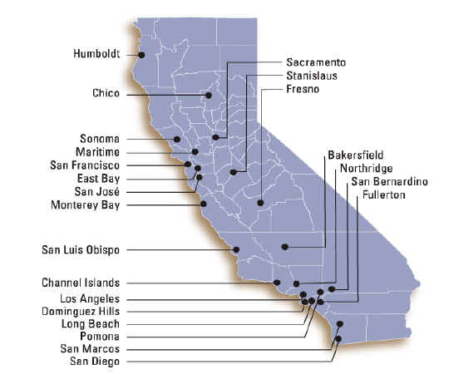
California State University
Apply: Oct. 1-Nov. 30 csumentor.edu
California State University (CSU)-23 : San Francisco, San Jose, Long Beach, East-Bay, Sonoma, San Diego, and more

Slide 3
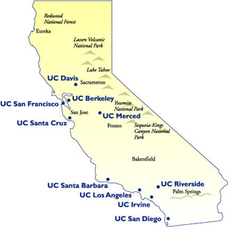
University of California
Oct. 1-Nov. 30
Universityofcalifornia.edu
University of California (UC)
  10 : UC Berkeley, UC Davis, UC Irvine, UC Los Angeles, UC Merced, UC Riverside, UC Santa Barbara, UC Santa Cruz,, UC San Diego, & UC San Francisco

Slide 4
California College System (Con’t)
Private/Independent College
  75+: Stanford, USF, USC, Mills, St. Mary, Claremont McKenna, etc.
Community College (CC)
  110+: City College of San Francisco, Skyline, College of San Mateo, Foothill, De Anza, and more

Slide 5

UC & CSU ADMISSIONS REQUIREMENTS
Subject Requirements
Test Requirements
GPA
Personal Statement- (UC only)

Slide 6
UC & CSU SUBJECT REQUIREMENTS
("a-g" requirements)
A. History—2 years (recommended: 3 years)
B. English—4 years
C. Mathematics—3 years (recommended: 4 years)
Algebra/Geometry/Advanced Algebra/Pre-Calculus/Calculus
D. Laboratory Science—2 years (recommended: 3-4 years)
Physics/Biology/Chemistry/Environmental Science/
E. Language other than English-2 years (recommended: 3-4 years)
Spanish/French/Chinese
F. Visual and Performing Arts--1 years
Dance/Drama/Theater/Music/Visual Art
G. College Preparatory Electives--1 year
*********NO D's OR F's!!!!*********

Slide 7
TEST REQUIREMENTS
 | SAT I | ACT w/ Writing | ACT | SAT II
UC | X | X
CSU | X |  | X
Community College
Private | X | Varies (depends on college)

Slide 8
SAT I & ACT :
SAT I (Reasoning Test) | ACT
Writing | Writing
Verbal | Verbal
Math | Math
 | Science Reasoning
 | Reading
SAT II (Subject Test)-- Optional:

Slide 9
GPA
UC GPA ﹕
  10th & 11th grades from A-G courses.
  Min GPA: 3.0
CSU GPA :
  10th & 11th grades from A-G courses.
  Min GPA: 2.0
GPA | ACT | SAT I
2.9 | 10 | 510
2.55 | 19 | 860
2. 0 | 30 | 1300

Slide 10
MINIMUM ELIGIBILITY vs. SELECTION PROCESS
Rigorous curriculum/classes
  AP=Advance Placement, Honors
12th grade courses
Extra-curricular activities
    Volunteering, work
    Special Talent, skills
    Awards & Honors
  Personal Statements
  Letter of Recommendations

Slide 11
FINANCIAL AID
FAFSA: Apply during 12th grade:
JAN. 1- MARCH 2
http://www.fafsa.gov/
Scholarships:
galileoweb.org/college/scholarships

Slide 12

COLLEGE FEES
2012-2013
 | Community College | CSU | UC | Private
TUITION | $686-$802 | $4,810-$6,498 | $11,030-$15,308 | $25,881-40,384
BOOKS | $1,704 | $1,704 | $1,704 | $1,704
DORMS | $3550-$11,556 (Live at Home) | $7,041-$12,414 (Dorms) | $11,400-14,384 (Dorms) | $8,568-12,350 (Dorm)
Transportation | $1,224 | $1,224 | $1,224 | $1,224
Living Expense | $3,120 | $3,120 | $3,120 | $3,120
TOTAL | $10,400- $18,290 | $17,899-$24,960 | $28,478-$35,740 | $40,497-$58,782

Slide 13
FINANCIAL AID
Grants
  Cal grant, University grant, Pell Grant
Loans
  Subsidized Loans:
  Perkins loan, Stafford loan (5%--8.25%)
Scholarships—Galileoweb.org/college/scholarships
  www.fastweb.com/ ，GATES MILLENIUM: http://www.gmsp.org
Work-Study
529 Scholarshare Savings Plan: http://www.scholarshare.com
Teach for America, Peace-Corps, Americorps

Slide 14

STUDENT FINANCIAL AID
 | City College of SF | U.C. San Diego | Stanford
COST | $7,000 | $30,000 | $50,000
- Estimated Family Contribution | -$2,000 | -$2,000 | -$2,000
Financial Need | $5,000 | $28,000 | $48,000

