Slide 1

Fear Factor: Are you ready?

Slide 2
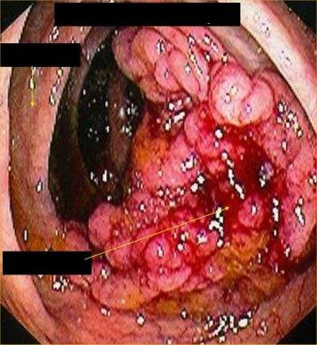
What ‘s happened??

Slide 3
Colon Cancer Facts
2nd leading cancer killer in US
Late discover
More women than men (2000)

Slide 4

Major Risk Factors
Obesity
Sedentary Lifestyle
Low Fiber Intake

Slide 5
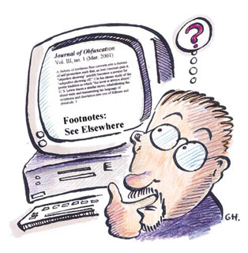
Want to Know More?
http://cancer-colon.org/

Slide 6
Sell it to ME!!!!!!!
Which diet is the best?
The Cabbage Soup Diet
The Chocolate Diet
The Hollywood Diet
The Atkins Diet
Not Bad Vegetables

Slide 7

Show-Time

Slide 8
Homework
Analysis commercials that posted in the website

