Slide 1
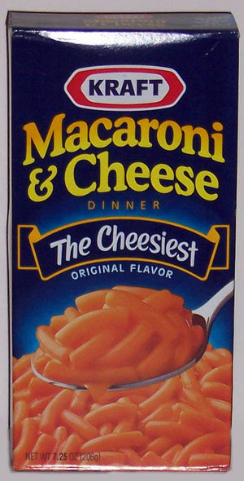
Food Labelling
03/16/09

Slide 2

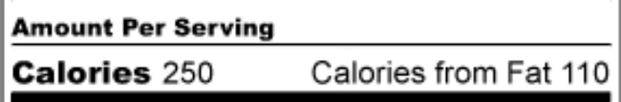
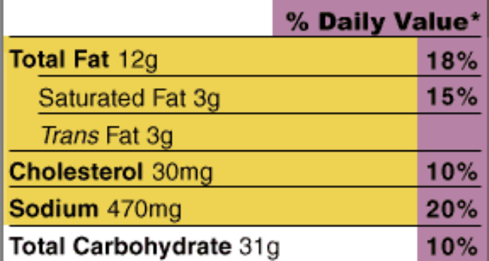
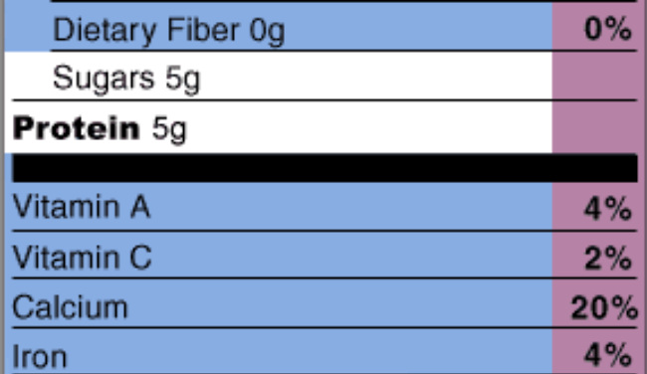
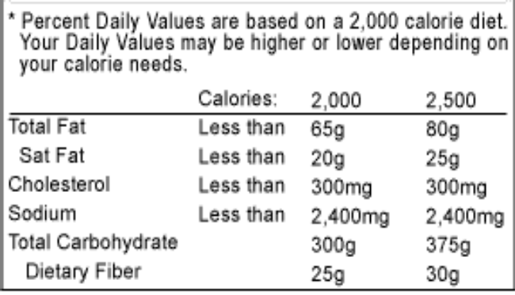

Slide 3

Nutrition Facts label – first place to look at
Serving sizes are standardized to make it easier to compare similar foods
Familiar units – cups, pieces or grams.

Slide 4
One Serving
Two Servings
Serving size | 1 cup (228g)
Calories | 250
Calories from Fat | 110
Total Fat | 12 g
Trans Fat | 1.5g
Saturated Fat | 3g
Cholesterol | 30mg
Sodium | 470mg
Total Carbohydrate | 31g
Dietary Fiber | 0g
Sugars | 5g
Protein | 5g
Serving size | 2 cup (456g)
Calories | 500
Calories from Fat | 220
Total Fat | 24g
Trans Fat | 3g
Saturated Fat | 6g
Cholesterol | 60mg
Sodium | 940mg
Total Carbohydrate | 62g
Dietary Fiber | 0g
Sugars | 10g
Protein | 10g

Slide 5

Calories = energy you get from a serving
Help you manage your weight (i.e. gain, lose, or maintain)
Half of the calories in a single serving comes from fat.

Slide 6
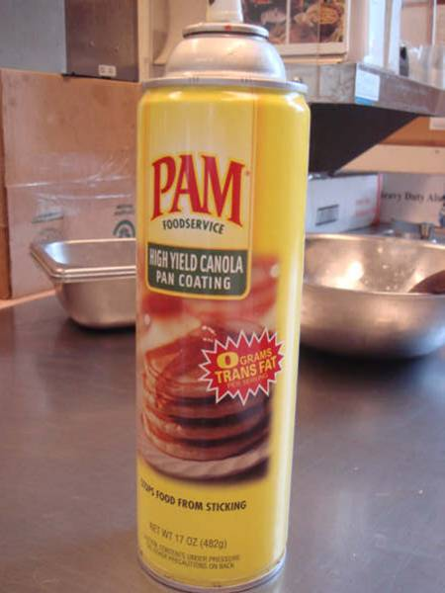

Slide 7
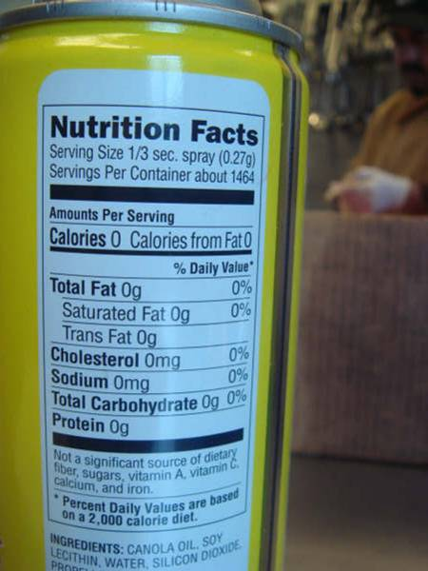
Notes:
How do you spray 1/3 of a second?!

