Slide 1



Slide 2
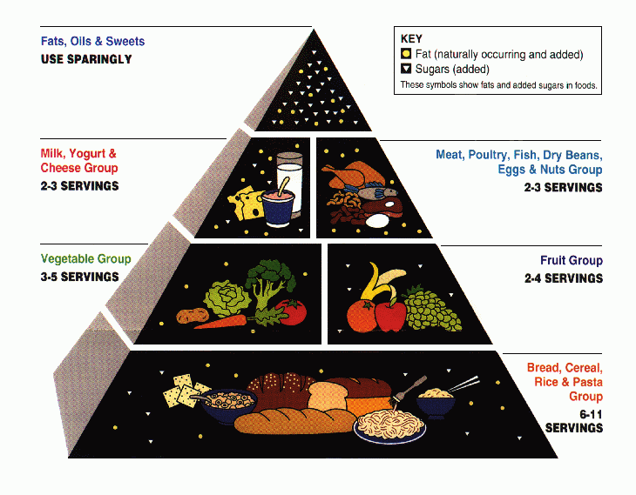


Slide 3
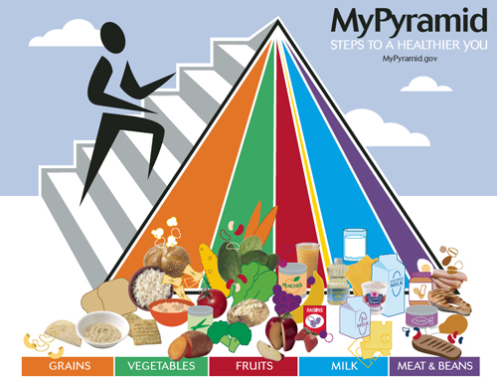

Slide 4



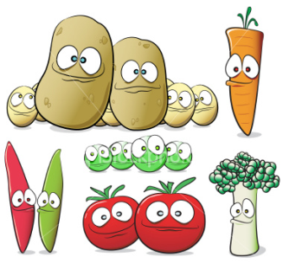

Slide 5
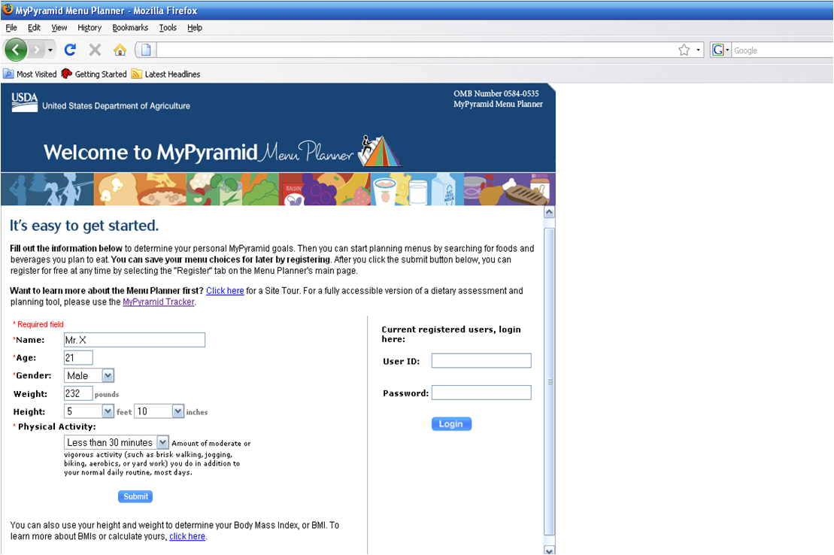
http://www.mypyramidtracker.gov/planner/launchPage.aspx
Notes:
In the pyramid, they ask you for your name, age, gender, wt, height, and physical activity.
One good thing is that they actually keep record of your information.

Slide 6
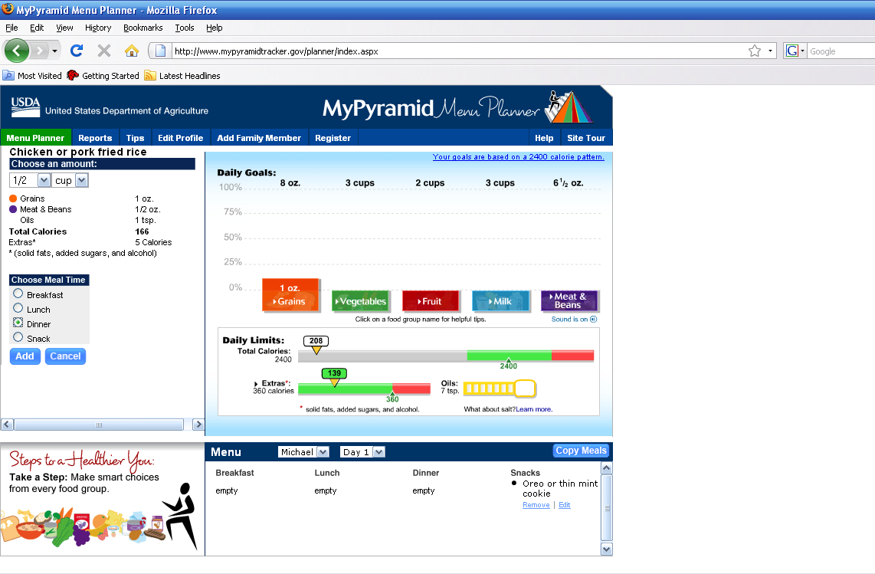
Notes:
And they have a pretty good database on food search; they have specific food items, e.g., the guy here is looking for a fried rice with pork or chicken. And he has oreo down at the bottom.

Slide 7

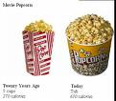
A portion = is the amount of food you choose to put on your plate. Portions may actually contain several servings.
A serving = the amount of food you see listed on the Nutrition Facts panel on packaged foods or what is recommended for the different food groups on the Food Guide Pyramid

Slide 8

Portion Estimation
3oz of cooked meat
1 oz of cheese
2 Tbsp. Peanut Butter
1 average Bagel
1 oz. Chips
1 cup-2 servings Pasta, cooked
1 teaspoon of mayonnaise
1 medium Apple
1 Pancake
1/2 cup Ice Cream
Small Cake
1 medium Potato
4 small cookies
A. bar of soap
B. Palm
C. women's fist
D. racquet ball
E. golf ball
F. A tennis ball
G. 2 handfuls
H. DVD
I. Four checkers
J. Thumb Tip
K. hockey puck
L. Thumb
M. computer mouse

Slide 9


Answer For Portion Estimation
B 3oz of cooked meat
L 1 oz of cheese
E 2 Tbsp. Peanut Butter
K 1 average Bagel
G 1 oz. Chips
F 1 cup-2 servings Pasta, cooked
J 1 teaspoon of mayonnaise
C 1 medium Apple
H 1 Pancake
D 1/2 cup Ice Cream
A Small Cake
M 1 medium Potato
I 4 small cookies
A. bar of soap
B. Palm
C. women's fist
D. racquet ball
E. golf ball
F. A tennis ball
G. 2 handfuls
H. DVD
I. Four checkers
J. Thumb Tip
K. hockey puck
L. Thumb
M. computer mouse

Slide 10


Record what you ate for three days, including breakfast, lunch and dinner. What are the challenges of including all food groups in a day? What make it success? Write at least 1 page (double spaced) essay to answer these questions.

Slide 11
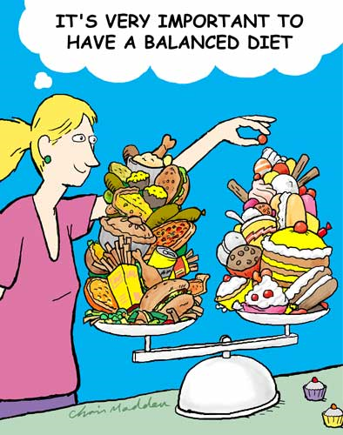
Contact Information
Email: galnutrition@gmail.com

