Slide 1

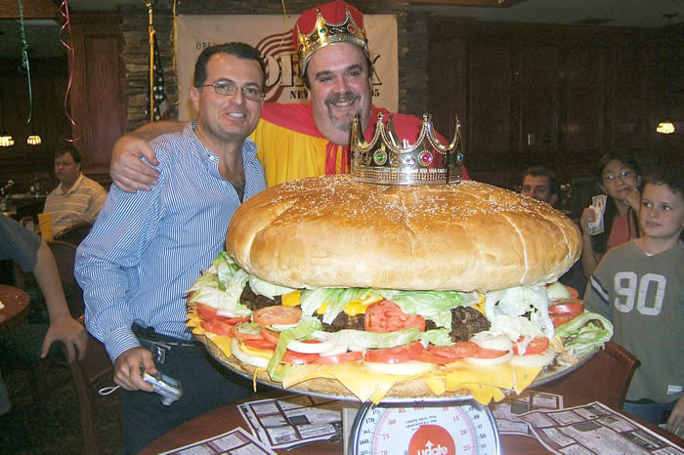

Slide 2
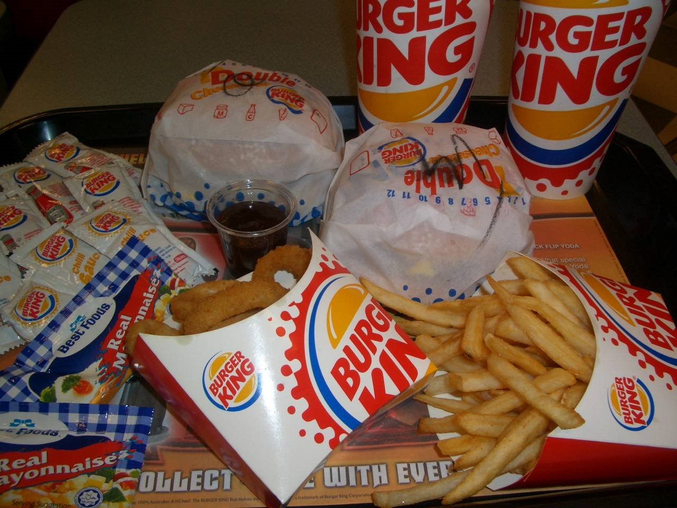
Why do people choose this?
Notes:
Taste good
Cheap
Fast
Commercial
We just go everyday
My friends want to go there; I just follow

Slide 3
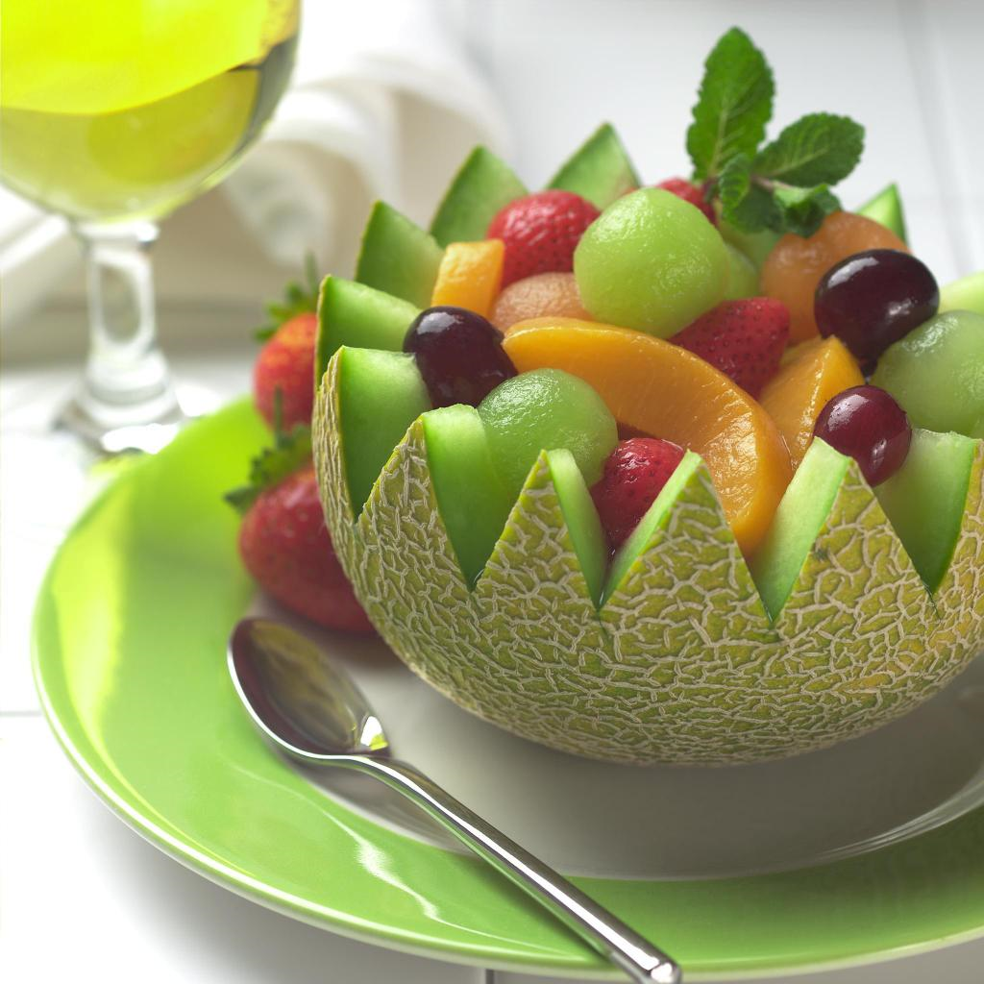
Why do people choose this?
Notes:
Look good! variety of colors
Taste good
High fiber and nutrients
I eat fruits everyday.

Slide 4
Some of the Factors Influencing Our Food Choices:
Advertising/Promotion
Convenience
Cost
Flavor and Texture
Habits
Influences by Parents
Influences by Peers
Knowledge/Beliefs of Nutrition/Health

Slide 5
Tracy Want to Be on a Diet.
Tracy, who is your best friend, is going to a prom in 2 weeks. She wants to lose 10 lbs because she wants to look good in her prom dress. Because she knows that you are a health academy student, she seeks for your advice on how to lose all extra lbs in 2 weeks.

Slide 6
HW: Help Mikey Out!
Michael thinks himself too skinny, so he decides to make some changes on his daily life to gain some weight and build some muscles, but he does not want to gain weight in fat. He needs your help!
According to the reading

