Slide 1
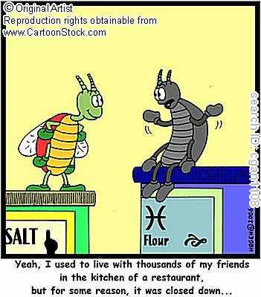


Slide 2

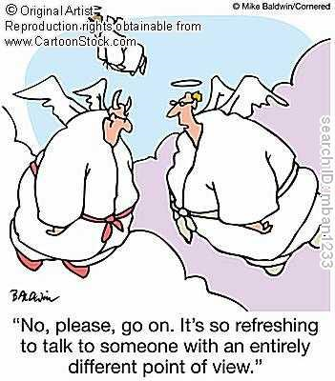

Slide 3
1. Tobbaco Tax: Tobacco taxes have been increasing steadily in recent years and is currently 45.13%. Do you believe the government has the right to continue increasing taxes?
2. High schools only require 2 years of physical education class. Do you think high schools should make it 4 years requirement in order for students to have physical activity
every day?
3. What do you think if public schools should be given the right to keep their students having lunch on campus mandatorily?

