Slide 1
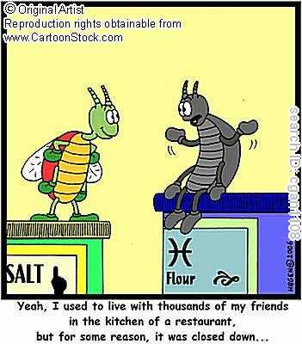


Slide 2

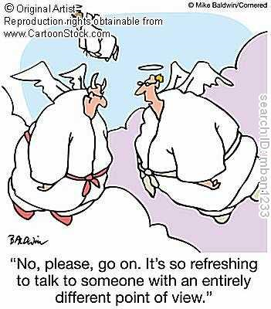

Slide 3
1. Tobbaco Tax: Tobacco taxes have been increasing steadily in
recent years and is currently 45.13%. Do you believe the government has the right to continue increasing taxes?
2. High schools only require 2 years of physical education class. Do you think
high schools should make it 4 years requirement in order for students to have physical activity
every day?
3. Tobacco has health warning label on its package to encourage people NOT to smoke. Then, should health/ nutrition warning label be put on fast food items such as McDonald and KFC to encourage people NOT to consume them?

