Slide 1

Do You Know How Food Portions Have
Changed in 20 Years?
National Heart, Lung, and Blood Institute
Obesity Education Initiative

Slide 2



COFFEE
20 Years Ago
Coffee
(with whole milk and sugar)
Today
Mocha Coffee
(with steamed whole milk and mocha syrup)
45 calories
8 ounces
How many calories
are in today's coffee?

Slide 3
About…
A) 300 Cal
B) 350 Cal
C) 400 Cal
D) 450 Cal

Slide 4
COFFEE
20 Years Ago
Coffee
(with whole milk and sugar)
Today
Mocha Coffee
(with steamed whole milk and mocha syrup)
45 calories
8 ounces
350 calories
16 ounces
Calorie Difference: 305 calories

Slide 5

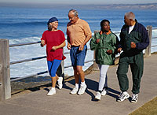
Maintaining a Healthy Weight is a Balancing Act
Calories In = Calories Out
How long will you have to walk in order to burn those extra 305 calories?*
*Based on 130-pound person

Slide 6
A) 20 min
B) 40 min
C)1 hr
D) 1 hr 20 min

Slide 7

Calories In = Calories Out
If you walk 1 hour and 20 minutes, you will burn approximately 305 calories.*
*Based on 130-pound person

Slide 8
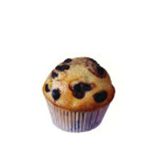
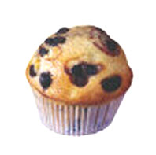
MUFFIN
20 Years Ago
Today
210 calories
1.5 ounces
How many calories are in today’s muffin?

Slide 9
About…
A) 200 Cal
B) 300 Cal
C) 400 Cal
D) 500 Cal

Slide 10
MUFFIN
20 Years Ago
Today
210 calories
1.5 ounces
500 calories
4 ounces
Calorie Difference: 290 calories

Slide 11
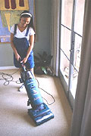
Maintaining a Healthy Weight is a Balancing Act
Calories In = Calories Out
How long will you have to vacuum in order to burn those extra 290 calories?*
*Based on 130-pound person

Slide 12
A) 30 min
B) 1 hr 30 min
C) 2 hr
D) 2 hr 30 min

Slide 13
Calories In = Calories Out
If you vacuum for 1 hour and 30 minutes you will burn approximately 290 calories.*
*Based on 130-pound person

Slide 14


PEPPERONI PIZZA
20 Years Ago
Today
500 calories
How many calories are in two large slices of today’s pizza?

Slide 15
A) 100 Cal
B) 150 Cal
C) 250 Cal
D) 350 Cal

Slide 16
PEPPERONI PIZZA
20 Years Ago
Today
500 calories
850 calories
Calorie Difference: 350 calories

Slide 17
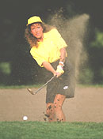
Maintaining a Healthy Weight is a Balancing Act
Calories In = Calories Out
How long will you have to play golf (while walking and carrying your clubs) in order to burn those extra 350 calories?*
*Based on 160-pound person

Slide 18
A) 1 hr
B) 1 hr 20 min
C)1 hr 40 min
D) 2 hr

Slide 19

Calories In = Calories Out
If you play golf (while walking and carrying your clubs) for 1 hour you will burn approximately 350 calories.*
*Based on 160-pound person

Slide 20
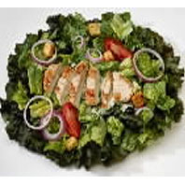
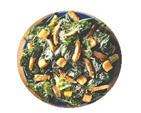
CHICKEN CAESAR SALAD
20 Years Ago
Today
390 calories
1 ½ cups
How many calories are in today’s chicken Caesar salad?

Slide 21
A) 400 Cal
B) 500 Cal
C) 600 Cal
D) 700 Cal

Slide 22
CHICKEN CAESAR SALAD
20 Years Ago
Today
390 calories
1 ½ cups
790 calories
3 ½ cups
Calorie Difference: 400 calories

Slide 23

Maintaining a Healthy Weight is a Balancing Act
Calories In = Calories Out
How long will you have to walk the dog in order to burn those extra 400 calories?*
*Based on 160-pound person

Slide 24
A) 1 hr 20 min
B) 1 hr 40 min
C) 2 hr
D) 2 hr 20 min

Slide 25
Calories In = Calories Out
If you walk the dog for 1 hour and 20 minutes, you will burn approximately 400 calories.*
*Based on 160-pound person

Slide 26


POPCORN
20 Years Ago
Today
270 calories
5 cups
How many calories
are in today’s large
popcorn?

Slide 27
A) 180 Cal
B) 270 Cal
C) 360 Cal
D) 450 Cal

Slide 28
POPCORN
20 Years Ago
Today
270 calories
5 cups
630 calories
11 cups
Calorie Difference: 360 calories

Slide 29

Maintaining a Healthy Weight is a Balancing Act
Calories In = Calories Out
How long will you have to do water aerobics in order to burn the extra 360 calories?*
*Based on 160-pound person

Slide 30
A) 30 min
B) 45 min
C) 1 hr
D) 1 hr 15 min

Slide 31
Calories In = Calories Out
If you do water aerobics for 1 hour and 15 minutes you will burn approximately 360 calories.*
*Based on 160-pound person

Slide 32
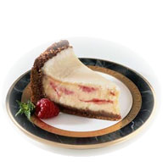
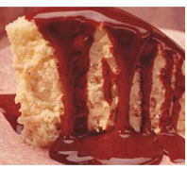
CHEESECAKE
20 Years Ago
Today
260 calories
3 ounces
How many calories are in
today’s large portion of
cheesecake?

Slide 33
A) 380 Cal
B) 480 Cal
C) 540 Cal
D) 640 Cal

Slide 34
CHEESECAKE
20 Years Ago
Today
260 calories
3 ounces
640 calories
7 ounces
Calorie Difference: 380 calories

Slide 35
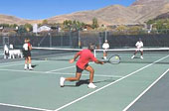
Maintaining a Healthy Weight is a Balancing Act
Calories In = Calories Out
How long will you have to play tennis in order to burn those extra 380 calories?*
*Based on 130-pound person

Slide 36
About …
A) 15 min
B) 30 min
C) 1 hr
D) 2 hr

Slide 37
Calories In = Calories Out
If you play tennis for 55 minutes you will burn approximately 380 calories.*
*Based on 130-pound person

Slide 38
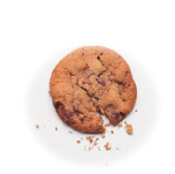
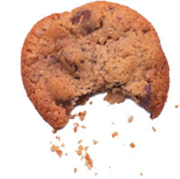
CHOCOLATE CHIP COOKIE
20 Years Ago
Today
55 calories
1.5 inch diameter
How many calories are in today’s large cookie?

Slide 39
A) 220 Cal
B) 350 Cal
C) 420 Cal
D) 500 Cal

Slide 40
CHOCOLATE CHIP COOKIE
20 Years Ago
Today
55 calories
1.5 inch diameter
275 calories
3.5 inch diameter
Calorie Difference: 220 calories

Slide 41
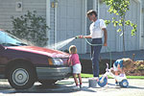
Maintaining a Healthy Weight is a Balancing Act
Calories In = Calories Out
How long will you have to wash the car to burn those extra 220 calories?*
*Based on 130-pound person

Slide 42
A) 1 hr 15 min
B) 1 hr 45 min
C) 2 hr 15 min
D) 2 hr 45 min

Slide 43
Calories In = Calories Out
If you wash the car for 1 hour and 15 minutes you will burn approximately 220 calories.*
*Based on 130-pound person

Slide 44
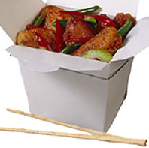
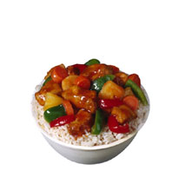
CHICKEN STIR FRY
20 Years Ago
Today
435 calories
2 cups
How many calories are in today’s chicken stir fry?

Slide 45
About …
A) 340 Cal
B) 430 Cal
C) 540 Cal
D) 630 Cal

Slide 46
CHICKEN STIR FRY
20 Years Ago
Today
435 calories
2 cups
865 calories
4 ½ cups
Calorie Difference: 430 calories

Slide 47
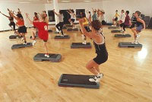
Maintaining a Healthy Weight is a Balancing Act
Calories In = Calories Out
How long will you have to do aerobic dance to burn those extra 430 calories?*
*Based on 130-pound person

Slide 48
A) 30 min
B) 1 hr
C) 1 hr 30
D) 2 hr

Slide 49
Calories In = Calories Out
If you do aerobic dance for 1 hour and 5 minutes you will burn approximately 430 calories.*
*Based on 130-pound person

Slide 50

Thank you for participating in
Portion Distortion II!
For more information about Maintaining a Healthy Weight
visit www.nhlbi.nih.gov

