Slide 1
Passport to Internship Success
Create a dynamic resume
Developed by SFUSD Career Technical Education

Slide 2

Do Now Activity!
What is the purpose of a resume?
What information do you think employers look for?

Slide 3
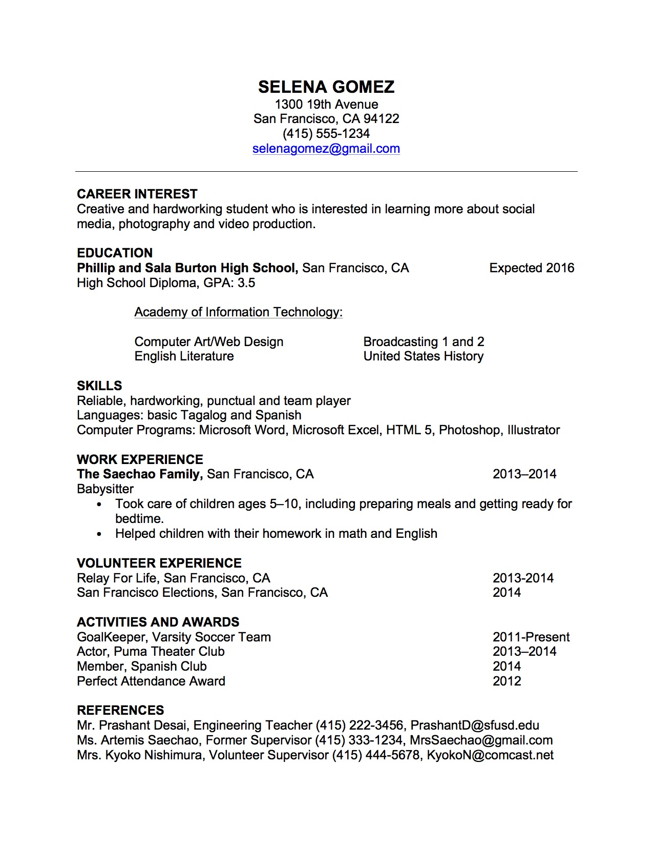
Components of a Resume
Notes:
NOTE:
Teachers have a homework assignment complete the “Reference Worksheet” before the resume workshop. Homework: have students download resume template from school loop before class. Skills assessment.

Slide 4
What to Consider for Your “Career Interest”
What do you enjoy on your free time?
Which are your favorite classes?
What classes would you like to take?
What do you want to gain from a summer internship?

Slide 5
Sample Career Interest
SKILLS
Creative and hardworking student who is interested in learning more about social media and video production.
SKILLS OR INTERESTS

Slide 6
Professional References
Ask people who know you well (i.e. teachers, counselors, mentors, work supervisors)
If you need a letter of recommendation, give a two week notice
Send an email to your interviewer
Provide her/him with the application and copy of your personal statement or resume

Slide 7
Resume Appearance
Arial or Times New Roman font
11-12 point font only
Resumes should be 1 page
Bold, Underline or Italicize will highlight certain parts of your resume
Keep margins to 1” on all sides

Slide 8

Make Your Resume Now
Download the “CTE Sample Resume” from School Loop
Save on your google drive
Name file “firstname lastname resume”
Vicente Fernandez Resume.doc

Slide 9
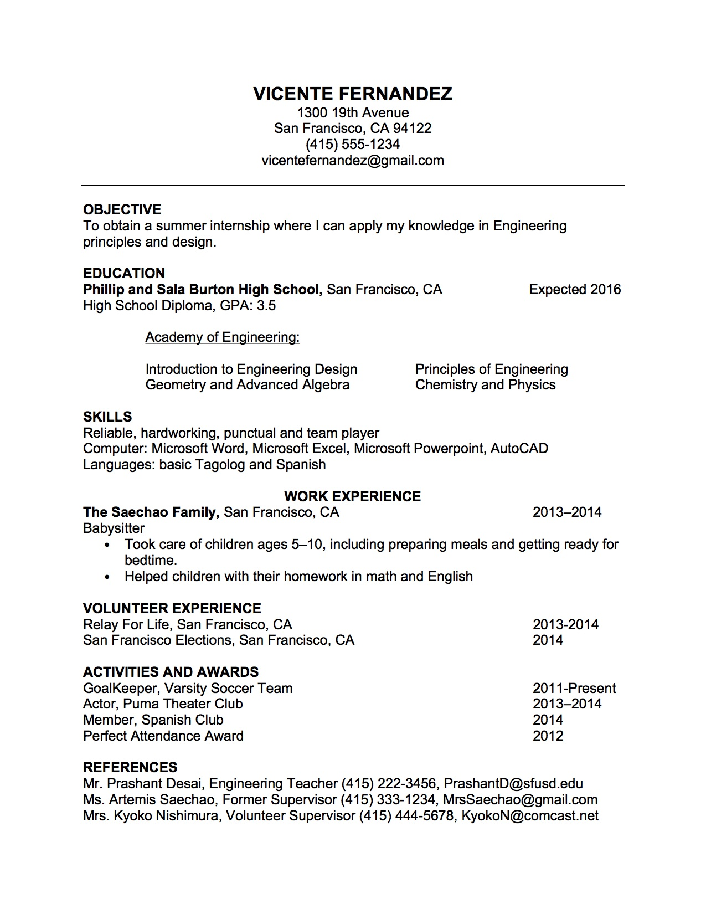
Make Your Professional Resume

