Slide 1
What to know senior year
Lauren Marshman,
Your Counselor

Slide 2
Agenda
UC updates
Personal Statement advice
Asking for Letter of Rec
CSU updates
EOP
Importance of Email
AB540 and Deferred Action
WUE
Upcoming Events/Field Trips

Slide 3
Uc updates
Essay recommendations
What they see
Purpose of essay
Interview
Conversational
Compare you to others at Gal
Common mistakes:
Talking about others
Not going in depth
Using a thesaurus too much
Sob Story

Slide 4
Personal statement Tidbits
Purpose
Your ‘interview’
What were you given, and how did you work with it?
Not necessarily sob story time
Gives context to the reader
Talk more deeply about an activity and what you got out of it
“hear your voice” not a thesaurus’ voice
Should resemble a conversation
Make sure you’re not talking more about others (ie parents, teacher)

Slide 5
Letter of Rec
Go to my webpage (galileoweb.org/marshmanl)
Click “letters of rec” at the top
http://galileoweb.org/marshmanl/letters-of-rec/

Slide 6
Csu updates
What is “impacted”?
What is “local serving area”?
Impacted (all grades, all majors)- hardest to get into
Fullerton
San Jose
Long Beach
San Diego
San Luis Obispo

Slide 7
Csu updates
Non-impacted
Bakersfield
Channel Islands
Dominguez Hills
East Bay
Maritime Academy
Stanislaus
SFSU
SATs
November is safest

Slide 8
ELM/EPT
ELM/EPT
What is it?
Why is it important?
Exemption through EAP or SAT or ACT
ELM/EPT Exemption
 | Exempt from ELM/EPT | Conditionally Exempt
SAT Math | 550 | 490
SAT Reading | 500 | 460
ACT Math | 23 | 20
ACT English | 22 | 19

Slide 9
ELM/EPT
Exemption
Conditional Exemption
English: must be in an honors or AP English
Math: must be in Precalc, AP Calc or AP Stats to meet exemption
No Exemption
ELM/EPT: October and January

Slide 10
Importance of email
All correspondences through email
Most colleges are no longer doing ANY mailings
Check spam
Be Professional
hi how do I get that? thnx! – amanda
Dear Mr. X, Thank you for your email. I was wondering how I could receive more information about that topic? Thank you, Amanda Bienes, Student ID 4523365

Slide 11
AB540 and Deferred action
AB 540
What is it?
In-state tuition
Who qualifies?
3 yrs in CA HS
Graduate
Deferred Action
Let’s you stay 2 yrs at a time, and work
Social security number
Who qualifies? http://www.e4fc.org/dacafaqs.html
Good websites:
E4fc.org
Caldreamact.org
Maldef.org
Sfsu.edu (search AB540)
AB 131 Calif Dream Act
Eligible for CalGrant
CSU/UC grants
EOP
Males – selective service

Slide 12
WUE
Western Undergraduate Exchange Program
Lets you attend western universities and pay in-state-tuition (or close to it)
Examples:
ASU and U of Arizona
Colorado State and U of Colorado
Univ of Hawaii
Univ of Nevada, Reno

Slide 13


Slide 14


Slide 15
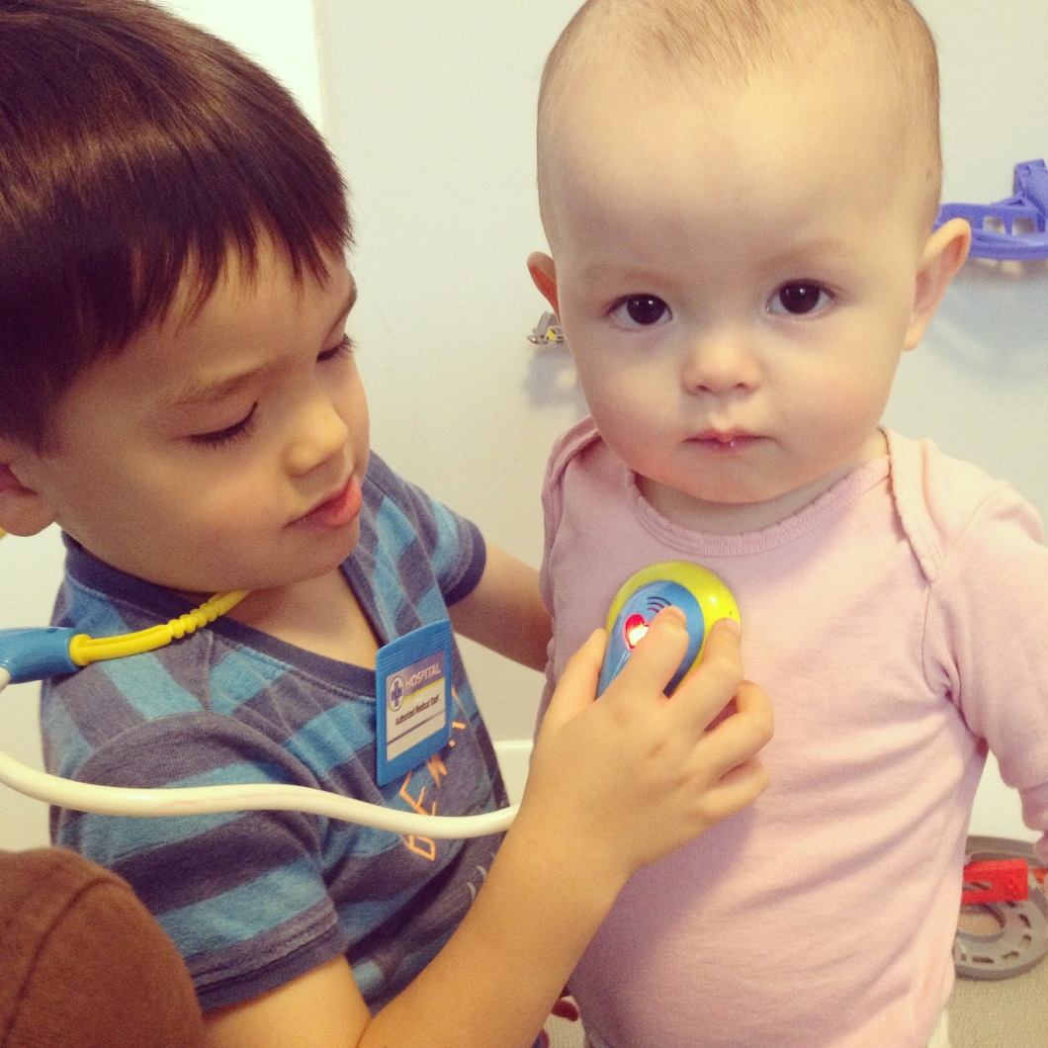
I left you for them

