Slide 1
Matter – Properties and Changes
Chemistry – the study of matter and energy
What is Matter??
What isn’t Matter??

Slide 2
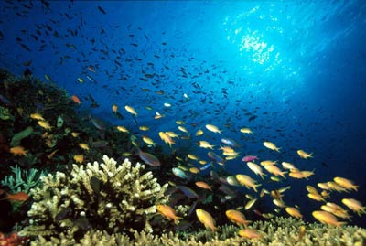

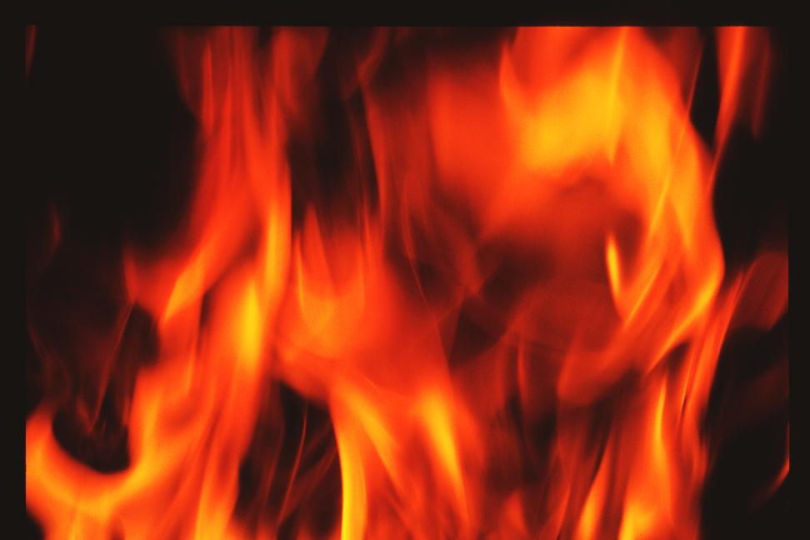
Matter? Name some matter
Matter?
Matter?

Slide 3

I. Properties of Matter
Physical Properties
Observed or measured w/out changing the composition of matter.

Slide 4
I. Properties of Matter
Physical Properties
Observed or measured w/out changing the composition of matter.
Examples:
State of Matter, Density, Solubility Texture, Color, Mass, odor, taste, hardness, melting & boiling point

Slide 5
State of Matter
also known as a phase. Elements and compounds can move from one phase to another phase when special physical forces are present. One example of those forces is temperature. When temperature changes, the phase can also change.
States of Matter Definitions –
Solid is the state in which matter maintains a fixed volume and shape; liquid is the state in which matter maintains a fixed volume but adapts to the shape of its container; and gas is the state in which matter expands to occupy whatever volume is available.

Slide 6
Plasma
Plasmas consist of freely moving charged particles, i.e., electrons and ions. Formed at high temperatures when electrons are stripped from neutral atoms.
Examples include:
Stars (the sun), Northern Lights, Ball Lightning

Slide 7
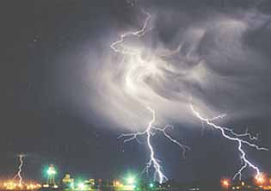

Slide 8
Physical Properties can be Intensive or Extensive
Extensive Properties depends on the quantity of matter present.
Intensive Properties
do not depend on the amount of substance.
Examples:
  Mass
  Volume
  Length
Examples:
  Density
  Color
  Texture
  Boiling Pt.

Slide 9
Chemical Properties
ability of a substance to combine with or change into one or more other substances
Examples:
Reactivity w/ acids
Combustibility
Reactivity w/ oxygen
Radioactivity

Slide 10
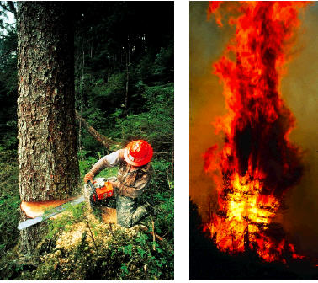
How is the tree changed by each action shown?
Which action do you think shows a more complete change?

Slide 11
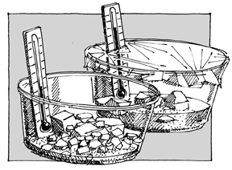
II. Matter Changes
Physical Change - Changes which alter a substance without changing its composition
Give some examples of physical changes:
  Change of shape
  Change of State
  Solute dissolving in a solvent

Slide 12

Chemical Changes change the chemical properties.
a process that involves one or more substances changing into new substances .
Give some examples of a chemical change:
  Combustion Fermentation
  Oxidation Corrosion
  Reaction w/ Acids

Slide 13
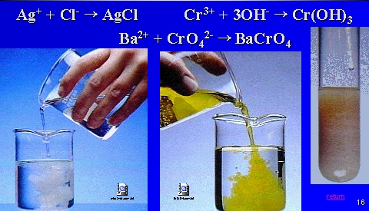
Evidence of chemical change:
Formation of a precipitate

Slide 14
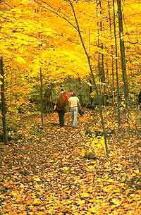
Evidence of chemical change:
Color Change

Slide 15
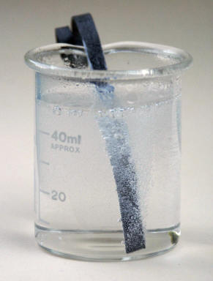
Evidence of chemical change:
Gas Evolution

Slide 16
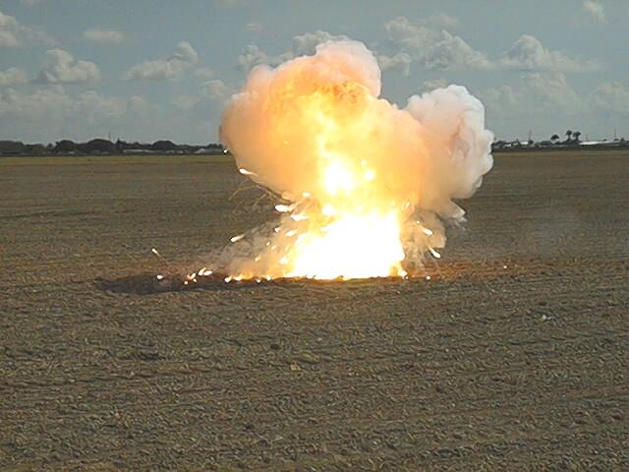
Evidence of chemical change:
Heat and Light

Slide 17

c. Law of Conservation of Mass

Slide 18
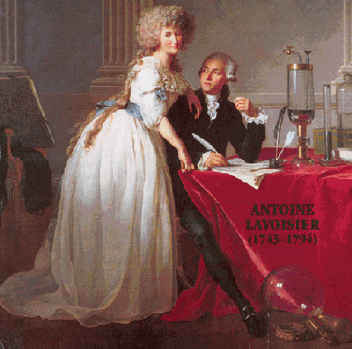
c. Law of Conservation of Mass
Mass is neither created or destroyed during a chemical reaction. Mass is conserved.

Slide 19
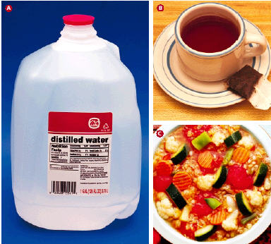
How is this liquid made?
What does it have in common with the other photos?

Slide 20
Mixtures of Matter (Classification of Matter)
Matter
a. Pure Substance
contains only one kind of atom or molecule
b. Mixture
combination of two or more pure substances in which each pure substance retains its individual chemical properties. Mixture are physically combined.

Slide 21
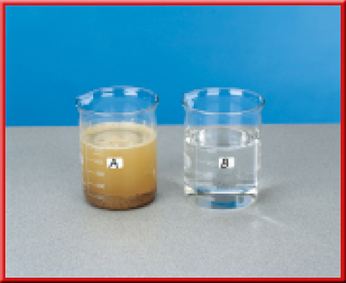
Mixtures of Matter (Classification of Matter)
Matter
b. Mixture
a. Pure Substance
Heterogeneous mixture
one that does not blend smoothly throughout and in which the individual substances remain distinct.

Slide 22
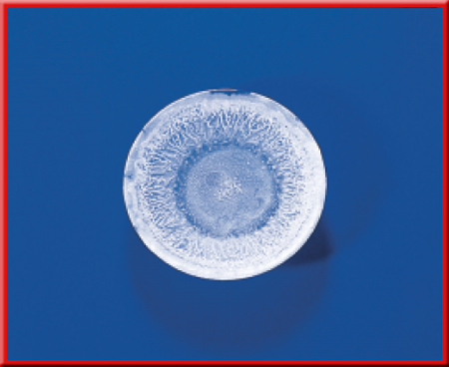
Matter
b. Mixture
Heterogeneous mixture
Homogeneous mixture:
constant composition throughout; it always has a single phase. Also referred to as Solution.
How could you tell this is a homogeneous mixture?
Boil it!

Slide 23


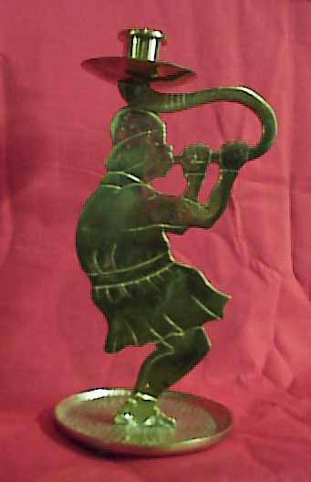
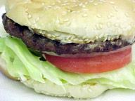
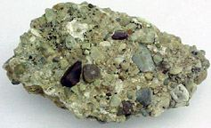
All of these things are mixtures. Which ones are homogeneous and which are heterogeneous?

Slide 24
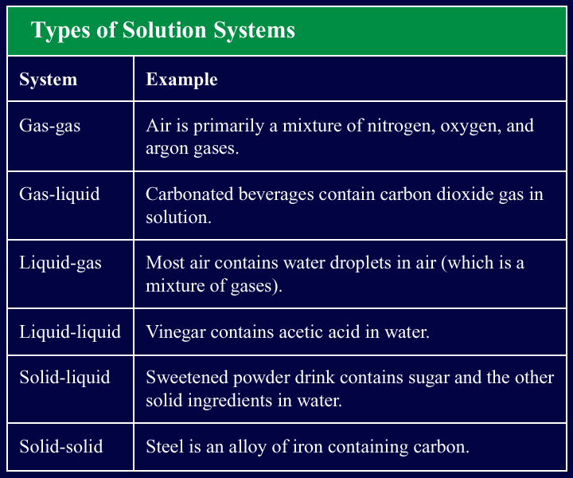
Can you think of different types of solutions?

Slide 25
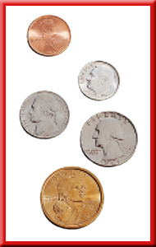
Give an example of a homogeneous solution of solid metal. What is this solution called?
An alloy

Slide 26
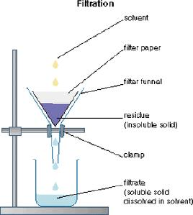
Separating Mixtures
Give some examples of how you would separate mixtures:
1. Filtration - a technique that uses a porous barrier to separate a solid from a liquid.

Slide 27
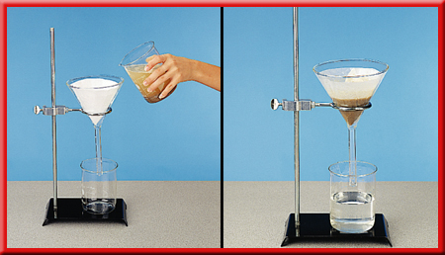
Separating Mixtures

Slide 28
2. Distillation - a technique that is based on differences in the boiling points of the substances involved. Mixtures are heated to their boiling points, then their vapor can be cooled and condensed, and collected.

Slide 29
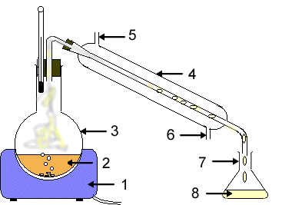

Slide 30
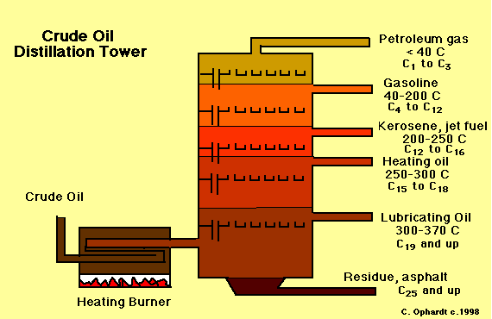

Slide 31
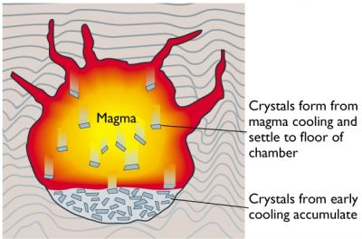
3. Crystallization - a technique that results in the formation of pure solid particles of a substance from a solution containing the dissolved substance.

Slide 32
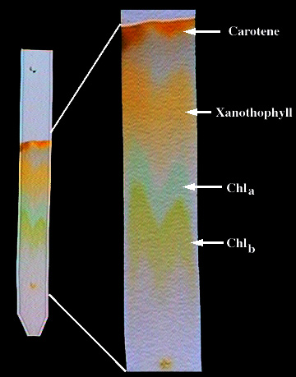
4. Chromatography - a technique that separates the components of a mixture on the basis of the tendency of each to travel or be drawn across the surface of another material.
Remember this lab?

Slide 33
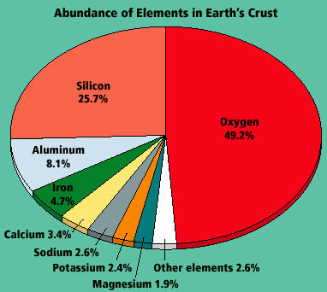
Which element is the most abundant in Earth’s crust?
What are some common items that are made up of some of these elements?

Slide 34
Mixtures of Matter (Classification of Matter)
Matter
b. Mixture
a. Pure Substance
Element
Compound

Slide 35
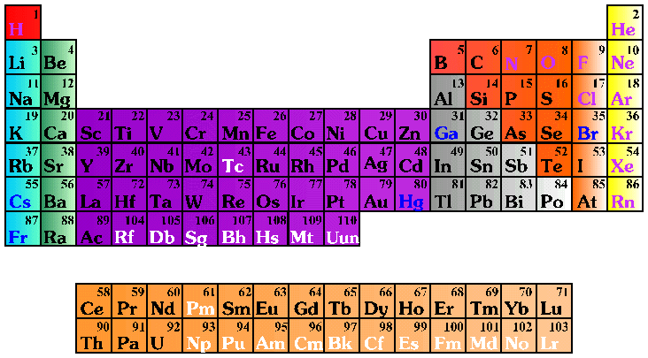

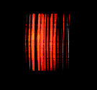
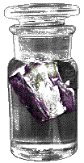
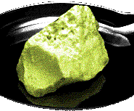
Elements and Compounds

Slide 36
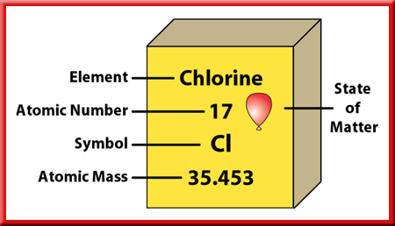
Elements and Compounds
Element – pure substance that cannot be separated into simplier substances by physical or chemical means.
91 naturally occuring
Hydrogen the most common
at room temp, 11 are gas, 3 are liquid, the rest solid

Slide 37
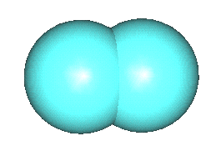
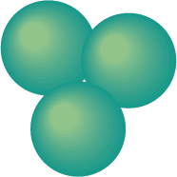
Elements
Special kind of element is called an Allotrope
Different molecular forms of an element in the same physical state
Example?
Ozone gas
Oxygen gas

Slide 38
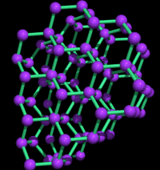
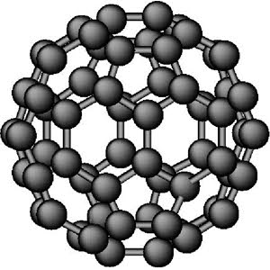
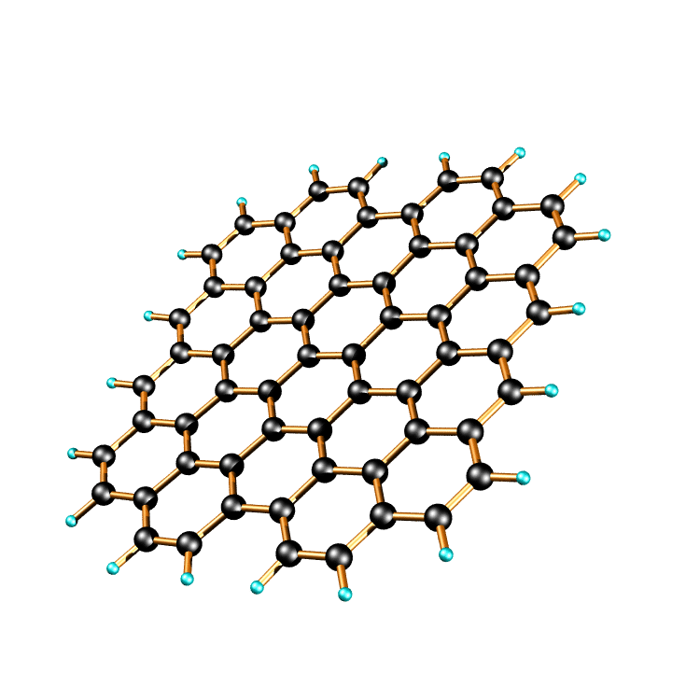
Carbon-60
Graphite
Diamond

Slide 39
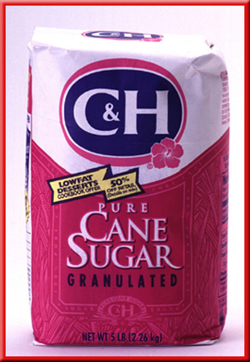

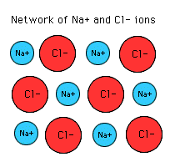


Compounds are a combination of two or more elements that are combined chemically.
carbon dioxide
water
methane
Sodium chloride
ammonia

Slide 40
How would you separate compounds?
carbon dioxide
water
Electricity
methane
ammonia
combustion
React with an acid
Sodium chloride

Slide 41
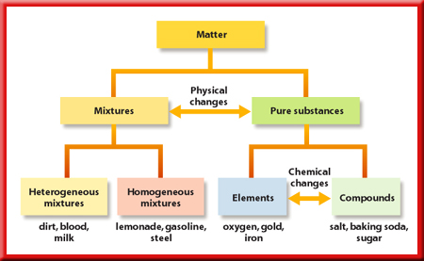

Slide 42
c.Law of Definite Proportions – regardless of the amount, a compound is always composed of the same elements in the same proportion by mass.
The mass of the compound is equal to the sum of the masses of the elements that make up the compound.

Slide 43

The ratio of the mass of each element to the total mass of the compound is a percentage called the percent by mass.

Slide 44
d. Law of Multiple of Proportions – when different compounds are formed by the combination of the same elements, different masses of one element combine with the same mass of the other element in a ratio of small whole numbers.

Slide 45
The two distinct compounds water (H₂O) and hydrogen peroxide (H₂O₂) illustrate the law of multiple proportions.
Each compound contains the same elements (hydrogen and oxygen).
Water is composed of two parts hydrogen (the element that is present in different amounts in both compounds).

Slide 46
Hydrogen peroxide is composed of two parts hydrogen and two parts oxygen.
Hydrogen peroxide differs from water in that it has twice as much oxygen.
When we compare the mass of oxygen in hydrogen peroxide to the mass of oxygen in water, we get the ration 2:1.

Slide 47
