Slide 1
I. Measuring Matter
Chemists need a convenient method for counting accurately the number of atoms, molecules, or formula units in a sample of a substance.
As you know, atoms and molecules are extremely small. There are so many of them in even the smallest sample that it’s impossible to actually count them.

Slide 2
I. Measuring Matter
That’s why chemists created their own counting unit called the mole.

Slide 3


A. Measuring Moles
The mole, commonly abbreviated mol, is the SI base unit used to measure the amount of a substance.
It is the number of representative particles, carbon atoms, in exactly 12 g of pure carbon-12.

Slide 4
A. Measuring Moles
Through years of experimentation, it has been established that a mole of anything contains 6.022 136 7 x 10²³ representative particles.
A representative particle is any kind of particle such as atoms, molecules, formula units, electrons, or ions.

Slide 5
A. Measuring Moles
The number 6.022 136 7 x 10²³ is called Avogadro’s number in honor of the Italian physicist and lawyer Amedeo Avogadro who, in 1811, determined the volume of one mole of a gas.
In your textbook, Avogadro’s number will be rounded to three significant figures— 6.02 x 10²³.

Slide 6
A. Measuring Moles
If you write out Avogadro’s number, it looks like this.
602 000 000 000 000 000 000 000

Slide 7
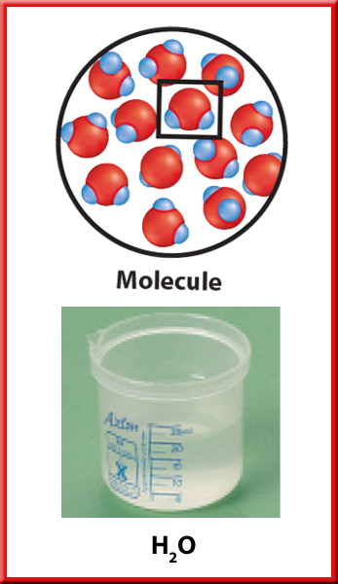
A. Measuring Moles
One-mole quantities of three substances are shown, each with a different representative particle.
The representative particle in a mole of water is the water molecule.

Slide 8
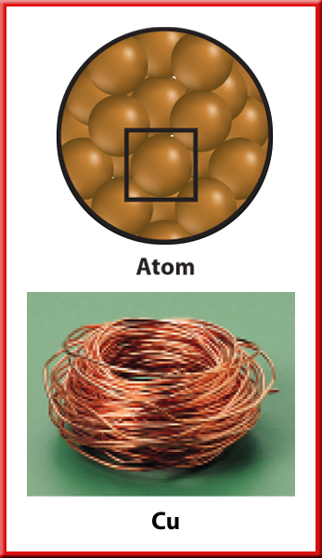
A. Measuring Moles
The representative particle in a mole of copper is the copper atom.

Slide 9
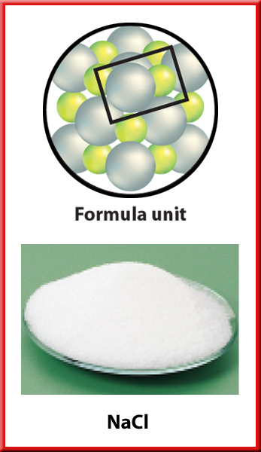
A. Measuring Moles
The representative particle in a mole of sodium chloride is the formula unit.

Slide 10

B . Converting Moles to Particles
Suppose you want to determine how many particles of sucrose are in 3.50 moles of sucrose. You know that one mole contains 6.02 x 10²³ representative particles.
Therefore, you can write a conversion factor, Avogadro’s number, that relates representative particles to moles of a substance.

Slide 11
B. Converting Moles to Particles
You can find the number of representative particles in a number of moles just as you found the number of roses in 3.5 dozen.
For sucrose, the representative particle is a molecule, so the number of molecules of sucrose is obtained by multiplying 3.50 moles of sucrose by the conversion factor, Avogadro’s number.

Slide 12
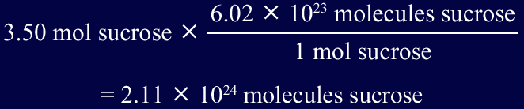
B. Converting Moles to Particles
There are 2.11 x 10²⁴ molecules of sucrose in 3.50 moles.

Slide 13

B. Converting Particles to Moles
Now, suppose you want to find out how many moles are represented by a certain number of representative particles.
You can use the inverse of Avogadro’s number as a conversion factor.

Slide 14
B. Converting Particles to Moles
Example:
Zinc is used as a corrosion-resistant coating on iron and steel. It is also an essential trace element in your diet.
Calculate the number of moles that contain 4.50 x 10²⁴ atoms of zinc (Zn).

Slide 15
B. Converting Particles to Moles
Multiply the number of zinc atoms by the conversion factor that is the inverse of Avogadro’s number.
1 mole Zn
4.50x10²⁴ atoms Zn
X
=
6.02x10²³ atoms Zn
=
7.48 mol Zn

Slide 16
II. Mass and the Mole
The relative scale of atomic masses uses the isotope carbon-12 as the standard.
Each atom of carbon-12 has a mass of 12 atomic mass units (amu).
The atomic masses of all other elements are established relative to carbon-12.

Slide 17
II. Mass and the Mole
For example, an atom of hydrogen-1 has a mass of 1 amu.
The mass of an atom of helium-4 is 4 amu.
Therefore, the mass of one atom of hydrogen-1 is one-twelfth the mass of one atom of carbon-12.
The mass of one atom of helium-4 is one-third the mass of one atom of carbon-12.

Slide 18
II. Mass and the Mole
You can find atomic masses on the periodic table, but notice that the values shown are not exact integers.
For example, you’ll find 12.011 amu for carbon, 1.008 amu for hydrogen, and 4.003 amu for helium.
These differences occur because the recorded values are weighted averages of the masses of all the naturally occurring isotopes of each element.

Slide 19
II. Mass and the Mole
You know that the mole is defined as the number of representative particles, or carbon-12 atoms, in exactly 12 g of pure carbon-12.
Thus, the mass of one mole of carbon-12 atoms is 12 g. What about other elements?
Whether you are considering a single atom or Avogadro’s number of atoms (a mole), the masses of all atoms are established relative to the mass of carbon-12.

Slide 20
II. Mass and the Mole
The mass in grams of one mole of any pure substance is called its molar mass.
The molar mass of any element is numerically equal to its atomic mass and has the units g/mol.

Slide 21

A. Converting Mass to Moles
A roll of copper wire has a mass of 848 g.
How many moles of copper are in the roll?
Use the atomic mass of copper given on the periodic table to apply a conversion factor to the mass given in the problem.

Slide 22
A. Converting Mass to Moles
1 mole Cu
848 g Cu
X
=
13.4 mol Cu
63.5 g Cu

Slide 23
B. Converting Moles to Mass
Calculate the mass of 0.625 moles of calcium.
Use the molar mass of calcium to apply a conversion factor to the number of moles given in the problem.

Slide 24
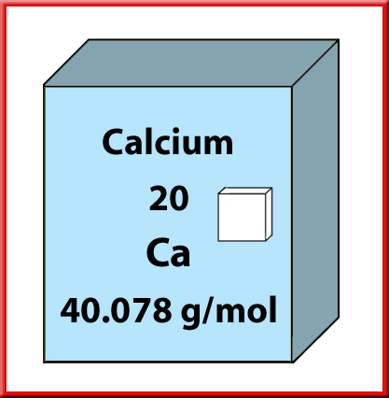

B. Converting Moles to Mass
According to the periodic table, the atomic mass of calcium is 40.078 amu, so the molar mass of calcium is 40.1g/mole.

Slide 25
B. Converting Moles to Mass
0.625 mol Ca
X
40.1 g Ca
25.1 g Ca
=
1 mol Ca

Slide 26
C. Converting Mass to Number of Particles
Calculate the number of atoms in 4.77 g lead.
To find the number of atoms in the sample, you must first determine how many moles are in 4.77 g lead.

Slide 27
Question 1
Calculate the number of molecules in 15.7 mol carbon dioxide.
Answer
9.45 x 10²⁴ molecular CO₂

Slide 28
Question 2
Calculate the number of moles in 9.22 x 10²³ atom iron.
Answer
1.53 mol Fe

Slide 29
Question 3
Calculate the mass of 6.89 mol antimony.
Answer
839g Sb

Slide 30
Question 4
A chemist needs 0.0700 mol selenium for a reaction. What mass of selenium should the chemist use?
Answer
5.53g Se

Slide 31
Question 5
Calculate the number of moles in 17.2 g of benzene (C₆H₆).
Answer
0.220 mol C₆H₆

Slide 32
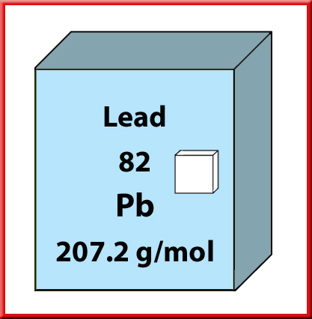
C. Converting Mass to Number of Particles
According to data from the periodic table, the molar mass of lead is 207.2 g/mol. Apply a conversion factor to convert mass to moles.
4.77 g Pb
1 mole Pb
X
207.2 g Pb

Slide 33
C. Converting Mass to Number of Particles
Now use a second conversion factor to convert moles to number of particles.
4.77 g Pb
1 mole Pb
6.02x10²³ atoms Pb
X
X
207.2 g Pb
1 mol Pb
=
1.39x10²² atom Pb

Slide 34
Converting Mass to Number of Particles
You can also convert from number of particles to mass by reversing the procedure above and dividing the number of particles by Avogadro’s number to determine the number of moles present.

Slide 35
III. Empirical and Molecular Formulas
Recall that every chemical compound has a definite composition—a composition that is always the same wherever that compound is found.
The composition of a compound is usually stated as the percent by mass of each element in the compound.

Slide 36
A. Percent composition
The percent of an element in a compound can be found in the following way.

Slide 37
Calculating Percent Composition
Example: Two iron oxide samples were analyzed. The first one had a mass of 36 g and was found to contain 28 g of Fe and 8 g of O. The other one had a mass of 160 g and was found to contain 112 g of Fe and 48 g of O. Are the samples the same compound?

Slide 38
Calculating Percent Composition
28 g Fe x 100 = 36 g Total
78% Fe
8 g O x 100 = 36 g Total
22% O

Slide 39
Calculating Percent Composition
112 g Fe x 100 = 160 g Total
70% Fe
48 g O x 100 = 160 g Total
30% O

Slide 40
Calculating Percent Composition
Are the two compounds the same?
No, they are not!

Slide 41
Calculating Percent Composition
As a check, be sure that the percentages add up to 100%. In this case, the percentages add up to 100.000%.

Slide 42
Calculating Percent Composition
Example: What is the percent composition of Na₂CO₃?
2(23) Na x 100
106 total
= 43% Na
12 x 100
106 total
= 11% C
3(16)
106 total
= 45% O

Slide 43
B. Determining Empirical formulas
You can use percent composition data to help identify an unknown compound by determining its empirical formula.
The empirical formula is the simplest whole-number ratio of atoms of elements in the compound. In many cases, the empirical formula is the actual formula for the compound.

Slide 44
B. Empirical formulas
For example, the simplest ratio of atoms of sodium to atoms of chlorine in sodium chloride is 1 atom Na : 1 atom Cl.
So, the empirical formula of sodium chloride is Na₁Cl₁, or NaCl, which is the true formula for the compound.

Slide 45
B. Empirical Formula from Percent Composition
The percent composition of an unknown compound is found to be 38.43% Mn, 16.80% C, and 44.77% O. Determine the compound’s empirical formula.
Because percent means “parts per hundred parts,” assume that you have 100 g of the compound.

Slide 46
B. Empirical Formula from Percent Composition
Follow these rules for Empirical Formulas:
Find or start with g of each element
Find moles of each element using Periodic Table
Divide by smallest moles to get whole #’s
Multiply if necessary to get whole #

Slide 47
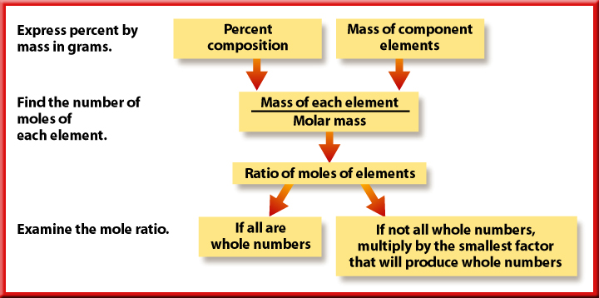

Slide 48
Find or start with g of each element –
that means 38.43%Mn = 38.43 g, 16.80%C = 16.80 g, and 44.77% O = 44.77g
B. Then calculate the number of moles of each element in the 100 g of compound.
=

Slide 49
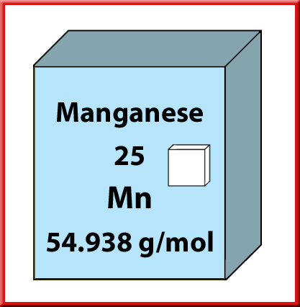
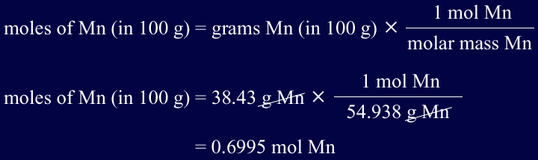
The number of moles of manganese may be calculated as follows.
=
Now find the number of moles of oxygen and carbon.

Slide 50
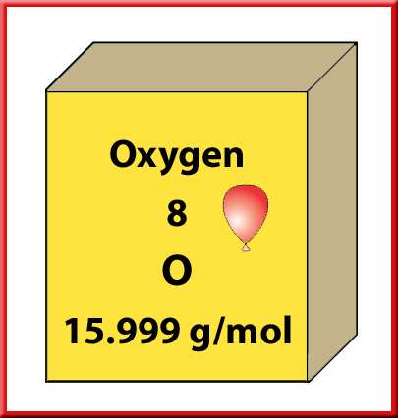
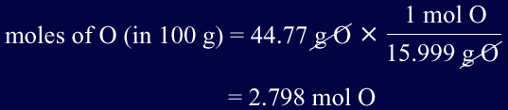
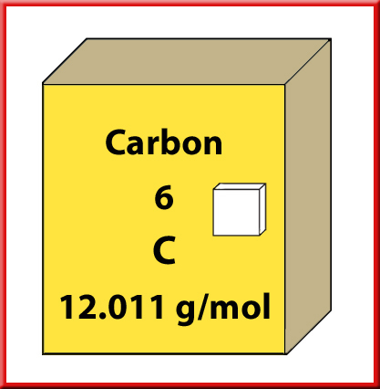
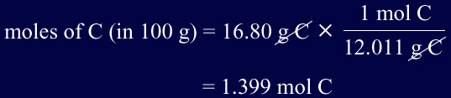
=

Slide 51
The results show the following relationship.
Rule C. To obtain the simplest whole-number ratio of moles, divide each number of moles by the smallest number of moles.

Slide 52



Rule C. To obtain the simplest whole-number ratio of moles, divide each number of moles by the smallest number of moles.

Slide 53
The empirical formula for the compound is
MnC₂O₄
Rule D. If you don’t have whole number you may have to double or triple your formula to get whole numbers.
Try one on your own – follow the rules
Hint ignore the 9.2 g for now….

Slide 54
C. Determining Molecular Formulas
For many compounds, the empirical formula is not the true formula.
Chemists have learned, though, that acetic acid is a molecule with the formula C₂H₄O₂, which is the molecular formula for acetic acid.
A molecular formula tells the exact number of atoms of each element in a molecule or formula unit of a compound.

Slide 55
Notice that the molecular formula for acetic acid (C₂H₄O₂) has exactly twice as many atoms of each element as the empirical formula (CH₂O).
The molecular formula for a compound is always a whole-number multiple of the empirical formula.
Divide molar mass of the compound by the molar mass of the empirical formula which should be a whole number.

Slide 56
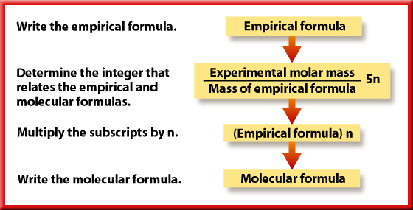

Slide 57
Rules for Molecular Formula
In order to determine the molecular formula for an unknown compound, you must know the molar mass of the compound in addition to its empirical formula.
Then you can compare the molar mass of the compound with the molar mass represented by the empirical formula as shown in the following example problem.

Slide 58
Then multiply by the empirical formula
Example
Maleic acid is a compound that is widely used in the plastics and textiles industries.
The composition of maleic acid is 41.39% carbon, 3.47% hydrogen, and 55.14% oxygen.

Slide 59
The composition of maleic acid is 41.39% carbon, 3.47% hydrogen, and 55.14% oxygen.
Its molar mass is 116.1 g/mol.
Calculate the molecular formula for maleic acid.
Find the empirical formula first!

Slide 60



Start by determining the empirical formula for the compound.

Slide 61
The numbers of moles of C, H, and O are nearly equal, so it is not necessary to divide through by the smallest value.
You can see by inspection that the smallest whole-number ratio is
1C : 1H : 1O, and the empirical formula is CHO.

Slide 62

Next, calculate the molar mass represented by the formula CHO.
Here, the molar mass is the sum of the masses of one mole of each element.

Slide 63

As stated in the problem, the molar mass of maleic acid is known to be 116.1 g/mol.
To determine the molecular formula for maleic acid, calculate the whole number multiple, n, to apply to its empirical formula.

Slide 64
This calculation shows that the molar mass of maleic acid is four times the molar mass of its empirical formula CHO.
Therefore, the molecular formula must have four times as many atoms of each element as the empirical formula.
Thus, the molecular formula is (CHO)4 = C₄H₄O₄
A check of the molecular formula for maleic acid in a reference book will confirm this result.

Slide 65
Question 1
Calculate the percent composition of aluminum oxide (Al₂O₃).
Answer
52.93% Al; 47.07% O

Slide 66
Question 2
Determine the percent composition of magnesium nitrate, which has the formula Mg(NO₃)₂.
Answer
16.39% Mg; 18.89% N; 64.72% O

Slide 67
Question 3
The composition of acetic acid is 40.00% carbon, 6.71% hydrogen, and 53.29% oxygen. Calculate the empirical formula for acetic acid.
Answer
CH₂O

Slide 68
Question 4
The composition of silver oxalate is 71.02% silver, 7.91% carbon, and 21.07% oxygen. If the molar mass of silver oxalate is 303.8 g/mol, what is its molecular formula?
Answer
Ag₂C₂O₄

Slide 69
Chemistry Tutors
Ms. Doherty –
Redwood High
945-3600 x6210
Katy McGarry – Previously taught at Drake High School
chem, physio, physics
717-9088

Slide 70
Chemistry Tutors
Nina Tychinin
Retired from Drake High School
883-7059
Mr. Lovelady –
Redwood High Dept. Chair
945-3600 x6228

