Slide 1
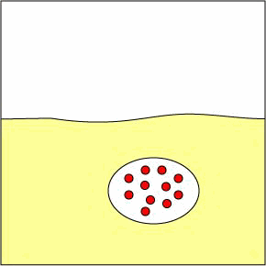
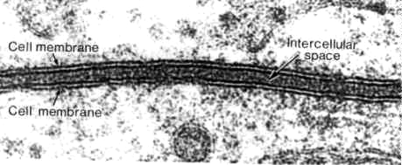
Cellular Transport Notes
Ch. 7.3

Slide 2
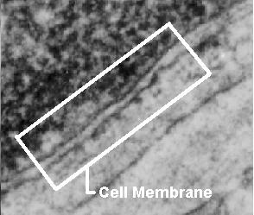
About Cell Membranes
All cells have a cell membrane
Functions:
  Controls what enters and exits the cell to maintain an internal balance called homeostasis
  Provides protection and support for the cell
TEM picture of a real cell membrane.

Slide 3
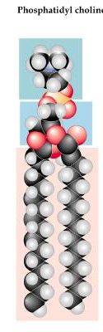
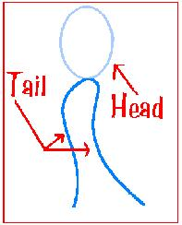
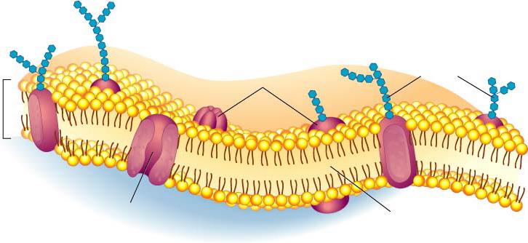
About Cell Membranes (continued)
Structure of cell membrane
Lipid Bilayer -2 layers of phospholipids
  Phosphate head is polar (water loving)
  Fatty acid tails non-polar (water fearing)
  Proteins embedded in membrane
Phospholipid
Lipid Bilayer

Slide 4
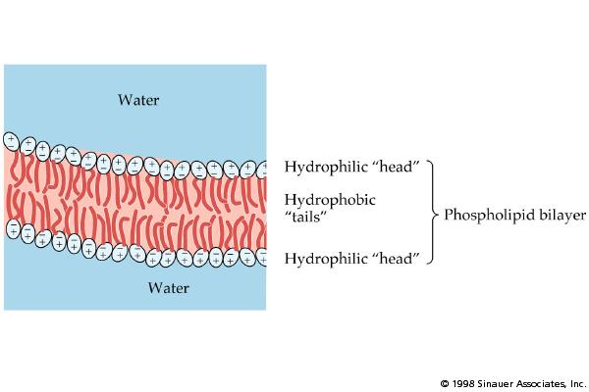
Polar heads love water & dissolve.
Fluid Mosaic Model of the cell membrane
Non-polar tails hide from water.
Membrane movement animation
Carbohydrate cell markers
Proteins

Slide 5
About Cell Membranes (continued)
4. Cell membranes have pores (holes) in it
  Selectively permeable: Allows some molecules in and keeps other molecules out
  The structure helps it be selective!
Pores

Slide 6
Structure of the Cell Membrane
Outside of cell
Carbohydrate
chains
Proteins
Lipid
Bilayer
Transport
Protein
Phospholipids
Inside of cell
(cytoplasm)
Animations
of membrane structure
Go to Section:

Slide 7
Types of Cellular Transport
Animations of Active Transport & Passive Transport
Weeee!!!
Passive Transport
cell doesn’t use energy
  Diffusion
  Facilitated Diffusion
  Osmosis
Active Transport
cell does use energy
  Protein Pumps
  Endocytosis
  Exocytosis
high
low
This is gonna be hard work!!
high
low

Slide 8
Passive Transport
cell uses no energy
molecules move randomly
Molecules spread out from an area of high concentration to an area of low concentration.
(High→Low)
Three types:

Slide 9
3 Types of Passive Transport
Diffusion
Facilitative Diffusion – diffusion with the help of transport proteins
Osmosis – diffusion of water

Slide 10
Passive Transport:
1. Diffusion
Simple Diffusion Animation
Diffusion: random movement of particles from an area of high concentration to an area of low concentration.
(High to Low)
Diffusion continues until all molecules are evenly spaced (equilibrium is reached)-Note: molecules will still move around but stay spread out.

Slide 11
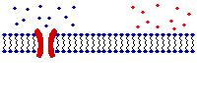
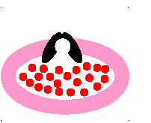
Passive Transport:
2. Facilitated Diffusion
A
B
2. Facilitated diffusion: diffusion of specific particles through transport proteins found in the membrane
  Transport Proteins are specific – they “select” only certain molecules to cross the membrane
  Transports larger or charged molecules
Facilitated diffusion (Channel Protein)
Diffusion (Lipid Bilayer)
Carrier Protein

Slide 12
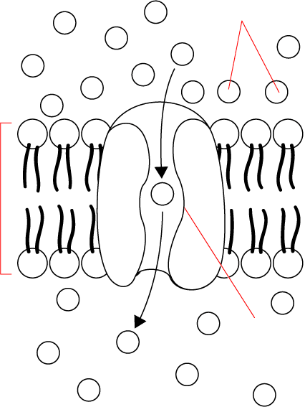
Passive Transport: 2. Facilitated Diffusion
Glucose
molecules
Cellular Transport From a-
High
High Concentration
Channel Proteins animations
Cell Membrane
Low Concentration
Protein
channel
Low
Transport Protein
Through a →
Go to Section:

Slide 13
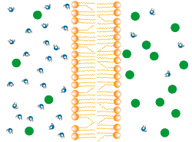
Passive Transport:
3. Osmosis
Osmosis animation
3.Osmosis: diffusion of water through a selectively permeable membrane
Water moves from high to low concentrations
Water moves freely through pores.
Solute (green) to large to move across.

Slide 14
Active Transport
cell uses energy
actively moves molecules to where they are needed
Movement from an area of low concentration to an area of high concentration
(Low → High)
Three Types:

Slide 15
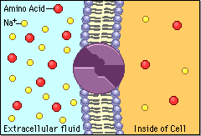
Types of Active Transport
Sodium Potassium Pumps (Active Transport using proteins)
1. Protein Pumps -transport proteins that require energy to do work
  Example: Sodium / Potassium Pumps are important in nerve responses.
Protein changes shape to move molecules: this requires energy!

Slide 16
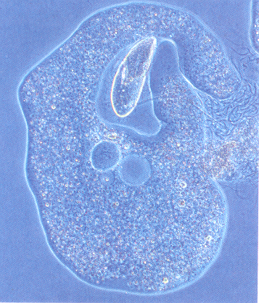
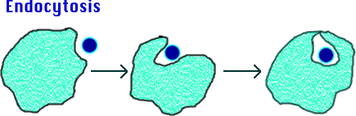
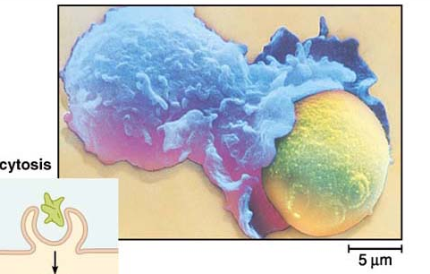
Types of Active Transport
2. Endocytosis: taking bulky material into a cell
  Uses energy
  Cell membrane in-folds around food particle
  “cell eating”
  forms food vacuole & digests food
  This is how white blood cells eat bacteria!

Slide 17
Types of Active Transport
3. Exocytosis: Forces material out of cell in bulk
  membrane surrounding the material fuses with cell membrane
  Cell changes shape – requires energy
  EX: Hormones or wastes released from cell
Endocytosis & Exocytosis animations

Slide 18
Effects of Osmosis on Life
Osmosis- diffusion of water through a selectively permeable membrane
Water is so small and there is so much of it the cell can’t control it’s movement through the cell membrane.

Slide 19
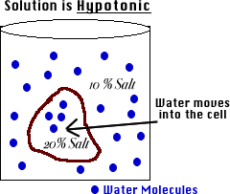
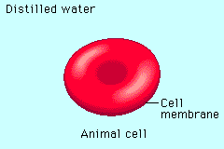
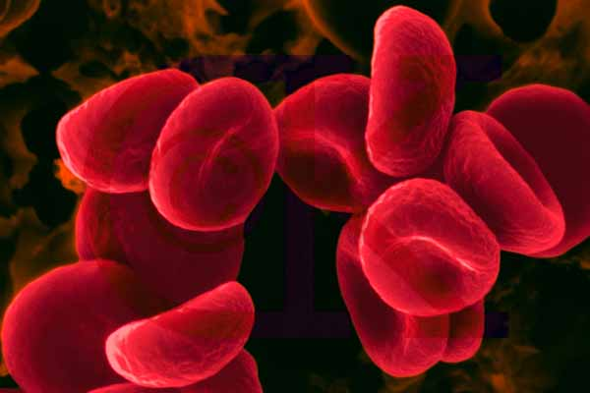
Hypotonic Solution
Osmosis Animations for isotonic, hypertonic, and hypotonic solutions
Hypotonic: The solution has a lower concentration of solutes and a higher concentration of water than inside the cell. (Low solute; High water)
Result: Water moves from the solution to inside the cell): Cell Swells and bursts open (cytolysis)!

Slide 20
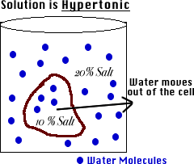
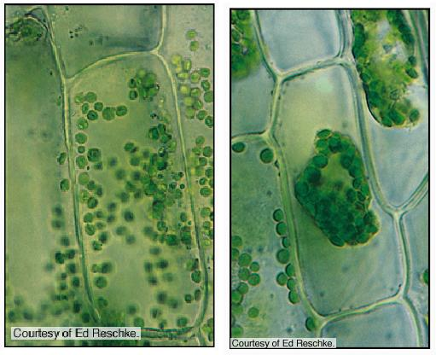
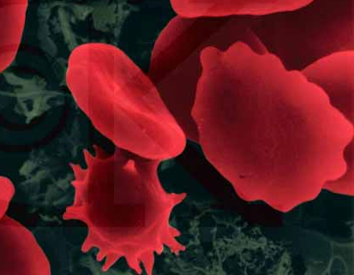
Hypertonic Solution
Osmosis Animations for isotonic, hypertonic, and hypotonic solutions
Hypertonic: The solution has a higher concentration of solutes and a lower concentration of water than inside the cell. (High solute; Low water)
shrinks
Result: Water moves from inside the cell into the solution: Cell shrinks (Plasmolysis)!

Slide 21
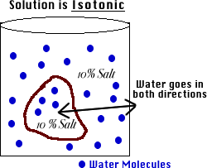
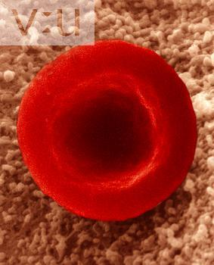
Isotonic Solution
Osmosis Animations for isotonic, hypertonic, and hypotonic solutions
Isotonic: The concentration of solutes in the solution is equal to the concentration of solutes inside the cell.
Result: Water moves equally in both directions and the cell remains same size! (Dynamic Equilibrium)

Slide 22
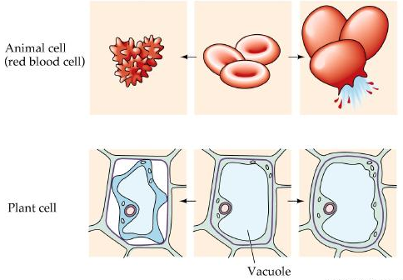
What type of solution are these cells in?
A
B
C
Hypertonic
Isotonic
Hypotonic

Slide 23
How Organisms Deal with Osmotic Pressure
Paramecium (protist) removing excess water video
Bacteria and plants have cell walls that prevent them from over-expanding. In plants the pressure exerted on the cell wall is called tugor pressure.
A protist like paramecium has contractile vacuoles that collect water flowing in and pump it out to prevent them from over-expanding.
Salt water fish pump salt out of their specialized gills so they do not dehydrate.
Animal cells are bathed in blood. Kidneys keep the blood isotonic by remove excess salt and water.

