Slide 1

The Organelles
-nucleus -cytoplasm
-nucleolus -cytoskeleton
-cell membrane -vacuole
-mitochondria -chloroplast
-golgi Apparatus -centrioles
-lysosomes -ribosomes
-endoplasmic reticulum(ER)
*Rough ER & Smooth ER

Slide 2
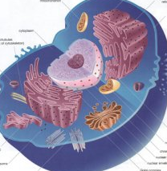
Nucleus
The “brain” of the cell
Controls all of the
cellular activities
DNA is inside the nucleus

Slide 3
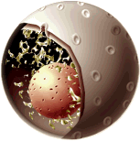
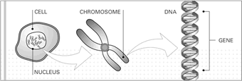
Nucleus
are found inside the nucleus
CHROMOSOMES-
carry the information that determines what traits a living thing will have
Chromosomes –
Notes:
http://www.bioethics.org.nz/publications/human-genes-discussion-jan04/html/page4.html

Slide 4
CELL MEMBRANE
holds the cell together
keeps all of the pieces (like the organelles and the cytoplasm) inside the cell
controls what goes in and out of the cell
Example: like a big plastic bag with tiny holes in it

Slide 5
Mitochondria
Mito = Mighty / Power
The Power-House of the cell
They break down food molecules so the cell has the energy to live
If a cell needs a lot of energy…it will have more mitochondria
Notes:
vilenski.org/science/safari/ cellstructure/mito.html

Slide 6
Endoplasmic Reticulum
also known as the “ER”
it is an organelle inside the cell that is
made up of membranes that are in the CYTOPLASM of the cell
There are two different
Smooth ER
Rough ER

Slide 7
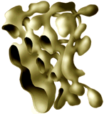
Smooth ER
Main function is to collect, maintain & transport things
Shaped slightly tubular
Creates steroids
Stores Ions for the cell to keep nutrients balanced

Slide 8

Rough ER
It has bumps all over it giving it a “rough” appearance
Bumps are called RIBOSOMES
ER collects the proteins (built by the ribosomes) and creates a bubble around them
VESICLE- is formed when the ER pinches off a part of its membrane

Slide 9
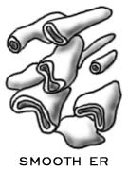
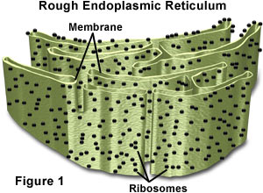
Smooth ER vs. Rough ER
Notes:
http://micro.magnet.fsu.edu/cells/animals/images/endoplasmic.jpg

Slide 10
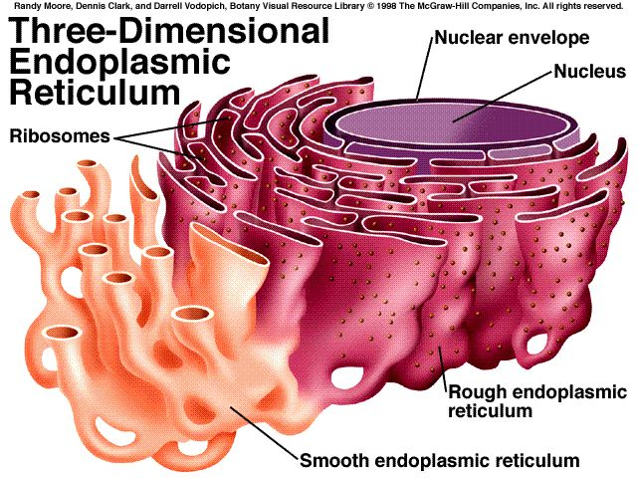
Notes:
http://www.science.siu.edu/plant-biology/PLB117/JPEGs%20CD/0073.JPG

Slide 11
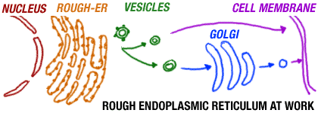

Secretion
Exocytosis
The release of intracellular molecules (hormones or proteins)
EXOCYTOSIS-

Slide 12
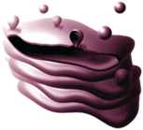
GOLGI APPARATUS
Also called the Golgi Complex
It is made up of a stack of flattened out sacs …like a loose stack of pancakes
WHAT DOES IT DO?
1) it takes simple molecules and combines them to make larger molecules.
2) takes those larger molecules and puts them into packs called GOLGI VESICLES

Slide 13
LYSOSOMES (primarily animal)
They combine with the food taken in by the cell
The enzymes in the lysosome bond to food & digest it (acidic interior)
Next…smaller molecules are released which are absorbed by the mitochondria

Slide 14
CYTOSKELETON
Chief functions include:
movement of material through the cell for stuff not diffusion or osmosis
maintaining the shape of the cell
keeping the cell from getting smashed

Slide 15
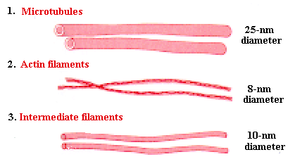
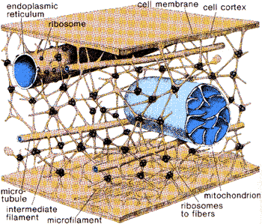
CYTOSKELETON
Notes:
http://images.google.com/imgres?imgurl=www.bi.umist.ac.uk/users/mjfjam/1CAT/cytoskeleton.gif&imgrefurl=http://www.bi.umist.ac.uk/users/mjfjam/1CAT/l007.htm&h=233&w=419&prev=/images%3Fq%3DCYTOSKELETON%26svnum%3D10%26hl%3Den%26lr%3D%26ie%3DUTF-8%26oe%3DUTF-8%26sa%3DG
http://images.google.com/imgres?imgurl=www.personal.psu.edu/users/a/m/amh244/cytoskeleton.GIF&imgrefurl=http://www.personal.psu.edu/users/a/m/amh244/cytoskeleton.
html&h=299&w=350&prev=/images%3Fq%3DCYTOSKELETON%26svnum%3D10%26hl%3Den%26lr%3D%26ie%3DUTF-8%26oe%3DUTF-8%26sa%3DG

Slide 16
VACUOLE
Vacuoles are “bubbles” that float in the cell
Vacuoles are more important to the survival of plant cells than they are to animal cells

Slide 17
VACUOLE: STORAGE IN PLANT CELLS
Vacuoles in plants support structure
Vacuoles hold onto things that the cell might need…like a backpack
There are some vacuoles that hold onto waste products, similar to having a big septic tank
Storing waste products protects the cell from contamination

Slide 18
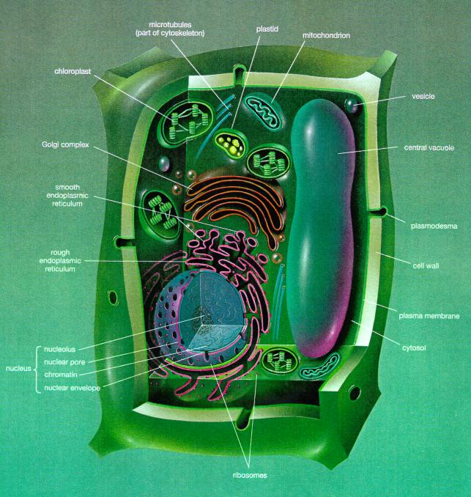
Chloroplast
Notes:
www.cbs.dtu.dk/staff/dave/ roanoke/oakcell.html

Slide 19
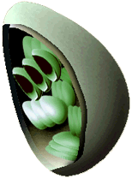
Chloroplast
the site of photosynthesis in eukaryotic cells
disk-like structures
composed of a single membrane
surrounding a fluid containing stacks of membranous disks

Slide 20
Ribosomes
small dot-like structures in cells
they are often associated with forming
rough ER
Ribosomes are the site of protein synthesis in cells
they are made in the nucleus of the cell
A ribosome can make the average protein in about one minute

