Slide 1
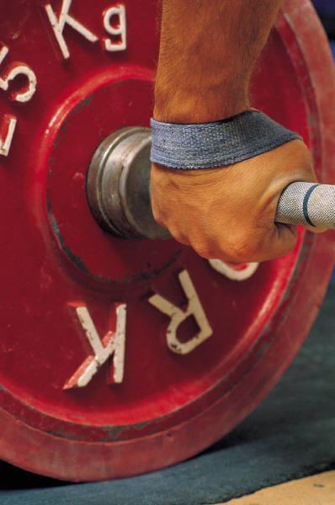
Base Units of the SI System
Quantity Base Unit Abbreviation
Time
Second
s
Length
Meter
m
Mass
Kilogram
kg
A kilogram is about 2.2 pounds.

Slide 2
Derived Units:
_______________________________ of base units
Combination
ü Volume cm³ (solids) or ml (liquids)
The derived unit for volume is the cubic meter, which is represented by a cube whose sides are all one meter in length.
For measurements that you are likely to make, the more useful derived unit for volume is the cubic centimeter (cm³).

Slide 3
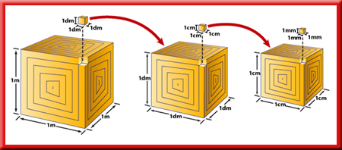
The cubic centimeter works well for solid objects with regular dimensions, but not as well for liquids or for solids with irregular shapes.
The metric unit for volume equal to one cubic decimeter is a liter (L).

Slide 4
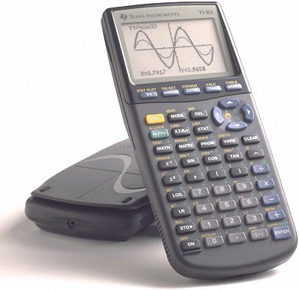

Derived Units:
ü Density g/cm³ (solids) or g/ml (liquids)
Density is a ratio that compares the mass of an object to its volume.
You can calculate density using this equation:

Slide 5
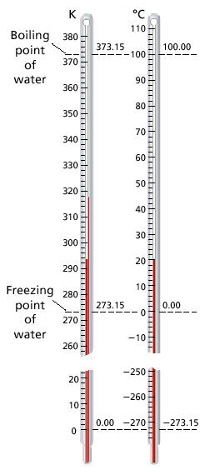
Temperature Scale
A kelvin (K) is the SI base unit of temperature.
Celsius Scale:
Water Freezes ________
Water Boils: __________
0ºC
100ºC
Kelvin Scale:
(add 273 to ºCelsius)
Water Freezes_______
Water Boils:________
273K
373K

Slide 6
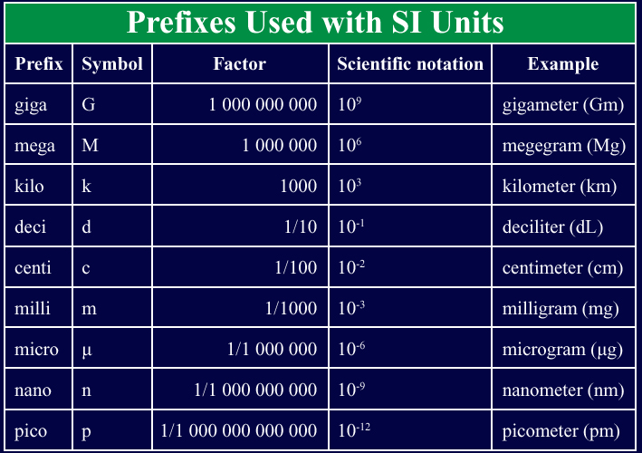

Slide 7
Scientific Notation
Handling numbers:
The diameter of the sun is 1,392,000 km
The density of the sun’s lower atmosphere is 0.000000028 g/cm³
in a gram of Hydrogen there are 602,214,000,000,000,000,000,000 atoms
distance between particles in a salt crystal is 0.000 000 002 814 cm
add 0.000 000 000 036 + 0.000 000 000 000 046 = ?
Would it be easy to make a mistake?

Slide 8
Easier to use scientific notation
Scientific notation expresses numbers as a multiple of two factors: a number between 1 and10; and ten raised to a power, or exponent.
M x 10^{n}
M = between 1 & 10
n = integer (1, 2, 3...)

Slide 9
The exponent tells you how many times the first factor must be multiplied by ten.
When numbers larger than 1 are expressed in scientific notation, the power of ten is positive.
When numbers smaller than 1 are expressed in scientific notation, the power of ten is negative.

Slide 10
Change the following data into scientific notation.
The diameter of the Sun is 1 392 000 km.
The density of the Sun’s lower atmosphere
is 0.000 000 028 g/cm³.

Slide 11
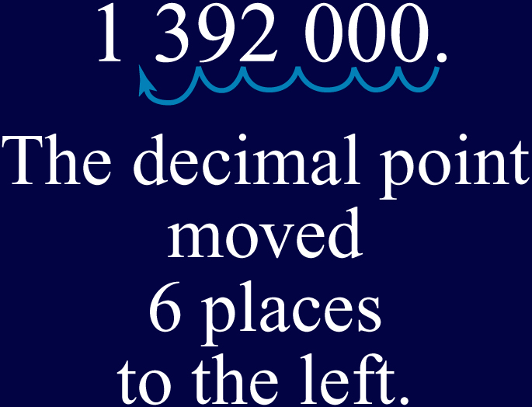
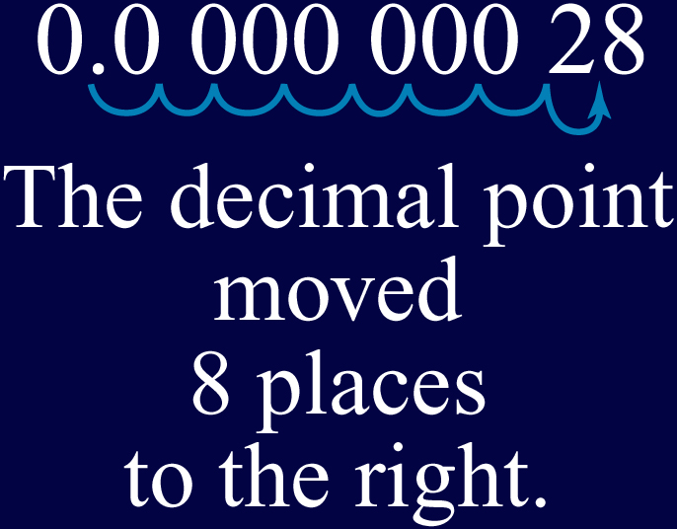
Move the decimal point to produce a factor between 1 and 10. Count the number of places the decimal point moved and the direction.

Slide 12
Try a few!
1. 6.3x10⁴ + 3.9x10³ =?
2. (8.0x10⁴) (5.0x10²) =?
3. 6.0x10⁷
9.0x10⁵
4. 3.0x10⁻⁸
5.0x10⁹

Slide 13
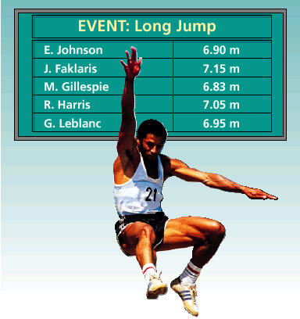
Who Won?
How far was the jump in feet?

Slide 14
Dimensional analysis is a method of problem-solving that focuses on the units used to describe matter.
For example, if you want to convert a temperature in degrees Celsius to a temperature in Kelvin, you focus on the relationship between the units in the two temperature scales.

Slide 15
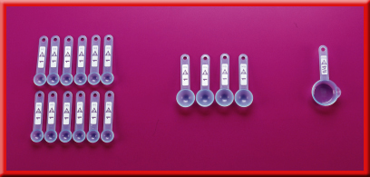
A conversion factor is a ratio of equivalent values used to express the same quantity in different units.

Slide 16
A conversion factor is always equal to 1.
Because a quantity does not change when it is multiplied or divided by 1, conversion factors change the units of a quantity without changing its value.

Slide 17
Dimensional Analysis (aka Factor label)
1. Rules
decide what info is given
Determine what info you want
Set up a plan, use conversion (bridge)
cancel units that are the same in the numerator and denominator
solve
check to make sure answer makes sense

Slide 18
Examples
a. How many meters in a one hundred yard dash? 1inch = 2.54 cm
3ft
1yd
12 in
1 ft
2.54 cm
1 in
1 m
100 cm
=
91.4m
100 yds
X
X
X
X
? m

Slide 19
X
X
100cm
1m
1 inch
2.54 cm
7.15 m
X
1 ft
12 in
Who Won?
J. Faklaris =
= 23.5 feet

Slide 20
b. How many kg in a 4 ounce McDonald's hamburger? 1kg = 1000g
16 ounces = 1 pound 1 pound = 454 grams

Slide 21
c. If Shaq is 7'2" tall how many millimeters tall is he? 1 inch = 2.54 cm

Slide 22
d. Convert 8 wags to warps. 1 wag = 12 zooms
1 wag = 12 zooms 1000 warps = 1bam 3 zoom = 1 bam

Slide 23
e. A computer switch switches 60 times in a microsecond, how many times does it switch in a minute? 1000000 microsecond = 1 sec

Slide 24
f. How many milliliters in a 12 fl oz can of soda? 1000ml = 1L 1L = 1.06 quarts 4 quarts = 1 gal
1gal = 128 fluid oz.

Slide 25
How Reliable are Measurements?
Accuracy & Precision
When scientists make measurements, they evaluate both the accuracy and the precision of the measurements.
Accuracy refers to how close a measured value is to an accepted value.
Precision refers to how close a series of measurements are to one another.

Slide 26
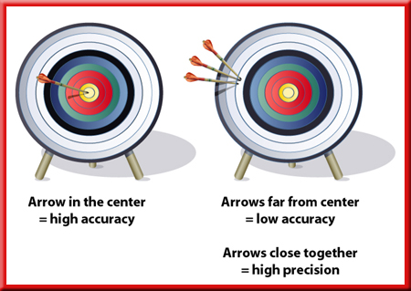
An archery target illustrates the difference between accuracy and precision.

Slide 27
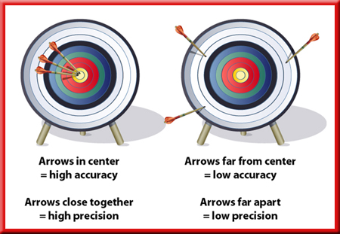
An archery target illustrates the difference between accuracy and precision.

Slide 28
How Reliable are Measurements? Percent Error
percent error:
percent error = |observed value - true value | x 100
true value

Slide 29
F. Significant Figures (sig figs)
margin of error?
Include all known values, plus one estimated value
Often, precision is limited by the available tools.
Scientists indicate the precision of measurements by the number of digits they report.
A value of 2.40 g is more precise than a value of 2.4 g.

Slide 30
Significant Figures (sig figs)
The digits that are reported are called significant figures.
Significant figures include all known digits plus one estimated digit.

Slide 31
Rules for significant figures
Non-zero measurements are always significant
(7.23 has three sig figs)
2. Zeros between non-zero numbers are always significant
(60.5 g = 3)

Slide 32
Rules for significant figures
3. zeros that act as place holders are not significant
ex:. 3 cm = 0.03 m _____ sig fig
4. All final zeros to the right of the decimal place and arise as a part of a measurement are significant
ex:0.0005030 _____ sig fig
1
Place holder
4

Slide 33
ex: 600? use scientific notation
6.00x10² = _____ sig fig
6.0x10² = ______ sig fig
6 x10² = ______ sig fig
1
3
2
1

Slide 34
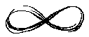
6. counting numbers and defined constants have an infinite number of sig figs
ex: 1000ml = 1L _____ sig fig
ex: H₂ = 2 atoms = all significant
infinite

Slide 35
7. At times the answer to a calculation contains more figures than are significant
ex: 3.6247 3 sig fig = 3.62
7.5647 4 sig fig = __________
6.2501 2 sig fig = __________
3.250 2 sig fig = __________
7.635 3 sig fig = __________
8.105 3 sig fig = __________
Rounding:
If less than 5, drop it and all figures to the right.
If it is more than 5, increase the number to be rounded by one
If it is 5 and followed by any digit, round up
If it is 5 and not followed by any digit, look at the figure to be rounded
Even #, drop 5 and figures that follow
Odd #, round up
7.565
6.3
3.3
7.64
8.10

Slide 36
7. The result of an addition or subtraction should be reported to the same number of decimal places as that of the term with the least number of decimal places.
ex: 1611.032
5.6
+ 32.4524
1649.0844?
=1649.1

Slide 37
8. The answer to a multiplication or division problem is rounded off to the same number of sig fig as is possessed by the least precise term used in the calculation.
ex: 152.06 x 0.24 =
36.4944?
= 36

