Slide 1
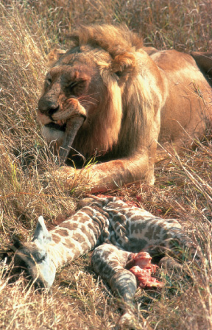
Energy and Metabolism

Slide 2
The Energy of Life
The living cell generates thousands of different reactions
Metabolism
  Is the totality of an organism’s chemical reactions
  Arises from interactions between molecules
An organism’s metabolism transforms matter and energy, subject to the laws of thermodynamics

Slide 3
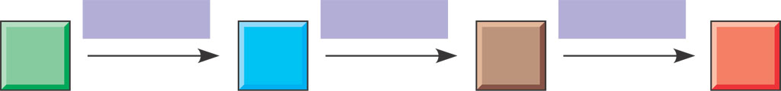
Metabolic Pathways
Biochemical pathways are the organizational units of metabolism
Metabolism is the total of all chemical reactions carried out by an organism
A metabolic pathway has many steps that begin with a specific molecule and end with a product, each catalyzed by a specific enzyme
Reactions that join small molecules together to form larger, more complex molecules are called anabolic.
Reactions that break large molecules down into smaller subunits are called catabolic.
Enzyme 1
Enzyme 2
Enzyme 3
A
B
C
D
Reaction 1
Reaction 2
Reaction 3
Starting
molecule
Product

Slide 4
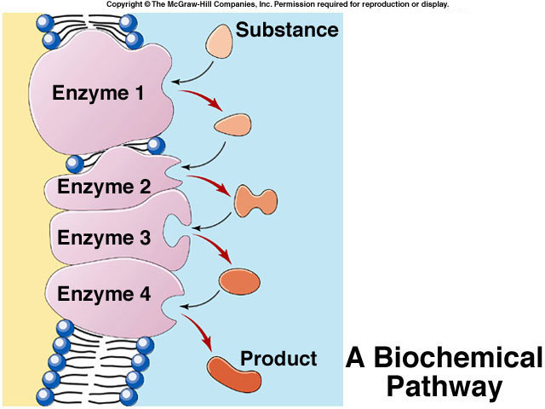
Metabolic Pathway
A sequence of chemical reactions, where the product of one reaction serves as a substrate for the next, is called a metabolic pathway or biochemical pathway
Most metabolic pathways take place in specific regions of the cell.

Slide 5

Forms of Energy
Kinetic energy is the energy associated with motion
Potential energy
  Is stored in the location of matter
  Includes chemical energy stored in molecular structure
Energy can be converted from one form to another
On the platform, a diver
has more potential energy.
Diving converts potential
energy to kinetic energy.
Climbing up converts kinetic
energy of muscle movement
to potential energy.
In the water, a diver has
less potential energy.

Slide 6
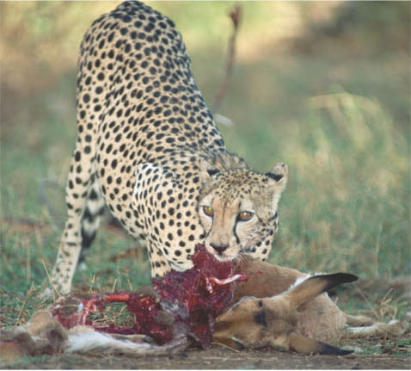
The First Law of Thermodynamics
According to the first law of thermodynamics
  Energy cannot be created or destroyed
  Energy can be transferred and transformed
Chemical
energy
For example, the chemical (potential) energy
in food will be converted to the kinetic
energy of the cheetah’s movement

Slide 7
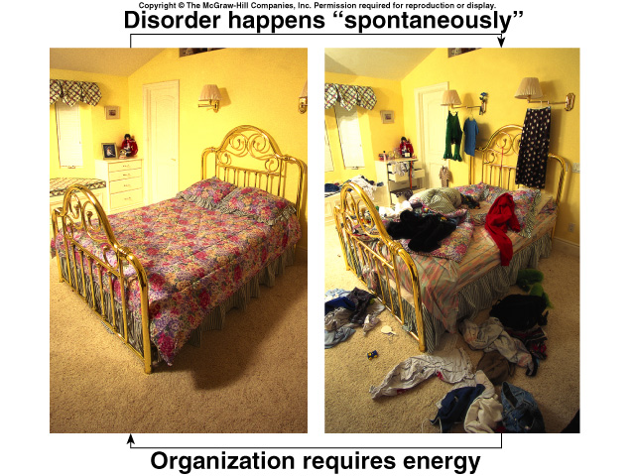
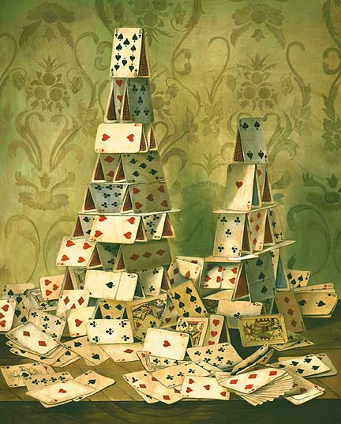
Second Law of Thermodynamics
The disorder (entropy) in the universe is continuously increasing.
  Energy transformations proceed spontaneously to convert matter from a more ordered, less stable form, to a less ordered, more stable form
  Spontaneous changes that do not require outside energy increase the entropy, or disorder, of the universe
  For a process to occur without energy input, it must increase the entropy of the universe

Slide 8
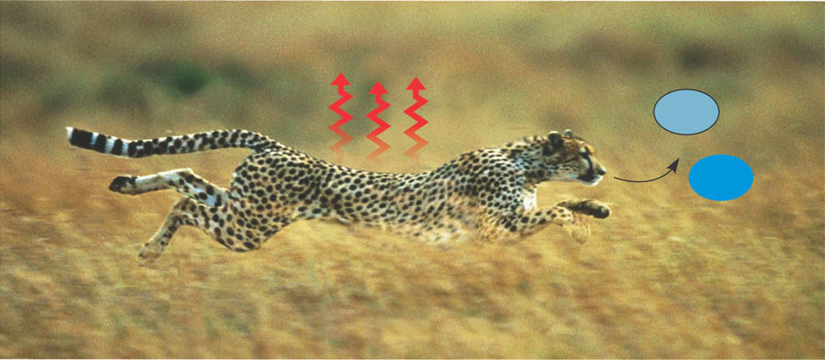
Second Law of Thermodynamics
  During each conversion, some of the energy dissipates into the environment as heat.
  During every energy transfer or transformation, some energy is unusable, often lost as heat
  Heat is defined as the measure of the random motion of molecules
  Living cells unavoidably convert organized forms of energy to heat
  According to the second law of thermodynamics, every energy transfer or transformation increases the entropy (disorder) of the universe
Heat
co₂
+
H₂O
For example, disorder is added to the cheetah’ssurroundings in the form of heat and the small molecules that are the by-products of metabolism.

Slide 9
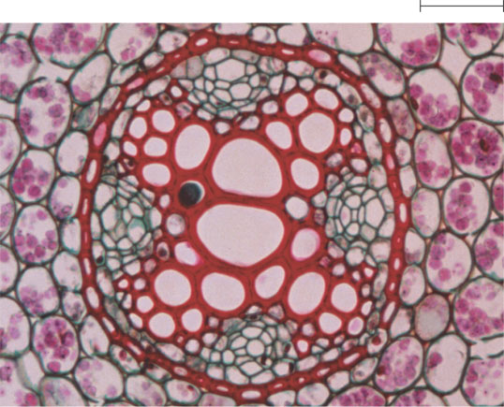
Biological Order and Disorder
Living systems
  Increase the entropy of the universe
  Use energy to maintain order
  A living system’s free energy is energy that can do work under cellular conditions
  Organisms live at the expense of free energy
50µm

Slide 10
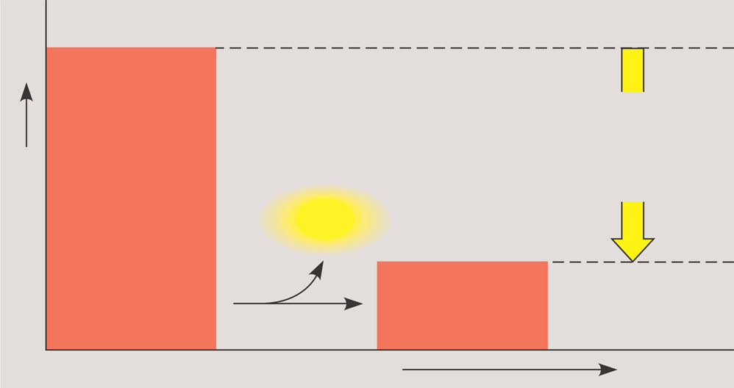
Exergonic reactions
Reactants have more free energy than the products
Involve a net release of energy and/or an increase in entropy
Occur spontaneously (without a net input of energy)
Reactants
Amount of
energy
released
(∆G <0)
Free energy
Energy
Products
Progress of the reaction
(a) Exergonic reaction: energy released

Slide 11
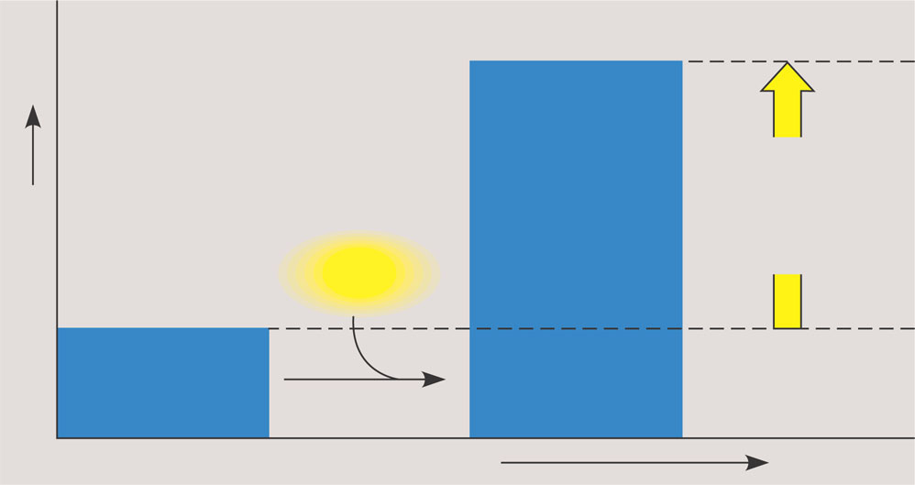
Endergonic Reactions
Reactants have less free energy than the products
Involve a net input of energy and/or a decrease in entropy
Do not occur spontaneously
Products
Amount of
energy
released
(∆G>0)
Free energy
Energy
Reactants
Progress of the reaction
(b) Endergonic reaction: energy required

Slide 12
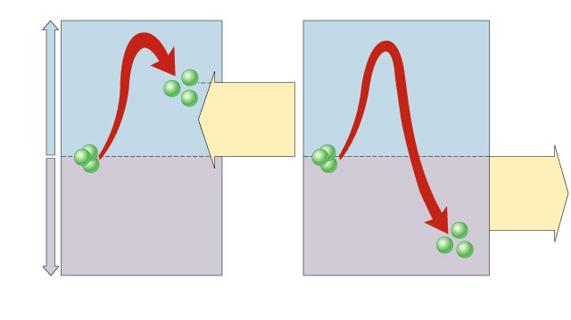
Product
Energy supplied
Energy
must be
supplied.
Reactant
Reactant
Energy is
released.
Energy released
Product
Endergonic
Exergonic
Copyright © The McGraw-Hill Companies, Inc. Permission required for reproduction or display.

Slide 13
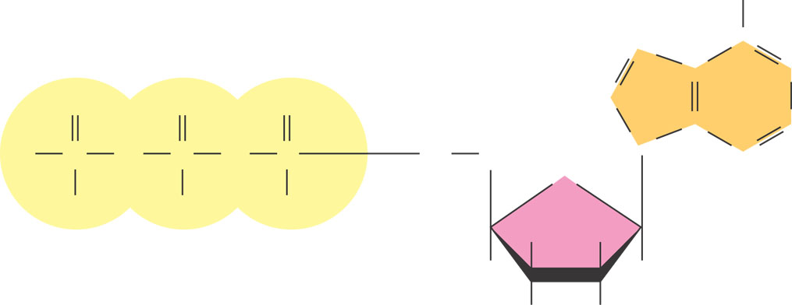
The Structure and Hydrolysis of ATP
ATP (adenosine triphosphate)
  Is the cell’s energy shuttle
  Provides energy for cellular functions
Adenine
NH₂
N
C
C
N
O
O
O
HC
-
C
N
CH
O
O
O
O
CH₂
N
-
-
-
O
O
O
O
H
H
Phosphate groups
H
H
Ribose
OH
OH

Slide 14
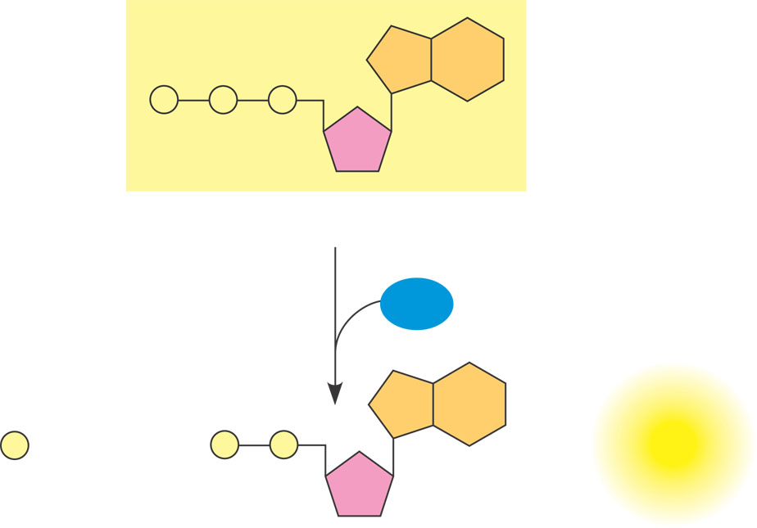
Hydrolysis of ATP
Energy is released from ATP when the terminal phosphate bond is broken
P
P
P
Adenosine triphosphate (ATP)
H₂O
P _{i}
+
P
P
Energy
Inorganic phosphate
Adenosine diphosphate (ADP)

Slide 15
Cellular Work
A cell does three main kinds of work
  Mechanical
  Transport
  Chemical
Energy coupling is a key feature in the way cells manage their energy resources to do this work
ATP powers cellular work by coupling exergonic reactions to endergonic reactions

Slide 16
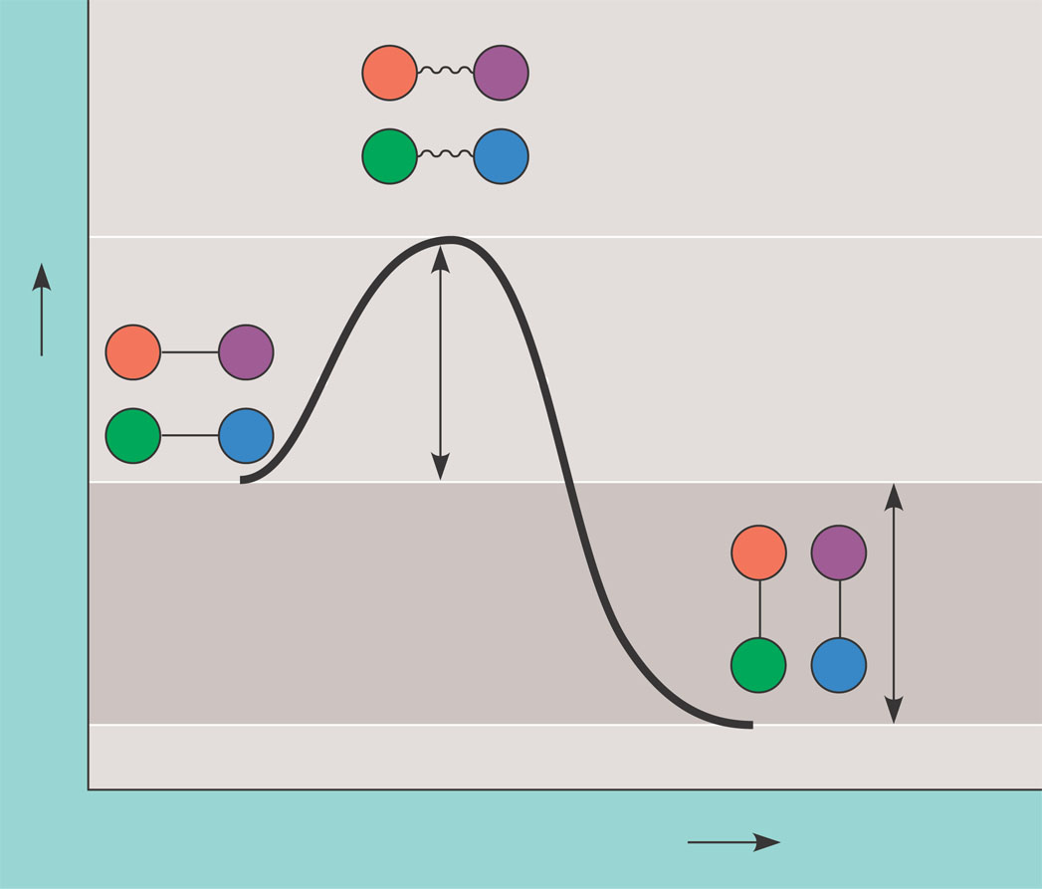
Activation Energy
All reactions, both endergonic and exergonic, require an input of energy to get started. This energy is called activation energy
The activation energy, E_{A}
  Is the initial amount of energy needed to start a chemical reaction
  Activation energy is needed to bring the reactants close together and weaken existing bonds to initiate a chemical reaction.
  Is often supplied in the form of heat from the surroundings in a system.
A
B
C
D
Transition state
A
B
E_{A}
C
D
Free energy
Reactants
A
B
∆G < O
C
D
Products
Progress of the reaction
Copyright © The McGraw-Hill Companies, Inc. Permission required for reproduction or display.

Slide 17
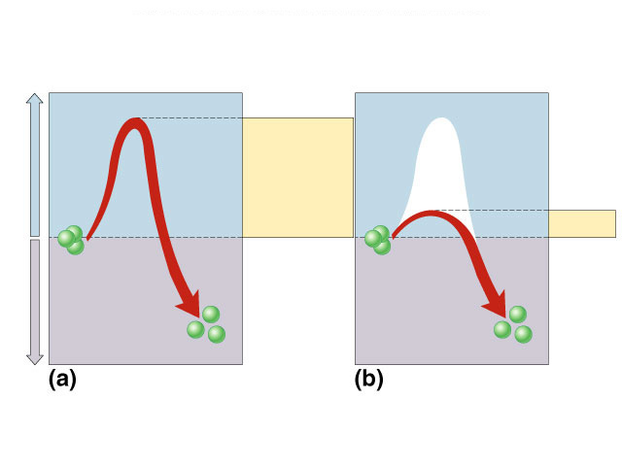
Increasing Reaction Rates
Add Energy (Heat) - molecules move faster so they collide more frequently and with greater force.
Add a catalyst – a catalyst reduces the energy needed to reach the activation state, without being changed itself. Proteins that function as catalysts are called enzymes.
Activation Energy and Catalysis
Energy supplied
Activation
energy
Activation
energy
Reactant
Reactant
Energy released
Product
Product
Uncatalyzed
Catalyzed
Copyright © The McGraw-Hill Companies, Inc. Permission required for reproduction or display.

Slide 18
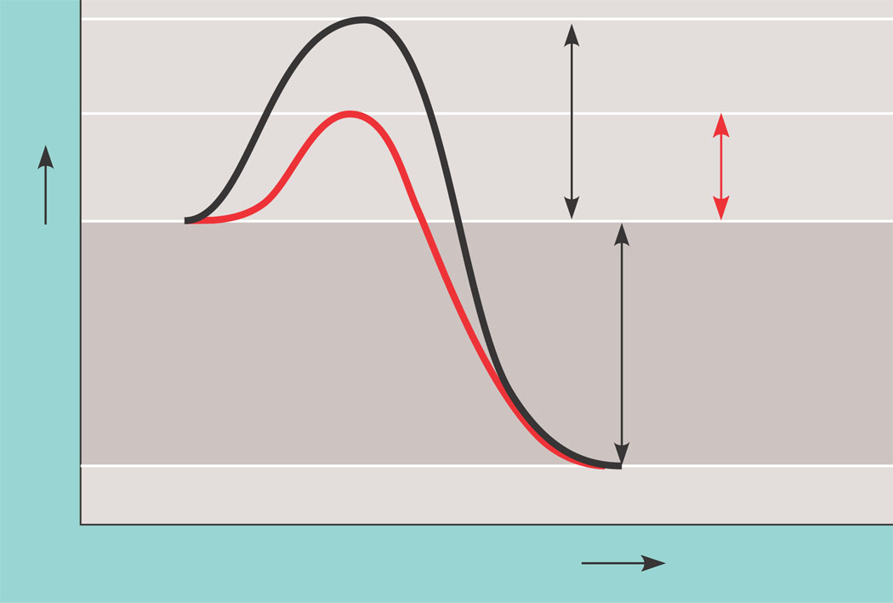
Enzymes Lower the E_{A} Barrier
An enzyme catalyzes reactions by lowering the E_{A} barrier
Course of
reaction
without
enzyme
E_{A}
without
enzyme
E_{A} with
enzyme
is lower
Reactants
Free energy
Course of
reaction
with enzyme
∆G is unaffected
by enzyme
Products
Progress of the reaction

Slide 19
Enzymes Are Biological Catalysts
Enzymes are proteins that carry out most catalysis in living organisms.
Unlike heat, enzymes are highly specific. Each enzyme typically speeds up only one or a few chemical reactions.
Unique three-dimensional shape enables an enzyme to stabilize a temporary association between substrates.
Because the enzyme itself is not changed or consumed in the reaction, only a small amount is needed, and can then be reused.
Therefore, by controlling which enzymes are made, a cell can control which reactions take place in the cell.

Slide 20
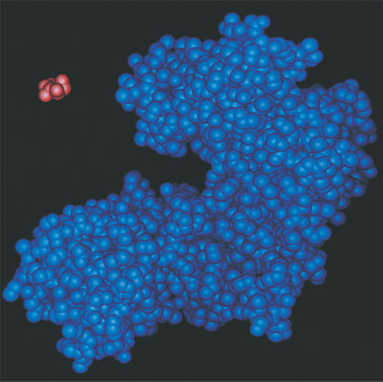
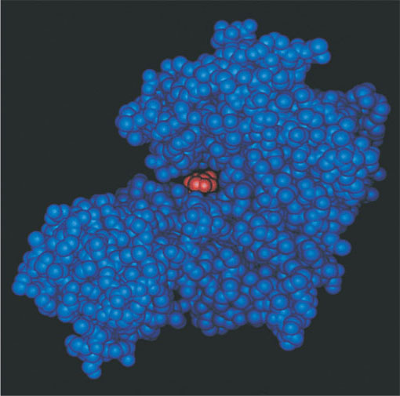
Substrate Specificity of Enzymes
Almost all enzymes are globular proteins with one or more active sites on their surface.
The substrate is the reactant an enzyme acts on
Reactants bind to the active site to form an enzyme-substrate complex.
The 3-D shape of the active site and the substrates must match, like a lock and key
Binding of the substrates causes the enzyme to adjust its shape slightly, leading to a better induced fit.
Induced fit of a substrate brings chemical groups of the active site into positions that enhance their ability to catalyze the chemical reaction
When this happens, the substrates are brought close together and existing bonds are stressed. This reduces the amount of energy needed to reach the transition state.
Substate
Active site
Enzyme- substrate
complex
Enzyme

Slide 21
Factors Affecting Enzyme Activity
Temperature - rate of an enzyme-catalyzed reaction increases with temperature, but only up to an optimum temperature.
pH - ionic interactions also hold enzymes together.
Inhibitors and Activators

Slide 22
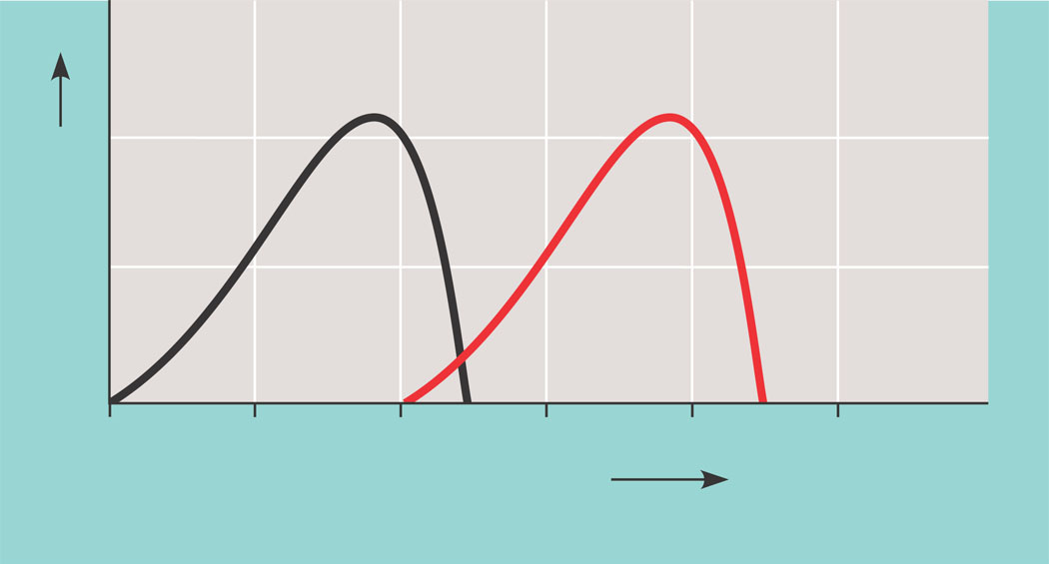
Effects of Temperature and pH
Each enzyme has an optimal temperature in which it can function
Optimal temperature for
typical human enzyme
Optimal temperature for
enzyme of thermophilic
(heat-tolerant)
bacteria
Rate of reaction
0
20
40
80
100
Temperature (Cº)
(a) Optimal temperature for two enzymes

Slide 23
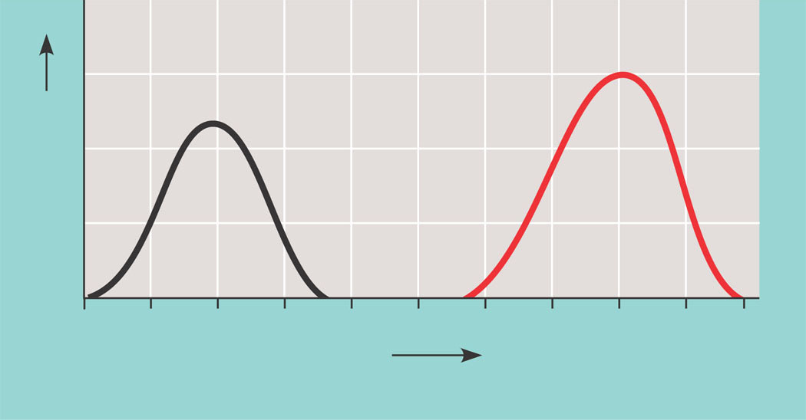
Effects of Temperature and pH
  Each enzyme has an optimal pH in which it can function
Optimal pH for pepsin
(stomach enzyme)
Optimal pH
for trypsin
(intestinal
enzyme)
Rate of reaction
0
1
2
3
4
5
6
7
8
9
(b) Optimal pH for two enzymes
Figure 8.18

Slide 24
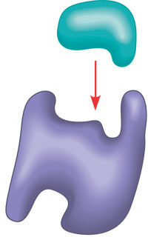
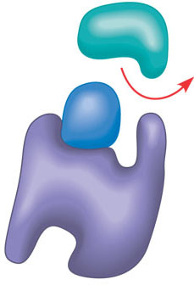
Enzyme Inhibitors
Competitive inhibitors bind to the active site of an enzyme, competing with the substrate
A substrate can
bind normally to the
active site of an
enzyme.
Substrate
Active site
Enzyme
(a) Normal binding
A competitive
inhibitor mimics the
substrate, competing
for the active site.
Competitive
inhibitor
(b) Competitive inhibition

Slide 25
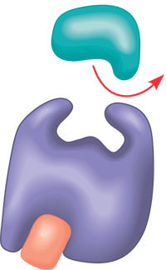
Enzyme Inhibitors
Noncompetitive inhibitors bind to another part of an enzyme, changing the function
A noncompetitive
inhibitor binds to the
enzyme away from
the active site, altering
the conformation of
the enzyme so that its
active site no longer
functions.
Noncompetitive inhibitor
(c) Noncompetitive inhibition

Slide 26
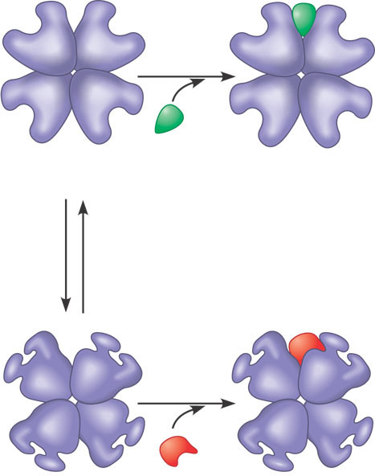
Allosteric Regulation of Enzymes
Allosteric regulation may either inhibit or stimulate an enzyme’s activity
Allosteric activater
stabilizes active from
Allosteric enyzme
with four subunits
Active site
(one of four)
Regulatory
site (one
of four)
Activator
Active form
Stabilized active form
Allosteric activater
stabilizes inactive form
Oscillation
Non-
functional
active
site
Inactive form
Inhibitor
Stabilized inactive
form
(a) Allosteric activators and inhibitors. In the cell, activators and inhibitors
dissociate when at low concentrations. The enzyme can then oscillate again.

Slide 27
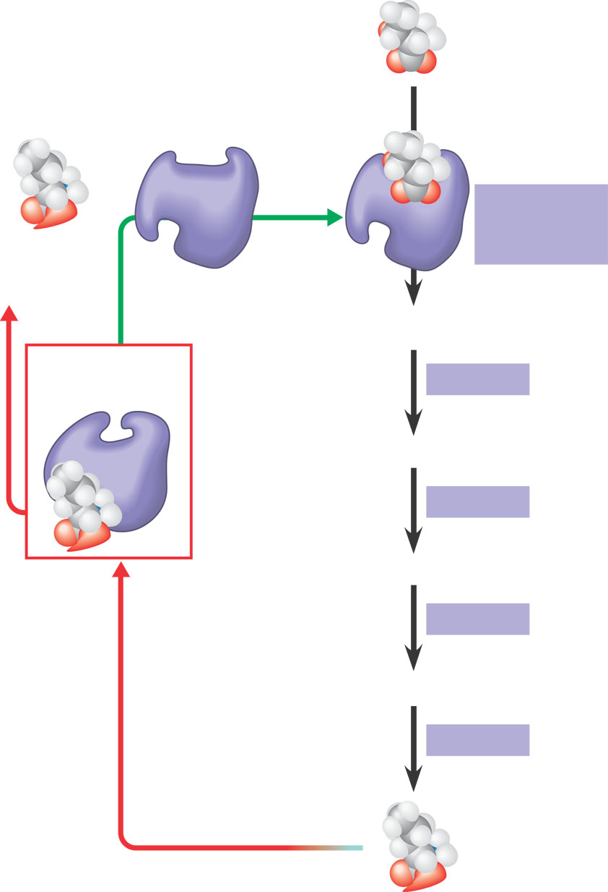
Feedback Inhibition
In feedback inhibition the end product of a metabolic pathway shuts down the pathway
When the cell produces increasing quantities of a particular product, it automatically inhibits its ability to produce more
Initial substrate
(threonine)
Active site
available
Threonine
in active site
Enzyme 1
(threonine
deaminase)
Isoleucine
used up by
cell
Intermediate A
Feedback
inhibition
Active site of
enzyme 1 no
longer binds
threonine;
pathway is
switched off
Enzyme 2
Intermediate B
Enzyme 3
Intermediate C
Isoleucine
binds to
allosteric
site
Enzyme 4
Intermediate D
Enzyme 5
End product
(isoleucine)

