Slide 1
ADP, ATP and Cellular Respiration
Copyright Cmassengale

Slide 2
What Is ATP?
Energy used by all Cells
Adenosine Triphosphate
Organic molecule containing high-energy Phosphate bonds
Copyright Cmassengale

Slide 3
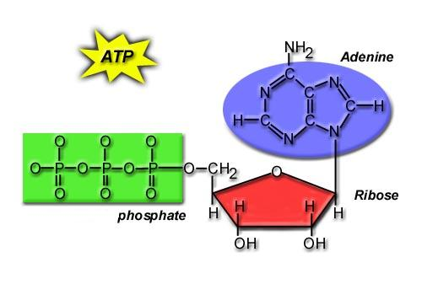
Chemical Structure of ATP
Adenine Base
3 Phosphates
Ribose Sugar
Copyright Cmassengale

Slide 4
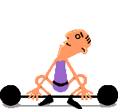
What Does ATP Do for You?
It supplies YOU with ENERGY!
Copyright Cmassengale

Slide 5
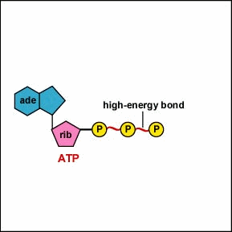
How Do We Get Energy From ATP?
By breaking the high- energy bonds between the last two phosphates in ATP
Copyright Cmassengale

Slide 6
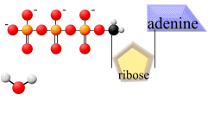
What is the Process Called?
HYDROLYSIS (Adding H₂O)
H₂O
Copyright Cmassengale

Slide 7
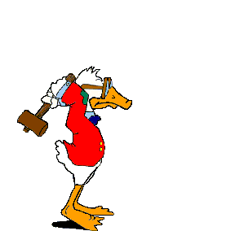
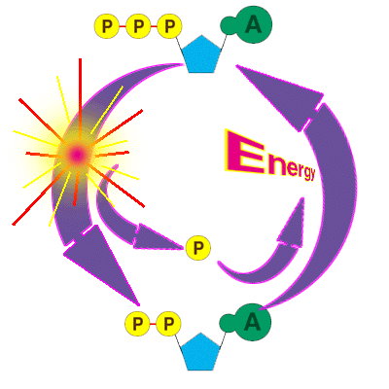
How Does That Happen?
An Enzyme!
ATPase
Copyright Cmassengale

Slide 8
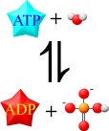
How is ATP Re-Made?
The reverse of the previous process occurs.
Another Enzyme is used!
ATP Synthetase
Copyright Cmassengale

Slide 9
The ADP-ATP Cycle
ATP Synthetase
ATP-ase
Copyright Cmassengale

Slide 10
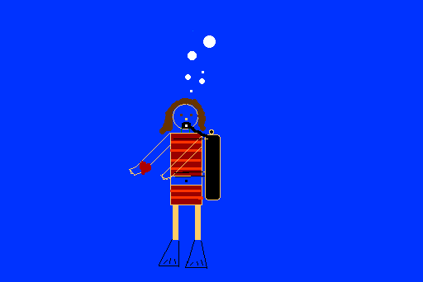
When is ATP Made in the Body?
During a Process called Cellular Respiration that takes place in both Plants & Animals
Copyright Cmassengale

Slide 11
Cellular Respiration
Includes pathways that require oxygen
Glucose is oxidized and O₂ is reduced
Glucose breakdown is therefore an oxidation-reduction reaction
Breakdown of one glucose results in 36 to 38 ATP molecules
Copyright Cmassengale

Slide 12
Overall Equation for Cellular Respiration
C₆H₁₂O₆ + 6O₂
YIELDS
6CO₂ + 6H₂0 + e⁻ + 36-38ATP’s
Copyright Cmassengale

Slide 13
What Type of Process is Cellular Respiration?
An Oxidation-Reduction Process or REDOX Reaction
Oxidation of GLUCOSE --> CO₂ + H₂O (e⁻ removed from C₆H₁₂O₆)
Reduction O₂ to H₂O (e⁻ passed to O₂)
Copyright Cmassengale

Slide 14
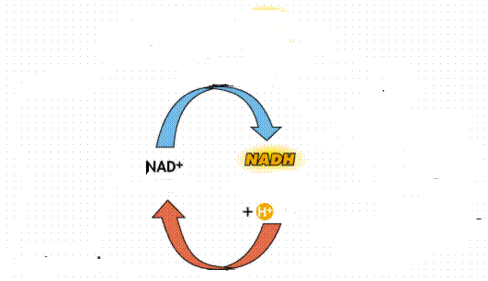
What Carries the Electrons?
NAD⁺ (nicotinadenine dinucleotide) acts as the energy carrier
NAD⁺ is a coenzyme
It’s Reduced to NADH when it picks up two electrons and one hydrogen ion

Slide 15
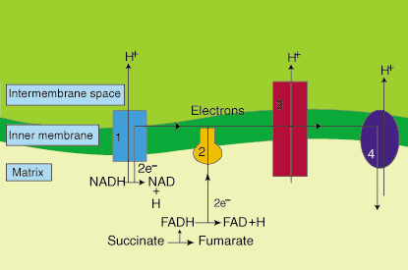
Are There Any Other Electron Carriers?
YES! Another Coenzyme!
FAD+ (Flavin adenine dinucleotide)
Reduced to FADH₂
Copyright Cmassengale

Slide 16
Other Cellular Respiration Facts
Metabolic Pathway that breaks down carbohydrates
Process is Exergonic as High-energy Glucose is broken into CO₂ and H₂O
Process is also Catabolic because larger Glucose breaks into smaller molecules
Copyright Cmassengale

Slide 17
What are the Stages of Cellular Respiration?
Glycolysis
The Krebs Cycle
The Electron Transport Chain
Copyright Cmassengale

Slide 18
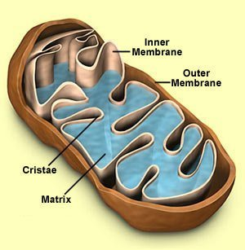
Where Does Cellular Respiration Take Place?
It actually takes place in two parts of the cell:
Glycolysis occurs in the Cytoplasm
Krebs Cycle & ETC Take place in the Mitochondria
Copyright Cmassengale

Slide 19
Review of Mitochondria Structure
Smooth outer Membrane
Folded inner membrane
Folds called Cristae
Space inside cristae called the Matrix
Copyright Cmassengale

Slide 20
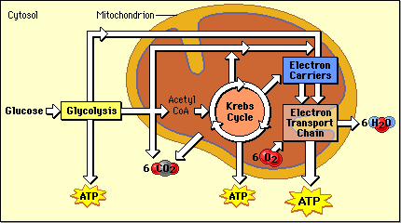
Diagram of the Process
Occurs across Cristae
Occurs in Cytoplasm
Occurs in Matrix
Copyright Cmassengale

Slide 21
Glycolysis Summary
Takes place in the Cytoplasm
Anaerobic (Doesn’t Use Oxygen)
Requires input of 2 ATP
Glucose split into two molecules of Pyruvate or Pyruvic Acid
Copyright Cmassengale

Slide 22
Glycolysis Summary
Also produces 2 NADH and 4 ATP
Pyruvate is oxidized to Acetyl CoA and CO₂ is removed
Copyright Cmassengale

Slide 23
Fermentation
Occurs when O₂ NOT present (anaerobic)
Called Lactic Acid fermentation in muscle cells (makes muscles tired)
Called Alcoholic fermentation in yeast (produces ethanol)
Nets only 2 ATP
Copyright Cmassengale

Slide 24
Krebs Cycle Summary
Requires Oxygen (Aerobic)
Cyclical series of oxidation reactions that give off CO₂ and produce one ATP per cycle
Turns twice per glucose molecule
Produces two ATP
Takes place in matrix of mitochondria
Copyright Cmassengale

Slide 25
Krebs Cycle Summary
Each turn of the Krebs Cycle also produces 3NADH, 1FADH₂, and 2CO₂
Therefore, For each Glucose molecule, the Krebs Cycle produces 6NADH, 2FADH₂, 4CO₂, and 2ATP
Copyright Cmassengale

Slide 26
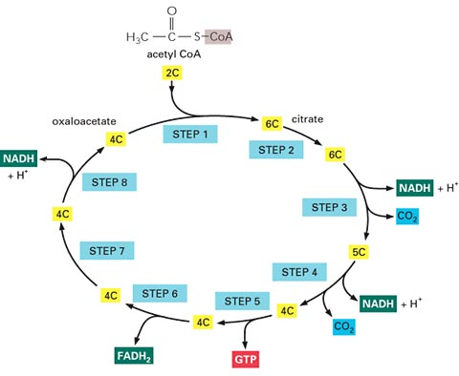
Krebs Cycle
ATP
Copyright Cmassengale
NETS: 3NADH, 1ATP, 1FADH₂, & 2CO₂

Slide 27
Electron Transport Chain Summary
34 ATP Produced
H₂O Produced
Occurs Across Inner Mitochondrial membrane
Uses coenzymes NAD+ and FAD+ to accept e- from glucose
NADH = 3 ATP’s
FADH₂ = 2 ATP’s
Copyright Cmassengale

Slide 28
Electron Transport Chain Animation
Copyright Cmassengale

Slide 29
Copyright Cmassengale

