Slide 1

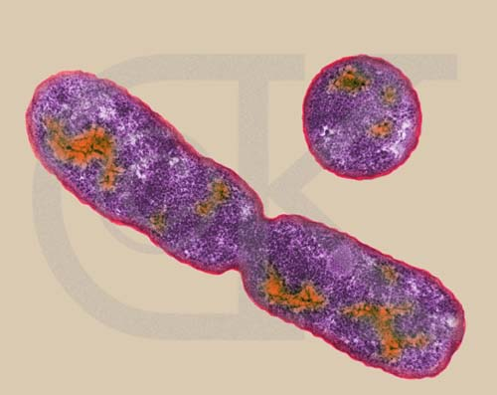
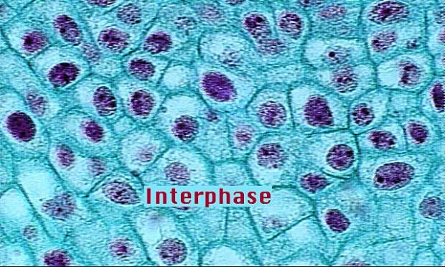
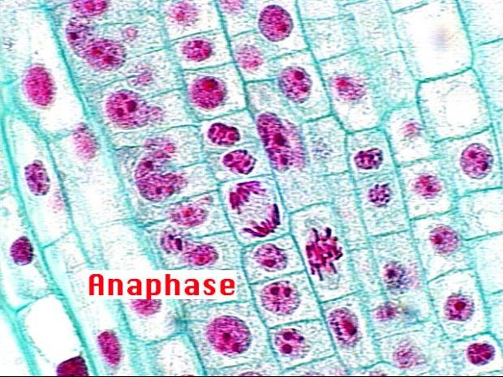
Mitosis and Meiosis
Cell Division

Slide 2
Why Do Cells Divide?
For growth, repair, and reproduction

Slide 3
Mitosis
Organisms grow by the addition of cells
In multicellular organism some of these cells perform functions different from other cells.

Slide 4
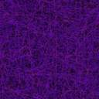
The process of a cell becoming different is differentiation.
Under normal conditions once an animal cell becomes specialized it can no longer form an entire organism, however plant cells are totipotent and any cell can form an entire plant.

Slide 5
When do cells divide?
Most limiting factor in size is the size of the cell membrane.
  Cells must obtain nutrients
  as volume increases, cell surface area does not increase as greatly
  larger cells require a larger surface area for survival

Slide 6
Cell Division vs. Nuclear Division
Cytokinesis: The actual division of the cell into two new cells.
Mitosis: The division of the nucleus of the cell into two new nuclei.
Note: Sometimes cells go through mitosis without going through cytokinesis. Describe a cell that did this.

Slide 7

Terminology
Chromatin - thin fibrous form of DNA and proteins
Sister chromatids- identical structures that result from chromosome replication, formed during S phase

Slide 8
Anatomy of a Chromosome
Centromere - point where sister chromatids are joined together
P=short arm; upward
Q=long arm; downward
Telomere-tips of chromosome
centromere
chromatids

Slide 9
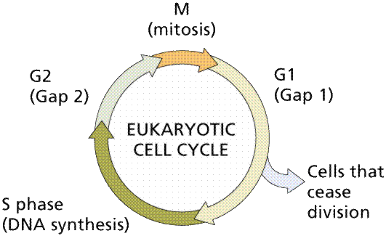
How Do Cells Divide?
Cell cycle - sequence of phases in the life cycle of the cell

Slide 10
Getting ready to split
Cell cycle has two parts:
  growth and preparation (interphase)
  cell division
    mitosis (nuclear division)
    cytokinesis (cytoplasm division)

Slide 11
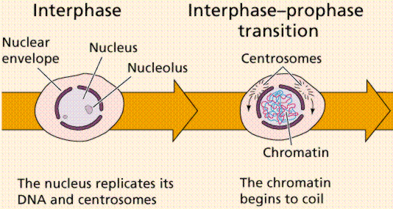
Interphase
Occurs between divisions
Longest part of cycle
3 stages

Slide 13
Interphase
G1 or Gap 1
  The cell just finished dividing so in Gap 1 the cell is recovering from mitosis

Slide 14
Interphase
S or Synthesis stage
  DNA replicates

Slide 15
Interphase
G 2 or Gap 2
  This is preparation for mitosis
  Organelles are replicated.
  More growth occurs.

Slide 16
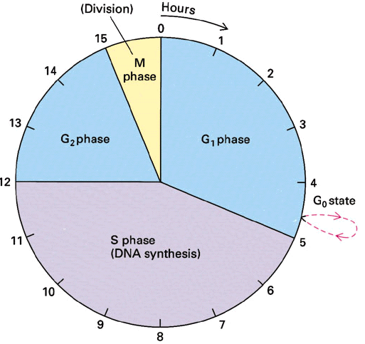

Slide 17
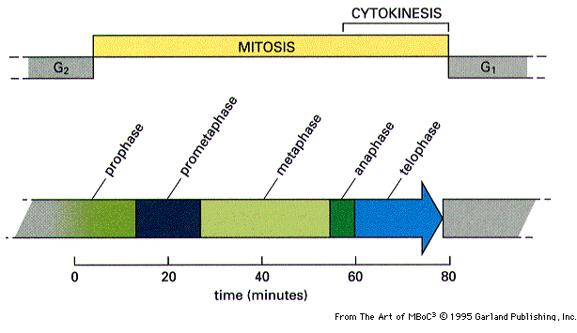
MITOSIS
Mitosis begins after G 2 and ends before G 1

Slide 18
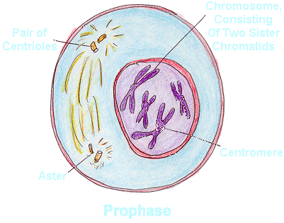
Prophase
Chromosome condense
Microtubles form
The nuclear envelope breaks down

Slide 19
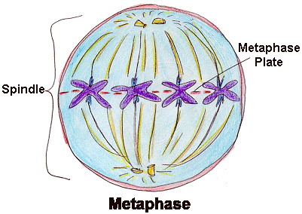
Metaphase
Chromosomes are pulled to center of cell
Line up along “metaphase plate”

Slide 20
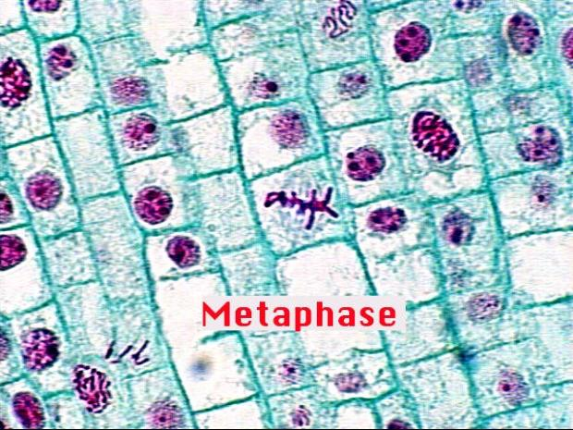

Slide 21
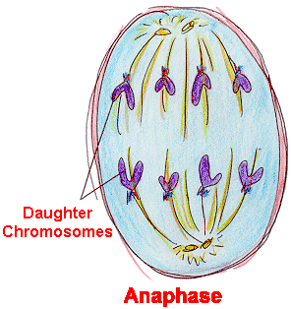
Anaphase
Centromeres divide
Spindle fibers pull one set of chromosomes to each pole
Precise alignment is critical to division

Slide 23
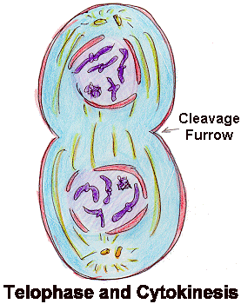

Telophase
Nuclear envelope form around chromosomes
Chromosomes uncoil
Cytokinesis
  animals - pinching of plasma membrane
  plants- elongates and the cell plate forms( future cellwall and cell membrane)

Slide 24
Meiosis

Slide 25
What is Meiosis?
A division of the nucleus that reduces chromosome number by half.
Important in sexual reproduction
Involves combining the genetic information of one parent with that of the the other parent to produce a genetically distinct individual

Slide 26
Terminology
Diploid - two sets of chromosomes (2n), in humans 23 pairs or 46 total
Haploid - one set of chromosomes (n) - gametes or sex cells, in humans 23 chromosomes

Slide 27
Chromosome Pairing
Homologous pair
  each chromosome in pair are identical to the other ( carry genes for same trait)
  only one pair differs - sex chromosomes X or Y

Slide 28
Phases of Meiosis
A diploid cell replicates its chromosomes
Two stages of meiosis
  Meiosis I and Meiosis II
  Only 1 replication

Slide 29
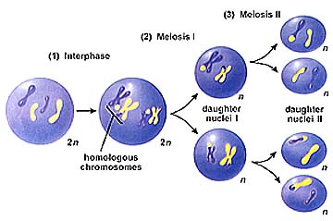

Slide 30
  Synapsis - pairing of homologous chromosomes forming a tetrad.
  Crossing over - chromatids of tetrad exchange parts.

Slide 31
Meiosis I

Slide 32
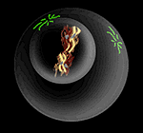
Prophase I
Chromosomes condense
Homologous chromosomes pair w/ each other
Each pair contains four sister chromatids - tetrad

Slide 33
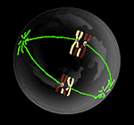
Metaphase I
Tetrads or homologous chromosomes move to center of cell

Slide 34
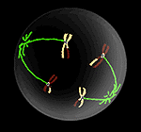
Anaphase I
Homologous chromosomes pulled to opposite poles

Slide 35
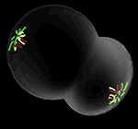
Telophase I
Daughter nuclei formed
These are haploid (1n)

Slide 36
Meiosis II
Daughter cells undergo a second division; much like mitosis
NO ADDITIONAL REPLICATION OCCURS

Slide 37
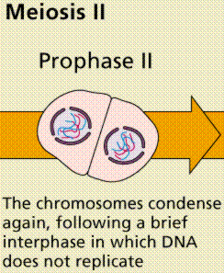
Prophase II
Spindle fibers form again

Slide 38
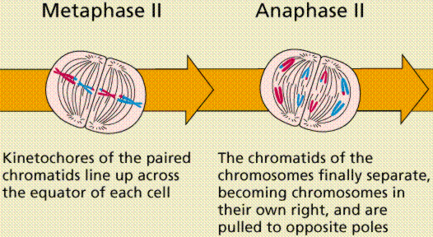
Metaphase II
Sister chromatids move to the center

Slide 39
Anaphase II
Centromeres split
Individual chromosomes are pulled to poles

Slide 40
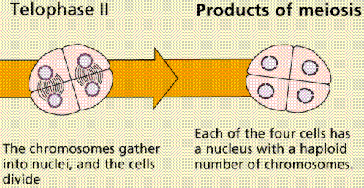
Telophase II & Cytokinesis
Four haploid daughter cells results from one original diploid cell

Slide 41
Review Mitosis & Meiosis
Both are forms of nuclear division
Both involve replication
Both involve disappearance of the nucleus, and nucleolus, nuclear membrane
Both involve formation of spindle fibers

Slide 42
DIFFERENCES
Meiosis produces daughter cells that have 1/2 the number of chromosomes as the parent. Go from 2n to 1n.
Daughter cells produced by meiosis are not genetically identical to one another.
In meiosis cell division takes place twice but replication occurs only once.

Slide 43
Value of Variation
Variation - differences between members of a population.
Meiosis results in random separation of chromosomes in gametes.
Causes diverse populations that over time can be stronger for survival.

