Slide 1
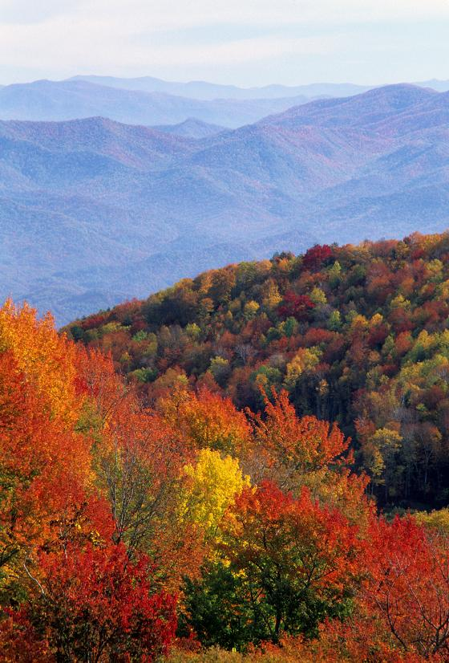
Photosynthesis

Slide 2
Photosynthesis in Overview
Process by which plants and other autotrophs store the energy of sunlight into sugars.
Requires sunlight, water, and carbon dioxide.
Overall equation:
6 CO₂ + 6 H₂0 → C₆H₁₂O₆ + 6 O₂
Occurs in the leaves of plants in organelles called chloroplasts.

Slide 3
Question:
Why are plants green?

Slide 4
Chlorophyll Molecules
Located in the thylakoid membranes.
Chlorophyll have Mg⁺ in the center.
Chlorophyll pigments harvest energy (photons) by absorbing certain wavelengths (blue-420 nm and red-660 nm are most important).
Plants are green because the green wavelength is reflected, not absorbed.

Slide 5
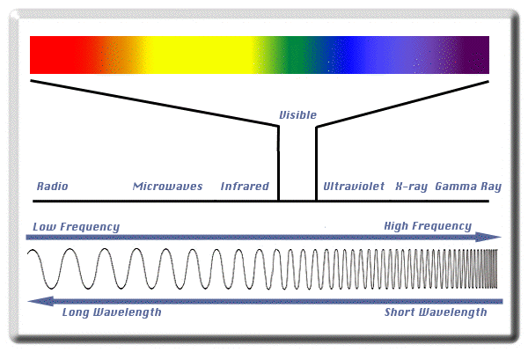
Electromagnetic Spectrum

Slide 6
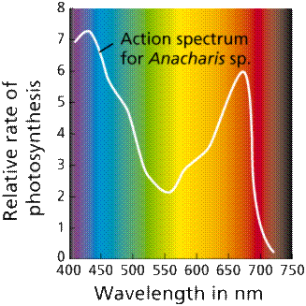
Absorption of Chlorophyll

Slide 7
Question:
During the fall, what causes the leaves to change colors?

Slide 8
Fall Colors
In addition to the chlorophyll pigments, there are other pigments present.
During the fall, the green chlorophyll pigments are greatly reduced revealing the other pigments.
Carotenoids are pigments that are either red or yellow.

Slide 9
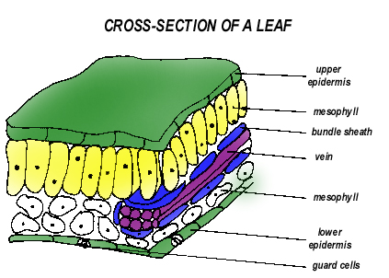
Leaf Structure
Most photosynthesis occurs in the palisade layer.
Gas exchange of CO₂ and O₂ occurs at openings called stomata surrounded by guard cells on the lower leaf surface.
Palisade
Spongy

Slide 10
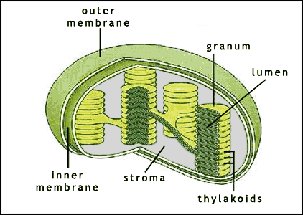
Chloroplast Structure
Inner membrane called the thylakoid membrane.
Thickened regions called thylakoids. A stack of thylakoids is called a granum. (Plural – grana)
Stroma is a liquid surrounding the thylakoids.

Slide 11
Pigments
Chlorophyll A is the most important photosynthetic pigment.
Other pigments called antenna or accessory pigments are also present in the leaf.
  Chlorophyll B
  Carotenoids (orange / red)
  Xanthophylls (yellow / brown)
These pigments are embedded in the membranes of the chloroplast in groups called photosystems.

Slide 12
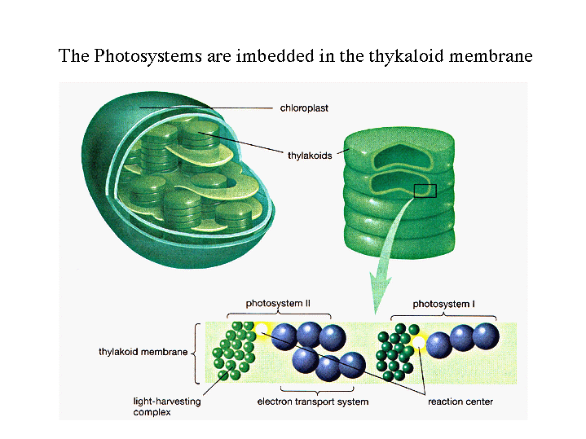

Slide 13
Photosynthesis: The Chemical Process
Occurs in two main phases.
  Light reactions
  Dark reactions, or Light-Independent reactions (aka – the Calvin Cycle)
Light reactions are the “photo” part of photosynthesis. Light is absorbed by pigments.
Dark reactions are the “synthesis” part of photosynthesis. Trapped energy from the sun is converted to the chemical energy of sugars.

Slide 14
Light Reactions
Light-dependent reactions occur on the thylakoid membranes.
  Light and water are required for this process.
  Energy storage molecules are formed. (ATP and NADPH)
  Oxygen gas is made as a waste product.

Slide 15
Noncyclic Electron Flow
Occurs in the thylakoid membrane
Uses PS II and PS I
P680 rxn center (PSII) - chlorophyll a
P700 rxn center (PS I) - chlorophyll a
Uses Electron Transport Chain (ETC)
Generates O₂, ATP and NADPH

Slide 16
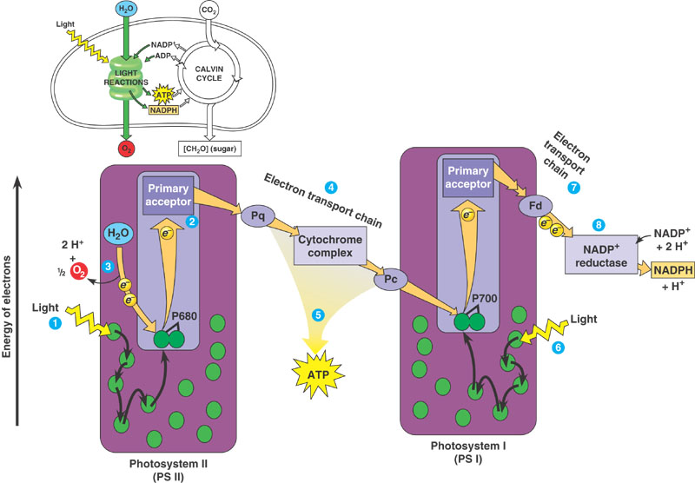
Noncyclic Electron Flow

Slide 17
Noncyclic Electron Flow
ADP + → ATP
NADP⁺ + H → NADPH
Oxygen comes from the splitting of H₂O, not CO₂
H₂O → 1/2 O₂ + 2H⁺
P
(Reduced)
(Reduced)
(Oxidized)

Slide 18
Chemiosmosis
Powers ATP synthesis.
Located in the thylakoid membranes.
Uses ETC and ATP synthase (enzyme) to make ATP.
Photophosphorylation: addition of phosphate to ADP to make ATP.

Slide 19
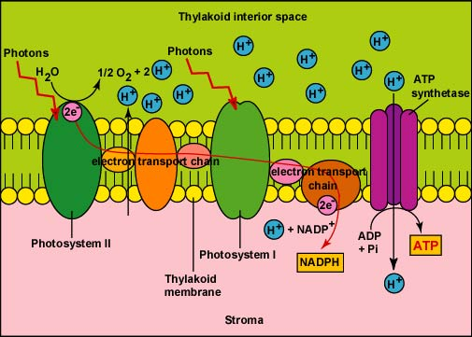
Chemiosmosis

Slide 20
Dark Reactions
Dark reactions (light-independent) occur in the stroma.
  Carbon dioxide is “fixed” into the sugar glucose.
  ATP and NADPH molecules created during the light reactions power the production of this glucose.

Slide 21
Calvin Cycle
Carbon Fixation (light independent rxn).
C₃ plants (80% of plants on earth).
Occurs in the stroma.
Uses ATP and NADPH from light rxn.
Uses CO₂.
To produce glucose: it takes 6 turns and uses 18 ATP and 12 NADPH.

Slide 22
Chloroplast
Stroma
Outer Membrane
Thylakoid
Granum
Inner Membrane

Slide 23
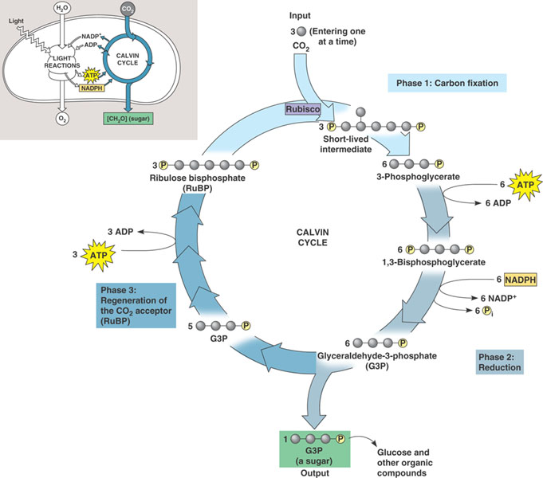
Calvin Cycle (C₃ fixation)

