Slide 1
Aim to Learn: California State Standard on Ecology: Stability in an ecosystem is a balance between competing effects; Biodiversity is the sum total of different kinds of organisms and is affected by habitat changes.

Slide 2
b. Students know how to analyze changes in an ecosystem resulting from changes in climate, human activity, introduction of nonnative species, or changes in population size.
Global Warming from CO2 (mainly), a nonrenewable resource
Ozone “Hole” from chlorofluorocarbons
Zebra Mussel in SF Bay; Plants & Animals in Hawaii

Slide 3
c. Students know how fluctuations in population size in an ecosystem are determined by the relative rates of birth, immigration, emigration, and death.
China, India, Africa – high birth rates
Immigration > emigration → Population Growth
Death Rate > Birth Rate → Population Decreases

Slide 4
d. Students know how water, carbon, and nitrogen cycle between abiotic resources and organic matter in the ecosystem and how oxygen cycles through photosynthesis and respiration.
Nutrient Cycle (water, nitrogen, carbon)

Slide 5
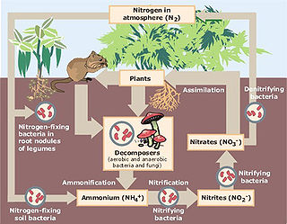
Nitrogen Cycle

Slide 6
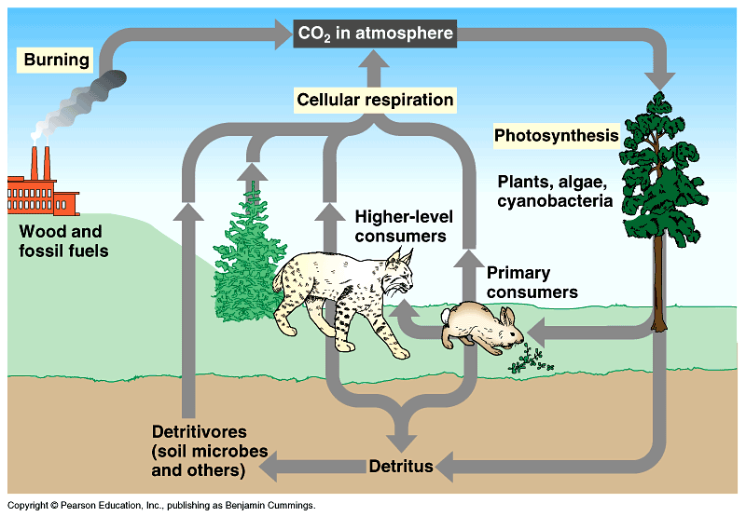
Carbon Cycle

Slide 7
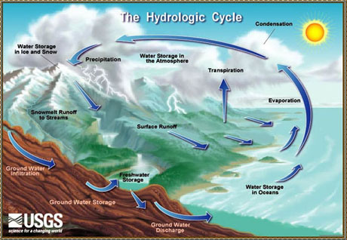

Slide 8
e. Students know a vital part of an ecosystem is the stability of its producers and decomposers.
Food Chain

Slide 9
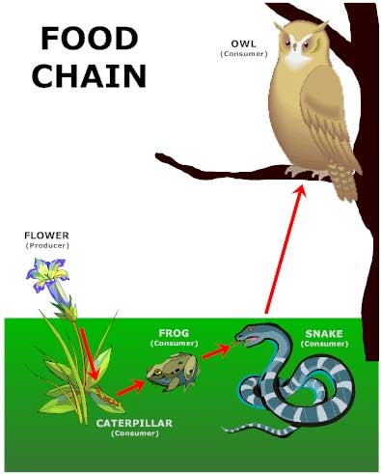

Slide 10
f. Students know at each link in a food web some energy is stored in newly made structures but much energy is dissipated into the environment as heat. This dissipation may be represented in an energy pyramid.
Food Pyramid

Slide 11
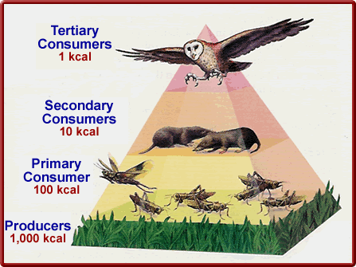
Energy Pyramid
(kcal is a unit of Energy)

Slide 12
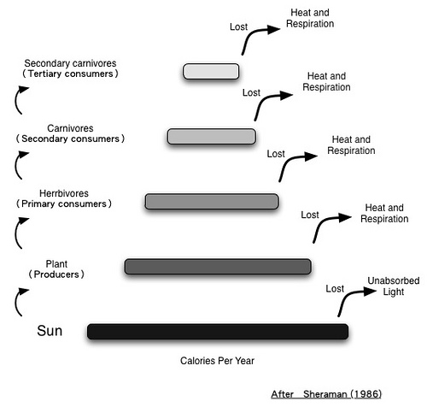
Much Energy is lost as Heat

