Slide 1
Chemical Reactions

Slide 2
I. What is a chemical reaction?
Definition: the process by which one or more substances are rearranged to form different substances. Another name for a chemical change.

Slide 3
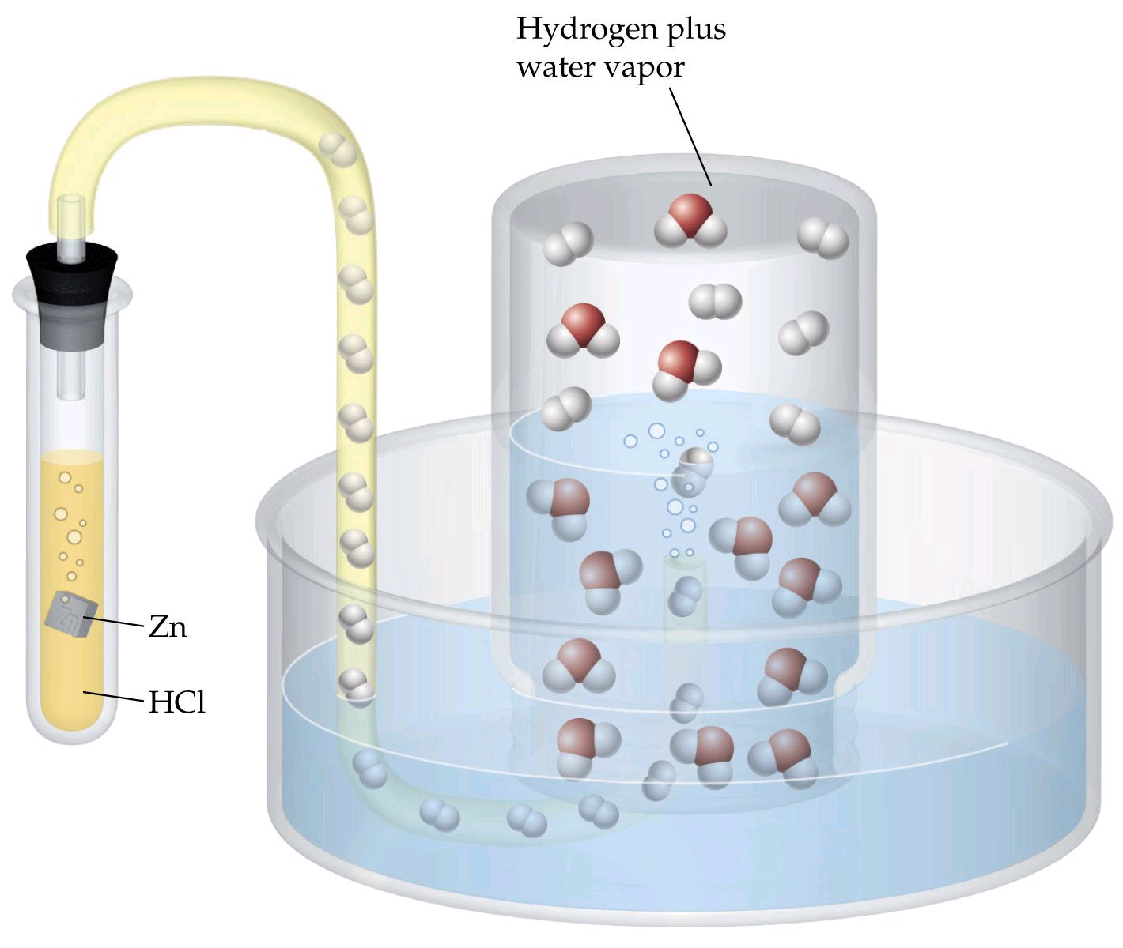
A. How can you tell a chemical reaction has taken place? Evidence?
1.Release of gas

Slide 4
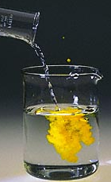
A. How can you tell a chemical reaction has taken place? Evidence?
2. Color changes
3. Formation of a precipitate

Slide 5
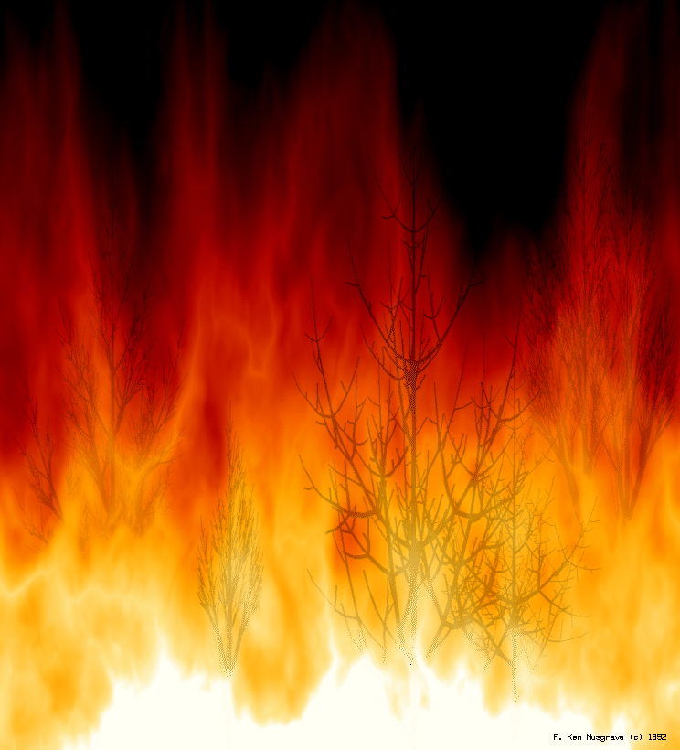
A. How can you tell a chemical reaction has taken place? Evidence?
4. Changes in heat and light (temperature change)

Slide 6
B. Chemical reactions release or absorb energy
Where does the energy come from?
Breaking and forming chemical bonds
C. Atoms are rearranged in a chemical change
This is where new substances come from

Slide 7
D. Particles must collide for a chemical reaction to occur
They must collide with enough energy

Slide 8

Exothermic Reactions Release Energy

Slide 9
II. Representing Chemical Reactions?
A. Atoms and mass are conserved
H₂(g) + O₂ (g)  H₂O(l)
Reactants
Products
Law of conservation of mass?
2 + 32 = 34g
18g?

Slide 10
B. Balancing Equations (coefficients indicate amounts of reactants and products)
H₂(g) + O₂ (g)  H₂O(l)
rules:
1. write the equation for reactants and products
*make sure you have the correct formulas (or skeleton equation) for the reactants and products

Slide 11
B. Balancing Equations (coefficients indicate amounts of reactants and products)
H₂(g) + O₂ (g)  H₂O(l)
2
2
2. count the atoms of each elements for both sides of the equation reactants and products
3. use coefficients to balance equations (do H and O last!)

Slide 12
H₂(g) + O₂ (g)  H₂O(l)
2
2
2. count the atoms of each elements for both sides of the equation reactants and products
3. use coefficients to balance equations (do H and O last!)
4. write the coefficients in their lowest possible ratio

Slide 13

Write a Balanced Equation
2
2
H2O (g)
CH₄(g) + ?  ? + ?
O2(g)
CO2(g)

Slide 14
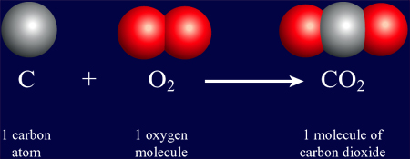
Balanced equations tell us:

Slide 15
Example:
Potassium chromate + lead(II) nitrate  potassium nitrate + lead (II) chromate
K₂CrO₄ + Pb(NO₃) ₂ 
KNO₃ + PbCrO₄
2

Slide 16
Example:
Sodium hydroxide + copper (II) sulfate  sodium sulfate + copper (II) hydroxide
NaOH + CuSO₄
2
Na₂SO₄ + Cu(OH)₂

Slide 17
Example:
Magnesium metal + hydrochloric acid  hydrogen gas + magnesium chloride
Mg_{(s)} + HCl(aq)
2
H₂(g) + MgCl_{2(s)}

Slide 18
III. What information is in an equation?
A. Equations as instructions
Describes process, identifies reactants, products, amounts and molar ratios

