Slide 1

PERIODICITY

Slide 2
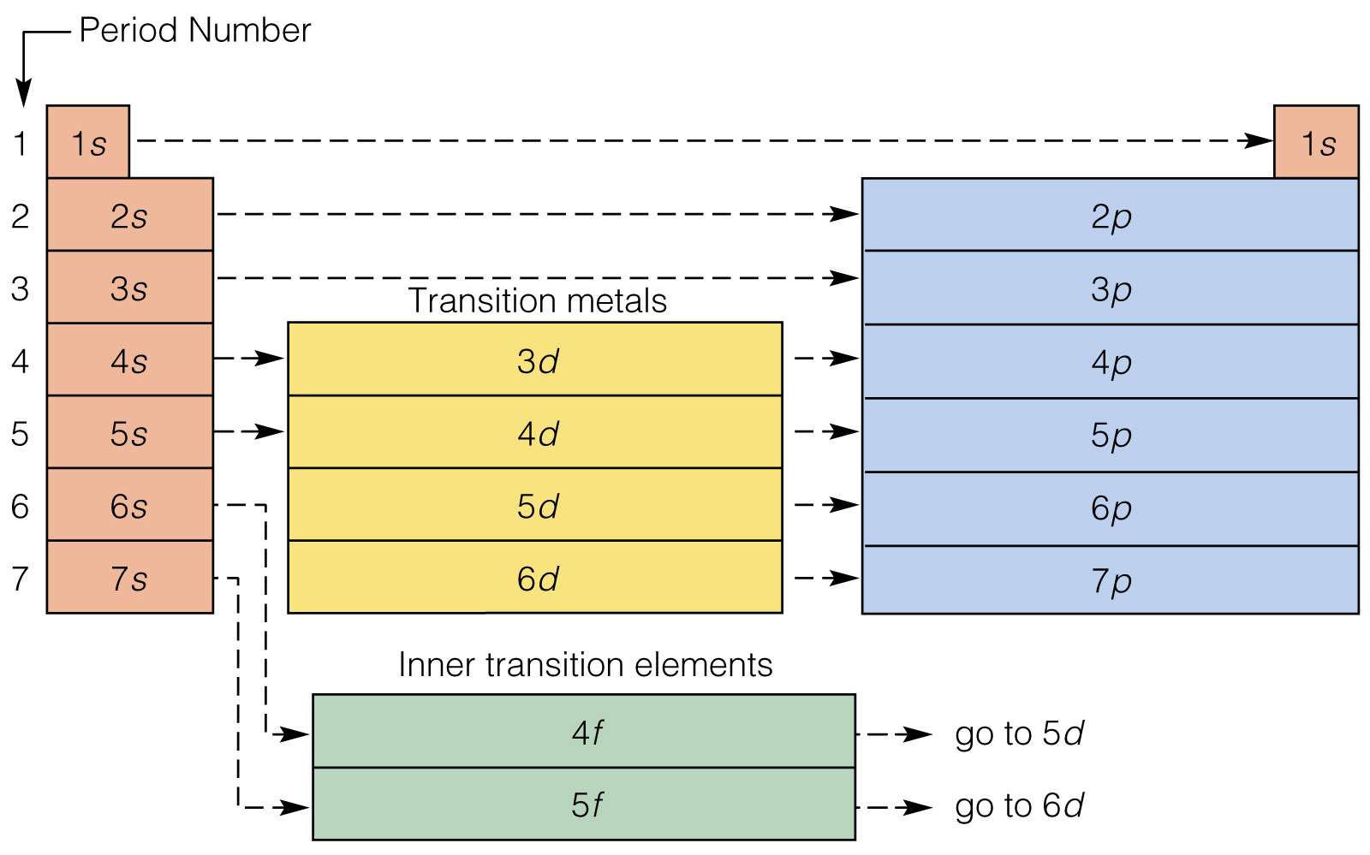

Slide 3
Electron Configurations
Don’t have to write out the entire electron configuration.
There is a short-cut:
Keeps focus on valence electrons
An atom’s inner electrons are represented by the symbol for the nearest noble gas with a lower atomic number.
K: [Ar]4s¹

Slide 4
Electron Configurations
For the element Phosphorus
-- 15 electrons
3s²3p³
1s²2s²2p⁶3s²3p³
P:
[Ne]
Must be a
Noble gas
(One just before
Element)

Slide 5
Electron Configurations
Let’s do a couple more:
Ba:
[Xe]
6s²
Hg:
[Xe]
6s²
4f¹⁴
5d¹⁰
V:
[Ar]
4s²
3d³

Slide 6
Electron Configurations
The chemistry of an atom occurs at the set of electrons called valence electrons
The valence electrons are electrons in an atom’s highest energy level.
For the Group – A elements, it is the outermost s & p e⁻ of the atom.
Specifically the 2 s electrons + 6 p electrons (octet electrons)
The arrangement of the valence e⁻ lead to the element’s properties.

Slide 7
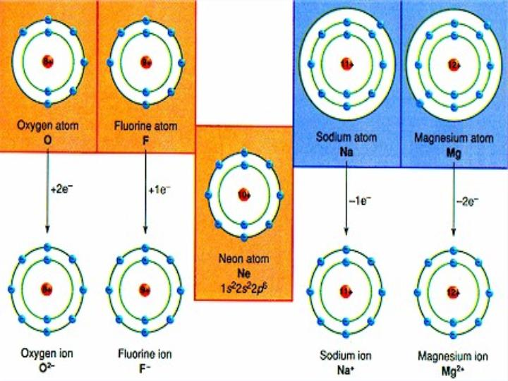

Slide 8
Periodic Properties
An element’s properties can go hand in hand with electron arrangement
We can use an element’s location on the PT to predict many properties.
Atomic radius
Electronegativity
Ionization energy
Ionic Size

Slide 9
Periodic Properties
As we examine atomic radius from left to right across the PT we see a grad-ual decrease in atomic size.
As e⁻ are added to the s and p sublevels in the same energy level, they are gradually pulled closer to the highly positive nucleus
The more e⁻’s in the atom the less dramatic this trend looks

Slide 10
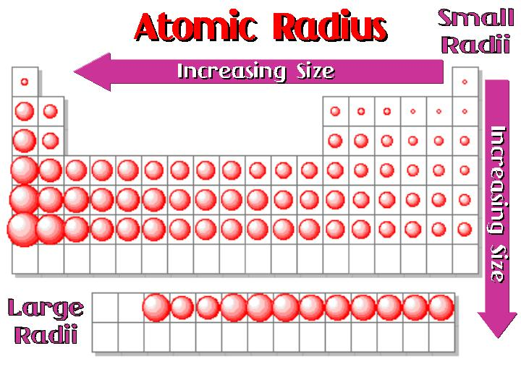

Slide 11
Periodic Properties
* We are adding protons into the nucleus which increases the p⁺-e⁻ interaction (attraction)
So the nucleus gains strength while the e⁻ aren’t gaining much distance, so the atom is drawn in closer and closer to the nucleus.
Decreasing the overall radius of the atom

Slide 12
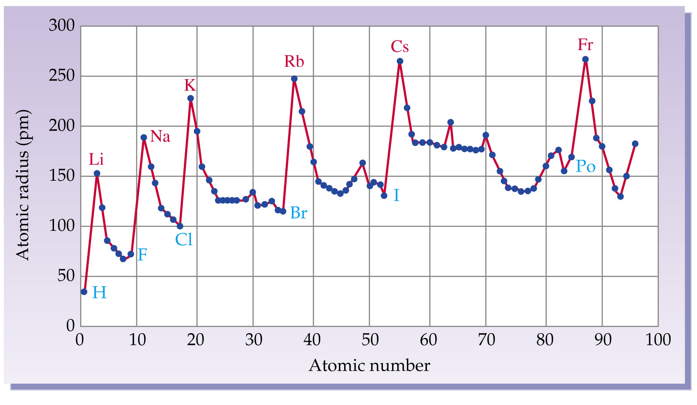

Slide 13
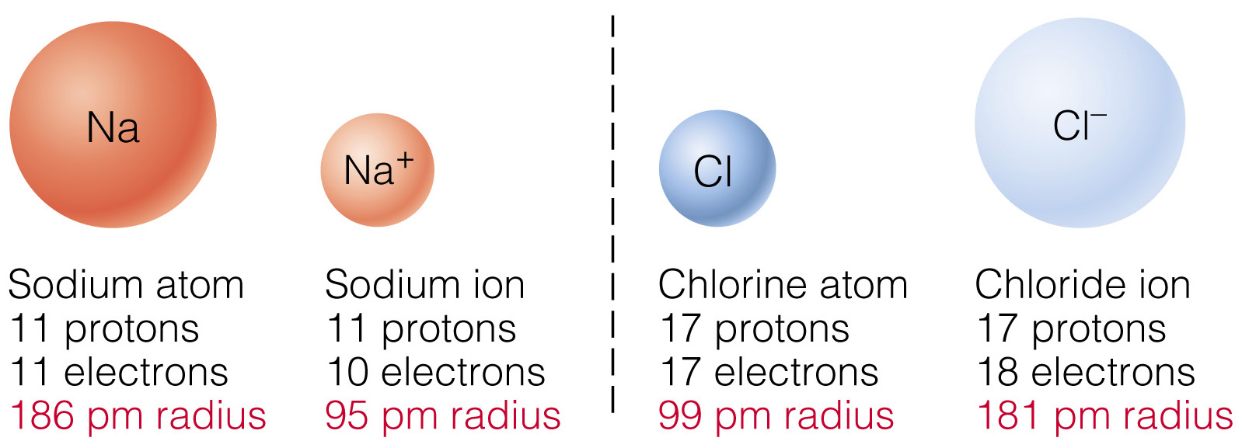
Periodic Properties
How does the size of an atom change when electrons are added or removed?
As an Atom loses 1 or more electrons (becomes positive), it loses a layer therefore, its radius decreases.

Slide 14
Periodic Properties
How does the size of an atom change when electrons are added or removed?
As an Atom gains 1 or more electrons (negative), it fills its valence layer, therefore, its radius increases.

Slide 15
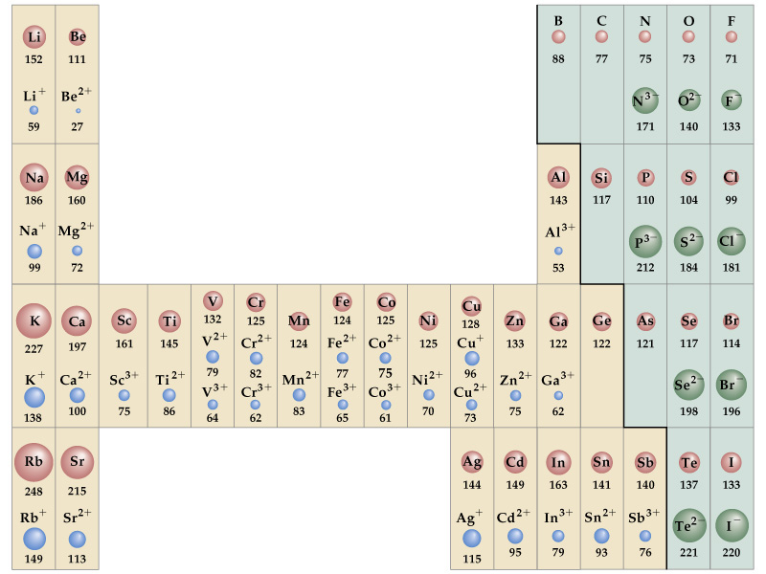

Slide 16
Periodic Properties
Elements in a group tend to form ions of the same charge.
Modeled by electron configurations.
4s
Loses 1
electron
4s
K:
[Ar]
[Ar]
Wants a full set of e⁻
+1
K

Slide 17
Periodic Properties
2s²
2p⁴
Gains
2 electrons
O:
[He]
[He]
Wants a complete set
-2
O

Slide 18
Periodic Trend of Ionic Charges
1
18
2
13
14
15
16
17
3
4
5
6
7
8
9
10
11
12
+1
tend to have
+2
+3
-3
-2
-1
+/- 4
more than one option
+ 3
+ 3 or + 4

Slide 19
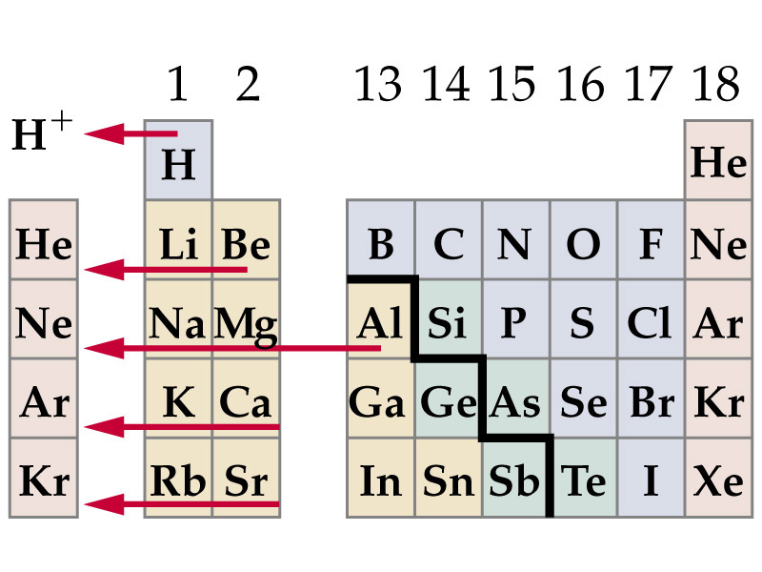
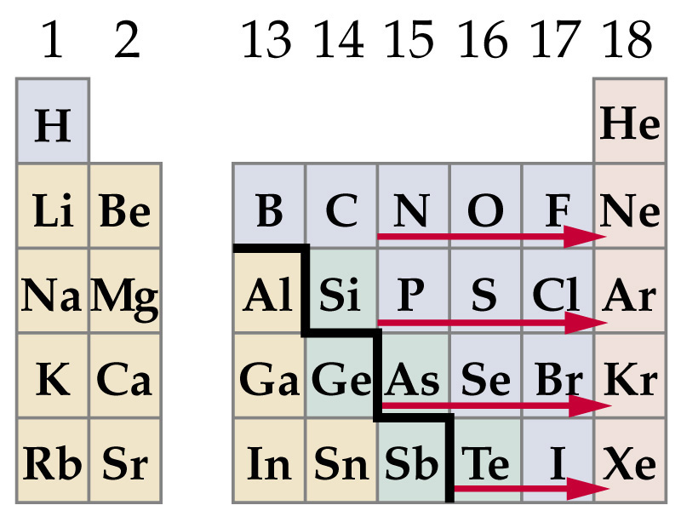
Tend to lose electrons to become positive
Tend to gain electrons to become negative

Slide 20
Periodic Properties
Another periodic trend on the table is ionization energy (a.k.a. potential)
Which is the energy needed to remove one of an atoms e⁻s.
Or a measure of how strongly an atom holds onto its outermost e⁻s.
If the e⁻s are held strongly the atom will have a high ionization energy

Slide 21
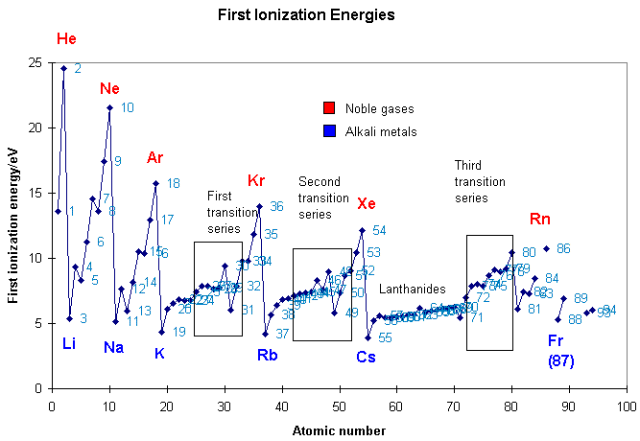

Slide 22
Periodic Properties
The ionization energy is generally measured for one electron at a time
You can also measure the amount of energy needed to reach in and pluck out additional electrons from atoms.
There is generally a large jump in energy necessary to remove additional electrons from the atom.

Slide 23
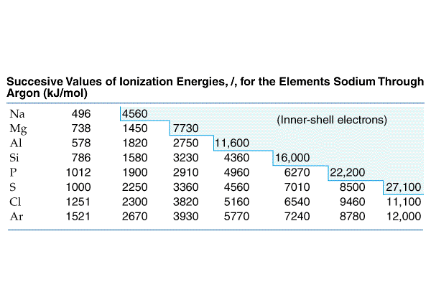
the amount of energy required to remove a 2p e– (an e⁻ in a full sublevel) from a Na ion is almost 10 times greater than that required to remove the sole 3s e⁻

Slide 24
Periodic Properties
There is simply not enough energy available or released to produce an Na²⁺ ion to make the compnd NaCl₂
Similarly Mg³⁺ and Al⁴⁺ require too much energy to occur naturally.
Chemical formulas should always describe compounds that can exist naturally the most efficient way possible

Slide 25
Periodic Properties
An atoms ability to lose an e⁻ or gain an e⁻ can be used to understand the Octet Rule
Octet Rule: atoms tend to gain, lose, or share electrons in order to acquire a full set of valence electrons.
2 e⁻ in the outermost s sublevel + 6 e– in the outermost p sublevel= a full valence shell

Slide 27
Periodic Properties
Electronegativity is a key trend.
It reflects the ability of an atom to attract electrons in a chemical bond.
F is the most electronegative element and it decreases moving away from F.
Electronegativity correlates to an atom’s ionization energy and electron affinity

Slide 28
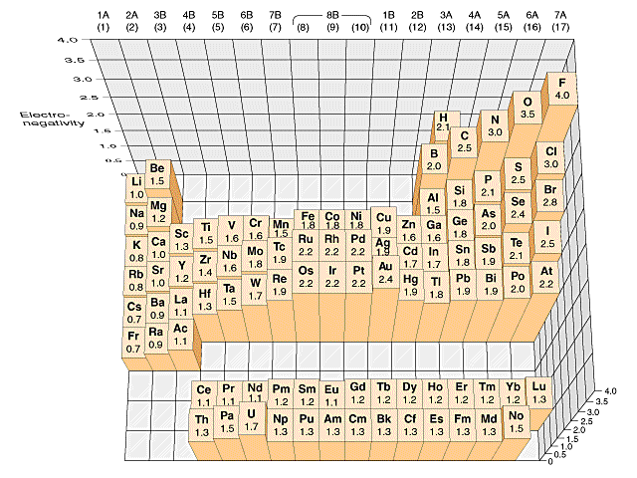

Slide 29
