Slide 1
Intermolecular Forces
Intermolecular forces are attractive forces between molecules.
Intramolecular forces hold atoms together in a molecule.
Intermolecular vs Intramolecular
41 kJ to vaporize 1 mole of water (inter)
930 kJ to break all O-H bonds in 1 mole of water (intra)
“Measure” of intermolecular force
boiling point
melting point
ΔH_{vap}
ΔH_{fus}
Generally, intermolecular forces are much weaker than intramolecular forces.
11.2

Slide 2
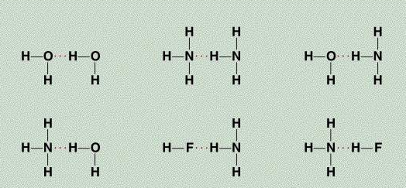
Types of Intermolecular Forces
1. Hydrogen Bond (strongest)
The hydrogen bond is a special dipole-dipole interaction between the hydrogen atom in a polar N-H, O-H, or F-H bond and an electronegative O, N, or F atom. IT IS NOT A BOND.
A
H
…
B
or
A
H
…
A
A & B are N, O, or F
11.2

Slide 3
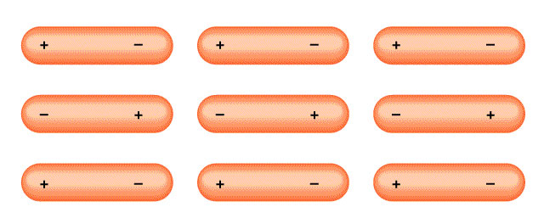
Types of Intermolecular Forces
2. Dipole-Dipole Forces
Attractive forces between polar molecules
Orientation of Polar Molecules in a Solid
11.2

Slide 4
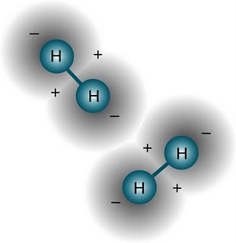
Types of Intermolecular Forces
3. Dispersion Forces – van der Wals forces/London forces (weakest)
Attractive forces that arise as a result of temporary dipoles induced in atoms or molecules
11.2

Slide 5
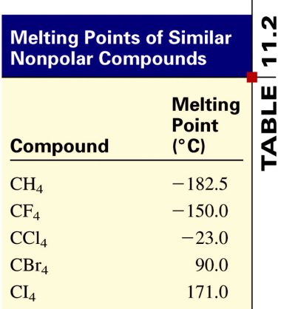
Intermolecular Forces
3. Dispersion (London) Forces Continued
Generally, the bigger the atoms or molecules, the greater the London forces between them.
Dispersion forces usually increase with molar mass.
11.2

Slide 6
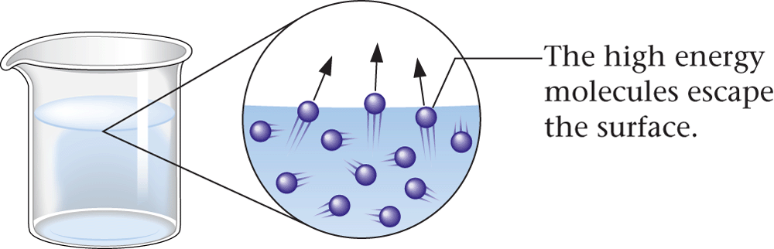
A. Evaporation and Vapor Pressure

Slide 7
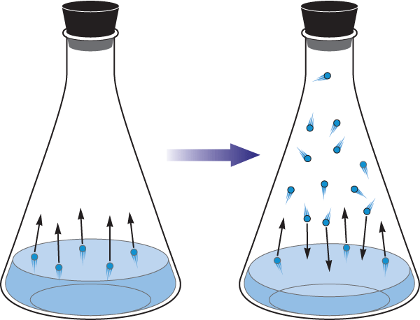
A. Evaporation and Vapor Pressure
Vapor Pressure
Condensation - process by which vapor molecules convert to a liquid
When no further change is visible the opposing processes balance each other - equilibrium

Slide 8
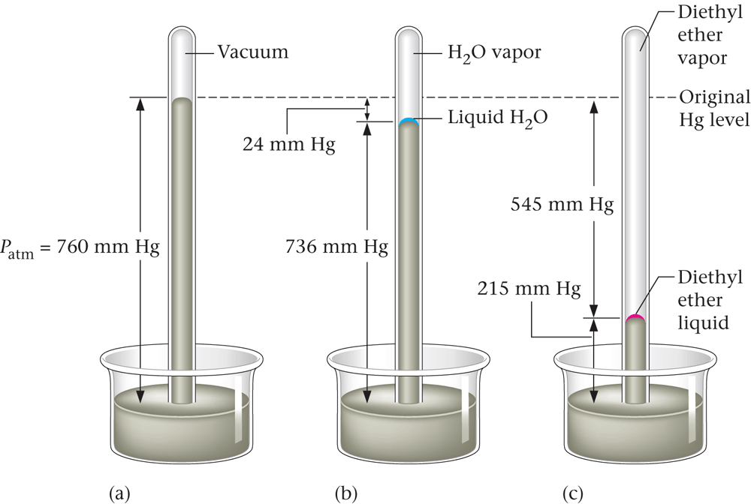
A. Evaporation and Vapor Pressure
Vapor Pressure
Vapor pressure - pressure of the vapor present at equilibrium with its liquid. Vapor pressures vary widely - relates to intermolecular forces

Slide 9
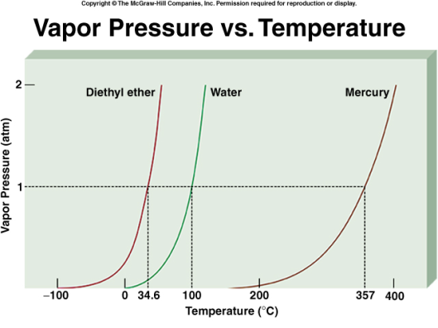

Slide 10
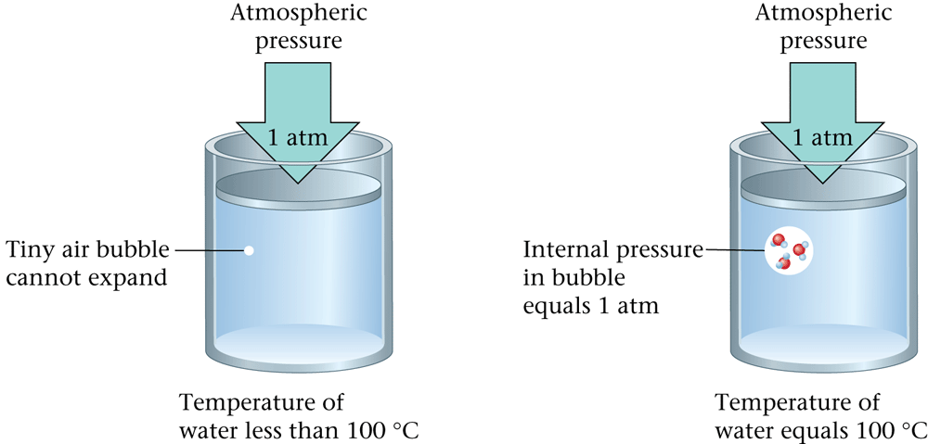
B. Boiling Point and Vapor Pressure

Slide 11
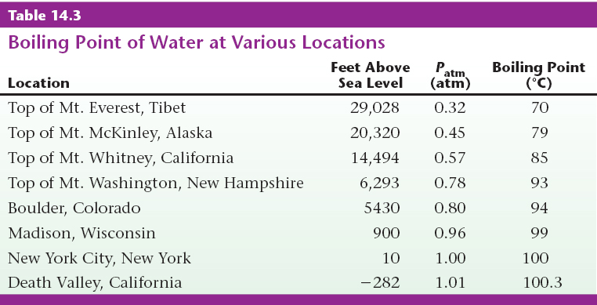
B. Boiling Point and Vapor Pressure

Slide 12
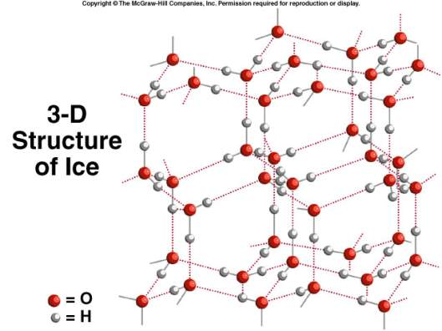
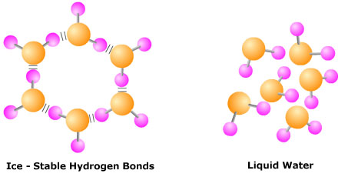
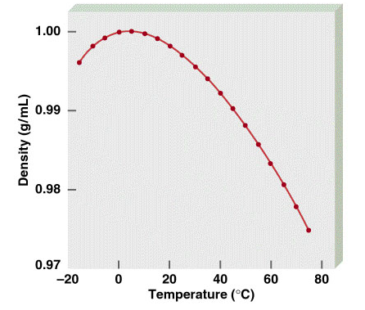
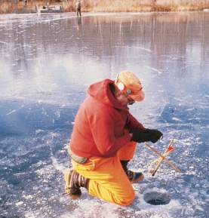
Density of Water
Ice is less dense than water
11.3

Slide 13
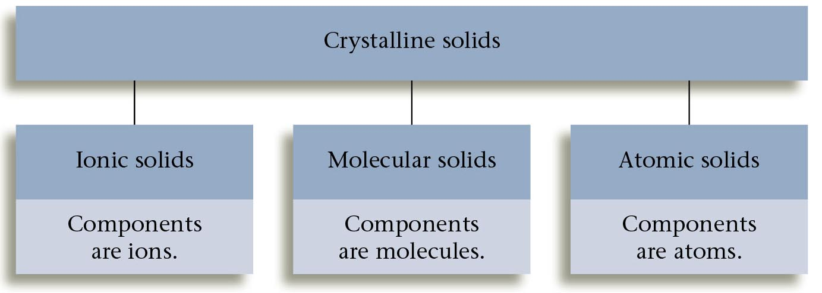
Figure 14.17: The classes of crystalline solids.

Slide 14
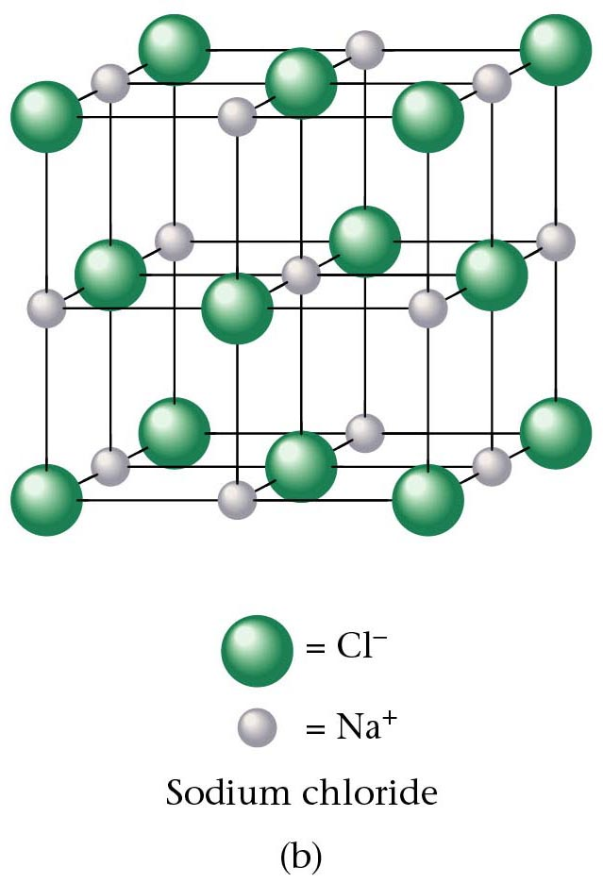
Types of Crystals/Solids
Ionic Crystals – Ion-Ion interactions are the strongest (including the “intermolecular forces” (H bonding, etc.)
Lattice points occupied by cations and anions
Held together by electrostatic attraction
Hard, brittle, high melting point
Poor conductor of heat and electricity
11.6

Slide 15
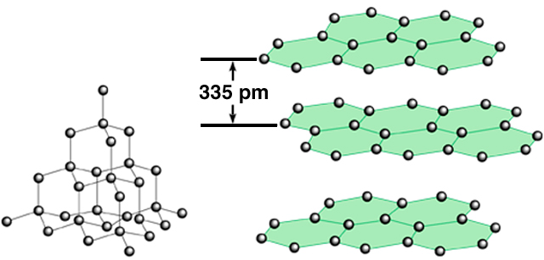
Atomic Solids
Covalently bonded– Stronger than IM forces but generally weaker than ion-ion
Lattice points occupied by atoms
Held together by covalent bonds
Hard, high melting point
Poor conductor of heat and electricity
carbon
atoms
diamond
graphite
11.6

Slide 16
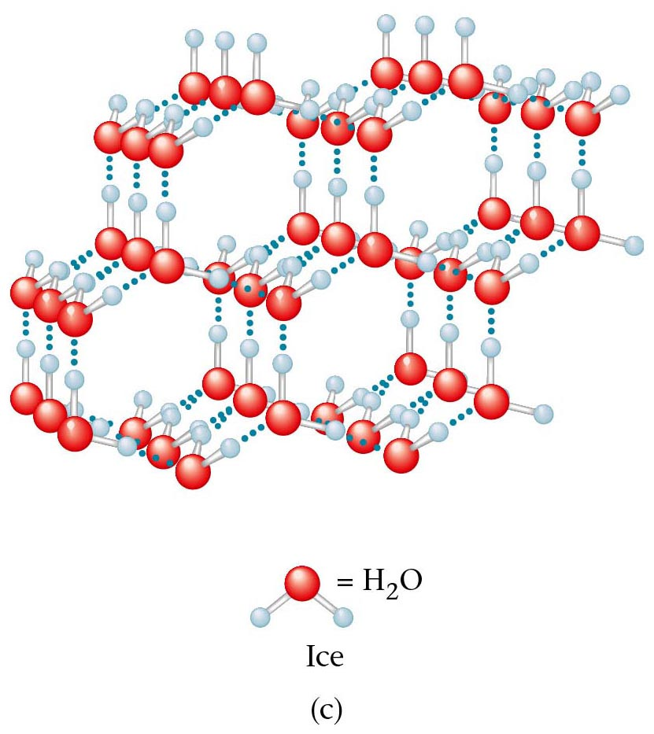
Molecular Solids
Molecular Solids
Lattice points occupied by molecules
Held together by intermolecular forces
Soft, low melting point
Poor conductor of heat and electricity
11.6

Slide 17
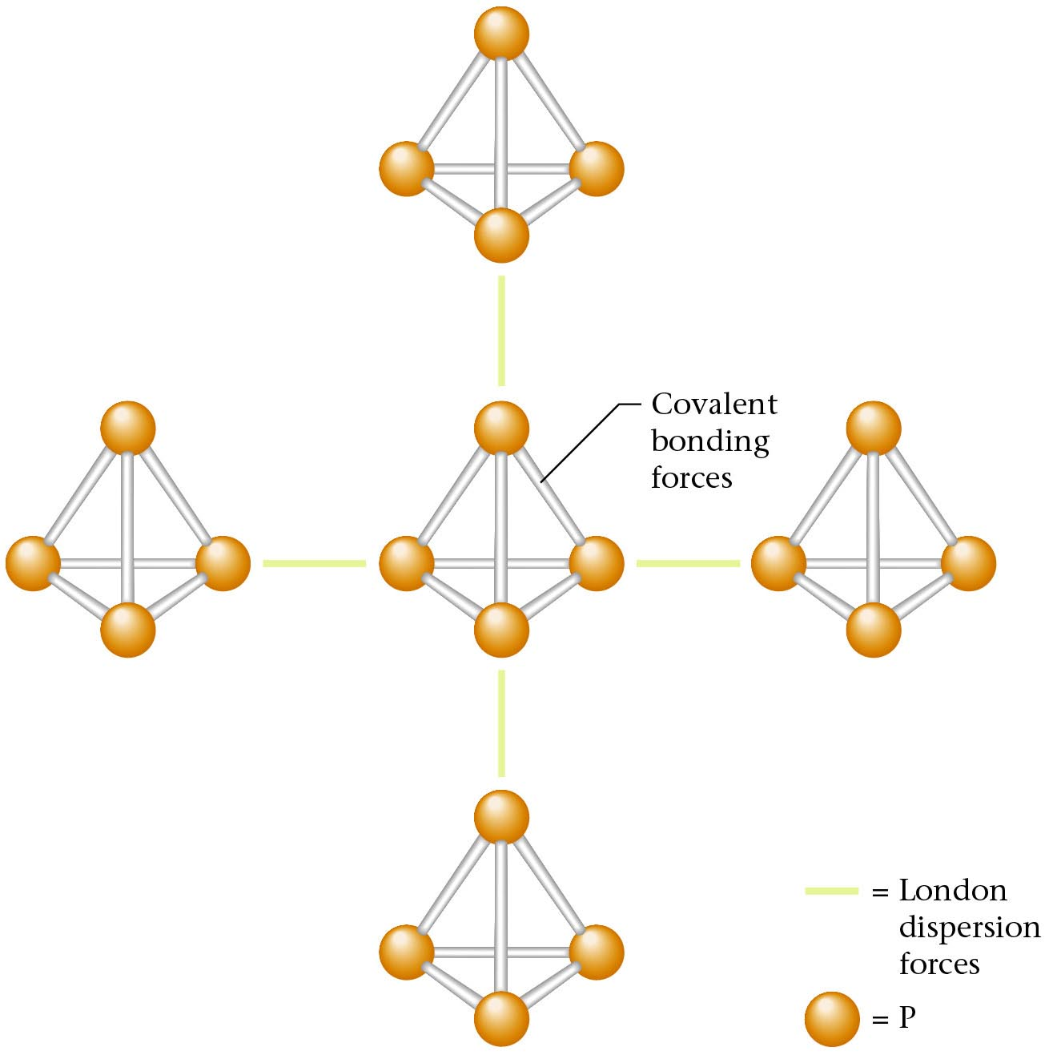
Figure 14.21: A representation of part of the structure of solid phosphorus, a molecular solid (P4)

Slide 18
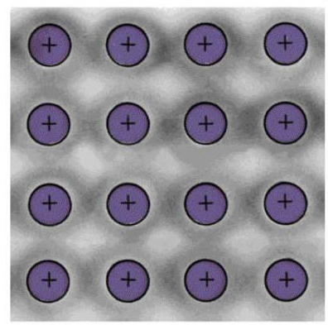
Metallic Solids – Pure and Alloy
Metallic– Typically weaker than covalent, but can be in the low end of covalent
Lattice points occupied by metal atoms
Held together by metallic bonds
Soft to hard, low to high melting point
Good conductors of heat and electricity
Cross Section of a Metallic Crystal
nucleus &
inner shell e⁻
mobile “sea”
of e⁻
11.6

Slide 19
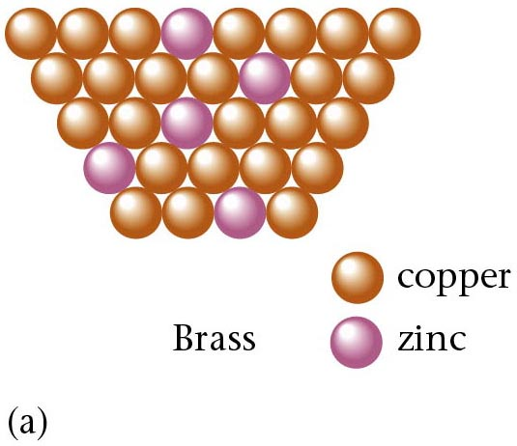
Figure 14.22: Molecular representation of brass, a substitutional ALLOY

Slide 20
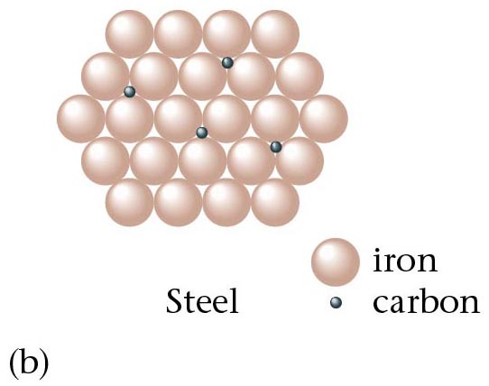
Figure 14.22: Molecular representation of steel, an interstitial ALLOY

