Slide 1
Matter – Properties and Changes
Chemistry – the study of matter and energy
What is Matter??
What isn’t Matter??

Slide 2

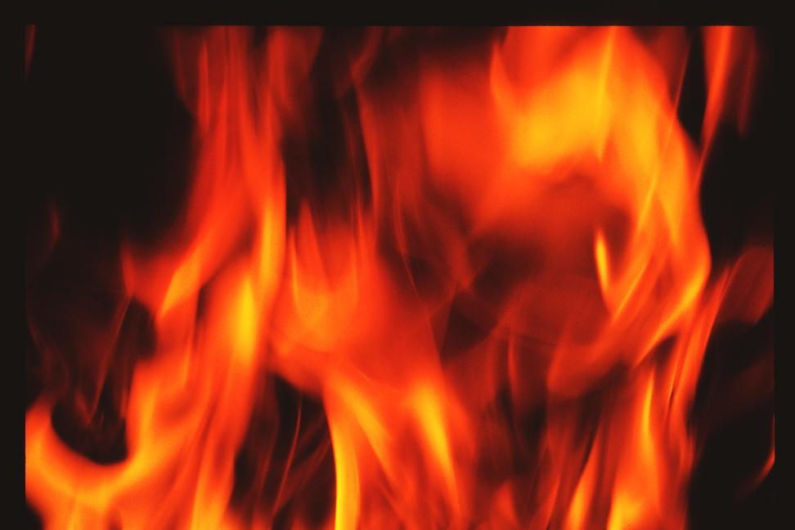
Matter? Name some matter
Matter?

Slide 3
I. Properties of Matter
Physical Properties
Observed or measured w/out changing the composition of matter.

Slide 4
I. Properties of Matter
Physical Properties
Observed or measured w/out changing the composition of matter.
Examples:
State of Matter, Density, Solubility Texture, Color, Mass, odor, taste, hardness, melting & boiling point

Slide 5
State of Matter
also known as a phase. Elements and compounds can move from one phase to another phase when special physical forces are present. One example of those forces is temperature. When temperature changes, the phase can also change.

Slide 6
Chemical Properties
ability of a substance to combine with or change into one or more other substances
Examples:
Reactivity w/ acids
Combustibility
Reactivity w/ oxygen
Radioactivity

Slide 7
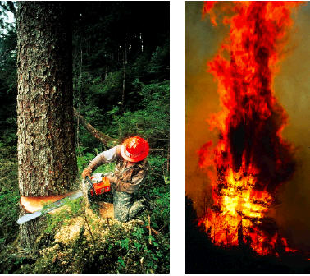
How is the tree changed by each action shown?
Which action do you think shows a more complete change?

Slide 8
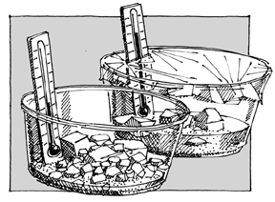
II. Matter Changes
Physical Change - Changes which alter a substance without changing its composition
Give some examples of physical changes:
  Change of shape
  Change of State
  Solute dissolving in a solvent

Slide 9

Chemical Changes change the chemical properties.
a process that involves one or more substances changing into new substances .
Give some examples of a chemical change:
  Combustion Fermentation
  Oxidation Corrosion
  Reaction w/ Acids

Slide 10
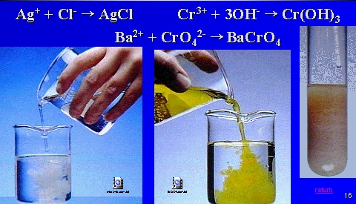
Evidence of chemical change:
Formation of a precipitate (a new solid)

Slide 11

Evidence of chemical change:
Color Change

Slide 12
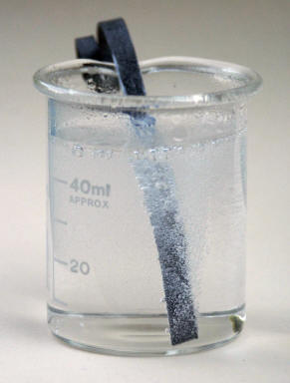
Evidence of chemical change:
Gas Evolution

Slide 13
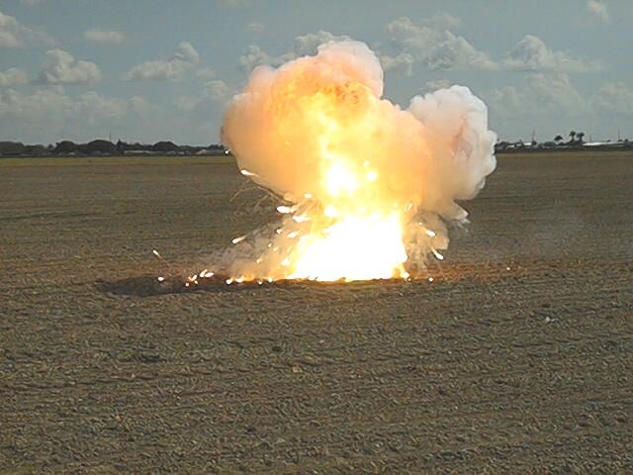
Evidence of chemical change:
Heat and Light

Slide 14
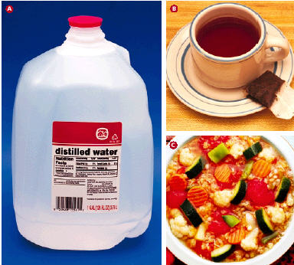
How is this liquid made?
What does it have in common with the other photos?

Slide 15
Mixtures of Matter (Classification of Matter)
Matter
a. Pure Substance
contains only one kind of atom or molecule
b. Mixture
combination of two or more pure substances in which each pure substance retains its individual chemical properties. Mixture are physically combined.

Slide 16
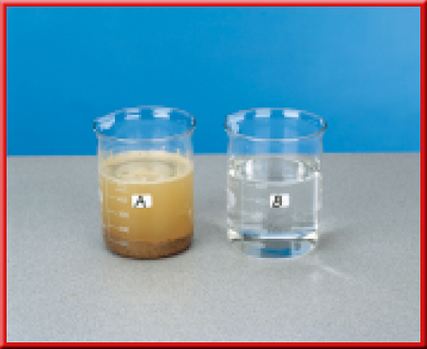
Mixtures of Matter (Classification of Matter)
Matter
b. Mixture
a. Pure Substance
Heterogeneous mixture
one that does not blend smoothly throughout and in which the individual substances remain distinct.

Slide 17
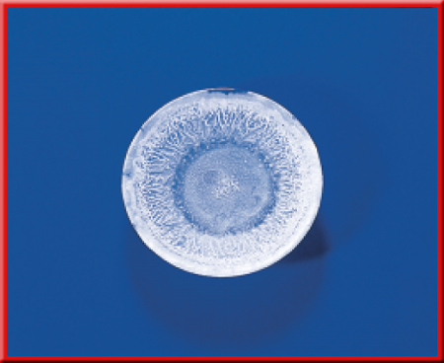
Matter
b. Mixture
Heterogeneous mixture
Homogeneous mixture:
constant composition throughout; it always has a single phase. Also referred to as Solution.
How could you tell this is a homogeneous mixture?
Boil it!

Slide 18


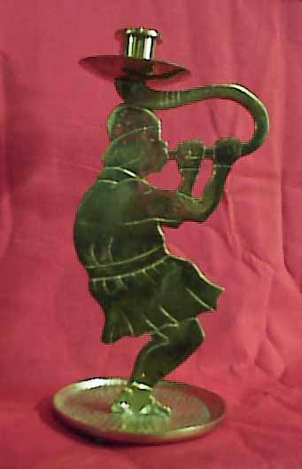
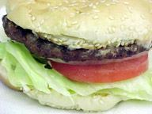
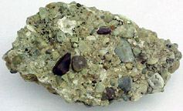
All of these things are mixtures. Which ones are homogeneous and which are heterogeneous?

Slide 19
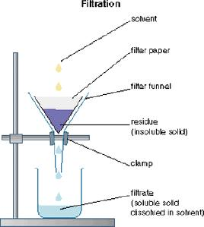
Separating Mixtures
Give some examples of how you would separate mixtures:
1. Filtration - a technique that uses a porous barrier to separate a solid from a liquid.

Slide 20
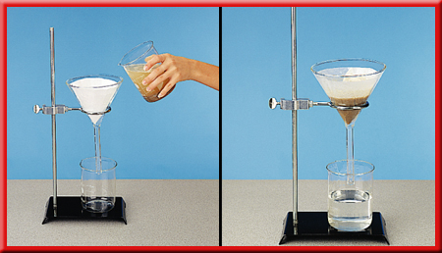
Separating Mixtures

Slide 21
2. Distillation - a technique that is based on differences in the boiling points of the substances involved. Mixtures are heated to their boiling points, then their vapor can be cooled and condensed, and collected.

Slide 22
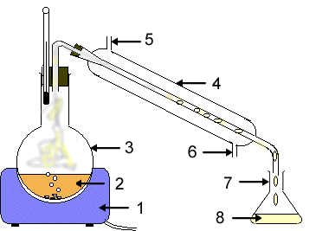

Slide 23
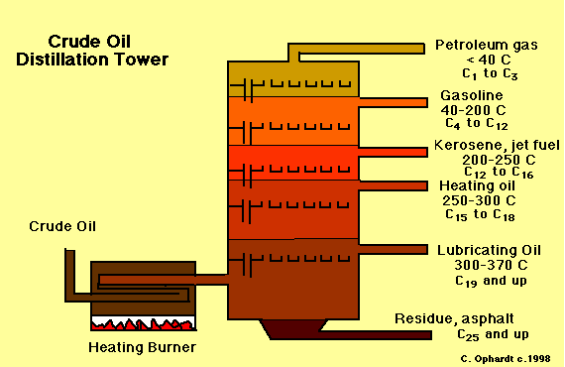

Slide 24
Mixtures of Matter (Classification of Matter)
Matter
b. Mixture
a. Pure Substance
Element
Compound

Slide 25
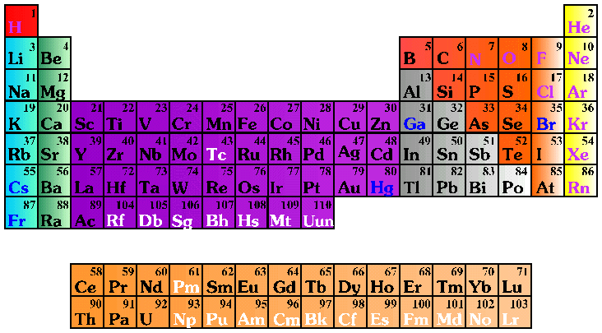
Elements and Compounds
Periodic Table of the Elements

Slide 26
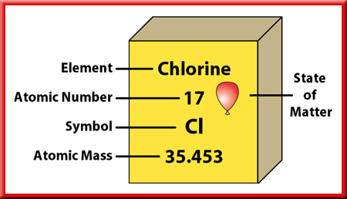
Elements and Compounds
Element – pure substance that cannot be separated into simplier substances by physical or chemical means.
91 naturally occuring; 27 more that have been lab-synthesized (so 118 total)
Hydrogen the most common
at room temp, 11 are gas, 3 are liquid, the rest solid

Slide 27
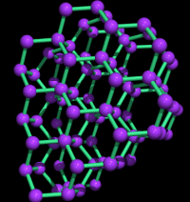
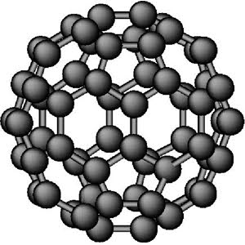
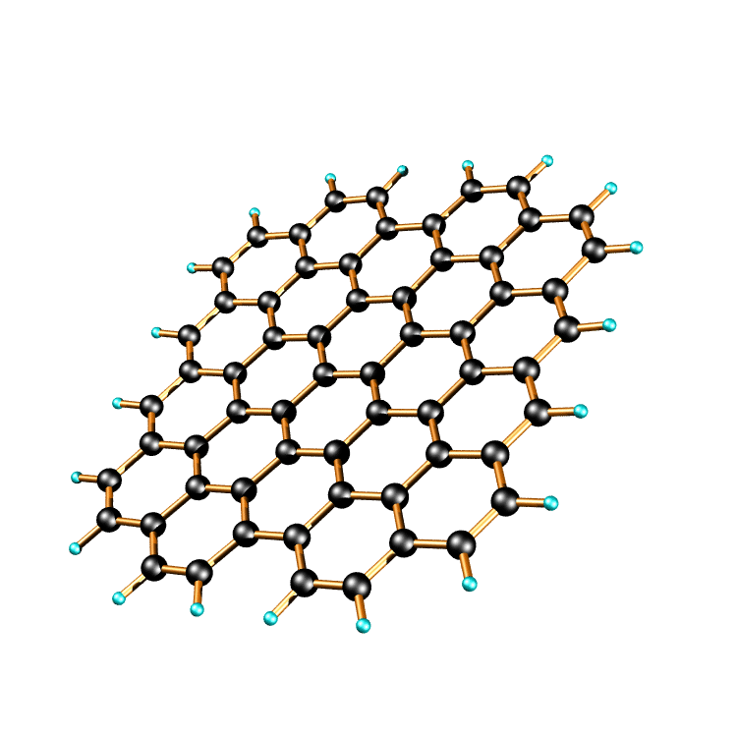
Carbon-60
Graphite
Graphite
Diamond
3 forms of the element carbon

Slide 28
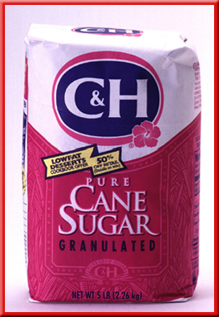

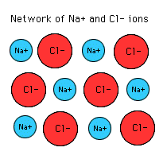


Compounds are a combination of two or more elements that are combined chemically.
carbon dioxide
water
methane
Sodium chloride
ammonia

Slide 29
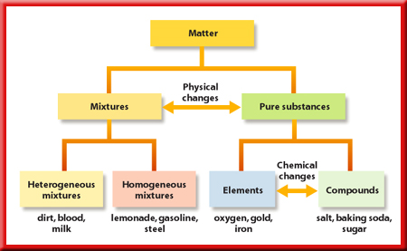

Slide 30
Vocabulary
Homogeneous mixture: one that has a uniform composition throughout and always has a single phase; also called a solution. Ex: salt water
Heterogeneous mixture: one that does not have a uniform composition and in which the individual substances remain present in more than one physical state. Ex: sand in water
Intensive property: a physical property that remains the same no matter how much of a substance is present
Extensive property: a physical property, such as mass, length, and volume, that is dependent upon the amount of a substance present.
Element: a pure substance that cannot be broken down into simpler substances by physical or chemical means. Example: carbon

Slide 31
Vocabulary, continued:
Substance: a form of matter that has a uniform and unchanging composition; also known as a pure substance.
Mixture: a physical blend of 2 or more pure substances in any proportion in which each substance retains its individual properties; can be separated by physical means
Chemical property: the ability or inability of a substance to combine with or change into one or more new substances
Physical property: a characteristic of matter that can be observed or measured without changing the sample’s composition – Ex: density, color, taste, melting point
Compound: a chemical combination of two or more different elements; can be broken down into simpler substances by chemical means and has properties different from those of its component elements
Example: water

Slide 32
Dalton’s Discovery:
c. Law of Constant Composition– regardless of the amount, a compound is always composed of the same elements in the same proportion by mass.

Slide 33
The two distinct compounds water (H₂O) and hydrogen peroxide (H₂O₂) illustrate the law of multiple proportions.
Each compound contains the same elements (hydrogen and oxygen).
Water is composed of two parts hydrogen (the element that is present in different amounts in both compounds).
But, on the other hand…

Slide 34
Hydrogen peroxide is composed of two parts hydrogen and two parts oxygen.
Hydrogen peroxide differs from water in that it has twice as much oxygen.
When we compare the mass of oxygen in hydrogen peroxide to the mass of oxygen in water, we get the ration 2:1.

Slide 35
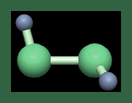
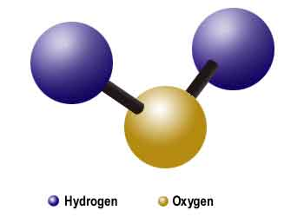
Symbols are shorthand for elements, but Formulas are shorthand for compounds.
Formulas on this slide.
Hydrogen peroxide, above: H₂O₂
Water, at right: H₂O

Slide 36
D. Subatomic Particle & the Nuclear Atom
Nucleus
contains positively charged protons and neutral neutrons
VERY dense! If a nucleus were the size of the dot in the exclamation point at the end of this sentence, its mass would be approximately as much as that of 70 automobiles!

Slide 37
D. Subatomic Particle & the Nuclear Atom
2. Protons (discovered by Rutherford)
Carries a charge of 1+, equal but opposite that of an electron
Mass = 1.6726x10⁻²⁴ g (1800x’s more than electron)
Found in nucleus
Referred to as atomic number
Atomic number = number of protons = number of electrons

Slide 38
D. Subatomic Particle & the Nuclear Atom
3. Neutrons (discovered by Chadwick)
No Charge
Mass = 1.6750x10⁻²⁴ g
Found in nucleus
Number of neutrons = mass number – atomic number

Slide 39
D. Subatomic Particle & the Nuclear Atom
4. Electrons (discovered by Thomson)
Negative charge (1-)
Relative mass is 1/1840 amu (actual mass is 9.115x10-28 g).
Located in the space surrounding the nucleus
number of protons = number of electrons
What is not neutral?
What is a charged atom called?
ion

Slide 40
D. Subatomic Particle & the Nuclear Atom
For Example: Sodium? How many protons?
Na = 11 protons
What if it has 10 electrons?
(+11) + (-10) = +1 charge
Na ¹ ⁺

Slide 41
D. Subatomic Particle & the Nuclear Atom
5. Atomic number
Refers to the number of protons
Determines the elements position on the periodic table

Slide 42
D. Subatomic Particle & the Nuclear Atom
6. Isotopes and Mass Number
All atoms of a particular element have the same number of protons and electrons, but neutrons may differ these types of elements are called Isotopes.
The sum of the number of protons and neutron is the Mass Number.
Mass number = protons + neutrons

Slide 43
D. Subatomic Particle & the Nuclear Atom
6. Isotopes and Mass Number
The atomic mass of an element is the weighted average mass of the isotopes of that element.
Chemists have taken samples of the different isotopes of a given element, for example Potassium-39, Potassium-40, and Potassium-41, and have averaged the masses to determine atomic mass. That is different from mass number, which is the mass of a specific atom or specific isotope.

Slide 44
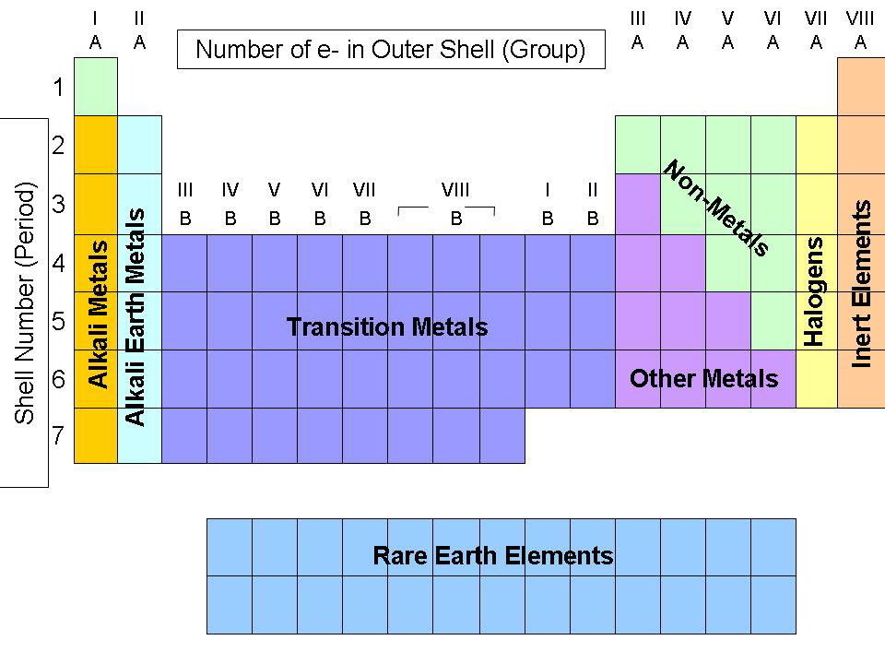
The Groups of the Periodic Table

Slide 45
A Vertical Column in the Periodic Table is called a Group or Family
Alkali Metals and Alkaline Earth Metals are Groups 1A and 2A, respectively. Alkali Metals form ions with +1 charge, and Alkaline Earth Metals for ions with +2 charge.

Slide 46
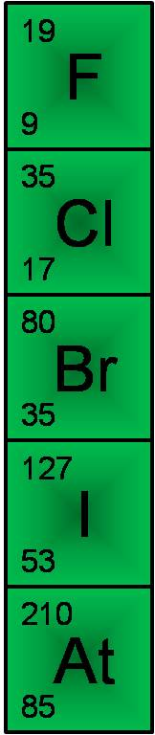
Halogen Family
Group 7A elements, the halogens, contain diatomic molecules. They all form ions with a -1 charge.
Group 7A elements have different colored gases.

Slide 47
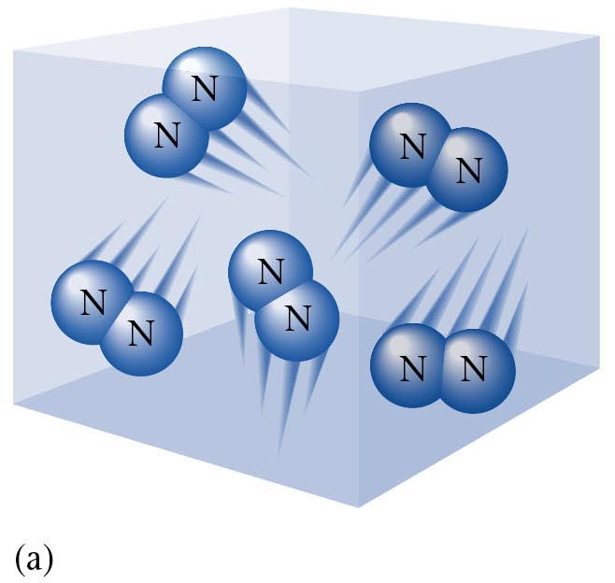
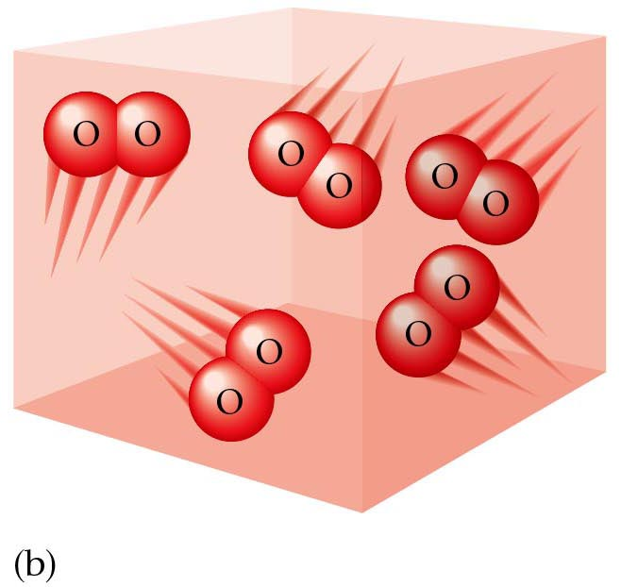
Diatomic Molecule
Nitrogen, N2, is diatomic, so it has 2 atoms instead of 1.
Other examples of diatomic molecules are oxygen, O2, chlorine, Cl2, and hydrogen, H2.

