Slide 1
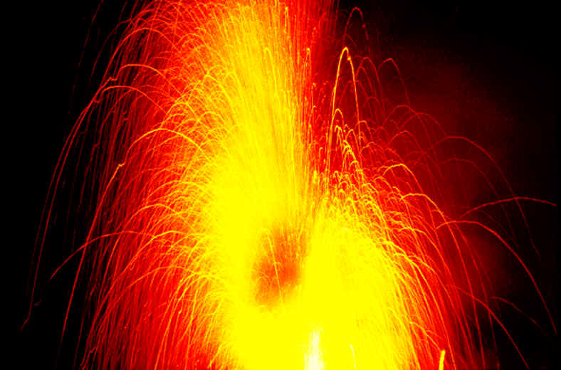

Slide 2
Chapter 10 Energy and Chemical Change
Energy
A. Definition:
Energy is the ability to do work or produce heat.

Slide 3
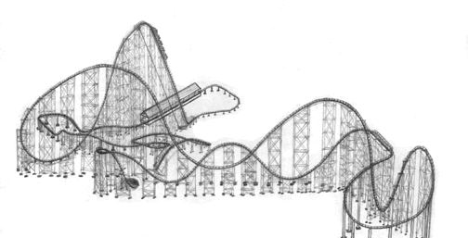
Energy
B. Two Forms:
Potential energy is energy due to the composition or position of an object.

Slide 4
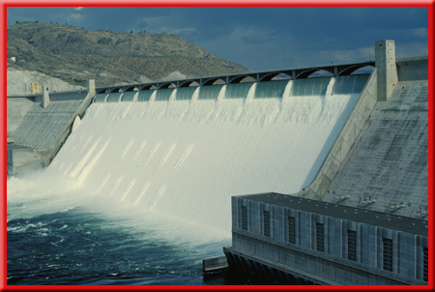
A example of potential energy of position is water stored behind a dam above the turbines of a hydroelectric generating plant.
When the dam gates are opened, the water rushes down and does work by turning the turbines to produce electrical energy.

Slide 5
B. Two Forms (cont’d):
Kinetic energy is energy of motion.
The potential energy of the dammed water is converted to kinetic energy as the dam gates are opened and the water flows out.

Slide 6
C. Chemical systems contain both potential and kinetic energy
As temperature increases the motion of the particles increases.
The potential energy of a substance can be chemical potential energy, because energy can be stored in the chemical bonds between atoms. When chemicals undergo a chemical reaction, they can release energy when their bonds are broken, or they can absorb energy to form new bonds.

Slide 7

D. Law of conservation of energy
To better understand the conservation of energy, suppose you have money in two accounts at a bank and you transfer funds from one account to another
Although the amount of money in each account has changed, the total amount of your money in the bank remains the same.

Slide 8
D. Law of conservation of energy
The law of conservation of energy states that in any chemical reaction or physical process, energy can be converted from one form to another, but it is neither created nor destroyed.

Slide 9
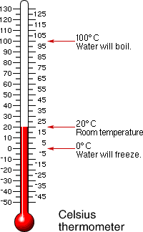
Temperature:
II. Measuring Heat
measure of the average kinetic energy of random motion of the particles in a substance

Slide 10
Heat: a measure of the total amount of energy transferred from an object of high temperature to one of low temperature

Slide 11
In the metric system of units, the amount of heat required to raise the temperature of one gram of pure water by one degree Celsius (1°C) is defined as a calorie (cal).
The SI unit of heat and energy is the joule (J). One joule is the equivalent of 0.2390 calories, or one calorie equals 4.184 joules.

Slide 12

The breakfast shown in the photograph contains 230 nutritional Calories.
How much energy in joules will this healthy breakfast supply?

Slide 13


You must convert nutritional Calories to calories and then calories to joules.

Slide 14
You’ve learned that one calorie, or 4.184 J, is required to raise the temperature of one gram of pure water by one degree Celsius (1°C).
That quantity, 4.184 J/(g∙°C), is defined as the specific heat (c) of water.

Slide 15
A. Specific heat capacity (c):
the amount of heat energy required to raise the temperature of one gram of that substance by one degree Celsius.
1. physical property
2. constant for most substances
3. metals usually low, and water usually high

Slide 16
B. Specific heat capacity (c):
Q = s x m x ΔT
q = (also H) heat energy
ΔT = change in temp
m = mass
s = specific heat capacity

Slide 17
example: how much heat energy is released to your body when a cup of hot tea containing 200 grams of water is cooled from 65 C to body temperature, 37 C? cp for water is 4.184 J/g C
Q = s x m x ΔT
Q =(4.184J/g C) (200g) (65C-37C)
Q = 23,408 J

Slide 18
B. Heat in Chemical Reactions and Processes
1. energy can be converted into other forms
2. measure changes in heat energy
Calorimeter: a device to measure heat energy
change in heat = change in temperature x mass of water x specific heat capacity

Slide 19
Chemical Energy and the Universe
Everything in the universe other than the system is considered the surroundings.
Therefore, the universe is defined as the system plus the surroundings.
universe = system + surroundings

Slide 20
e. Exothermic
C₆H₁₂O₆ (s) + 6O₂ (g) -
6CO₂ (g) + 6H₂O(l)
Above is Cellular Respiration, where energy is released for cells to live: H = -2870 kJ
f. Endothermic
6CO₂(g) + 6H₂O(l)
C₆H₁₂O₆ (s) + 6O₂ (g)
Above is Photosynthesis, where energy is absorbed to make the glucose: H = +2870 kJ

