Slide 1

PERIODICITY

Slide 2
Electron Configurations
The chemistry of an atom occurs at the set of electrons called valence electrons
The valence electrons are electrons in an atom’s highest energy level.
For the Group – A elements, it is the outermost s & p e⁻ of the atom.
Specifically the 2 s electrons + 6 p electrons (octet electrons)
The arrangement of the valence e⁻ lead to the element’s properties.

Slide 3
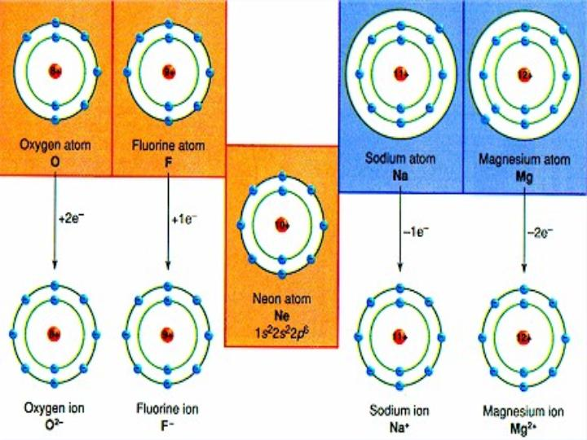

Slide 4
Periodic Properties
An element’s properties can go hand in hand with electron arrangement
We can use an element’s location on the PT to predict many properties.
Atomic radius
Electronegativity
Ionization energy
Ionic Size

Slide 5
Periodic Properties
As we examine atomic radius from left to right across the PT we see a gradual decrease in atomic size.
As e⁻ are added to the s and p sublevels in the same energy level, they are gradually pulled closer to the highly positive nucleus (negatively charged electrons are attracted to the positively charged proton → opposites attract!!)
The more e⁻’s in the atom the less dramatic this trend looks

Slide 6
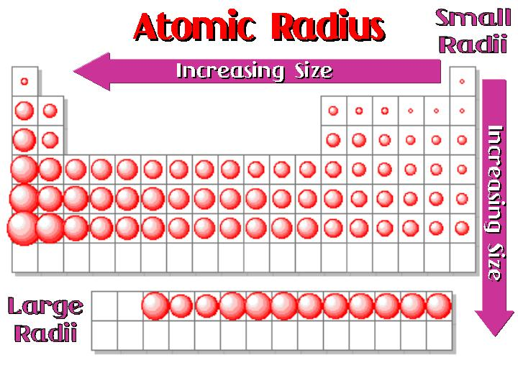

Slide 7
Periodic Properties
* We are adding protons into the nucleus which increases the p⁺-e⁻ interaction (attraction)
So the nucleus gains strength while the e⁻ aren’t gaining much distance, so the atom is drawn in closer and closer to the nucleus.
Decreasing the overall radius of the atom

Slide 8
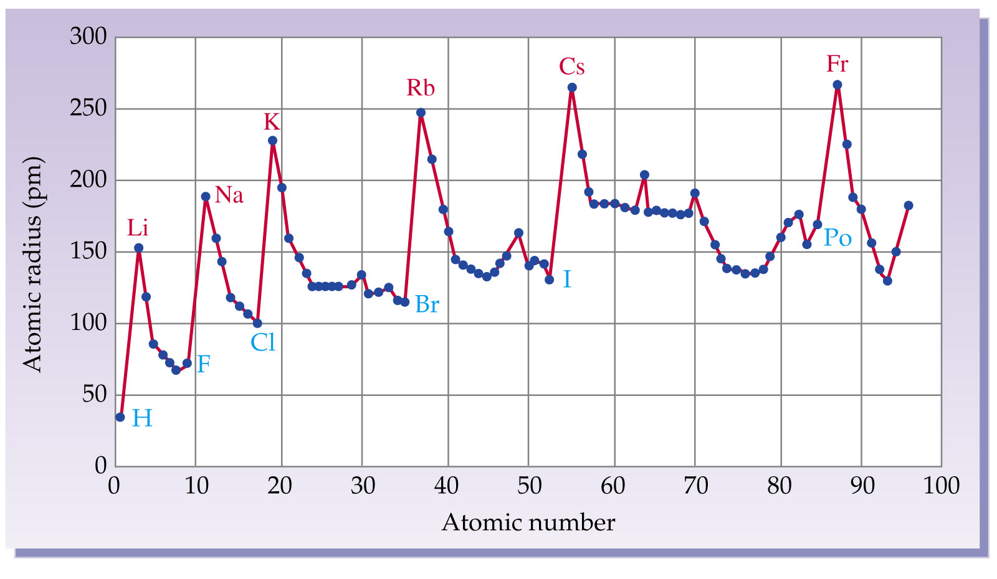

Slide 9
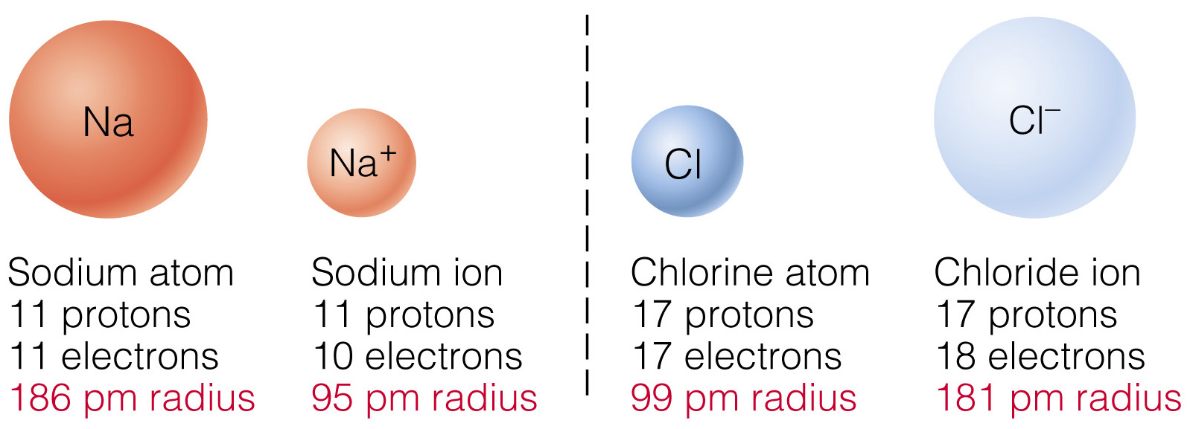
Periodic Properties
How does the size of an atom change when electrons are added or removed?
As an Atom loses 1 or more electrons (becomes positive), it loses a layer therefore, its radius decreases.

Slide 10
Periodic Properties
How does the size of an atom change when electrons are added or removed?
As an Atom gains 1 or more electrons (negative), it fills its valence layer, therefore, its radius increases.

Slide 11
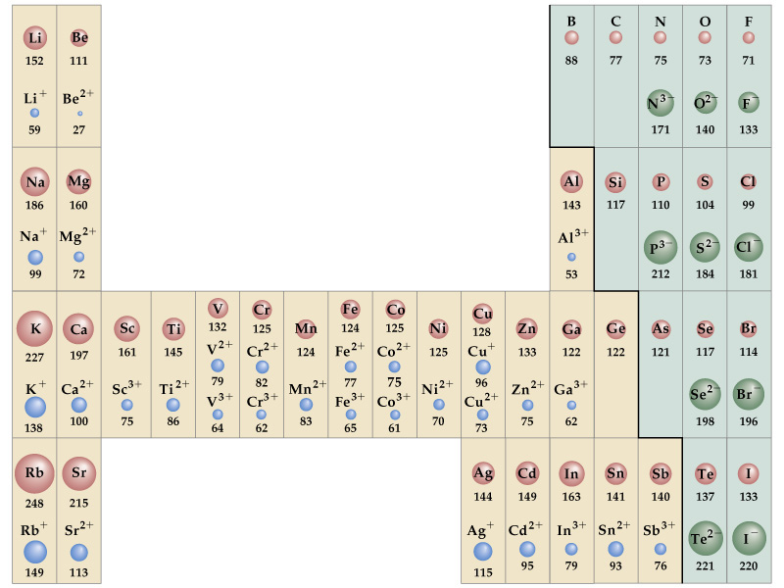

Slide 12
Periodic Properties
Elements in a group tend to form ions of the same charge.
Modeled by electron configurations.
4s
Loses 1
electron
4s
K:
[Ar]
[Ar]
Wants a full set of e⁻
+1
K

Slide 13
Periodic Properties
2s²
2p⁴
Gains
2 electrons
O:
[He]
[He]
Wants a complete set
-2
O

Slide 14
Periodic Trend of Ionic Charges
1
18
2
13
14
15
16
17
3
4
5
6
7
8
9
10
11
12
+1
tend to have
+2
+3
-3
-2
-1
+/- 4
more than one option
+ 3
+ 3 or + 4

Slide 15
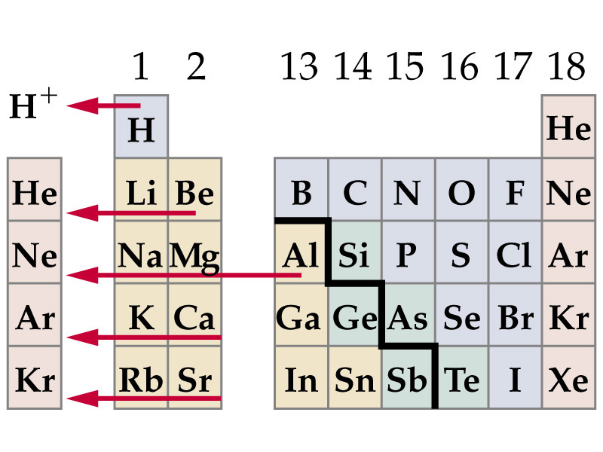
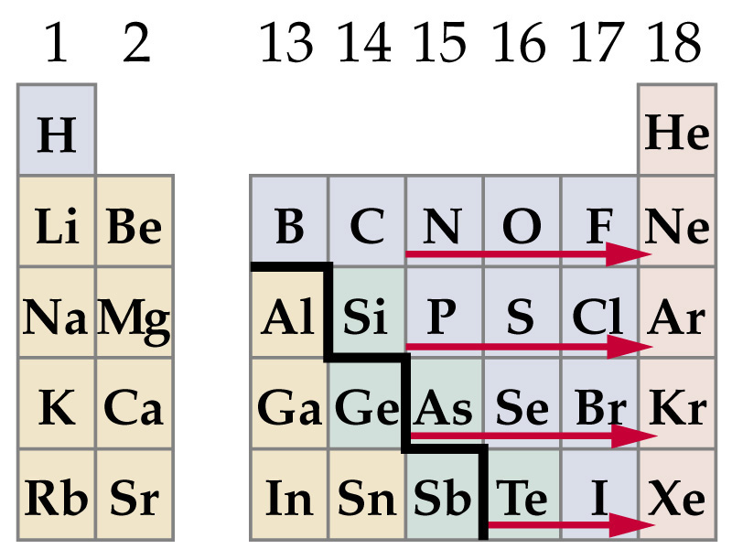
Tend to lose electrons to become positive
Tend to gain electrons to become negative

Slide 16
Periodic Properties
Another periodic trend on the table is ionization energy (a.k.a. potential)
Which is the energy needed to remove one of an atom’s e⁻s.
Or a measure of how strongly an atom holds onto its outermost e⁻s.
If the e⁻s are held strongly the atom will have a high ionization energy

Slide 17
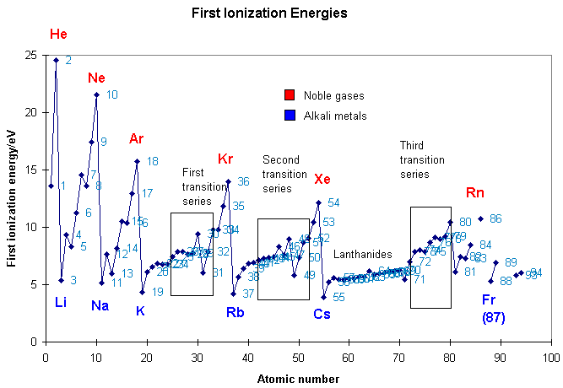

Slide 18
Periodic Properties
The ionization energy is generally measured for one electron at a time
You can also measure the amount of energy needed to reach in and pluck out additional electrons from atoms.
There is generally a large jump in energy necessary to remove additional electrons from the atom.

Slide 19
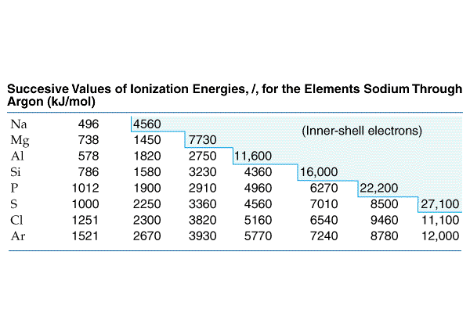
the amount of energy required to remove a 2p e– (an e⁻ in a full sublevel) from a Na ion is almost 10 times greater than that required to remove the sole 3s e⁻

Slide 20
Periodic Properties
There is simply not enough energy available or released to produce an Na²⁺ ion to make the compnd NaCl₂
Similarly Mg³⁺ and Al⁴⁺ require too much energy to occur naturally.
Chemical formulas should always describe compounds that can exist naturally the most efficient way possible

Slide 21
Periodic Properties
An atom’s ability to lose an e⁻ or gain an e⁻ can be used to understand the Octet Rule
Octet Rule: atoms tend to gain, lose, or share electrons in order to acquire a full set of valence electrons.
2 e⁻ in the outermost s sublevel + 6 e– in the outermost p sublevel= a full valence shell

Slide 23
Periodic Properties
Electronegativity is a key trend.
It reflects the ability of an atom to attract electrons in a chemical bond.
F is the most electronegative element and it decreases moving away from F.
Electronegativity correlates to an atom’s ionization energy and electron affinity

Slide 24
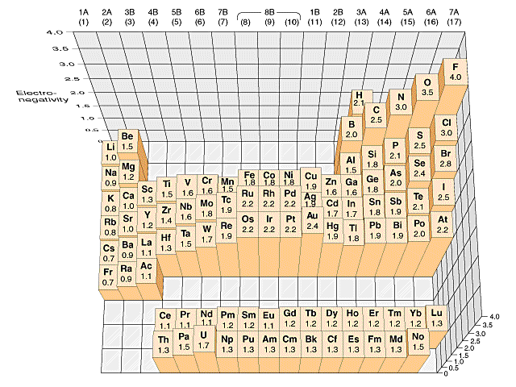

Slide 25
