Slide 1
Chapter 14 States of Matter
Forces of Attraction
Liquids and Solids
Phase Changes

Slide 2
I. Forces of Attraction
Intramolecular forces? (forces within)
Covalent Bonds, Ionic Bonds, and metallic bonds
Intermolecular Forces? (forces between)
London dispersion forces, dipole-dipole forces, and hydrogen bonding

Slide 3
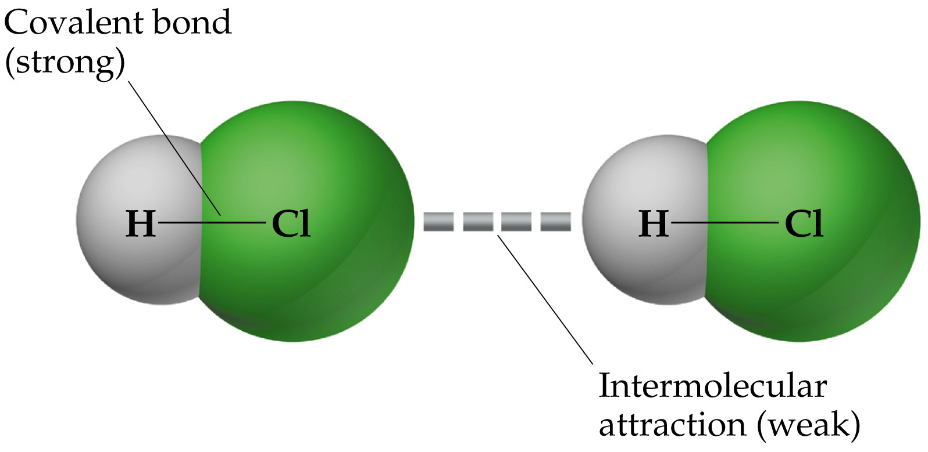

Slide 4
A. London dispersion forces
Weak force that results from a temporary shift in the density of electrons in electron clouds.
Occur between non-polar molecules

Slide 5
A. London dispersion forces
one part of molecule becomes temporarily (-) and repels electron in neighboring molecule so that end becomes (+)
charge distribution is constantly shifting, but net effect is an overall force of attraction between molecules

Slide 6
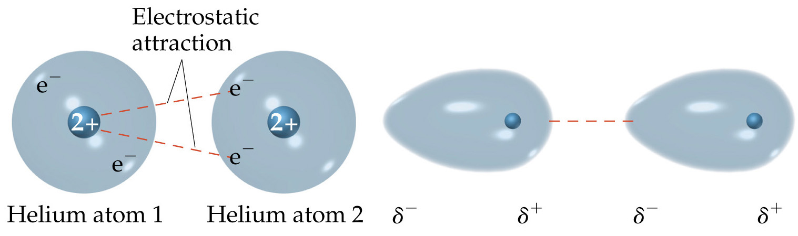
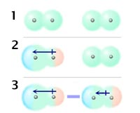

Slide 7
B. Dipole-dipole forces
  occur between polar molecules
  effective only over short distances, force increases as distance decreases

Slide 8
forces increase with number of electrons, therefore, atomic mass increases force (directly related to number of electrons present)
greater force than London dispersion forces

Slide 9
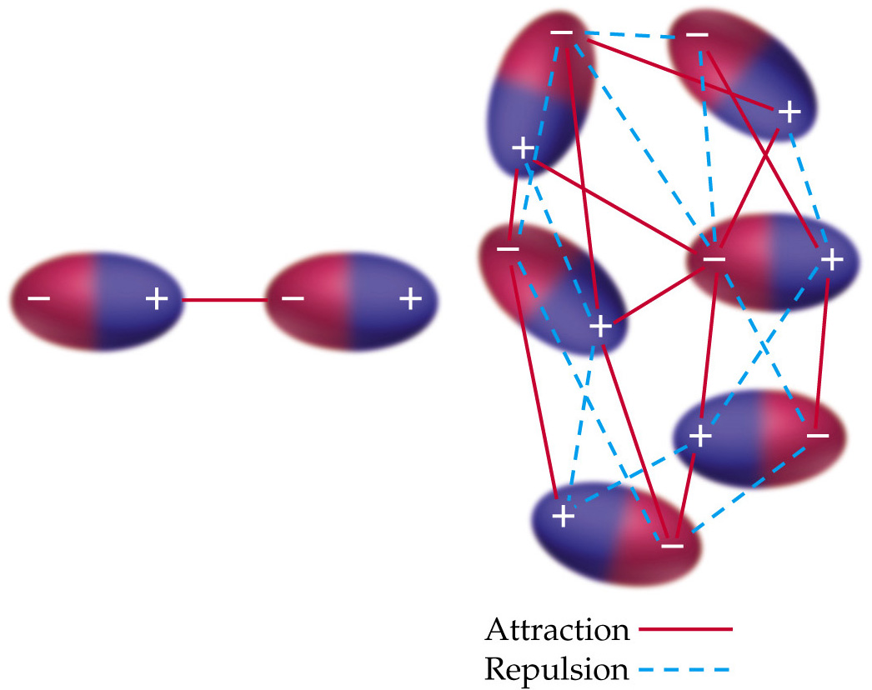

Slide 10
C. Hydrogen Bonding
occurs between molecules containing hydrogen & a very electronegative atom (F, O, N)
a very strong type of dipole-dipole force (10 times stronger than London dispersion forces)

Slide 11
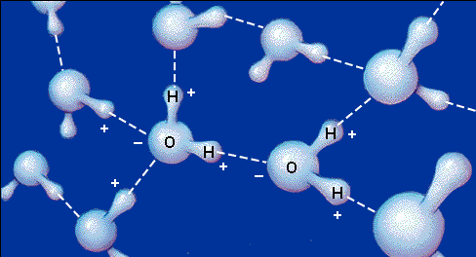
Examples of hydrogen bonding are Water, DNA, and proteins:

Slide 12
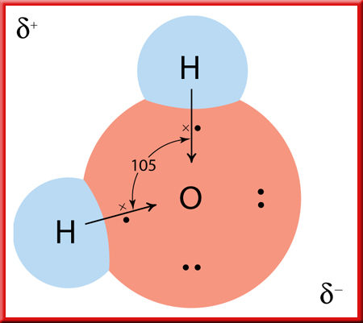
Because of the molecule’s bent structure, the poles of positive and negative charge in the two bonds do not cancel, and the water molecule as a whole is polar. This bent structure coupled with the hydrogen bonding makes water liquid at room temperature.

Slide 13
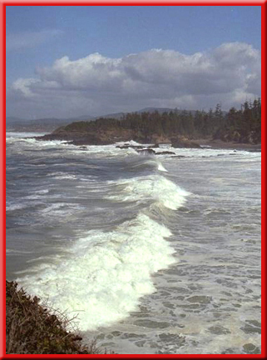
States of Water
Water occurs primarily in the liquid and solid
states on Earth, rather than as a gas.
The intermolecular hydrogen bonds hold the water molecules together strongly enough that they cannot readily escape into the gaseous state at ordinary temperatures.

Slide 14
States of Water
That is why water has such a high boiling
point for such a small molecule, 100°C.
(as opposed to a similarly small compound with only 3 atoms – CO2: boiling temperature -57°C)

Slide 15
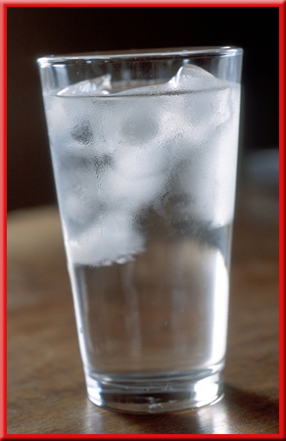
Ice Floats
You know that if you drop an ice cube into a glass of water, the ice floats.
You also know this means that the density of the solid water is less than that of liquid water.

Slide 16
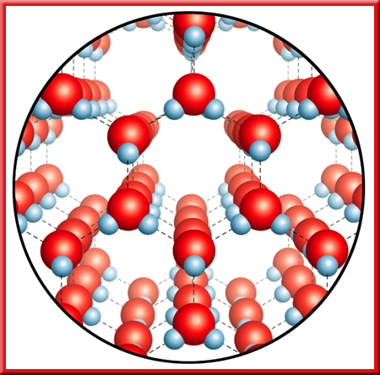
Solutions: Basic Concepts
Ice Floats
You can account for this if you know what is happening to the molecular arrangement.
Below 4°C, the water molecules are beginning to approach the solid state, which is highly organized. Notice all the space between the molecules in the diagram. More space = less dense = floats

Slide 17
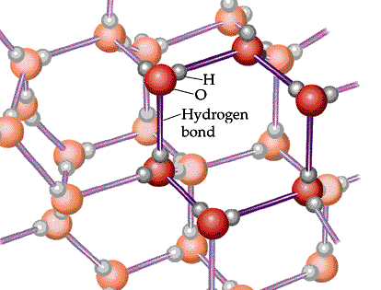
Hydrogen Bonds in Ice

Slide 18
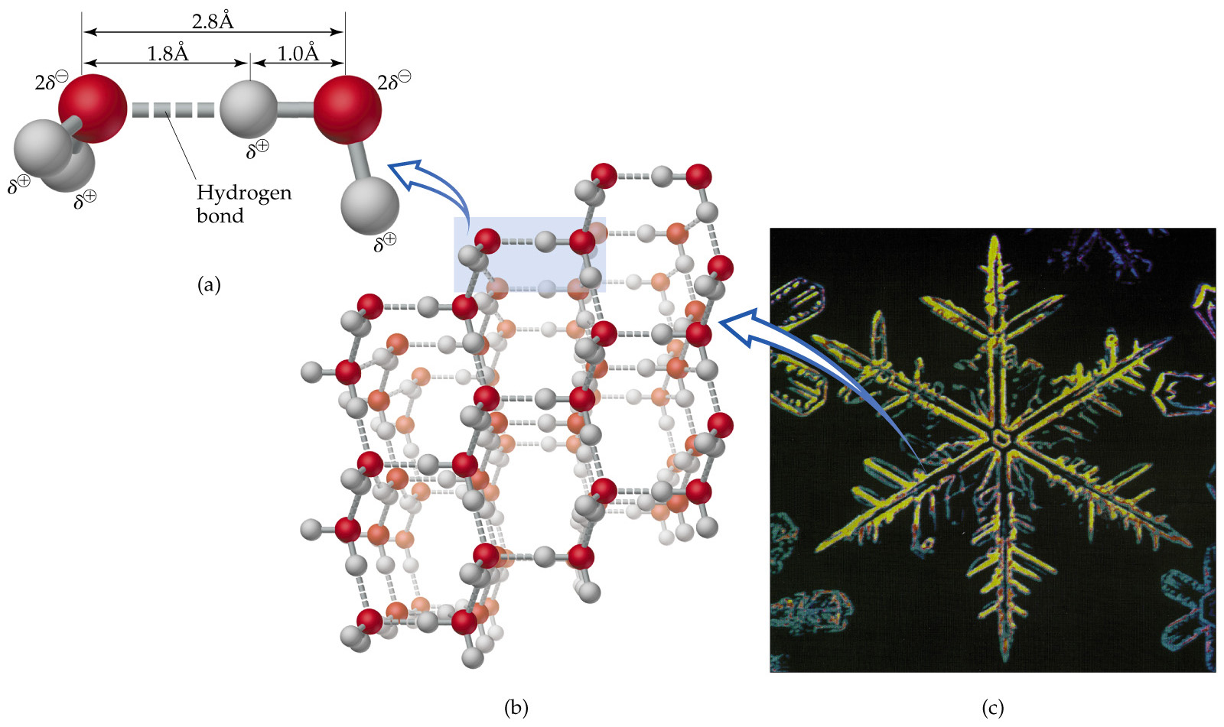

Slide 19
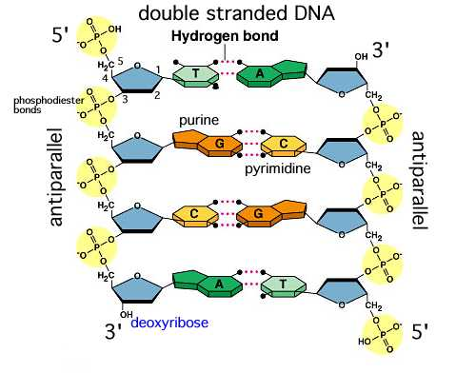
DNA

Slide 20

Water has a high surface because its molecules can form multiple hydrogen bonds.

Slide 21
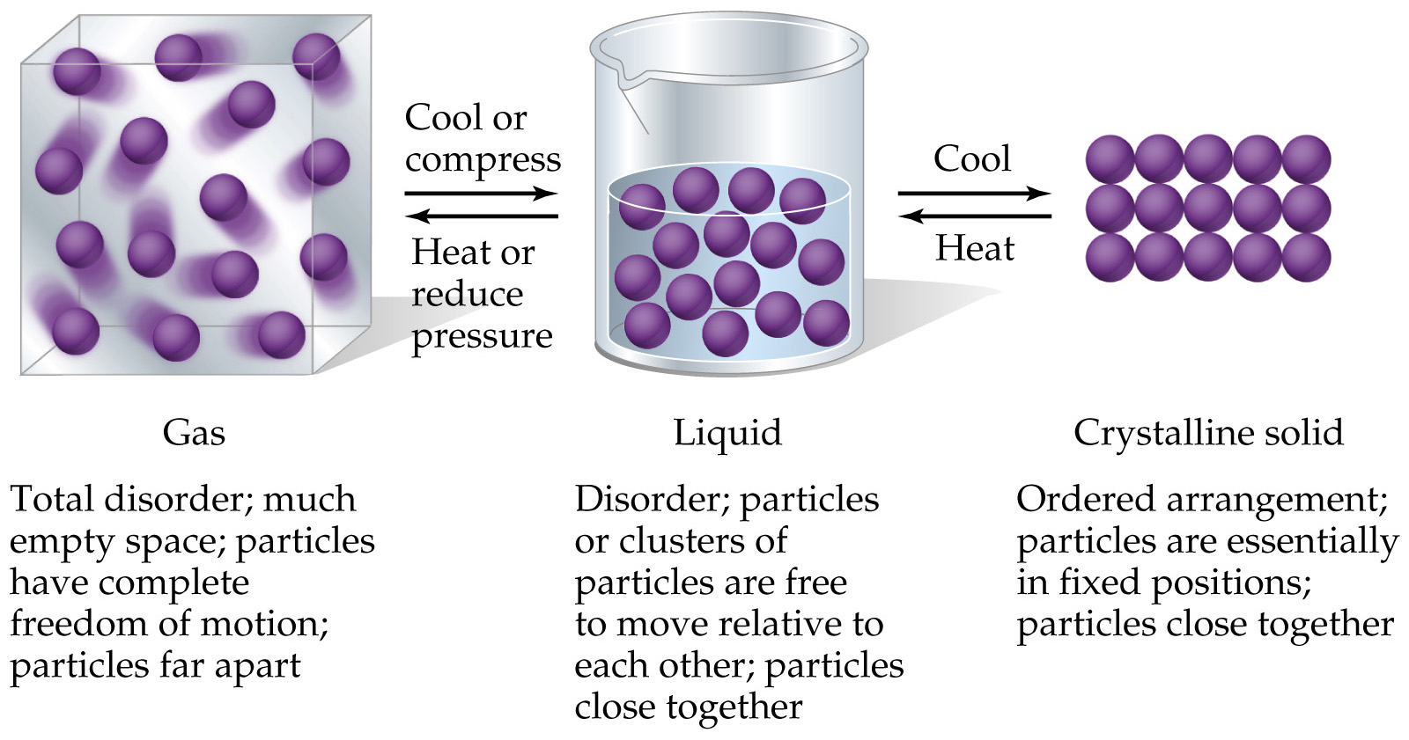
II. Liquids and Solids

Slide 22
Bonding in Solids: Types of Crystalline Solids: atomic, ionic, & molecular (ice –H2O, dry ice – CO2)
Atomic solids include: diamond (made of Carbon atoms), iron, argon
Notice Iron is on the list of atomic solids, so metals are atomic solids too. Most metals, like iron, consist of the positive nuclei of the atoms with a sea of electrons around them. There are also alloys, or a substance that contains a mixture of elements and has metallic properties. Two familiar alloys are brass (copper and zinc) and steel (iron and carbon).

Slide 23
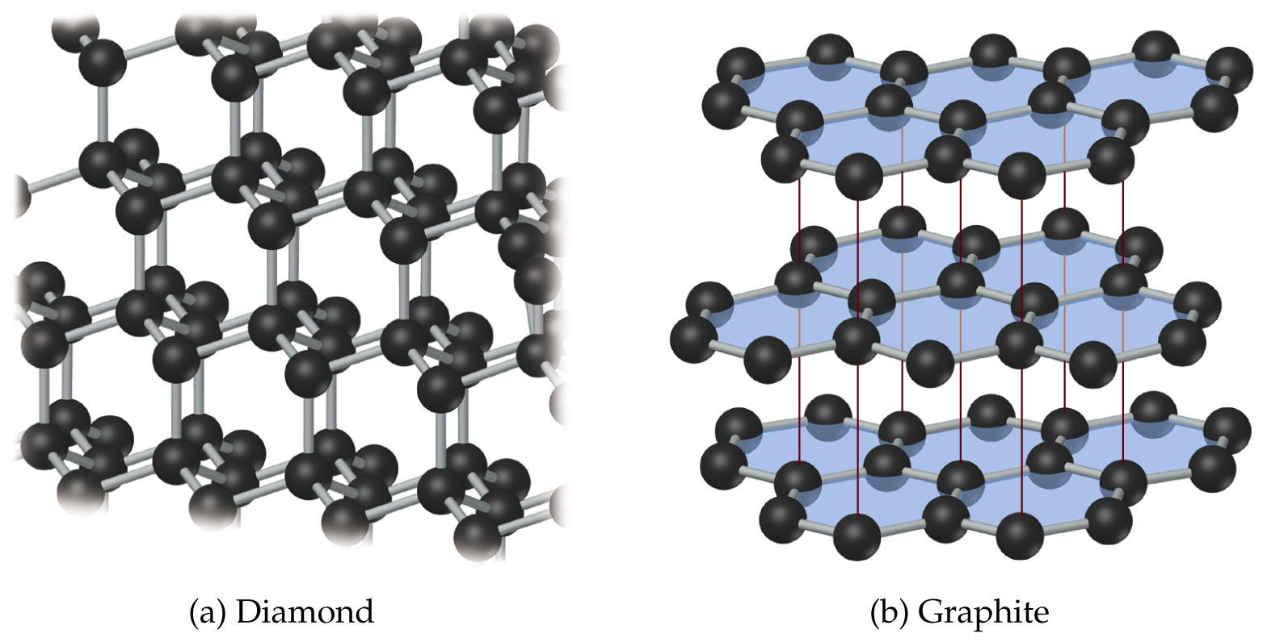
Two forms of Carbon: diamond and graphite

Slide 24
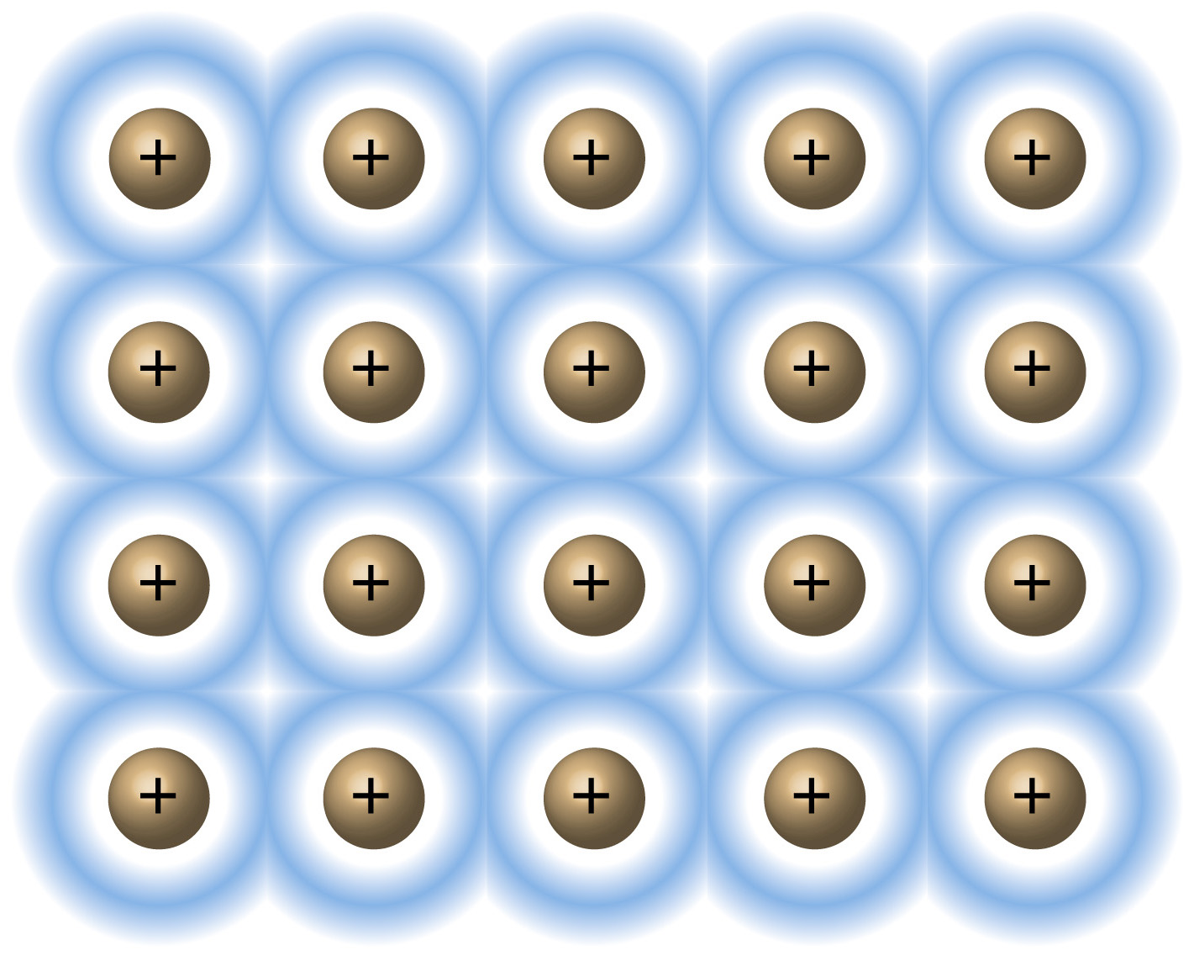
Ionic Metallic

Slide 25
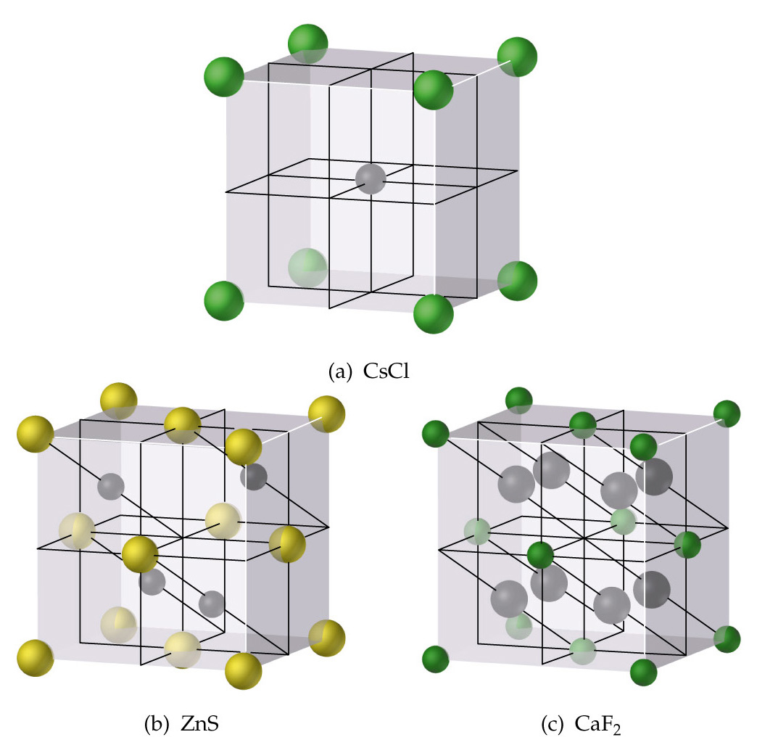
Ionic Solids

Slide 26
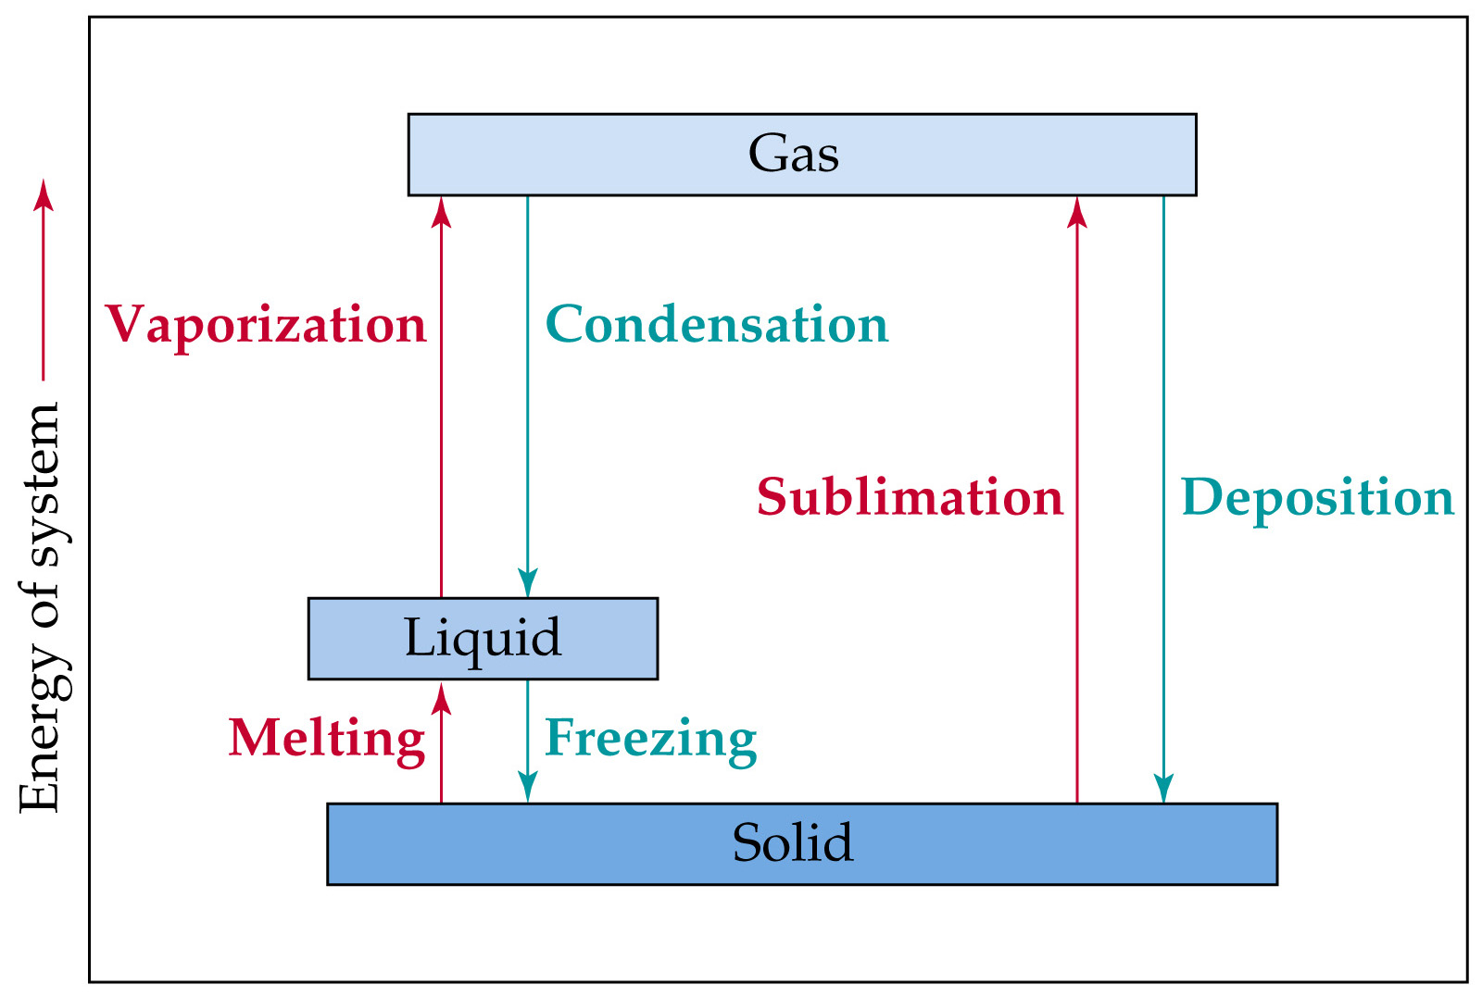
VI. Phase Changes

Slide 27
The normal freezing point of water is 0°C or 273 K.
The normal boiling point of water is 100°C or 373 K.
The greater the attractions between atoms or molecules in a liquid, the lower the vapor pressure, because those attractions prevent the liquid going from liquid to gas.
As temperature increases, vapor pressure increases.
As atmospheric pressure decreases, the boiling temperature of the liquid decreases.

