Slide 1
Chapter 15: Solutions

Slide 2
Chapter 15 Solutions
What are Solutions? (15.1)
Solution - homogeneous mixture made up of individual molecules, atoms or ions.
B. Solute – the substance being dissolved
For example: salt, sugar, food coloring
C. Solvent - the substance doing the dissolving
For example: water

Slide 3
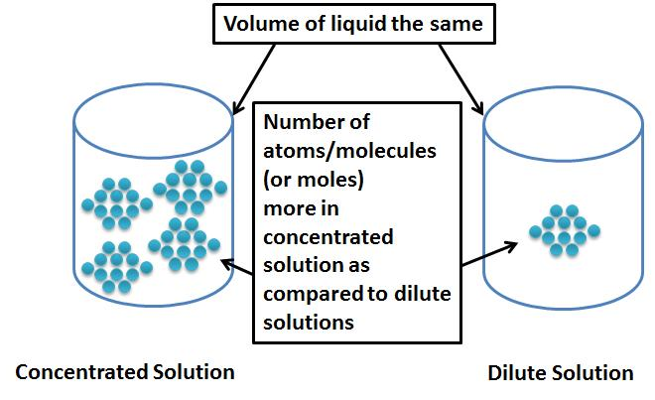
Dilute vs. Concentrated Solutions

Slide 4
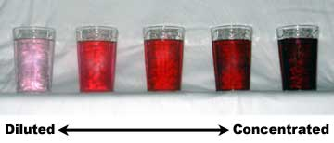

Slide 5
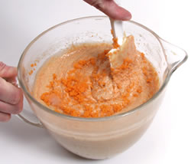
Factors that affect rate of dissolving (“dissolution”) – must increase collisions between solute and solvent
Agitating the mixture (stirring)

Slide 6
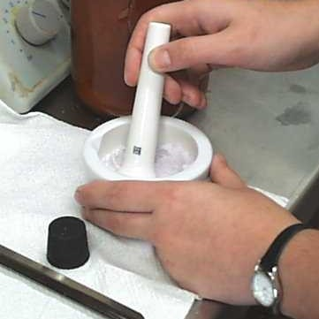
Factors that affect rate of dissolving “dissolution”)– must increase collisions between solute and solvent
Increasing the surface area

Slide 7
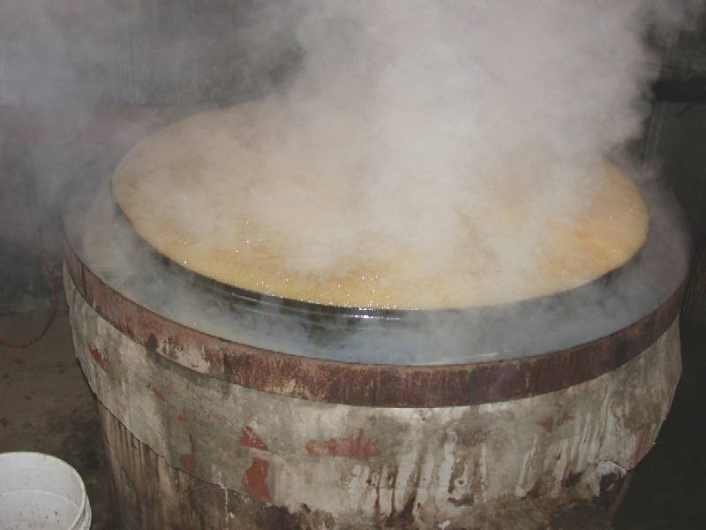
3. Increasing the temperature which increases the kinetic energy
dissolving sugar for syrup

Slide 8
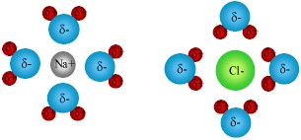
III. Solubility (15.1)
Unsaturated ➢the amount of solute dissolved is less than the maximum that could be dissolved
NaCl_{(s)} → Na⁺¹_{(aq)} + Cl⁻¹ _{(aq)}

Slide 9
III. Solubility (15.1)
Saturated ➢solution holds the maximum amount of solute per amount of the solution under the given conditions NaCl_{(s)} → Na⁺¹_{(aq)} + Cl⁻¹ _{(aq)}
Supersaturated ➢ solutions contain more solute than the usual maximum amount and are unstable
They cannot permanently hold the excess solute in solution and may release it suddenly back into solid state
NaCl_{(s)} → Na⁺¹_{(aq)} + Cl⁻¹ _{(aq)}

Slide 10
Helpful Youtube video links:
Solute solvent solution dissolving: http://www.youtube.com/watch?v=hydUVGUbyvU
Unsaturated, saturated, supersaturated, solutes’ effect on freezing point http://www.youtube.com/watch?v=VTmfQUNLlMY
Overview/Application: http://www.youtube.com/watch?v=9h2f1Bjr0p4
Freezing point depression/colligative properties/ice cream: http://www.youtube.com/watch?v=TBkNstDmtj0
Background and Molarity and M1V1 = M2V2 calculations: http://www.youtube.com/watch?v=F2BRpFihX3M

