Slide 1
The impact of anti-corruption audits on bureaucratic careers: Evidence from Brazilian municipalities
Romain Ferrali, Galileu Kim
NYU-Abu Dhabi, Princeton University

Slide 2
Motivation
Political and administrative institutions exposed to corruption.
Audits are a popular anti-corruption instrument.
Effect of audits on politicians is well-known: electoral and legals sanctions (Ferraz & Finan 2011; Avis, Ferraz & Finan 2018)
Bureaucrats’ behavior under audits is unclear.
Perhaps bureaucrats and politicians share a common fate.
Fundamental differences in their career structures.
Bureaucrats have lifelong tenure/profitable opportunities in the private sector ➔ different career incentives

Slide 3
This paper
How do bureaucrats’ career choices respond to anti-corruption audits?
Audits have little effect on bureaucrat’s behavior, and hence little effect on corruption in public administration.
Unlike politicians, bureaucrats have long-term careers.
In this environment, audits have both short-term and long-term effects.
Identifying long-term effects require theory: structural estimation.
Career model that incorporates audits and corruption.
Audits are no panacea: little effect on
Notes:
- we're gonna show you that audits have little effect on bureaucrats'
behavior, and hence little effect on corruption
- the problem is complicated because, unlike politicians, bureaucrats have
LT careers.
--> in this environment, anti-corruption audits may have a variety of both
ST & LT effects. [contribution 1]
- while ST is easy, LT is harder --> structural estimation. [contribution 2]
- finding: little effect on both ST and LT. More worrying, audits are not
a panacea.

Slide 4
Results
Theory: anti-corruption audits may affect career decisions in a variety of ways, including:
Short-term responses → waves of departures/fewer corruption immediately after an audit.
Long-term responses → permanent deterrence through threat of sanction.
Empirics:
Reduced form findings (short term). Audits have no effect on career behavior, but there is a temporary, small improvement in management. No evidence that electoral accountability trickles down to bureaucrats.
Structural findings (short & long term). Overall, audits have little effect on corrupt behavior. Making the program more efficient does not substitute for long-term improvements in local institutional environment.

Slide 5
Outline
Theory
Reduced form
Structural estimation

Slide 6
Theory

Slide 7
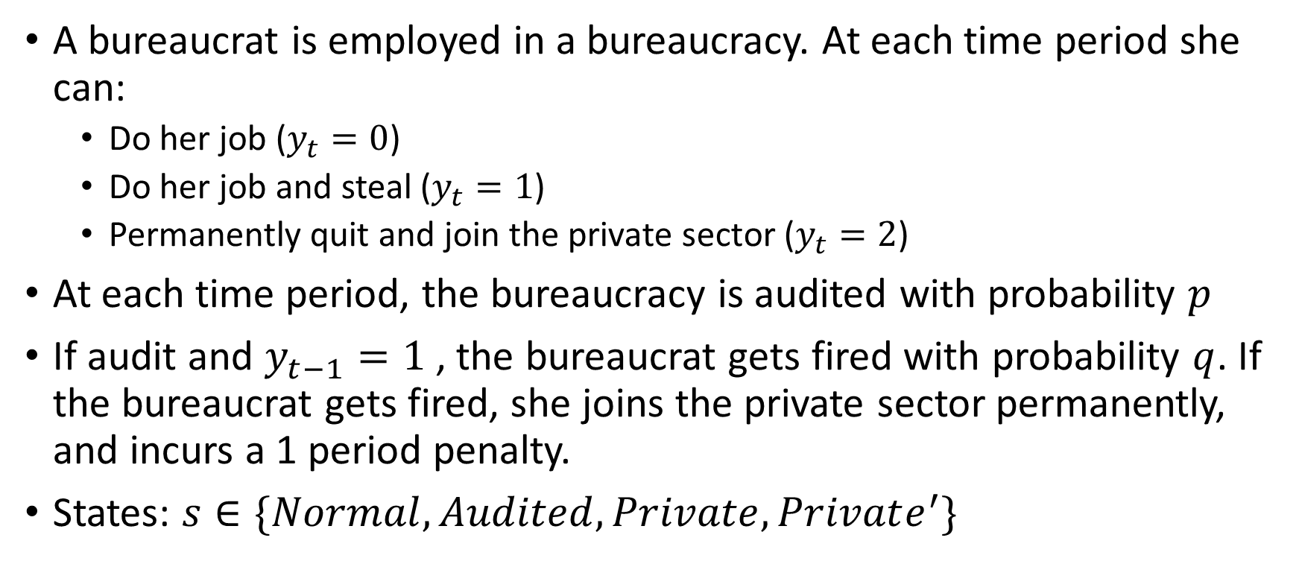
Setting
A bureaucrat is employed in a bureaucracy. At each time period she can:
Do her job ($y_{t}=0$)
Do her job and steal ($y_{t}=1$)
Permanently quit and join the private sector ($y_{t}=2$)
At each time period, the bureaucracy is audited with probability $p$
If audit and $y_{t−1}=1$, the bureaucrat gets fired with probability $q$. If the bureaucrat gets fired, she joins the private sector permanently, and incurs a 1 period penalty.
States: $s∈\{Normal, Audited,Private, Private^{′}\}$
Notes:
APSA: merge this slide with slide 8 (payoffs column), get rid of 8, 9, 10, 11

Slide 8
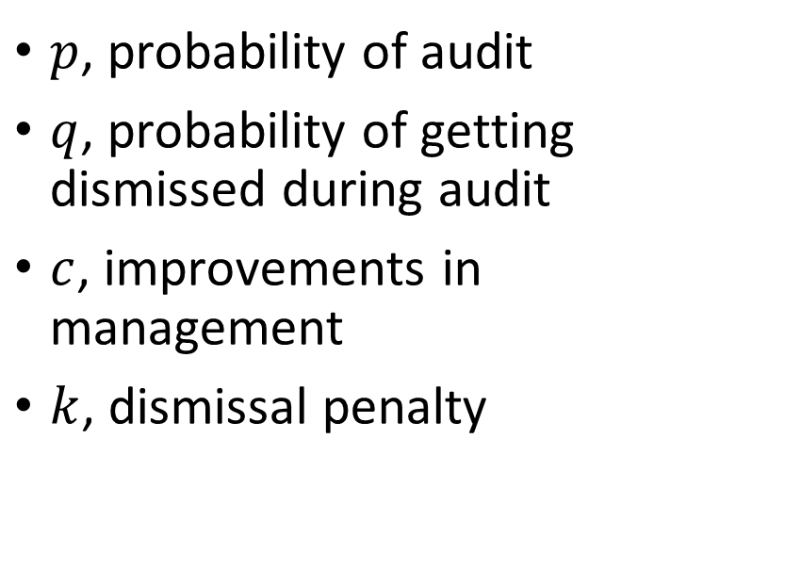
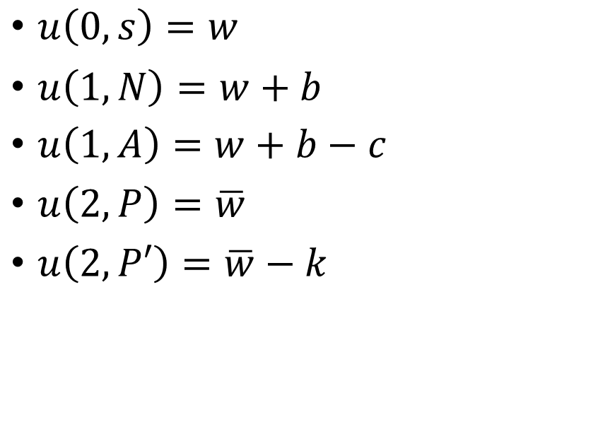
Payoffs and parameters
Per-period payoffs
Audit-related parameters
$u\left(0,s\right)=w$
$u\left(1,N\right)=w+b$
$u\left(1,A\right)=w+b−c$
$u\left(2,P\right)=\overline{w}$
$u\left(2,P′\right)=\overline{w}−k$
$p$, probability of audit
$q$, probability of getting dismissed during audit
$c$, improvements in management
$k$, dismissal penalty

Slide 9

The problem
$$\max_{π∈Π}\left(1−δ\right) 𝔼\left[\sum_{t=0}^{∞}{δ^{t}u(π\left(s_{t}\right),s_{t})}\right]$$
$Π$ is the set of all stationary policies $π:𝒮→𝒜$

Slide 10

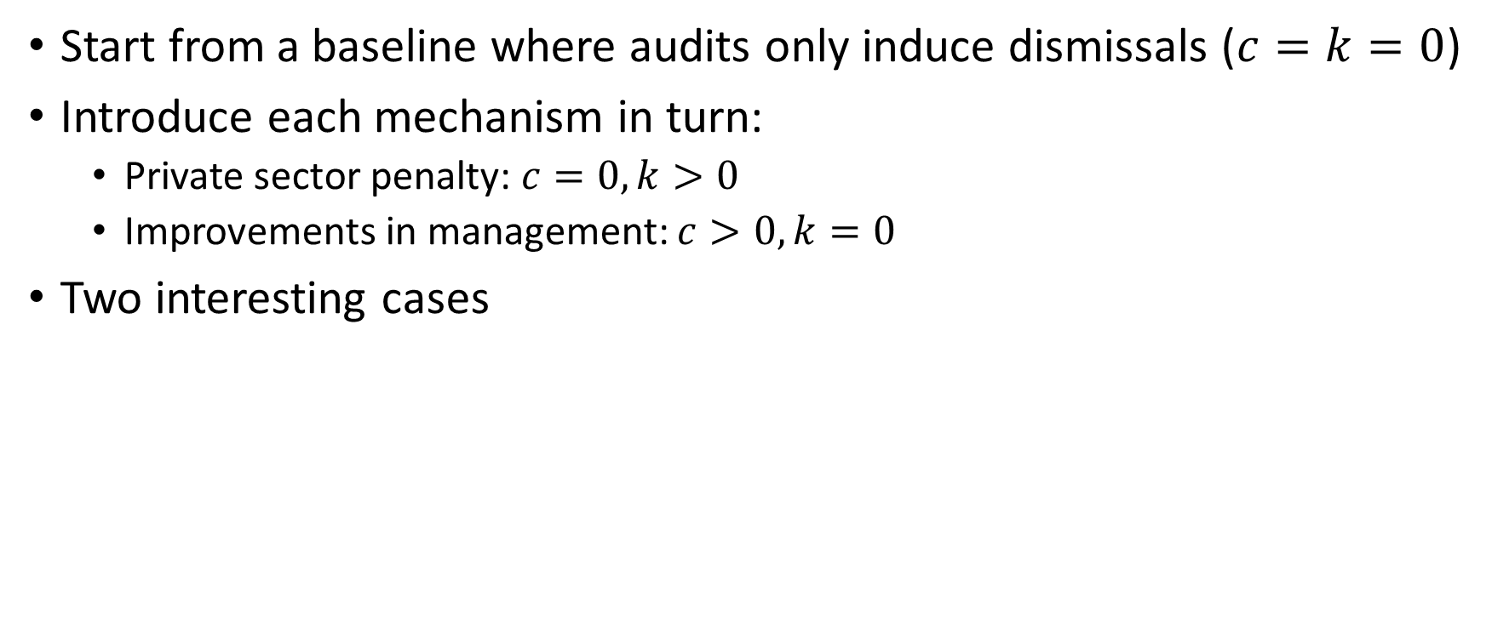



Approach
Start from a baseline where audits only induce dismissals ($c=k=0$)
Introduce each mechanism in turn:
Private sector penalty: $c=0, k>0$
Improvements in management: $c>0, k=0$
Two interesting cases
$$w$$
$$w+b$$
$$w$$
$$\overline{w}$$
better paid in public sec.
better paid in private sec.
uninteresting

Slide 11

The baseline
If better paid in private sector: steal until you get caught
If better paid in public sector:
If $b$ sufficiently large (relative to $p, q, w$), then steal until you get caught
Otherwise: never steal ← deterrence

Slide 12
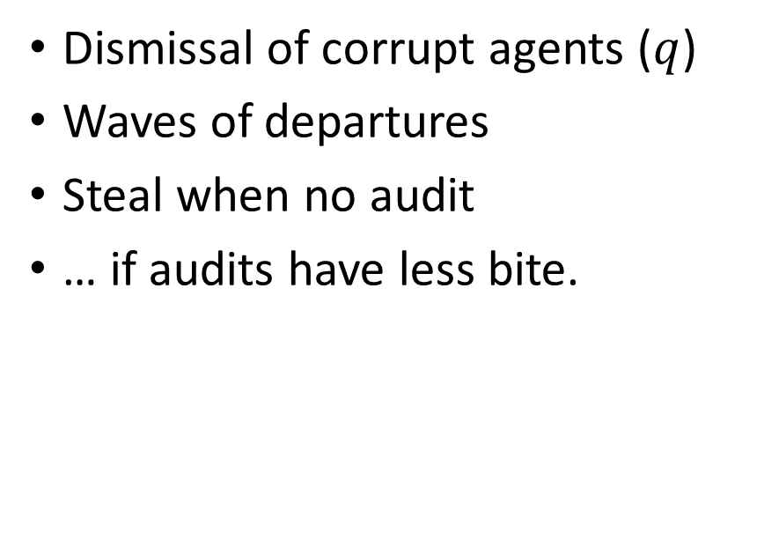
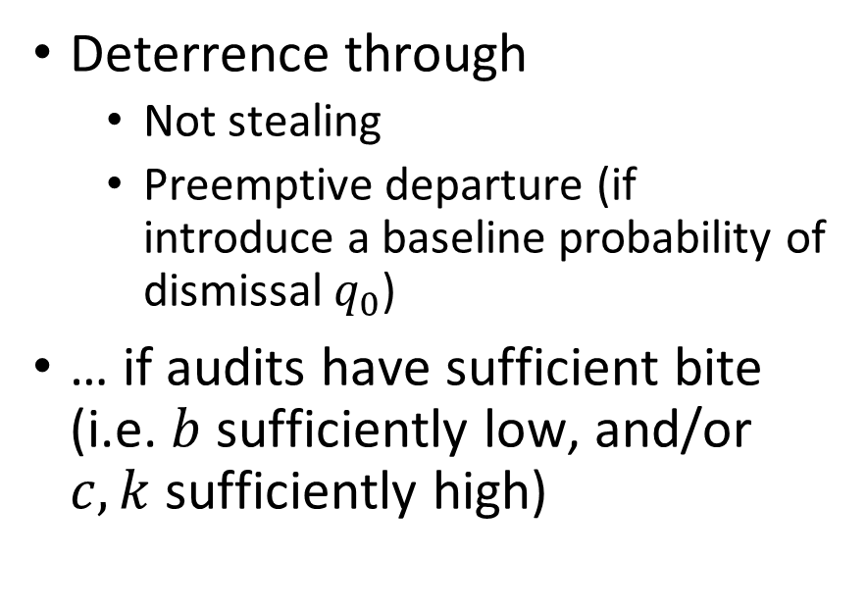
Findings
Long-term effects
Short-term effects
Deterrence through
Not stealing
Preemptive departure (if introduce a baseline probability of dismissal $q_{0}$)
… if audits have sufficient bite (i.e. $b$ sufficiently low, and/or $c, k$ sufficiently high)
Dismissal of corrupt agents ($q$)
Waves of departures
Steal when no audit
… if audits have less bite.
So, which mechanism is it?

Slide 13
Reduced-form estimates

Slide 14
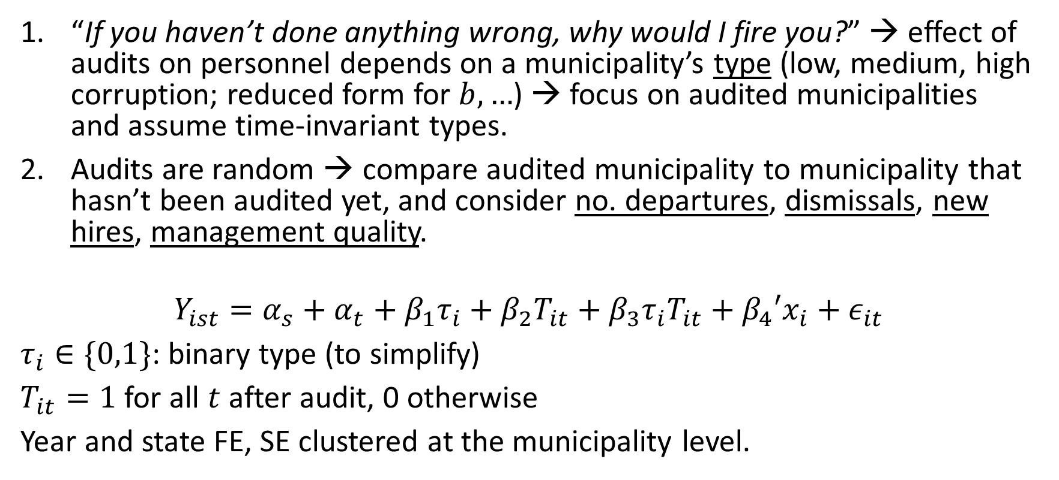
Approach: are there any short-term effects?
“If you haven’t done anything wrong, why would I fire you?” → effect of audits on personnel depends on a municipality’s type (low, medium, high corruption; reduced form for $b, …$) → focus on audited municipalities and assume time-invariant types.
Audits are random → compare audited municipality to municipality that hasn’t been audited yet, and consider no. departures, dismissals, new hires, management quality.
$$Y_{ist}=α_{s}+α_{t}+β_{1}τ_{i}+β_{2}T_{it}+β_{3}τ_{i}T_{it}+β_{4}′{x_{i}+ε}_{it}$$
$τ_{i}∈\{0,1\}$: binary type (to simplify)
$T_{it}=1$ for all $t$ after audit, 0 otherwise
Year and state FE, SE clustered at the municipality level.

Slide 15
Data
Audits: CGU, reports number of irregularities discovered (3 levels) → 4 measures of corruption (no. faults, no. severe faults, normalized by amount audited).
Each year, 1-3 lotteries, with 2 municipalities per state picked at random for audit.
Personnel: RAIS, all employees in Brazil → focus on high-ranking bureaucrats.
Management: MUNIC, self-reported measure of good practices → count

Slide 16
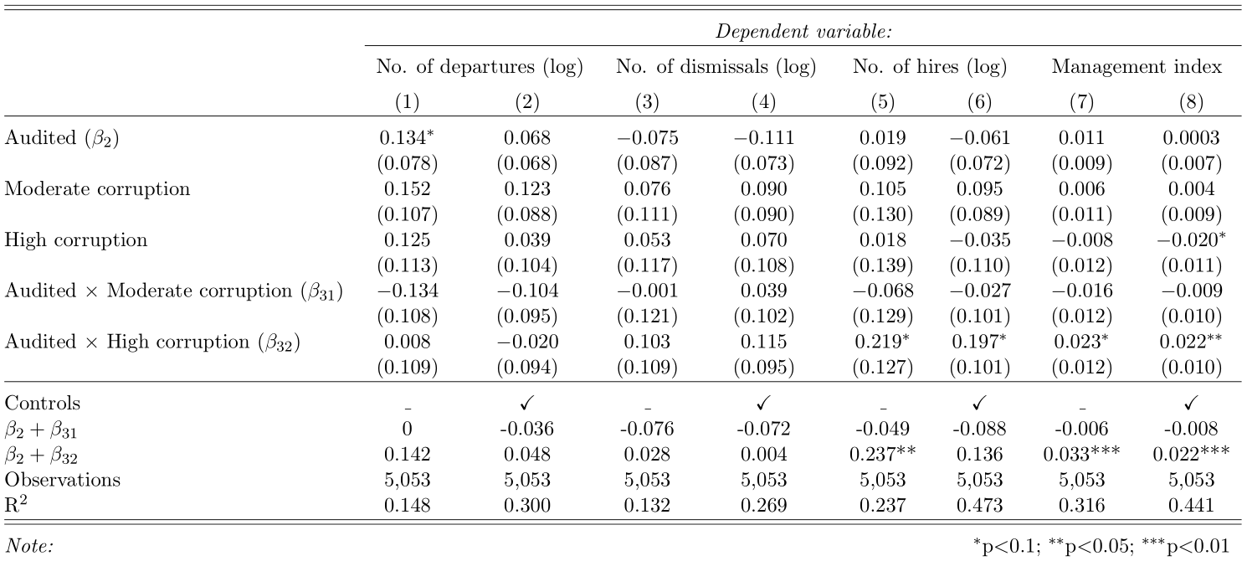

Slide 17
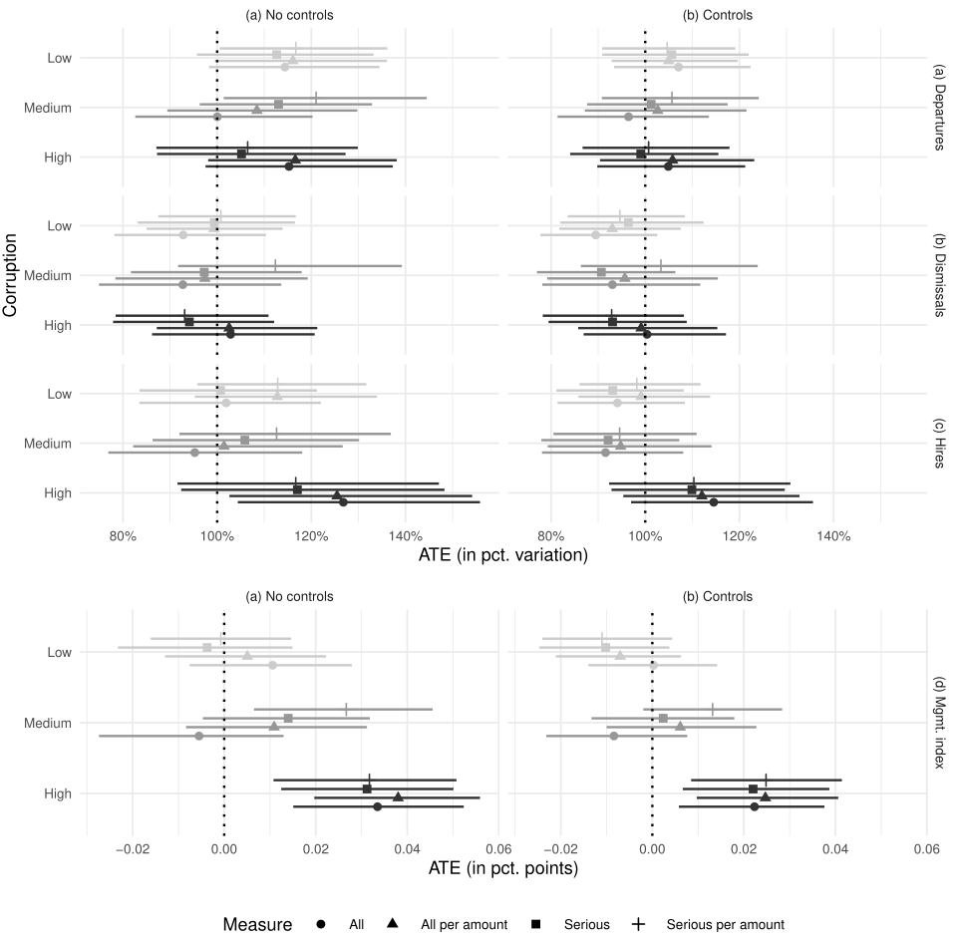

Slide 18
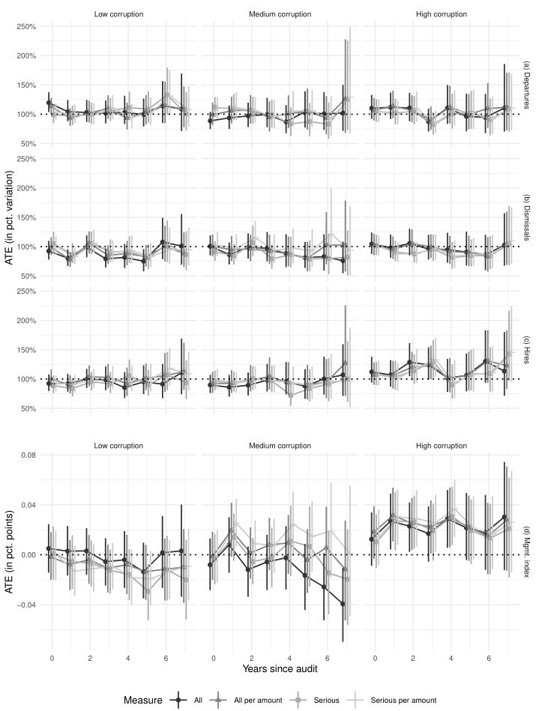

Slide 19
Electoral accountability does not trickle down to bureaucrats
Easy test: do mayoral patronage appointments get dismissed/leave after an audit?
Consider only bureaucrats hired during the 1st year of a mayor’s 1st term, and compare those who underwent audit to those who did not.
If not, do they get dismissed/leave when a new mayor takes over? [not shown]
Consider the same cohort, but only those for which mayor lost the elections. Compare the same 2 groups, but during the 2nd term.

Slide 20
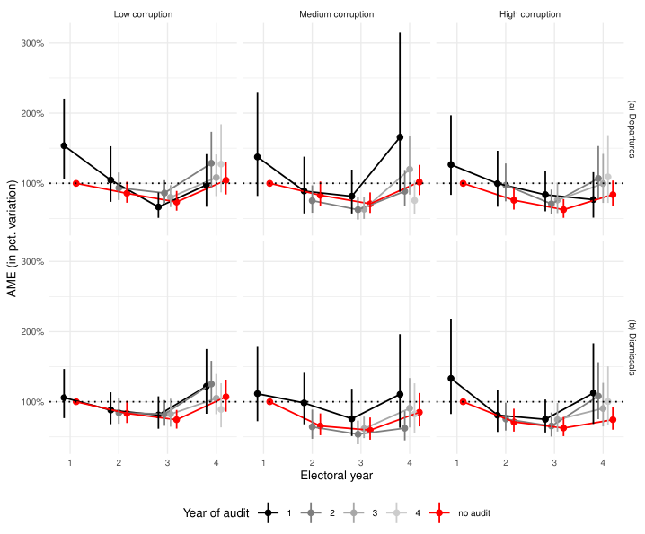

Slide 21
Summary
Audits have no observable short-term effect on career outcomes (i.e. departures, dismissals)
They lead to small, temporary improvements in managerial quality.
No evidence of political accountability.
Why do audits have no observable short-term effect?
Perhaps agents steal when no audit? (unobservable, short term)
Perhaps agents are permanently deterred?
→ structural estimation

Slide 22
Structural estimation

Slide 23
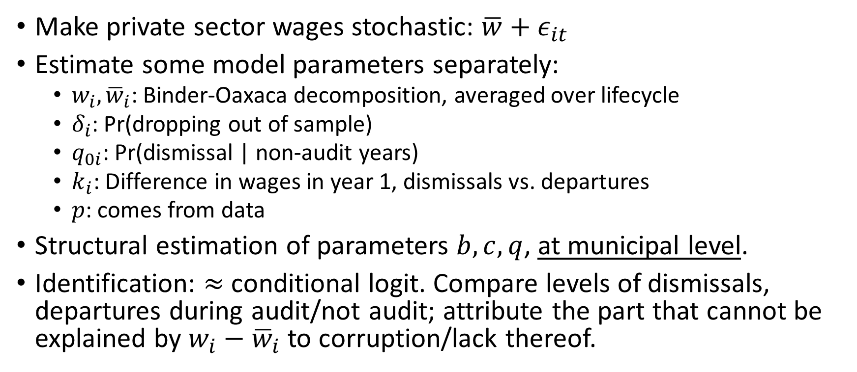
Approach
Make private sector wages stochastic: $\overline{w}+ε_{it}$
Estimate some model parameters separately:
$w_{i}, {\overline{w}}_{i}$: Binder-Oaxaca decomposition, averaged over lifecycle
$δ_{i}$: Pr(dropping out of sample)
$q_{0i}$: Pr(dismissal | non-audit years)
$k_{i}$: Difference in wages in year 1, dismissals vs. departures
$p$: comes from data
Structural estimation of parameters $b, c, q$, at municipal level.
Identification: $≈$ conditional logit. Compare levels of dismissals, departures during audit/not audit; attribute the part that cannot be explained by $w_{i}−{\overline{w}}_{i}$ to corruption/lack thereof.

Slide 24
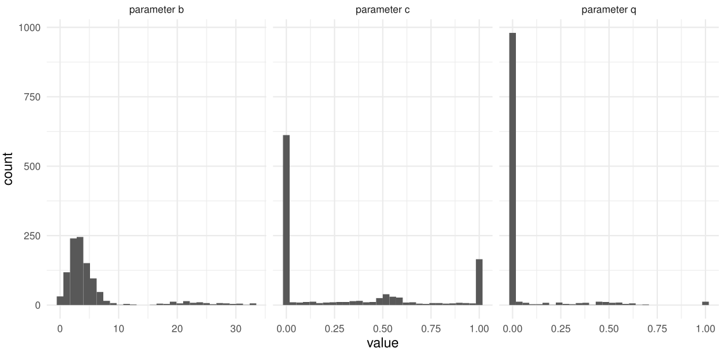
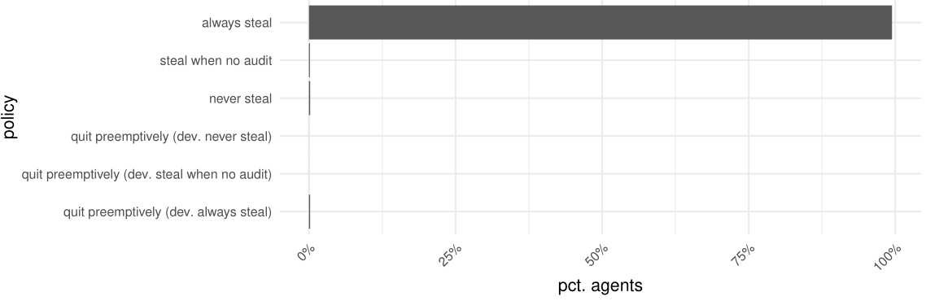

Slide 25
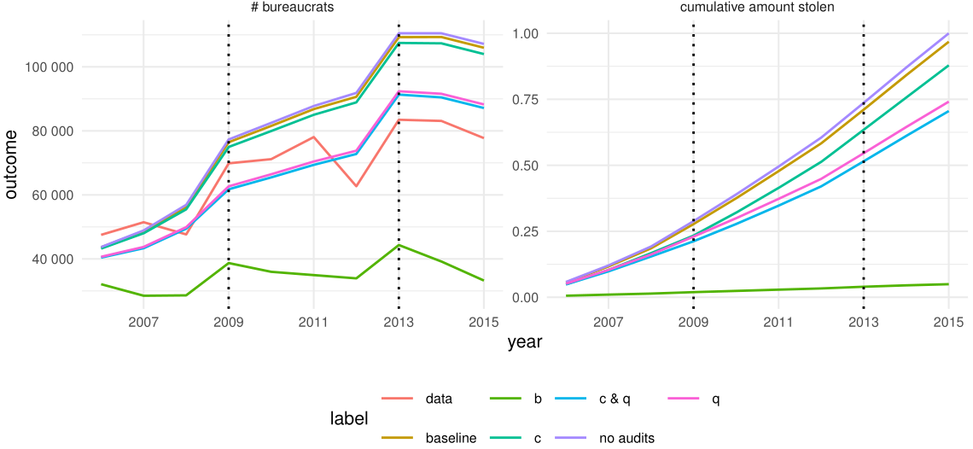

Slide 26
Conclusion

