Slide 1

Governing through Patronage: The Bargain for Education in Decentralized Brazil
Galileu Kim

Slide 2
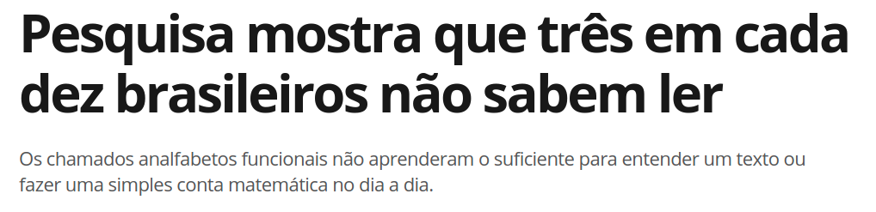
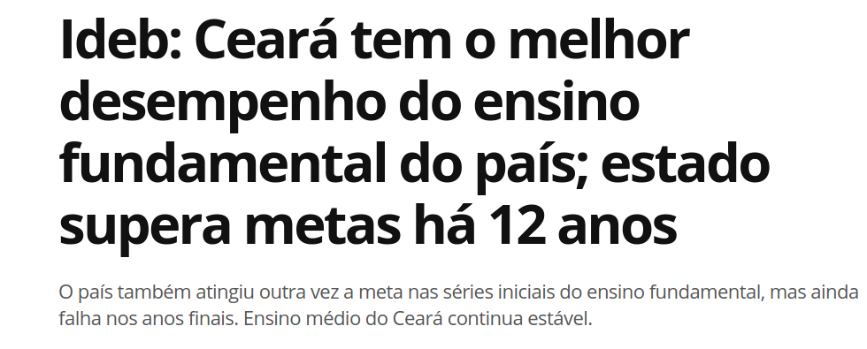
Three out of every ten Brazilians are unable to read or write.
Ceará, one of the poorest states in Brazil, has the best performing public schools

Slide 3
How can governments improve the quality of public education?

Slide 4
Motivation
Previous studies find that bureaucratic incentives work.
Duflo et al. 2012, Dal Bó et al. 2013
In developing countries, politicians manage education.
Political incentives shape bureaucracies.
Fieldwork in Brazil to interview politicians and bureaucrats.
Understand how patronage operates at a local level.

Slide 5
I saw excellent professionals which worked here - school administrators - being removed from office and sent back into the classroom. In their place, administrators without leadership or competence were appointed school principals.
Former Secretary of Education, Iguatu

Slide 6
Findings
Public education in Brazil captured by political elites.
Mayors exchange patronage for support.
Propose a theory of legislative vote-buying.
Patronage increases with legislative opposition.
Validation with large-scale educational data.
Negative downstream effects of patronage on student learning.

Slide 7
Contribution
Politics of personnel and public service delivery.
Finan et al. 2015, Pepinsky 2017
Individual incentives and bureaucratic performance.
Gulzar and Pasquale 2017, Duflo et al. 2012
Patronage and state capacity.
Yashar, Centeno and Kohli 2017, Stokes et al. 2013

Slide 8
Outline
Institutional Context and Data
Theory
Empirical Results
Conclusion

Slide 9
Context & Data
Municipalities responsible for basic education.
Governed by mayor and city council.
Personnel decisions under mayoral jurisdiction.
Teachers and principals (RAIS and School Census)
Student learning evaluation.
Prova Brasil and Spaece

Slide 10
Uneven quality of education

Slide 11
Theory
Executive-legislative bargain.
Allocation (alotação) of jobs for legislative support.
A mayor and opposition bargain over votes.
Mayor enacts policy, exchanges patronage.
Empirical implications.
Legislative opposition increases allocation.

Slide 12
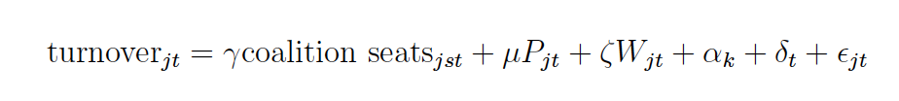
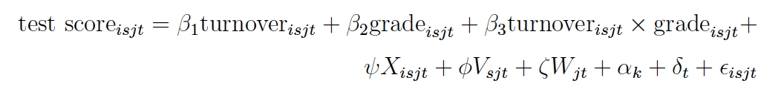
Empirical results
Legislative opposition increases bureaucratic turnover.
Bureaucratic turnover lowers student learning.
Electoral accountability does not bite.
Quality of education does not

