Slide 1

Governing through Patronage: The Bargain for Education in Decentralized Brazil
Galileu Kim
Notes:
Hello everyone, my name is Galileu Kim. I am delighted to be here at the Brazil Lab and share with you some of my research. In this paper I investigate how mayors bargain over education in local governments of Brazil.

Slide 2
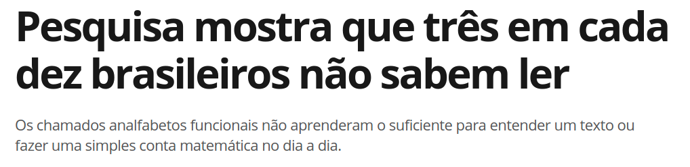
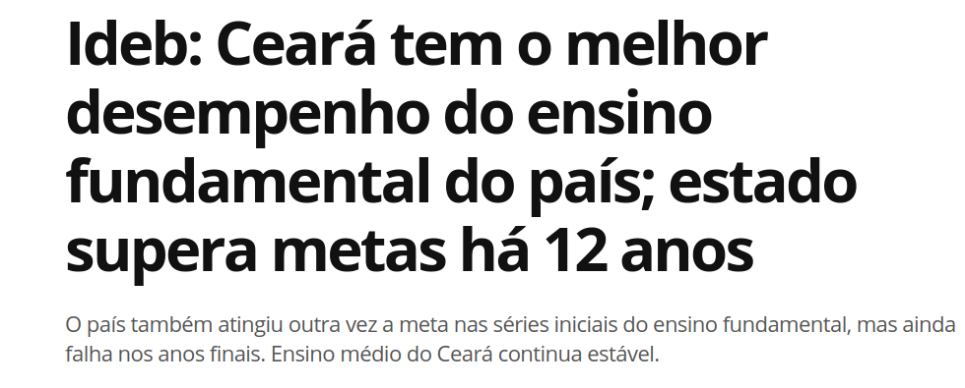
Three out of every ten Brazilians are unable to read or write.
Ceará, one of the poorest states in Brazil, has the best performing public schools
Notes:
Let’s start with a few facts. Brazil is not doing great in public education. In fact, even to this day, three out of every ten Brazilians are unable to read or write. But this is not the only story. In Brazil, public education is actually managed by municipalities.
And among these municipalities, there are some islands of excellence. The state of Ceará, a poor state in the Northeast, has been able to rock the charts in public education. In the last edition of the IDEB, over half of the top performing public schools were from Ceará, many of them in the notorious municipality of Sobral.

Slide 3
How can governments improve the quality of public education?
Notes:
So how can we get there? How can we ensure that citizens gain access to high quality public education in the context of a decentralized provision of public services?

Slide 4
Motivation
Individual incentives to politicians and bureaucrats.
Gulzar and Pasquale (2017), Duflo et al. (2012)
Political actors embedded in democratic institutions.
Multiple elected officials, competing agendas.
Fieldwork in Brazil to interview politicians and bureaucrats.
Local politics shapes patronage.
Notes:
Some scholars would argue that individual incentives work. Adding monitoring technologies to teachers may reduce absenteeism. Electoral incentives may also work, as politicians can credit claim and push bureaucrats to work harder.
But in many developing countries, politicians and bureaucrats are embedded in democratic institutions. In fact, because of these institutions, multiple elected officials compete over the same public resources, with potentially negative consequences.
To get at this story, I conducted over the course of two years fieldwork in municipalities across Brazil, interviewing politicians and bureaucrats to understand how this competition over public sector jobs operates -> and ultimately shape the quality of public education.

Slide 5
Here, we are invited to work at the school by the department of education, with the [political] candidate, the city councilor...deciding which are the positions they are searching for and appointing people they think have
the necessary qualifications.
- School Principal, Iguatu
Notes:
Here is an illustration of the story I uncovered. Contrary to expectations of a direct accountability story between mayors and bureaucrats, I found that elected officials for the local chamber, the city councilors, played a key role over appointees. Upon further investigation, I found evidence to shore up this story. And this is what I present to you today.

Slide 6
Findings
Public education in Brazil captured by political elites.
Mayors exchange patronage for support.
Propose a theory of legislative vote-buying.
Patronage increases with legislative opposition.
Validation with large-scale educational data.
Connect effects of patronage on student learning.
Notes:
So what did I find?
First, that public education appointments in Brazil are captured by local political elites. Mayors exchange positions in the department of education for political support.
This is driven by executive-legislative bargain. I find that the stronger the opposition, the more public sector jobs the mayor offers in exchange.
To verify these hypotheses, I collecte large-scale administrative data that includes over 2 million teachers and school principals, as well national evaluations of student learning.

Slide 7
Contribution
Politics of personnel appointment.
Akhtari et al. 2017, Colonnelli et al. 2019
Electoral accountability and public services.
Boas and Hidalgo 2018, Besley 2006.
Political competition and public goods provision.
Gottlieb and Kosec 2019
Notes:
This research dialogues with a growing body of research on the politics of patronage appointment. While previous studies have focused on the structure of partisan networks and campaign donors, I bring in local democratic institutions and how these shape patronage dynamics.
Second, I dialogue with literature on electoral accountability and show that the link between politician and voters is less direct than usually assumed. In fact, politicians are more concerned with power-sharing with stakeholders than the preferences of voters.
Lastly, I build on an emerging body of literature that explores the ambiguous effects of political competition over public goods provision, showing that political opposition can have negative downstream effects.

Slide 8
Outline
Context and Data
Theory
Empirical Results
Conclusion
Notes:
Here is an outline of today’s presentation. I will give you some context on Brazil and the data sources used. Then I outline the theory that guides the empirical estimation. I present empirical results and finally conclude.

Slide 9
Context and Data
Municipalities responsible for primary education.
Mayors enact, city council approves.
Personnel decisions under mayoral jurisdiction.
Teachers and principals (RAIS and School Census)
Student learning evaluation.
Prova Brasil and Spaece
Notes:
Municipalities in Brazil are responsible for administering public, primary education. Each of these municipalities is governed by a mayor, who can enact different policies and law, subject to the approval of the local city council.
Personnel decisions are nominally under mayoral jurisdiction, but as will become hopefully clear in the rest of the presentation, city councilors play an important role.
To get at these personnel decisions I use two primary sources of data. One is the RAIS, which includes detailed information on all municipal teachers and school principals. The other is the School Census, which allows me to track down teachers across schools and over times with a unique teacher id.
To assess the quality of education, I use data from the Prova Brasil, a nation-wide evaluation administered every two years by the Ministry of Education. Participation by public schools is mandatory. Another evaluation I used is the SPAECE, administered by the state of Ceará every year to all public schools.

Slide 10
Uneven quality of education
Notes:
Using the Prova Brasil data, we can provide a picture of the uneven quality of education in Brazil. Note that the red colors indicate higher municipal average scores, while cooler colors denote lower scores. While there are regional clusters, even within those regions there are municipalities that outperform their peers. In the Northeast, we see Ceará doing quite well. In the South, many municipalities in Rio Grande do Sul are performing quite poorly.

Slide 11
Theory
Buying legislative supermajorities
Groseclose and Snyder 1996, Banks 2000
Allocation (alotação) of jobs builds legislative coalition.
Mayor enacts policy, exchanges patronage.
Empirical implications.
Legislative opposition increases allocation.
Notes:
To understand what is driving this municipal variation, I use a canonical vote-buying model by Groseclose and Snyder and expanded on by Banks. I analyze patronage appointment decisions as an outcome of an executive-legislative bargain.
The goal of the mayor is to enact her preferred policy, but to do so she must win over sufficient votes in the city council. The exchange currency are public sector appointments.
The main implication of the model is that the greater the opposition in the legislature, the more patronage the mayor needs to engage in to garner votes.

Slide 12
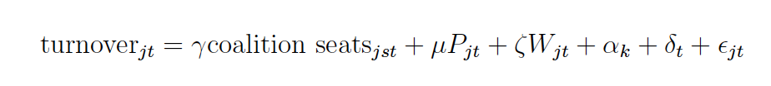
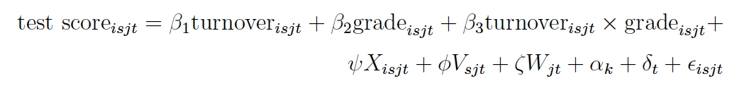
Empirical results
Legislative opposition increases bureaucratic turnover.
Bureaucratic turnover lowers student learning.
Electoral accountability does not bite.
Quality of education does not affect reelection.
Notes:
Here are the set of statistical models which I estimate in this paper.
The first one gets at the effect of legislative opposition on bureaucratic turnover. I specify this in a set of metrics: new hires into the bureaucracy and turnover index, measuring this at the individual and municipal level. The parameter of interest is gamma, the coefficient associated with an increase in legislative support. I measure this as the proportion of legislative seats captured by the mayor’s electoral allies.
Second, I assess the effect of bureaucratic turnover on student test scores. I estimate a multilevel model controlling for municipal, school and classroom characteristics, as well as allowing for heterogeneous effects of turnover according to the grade-level of the student.
Finally, in a set of estimations which I do not show here, I find that the quality of student learning is not related to the probability of incumbent reelection. Mayors do not face an electoral sanction.
All models include state and year fixed effects.

Slide 13
Notes:
Here I present the findings of the first estimation. The parameter of interest, the effect of legislative support on bureaucratic turnover is in the first row. The greater the proportion of seats controlled by the mayor’s electoral coalition, the less patronage we observe, either in terms of the proportion of hired teachers and school principals, or a school-level teacher turnover index.
Note that these findings are robust to a set of additional covariates. For comparison, I present estimates for the coefficients of explanatory variables we would expect to influence bureaucratic turnover. Note that the level of economic development, operationalized by the municipal median wage, provides mixed results, while patronage seems to increase with the size of municipalities. Lastly, literacy rates seem to decrease the amount of patronage observed, consistent with a recent study by Boas, Hidalgo and Toral 2019.

Slide 14
Notes:
We turn now to the estimated effects of bureaucratic turnover on student learning. Using two different performance metrics (Spaece and Prova Brasil), I find that the effects are similar: school principal rotation, teacher rotation and teacher turnover all lead to negative effects on student learning. This is robust to the introduction of a set of controls, such as school characteristics and municipal covariates. Therefore, the bureaucratic turnover induced by political dynamics in the first set of estimations have a clear negative downstream effect on student learning.
A word of caution: these estimates are based on observational data and therefore subject to well-known concerns about identification and endogeneity. I have done some preliminary analysis on an RDD exploiting electoral quotients , using Thomas Fujiwara’s recommendation, but I'm still unsure whether it captures the relevant mechanism. If you have any thoughts about additional analysis I could conduct that would be extremely helpful.

Slide 15
Conclusion
Patronage is shaped by the local institutional context.
Negative effects on student learning.
Quality of public services is secondary.
Primacy of power-sharing with other elites.
Extend to patronage networks of city councilors.
Party affiliation of local bureaucrats.
Notes:
To conclude, I show that the degree of patronage is shaped by the local institutional context. Mayors who face stronger legislative opposition engage in more patronage, with negative consequences for student learning.
This suggests that the quality of public service provision is a second-order priority for elected officials, who are more concerned with enacting policy in their administrative term through power-sharing agreements with other political elites.
In another project, I want to extend these findings onto mapping patronage networks of city councilors in the municipal bureaucracy, exploiting party affiliation. If you want to join forces, please let me know.

Slide 16
Thank you.
Contact: galileuk@princeton.edu
Website: kimgalileu.com

