Slide 1
Predicting the cost of emergency admission for patients with major depressive disorder
Evgeny Galimov 24/01/24

Slide 2
Research question
Research question: What features are important for predicting the cost of emergency hospital stay among patient with major depressive disorder?

Slide 3
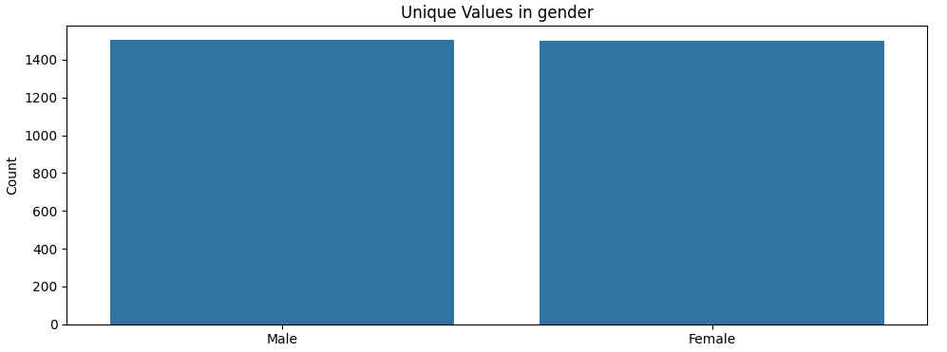
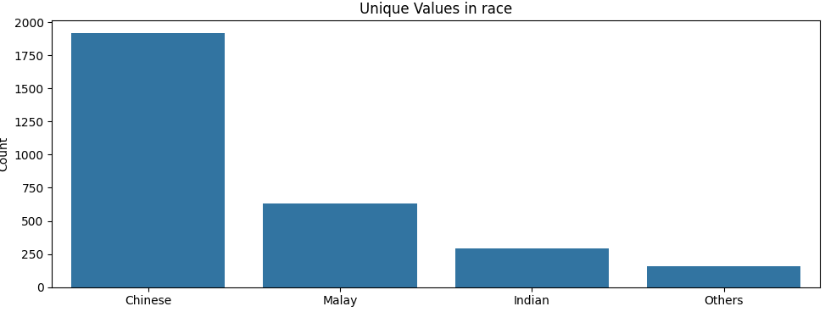
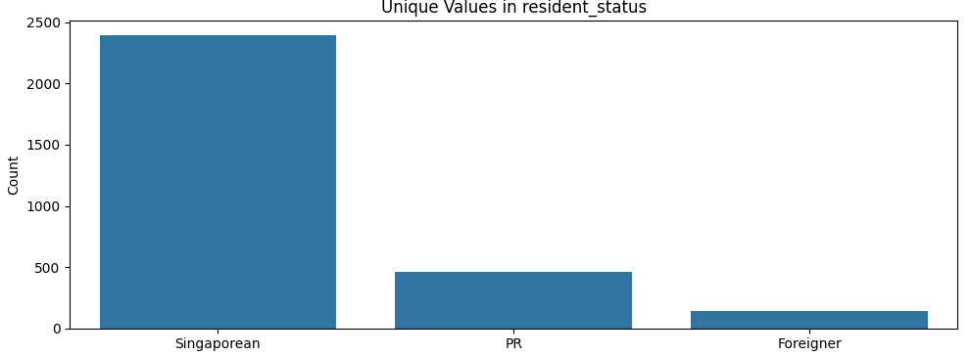
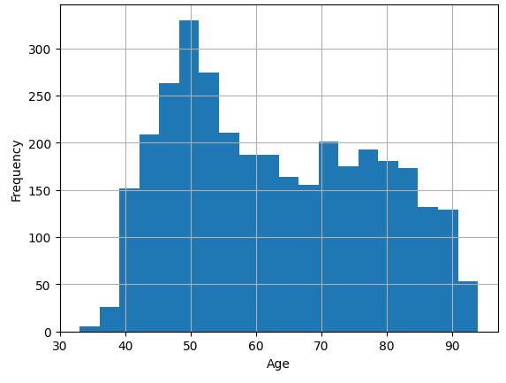
Demographics

Slide 4
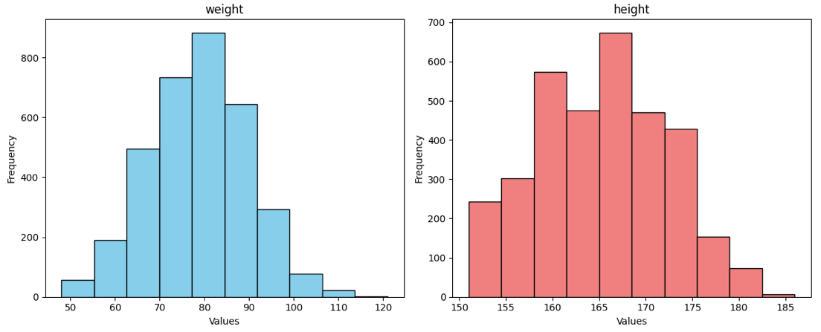
Weight and height

Slide 5
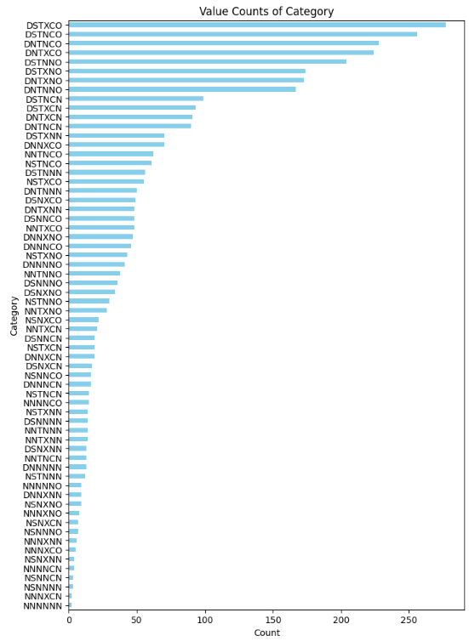

Treatment approach frequency

Slide 6
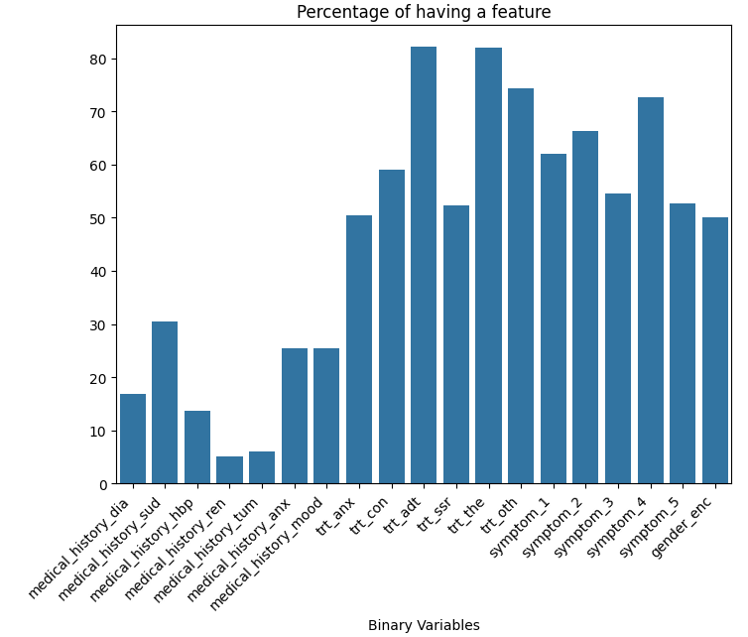
Clinical features’ percentages

Slide 7
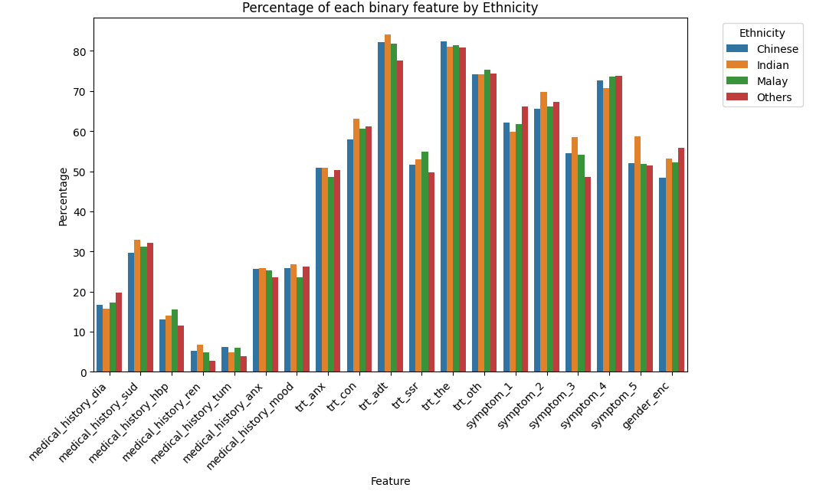
Clinical features’ percentages for different ethnicity

Slide 8
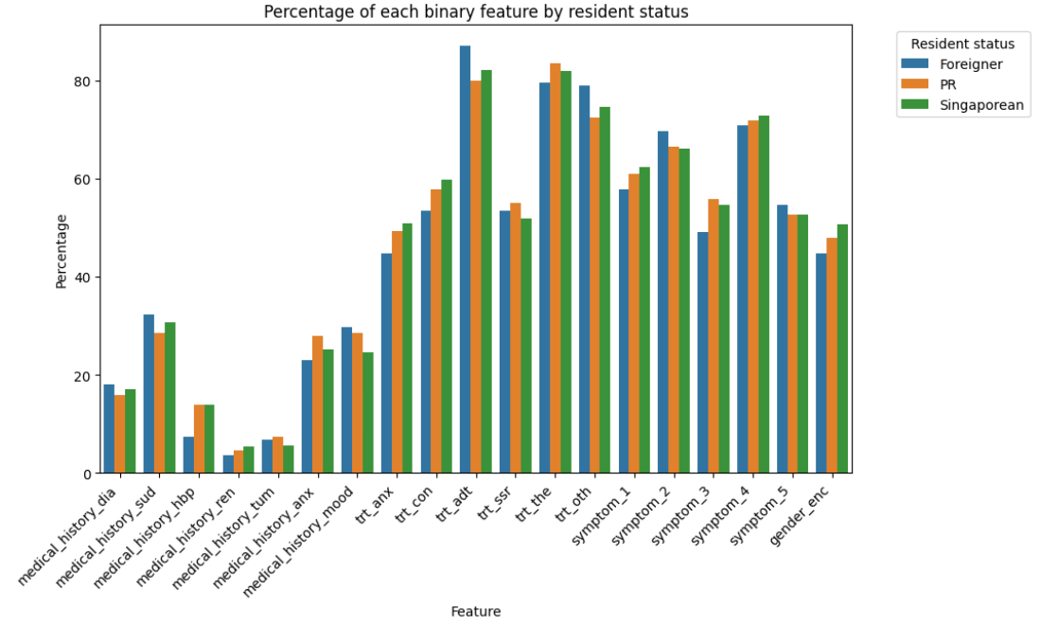
Clinical features’ percentages for different resident statuses

Slide 9
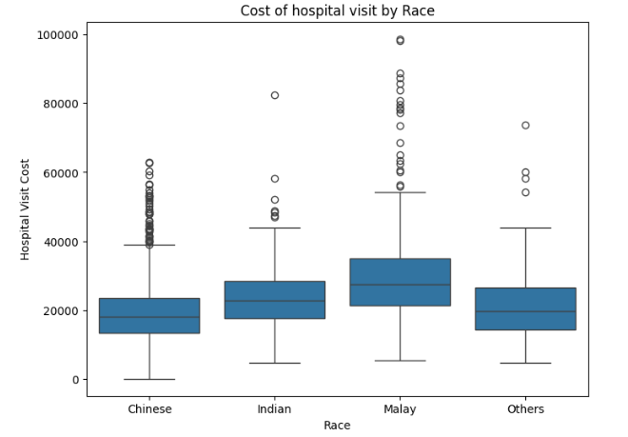
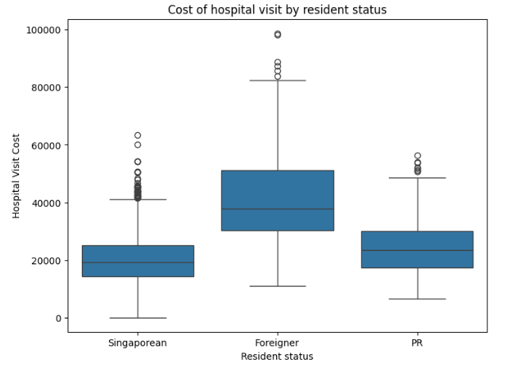
Race and resident status VS cost of hospital stay

Slide 10
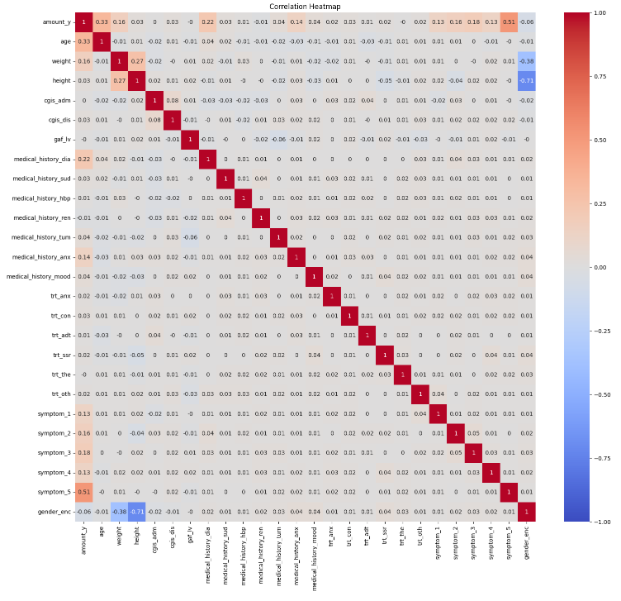
Correlation plot

Slide 11
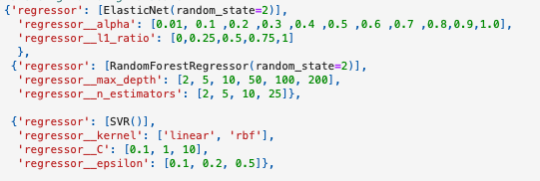
Grid search for parameters for regressors

Slide 12
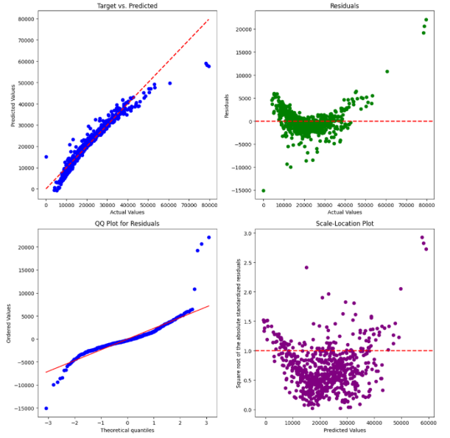
Diagnostics of the elastic net model

Slide 13
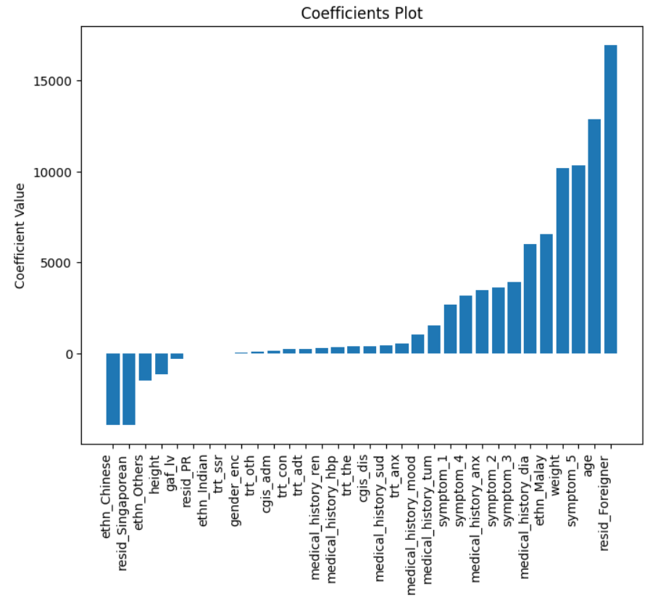
Coefficients for the elastic net model

