Slide 1
Predicting the cost of emergency admission for patients with major depressive disorder
Evgeny Galimov 24/01/24

Slide 2
Research question
Research question: What features are important for predicting the cost of emergency hospital stay among patient with major depressive disorder?

Slide 3
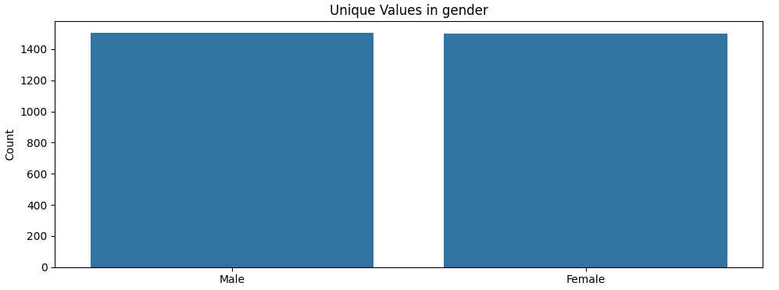
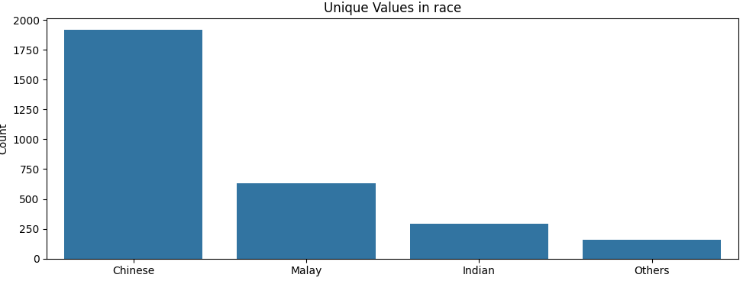
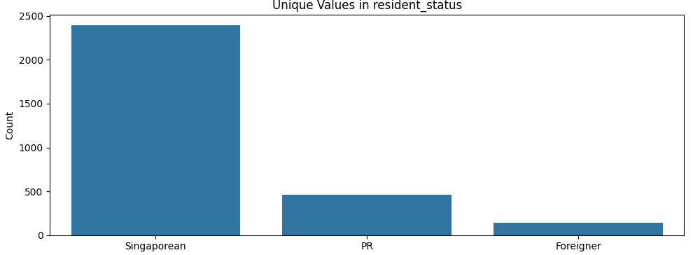
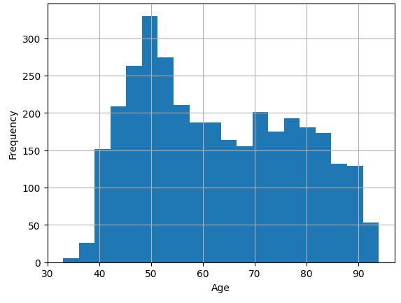
Demographics

Slide 4
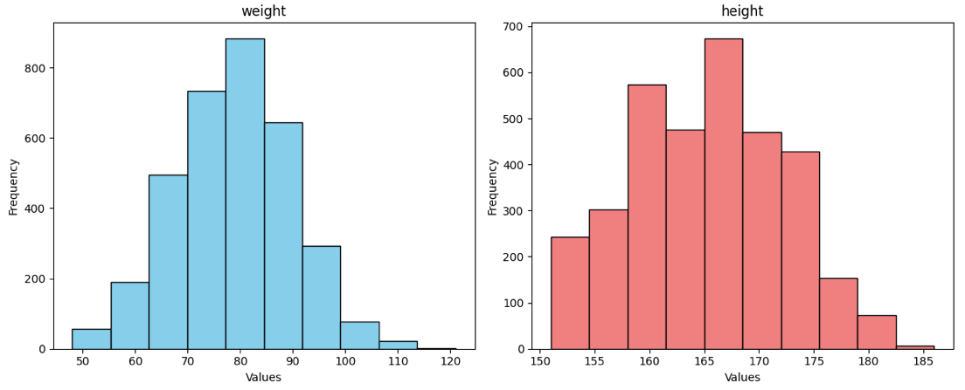
Weight and height

Slide 5
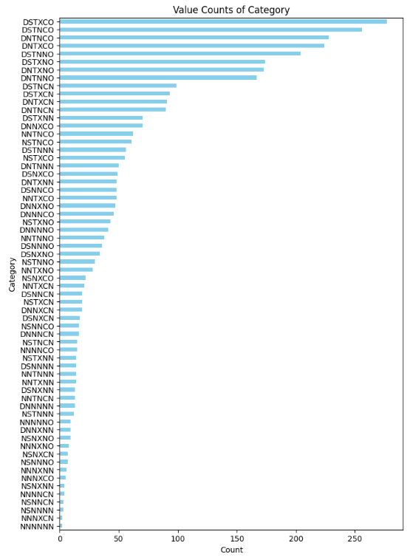

Treatment approach frequency

Slide 6
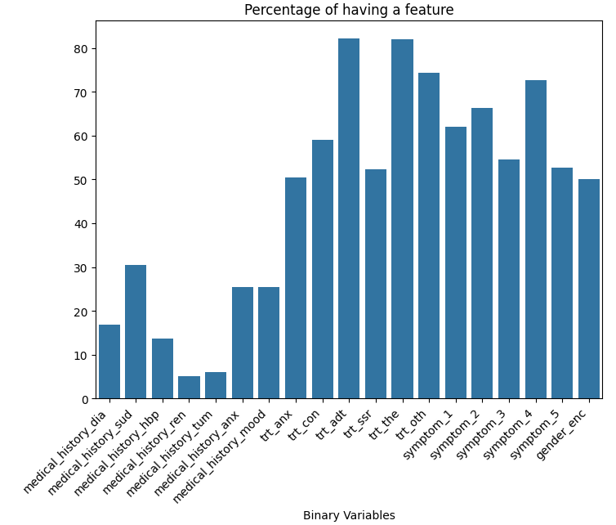
Clinical features’ percentages

Slide 7
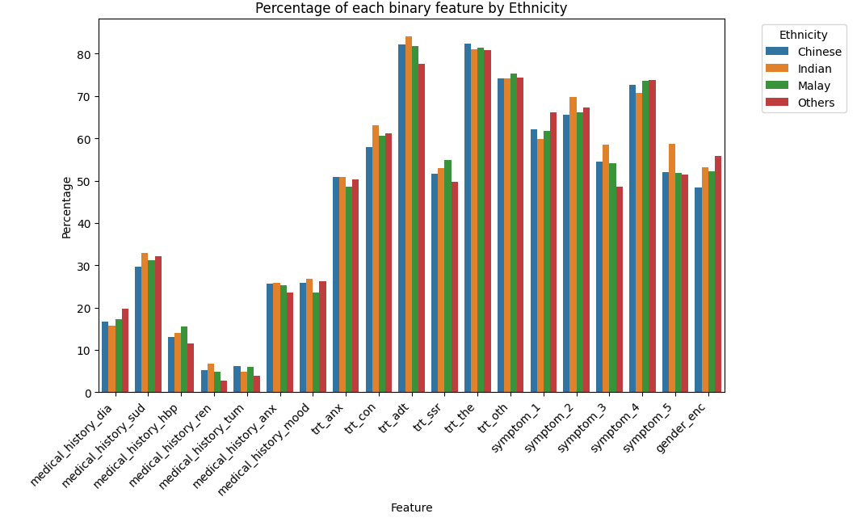
Clinical features’ percentages for different ethnicity

Slide 8
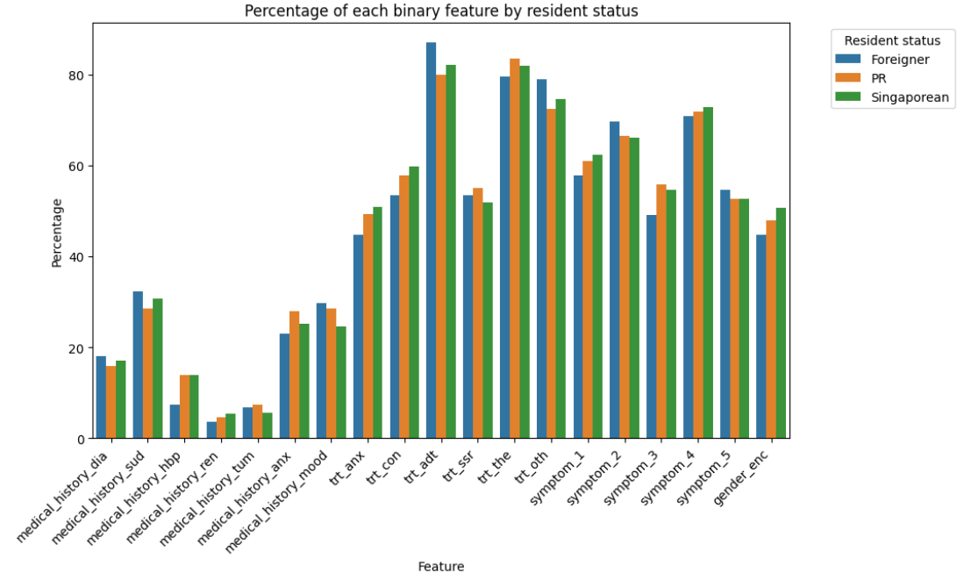
Clinical features’ percentages for different resident statuses

Slide 9
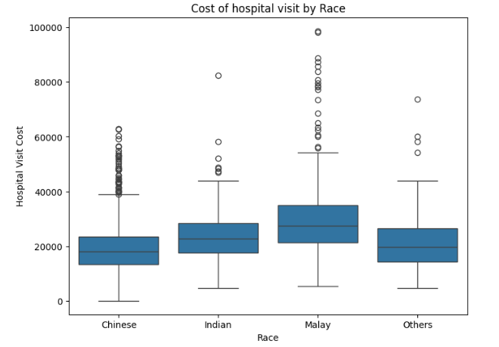
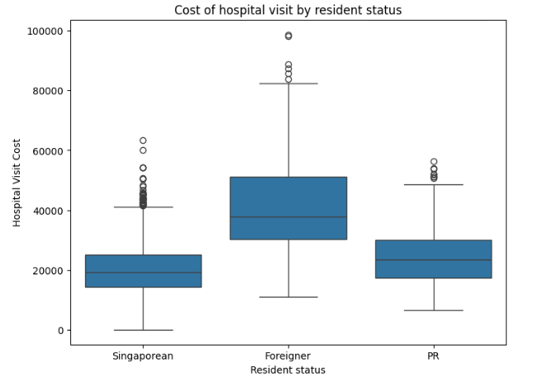
Race and resident status VS cost of hospital stay

Slide 10
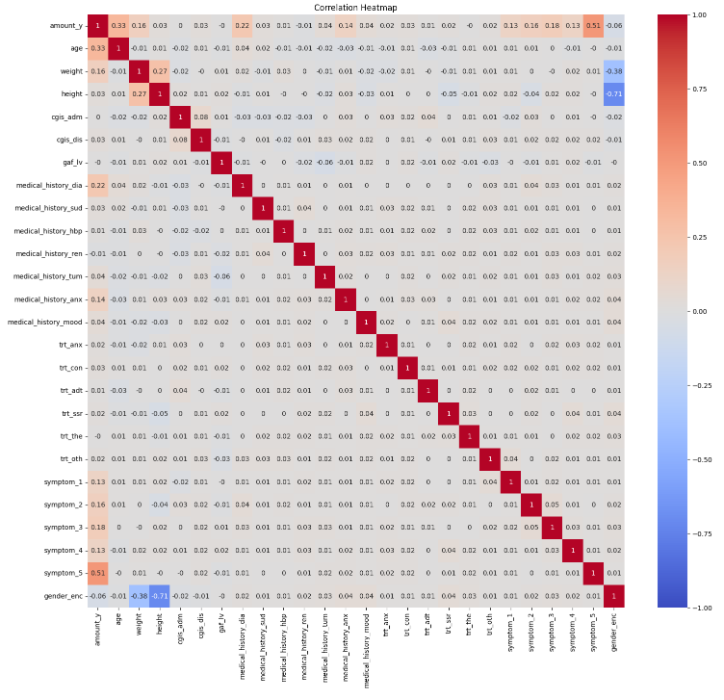
Correlation plot

Slide 11
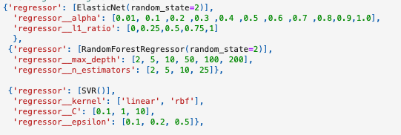
Grid search for parameters for regressors

Slide 12
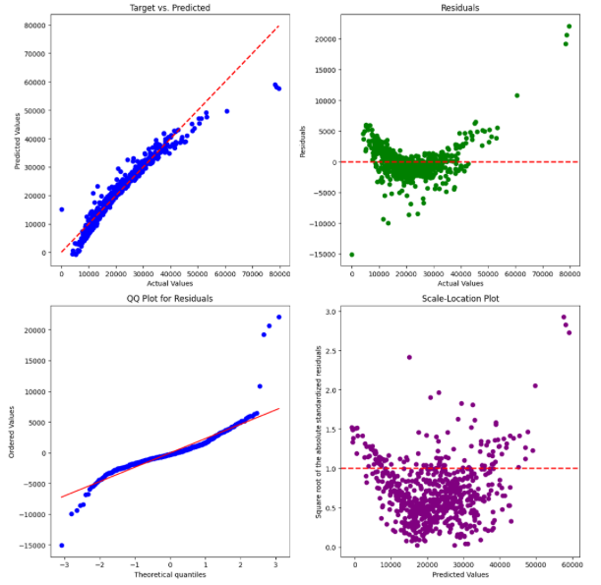
Diagnostics of the elastic net model

Slide 13
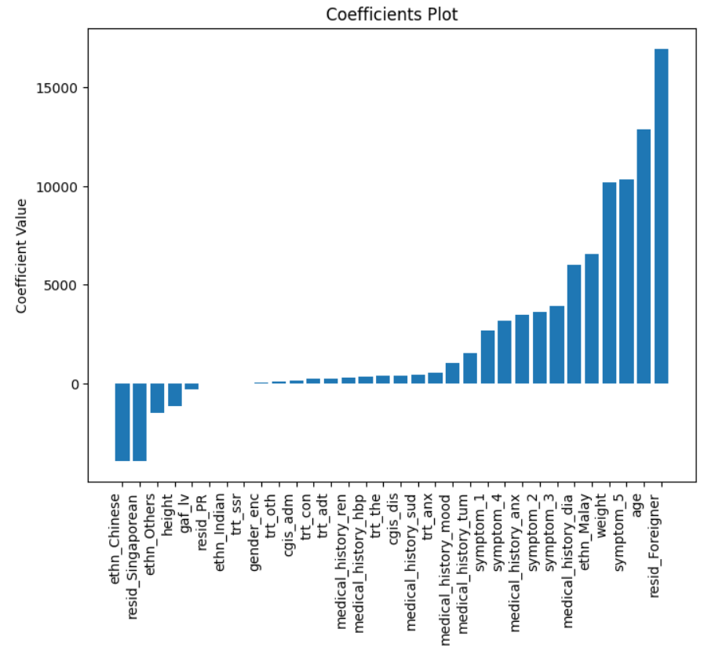
Coefficients for the elastic net model

Slide 14
Key findings
Patients receive diverse combinations of drugs and psychotherapy
Antidepressants and psychotherapy are most often prescribed for patient admitted in emergency departments
Clinical features’ distributions are similar among different ethnicities and residential statuses
Cost of hospital stay is higher for Malay and lower for Chinese.
Cost of hospital stay is higher patients with residential status ‘Foreigner’
Cost of hospital stay is positively correlated with weight, age, medical history of diabetes and anxiety, symptoms,
especially symptom 5.
Predictors are mostly not correlated with each other, except weight and height
Grid search among elastic net, SVR and ransom forest regressor found that elastic net performs the best
For the elastic net model, residential status ‘Foreigner,’ age, symptom 5, weight, Malay ethnicity, and
medical history of diabetes had the strongest effect on increasing the cost of hospital stay.
On the other hand, Chinese ethnicity and residential status ‘Singaporean’ had the strongest effect on decreasing it

